Slide 1


MK 333/326 International Marketing
Assignment 5: Cross Cultural Management Style
By Ajarn Suwalya K.

Slide 2

MK 333/326 Group Assignment 6:
Chapter 5
Topic: Cross Cultural Management Style
Each group is to prepare a one slide presentation on the Management Style of your project country vs. Thailand Management Style by addressing the below.
What are the differences?
What are the similarities?
How should each manager adapt themselves in the new country work environment?
Please refer to the text of Chapter 5. Please be specific as possible. You may use graphs, visuals and examples to illustrate your point across to me. Maximum 1 page ppt slide. Due after mid term on Thursday March 18, 2021.
Notes:
1

Slide 3
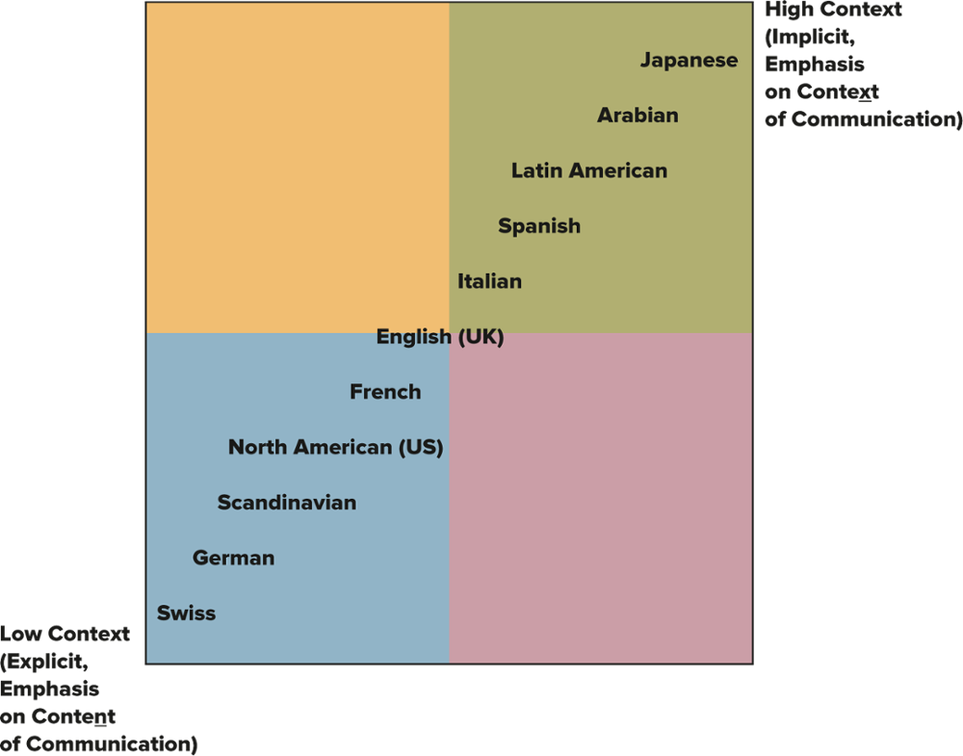
Exhibit 5.2 Context, Communication, and Cultures: Edward Hall’s Scale
Note: Patterned after E.T. Hall
Jump to long description.

Slide 4
Exhibit 5.8 Dimensions of Culture: A Synthesis
Information-Oriented (IO)
Low context
Individualism
Low power distance
Bribery less common
Low distance from English
Linguistic directness
Monochronic time
Internet
Focus on the foreground
Competition
Relationship-Oriented (RO)
High context
Collectivism
High power distance (including gender)
Bribery more common*
High distance from English
Linguistic indirectness
Polychronic time
Face-to-face
Background
Reduce transaction costs
*We note that Singapore, Hong Kong, Japan, and Chile do not fit all the rules here. Most would agree that all four are relationship-oriented cultures.
Notes:
*We note that Singapore, Hong Kong, Japan, and Chile do not fit all the rules here. Most would agree that all four are relationship-oriented cultures.

Slide 5

11 Countries for MK 333/326
Sequence
1.Germany
2.India
3.New Zealand
4.Switzerland
5.Spain
6.France
7.Sweden
8.Russia
9.Italy
10.Portugal
11.Canada

Slide 6
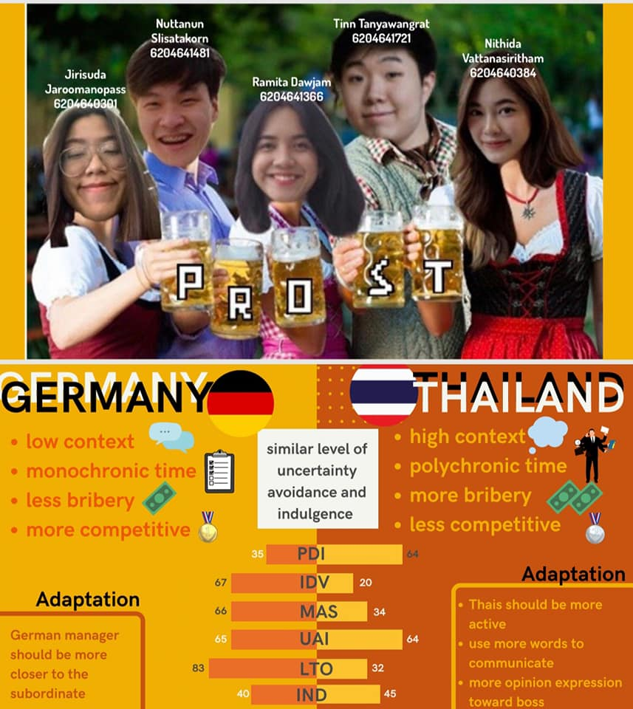
Germany

Slide 7
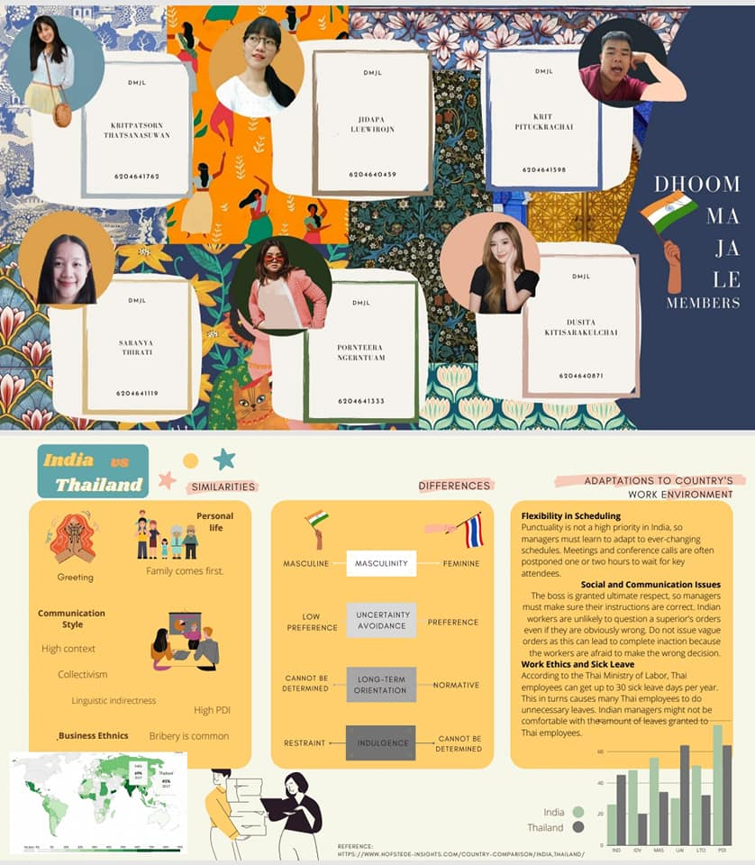
India

Slide 8

New Zealand

Slide 9
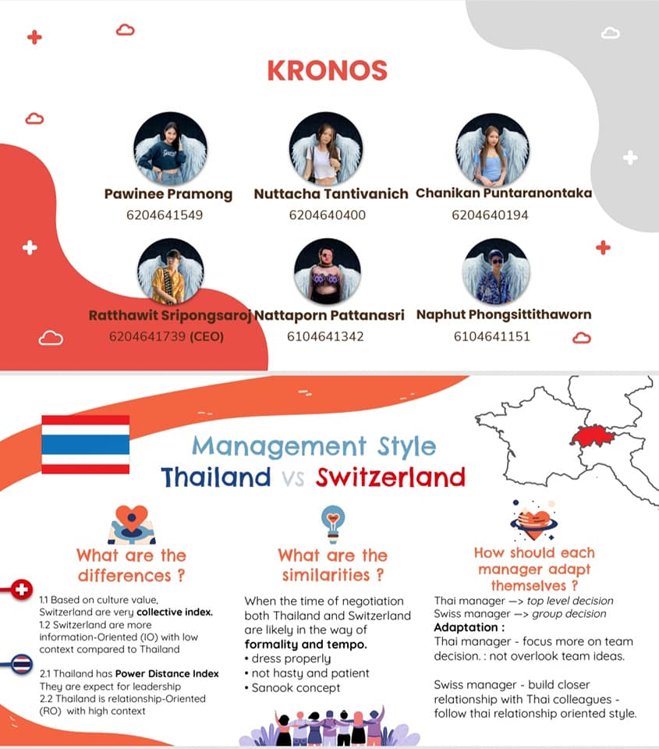
Switzerland

Slide 10
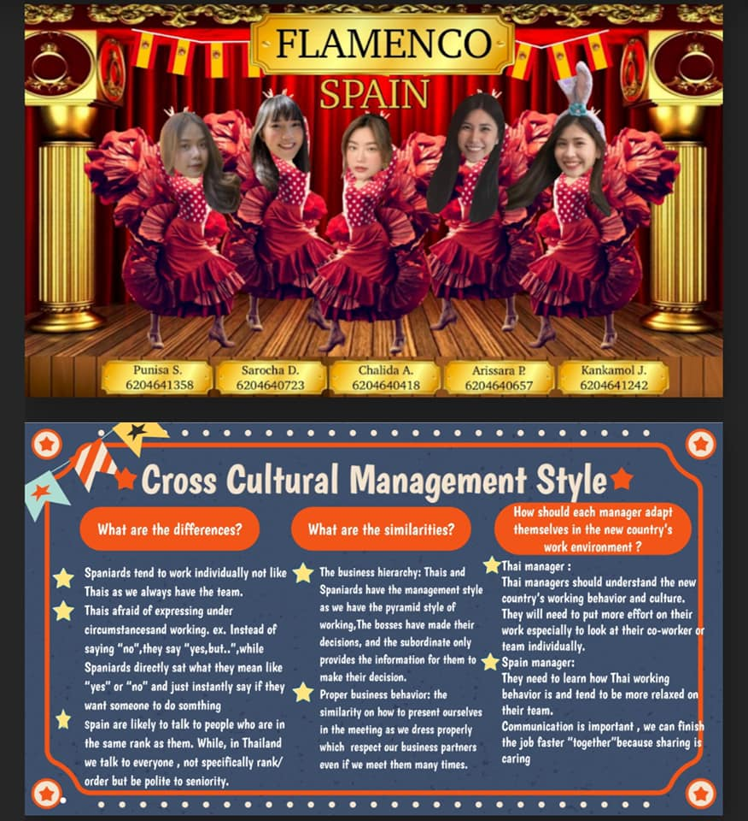
Spain

Slide 11
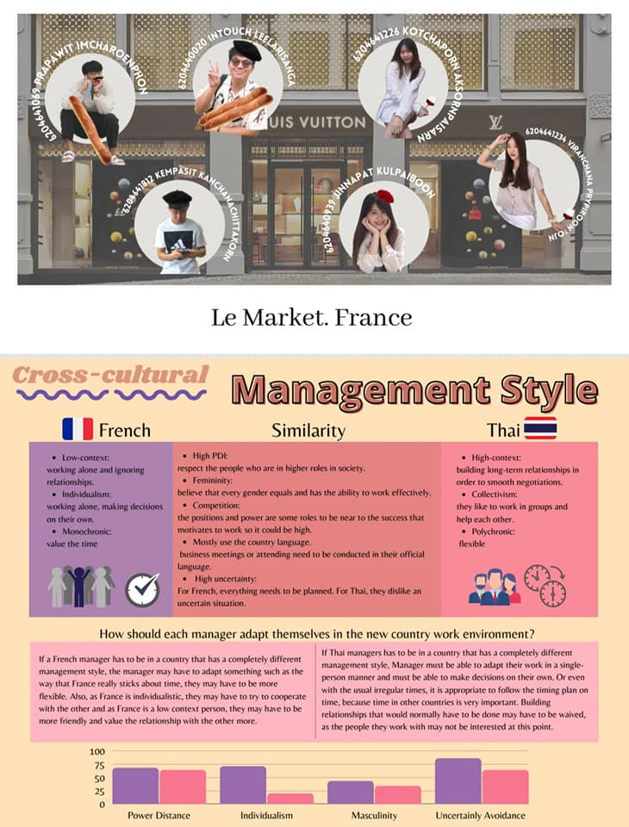
France

Slide 12
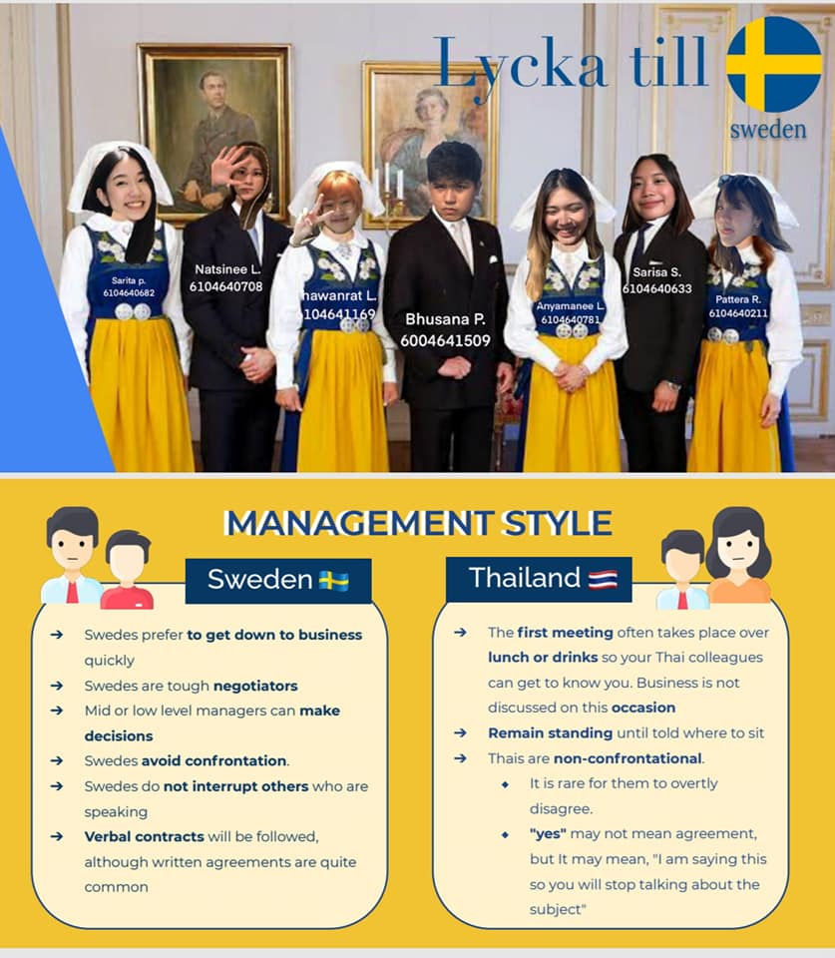
Sweden

Slide 13
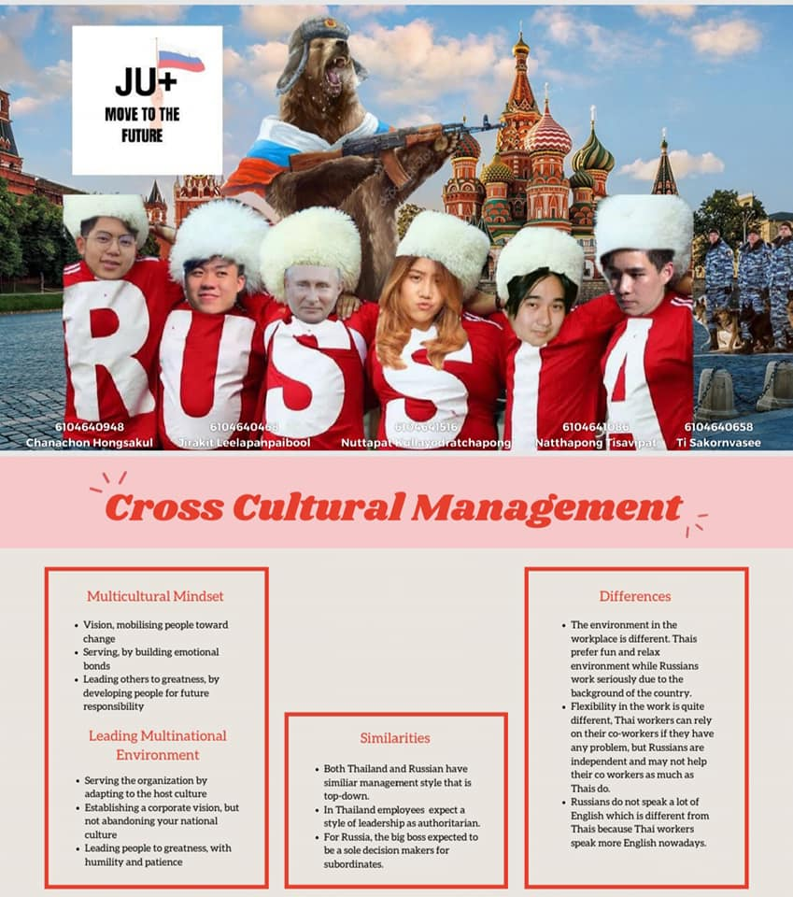
Russia

Slide 14
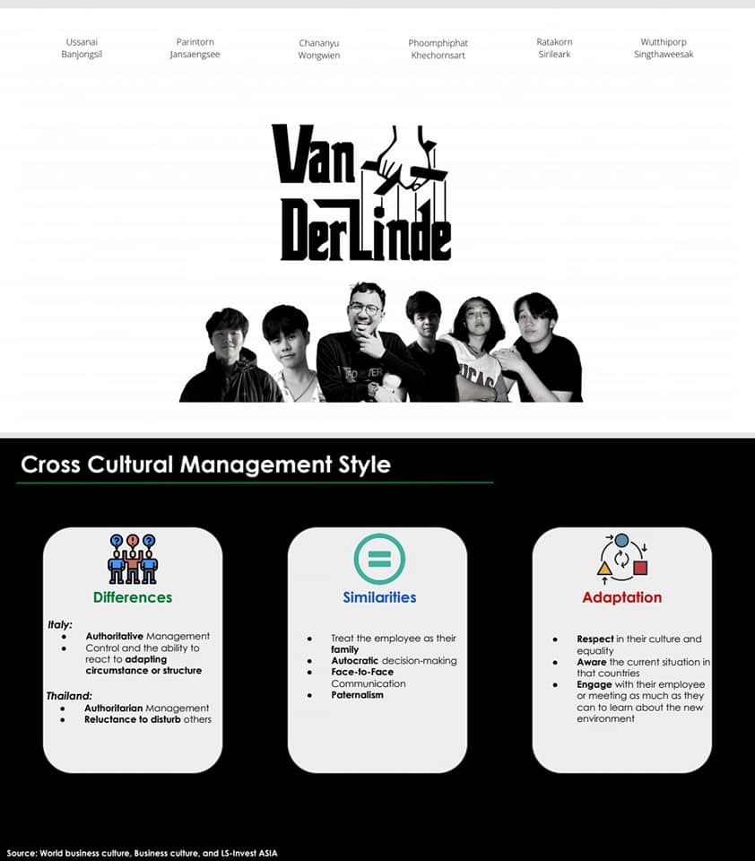
Italy

Slide 15
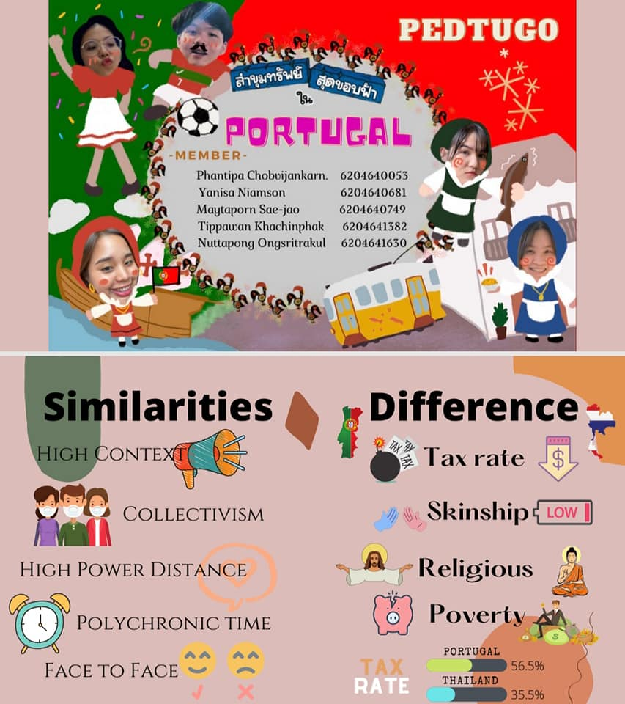
Portugal

Slide 16
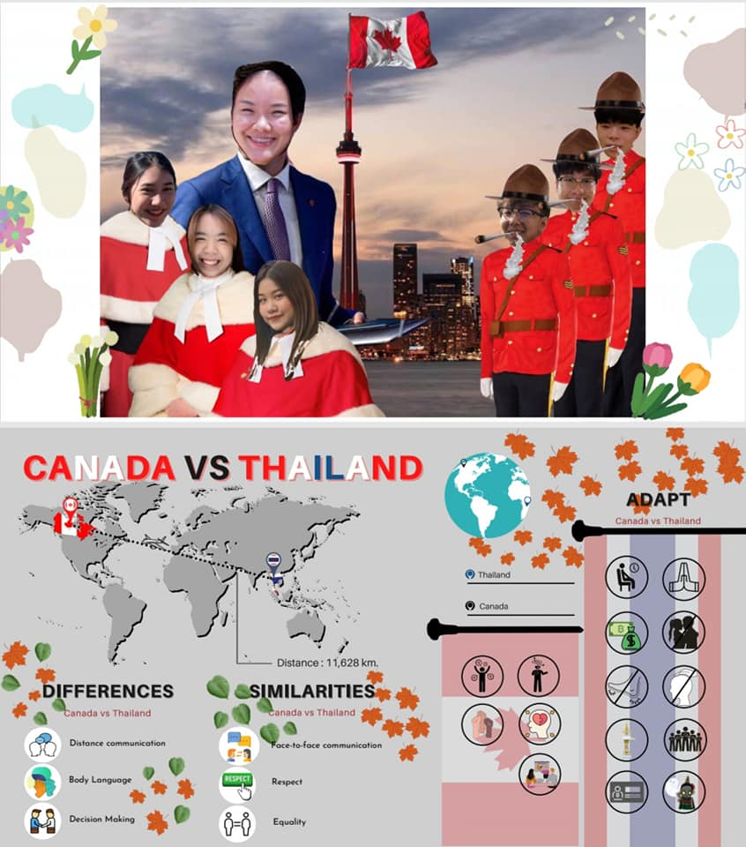
Canada

Slide 17


