Slide 1

Chapter 2 & 3: Homework

Slide 2

Group Homework
Group Homework : Chapter Presentations
1.Each group will be assigned 2 cases/class
& presented in the following class.
2. You are allowed no more than 3 page ppt slides, and 7 minutes presentation for each case
3. Contents should include :Summary of case and answers, suggestions etc.
4. After each presentation, we will have class discussion therefore everyone should read the cases before coming to class.
Notes:
1

Slide 3
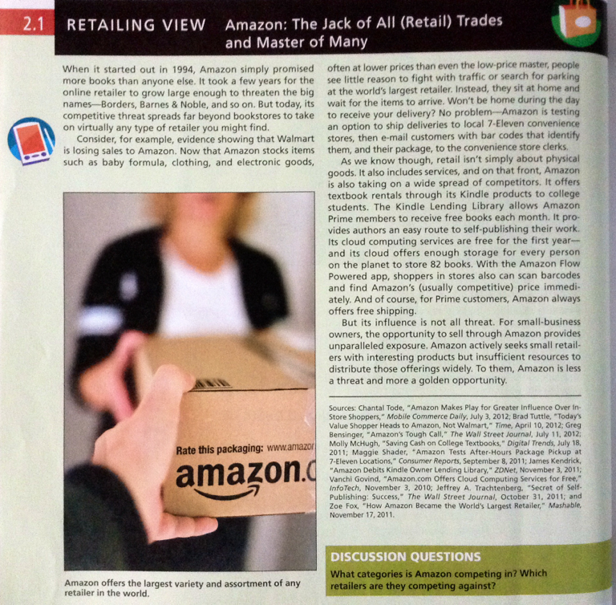
Chapter Presentation 2.1
Page 40
Due Monday
Due Monday
January 22
Notes:
1

Slide 4
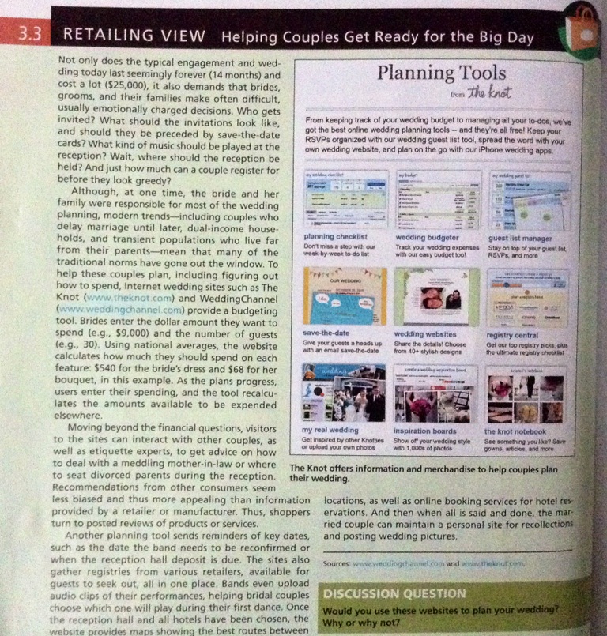
Chapter Presentation 3.3
Page 76
Due Monday
January 22
Notes:
1

Slide 5

Individual Homework-
Each Student is to design a namecard to bring to every class with criteria as follows:
First full name
Represent yourself in terms if creativity
Design as if you were branding yourself as a retail store
Special prize with be awarded to the winner
Due Monday January 22
Notes:
1

Slide 6


