Slide 1
Armstrong, Kotler
& da Silva
Marketing : An Introduction
An Asian Perspective
5
Consumer and Business Buyer Behavior
MK 202 Fundamentals of Marketing
Ajarn Suwalya Khemvaraporn

Slide 2
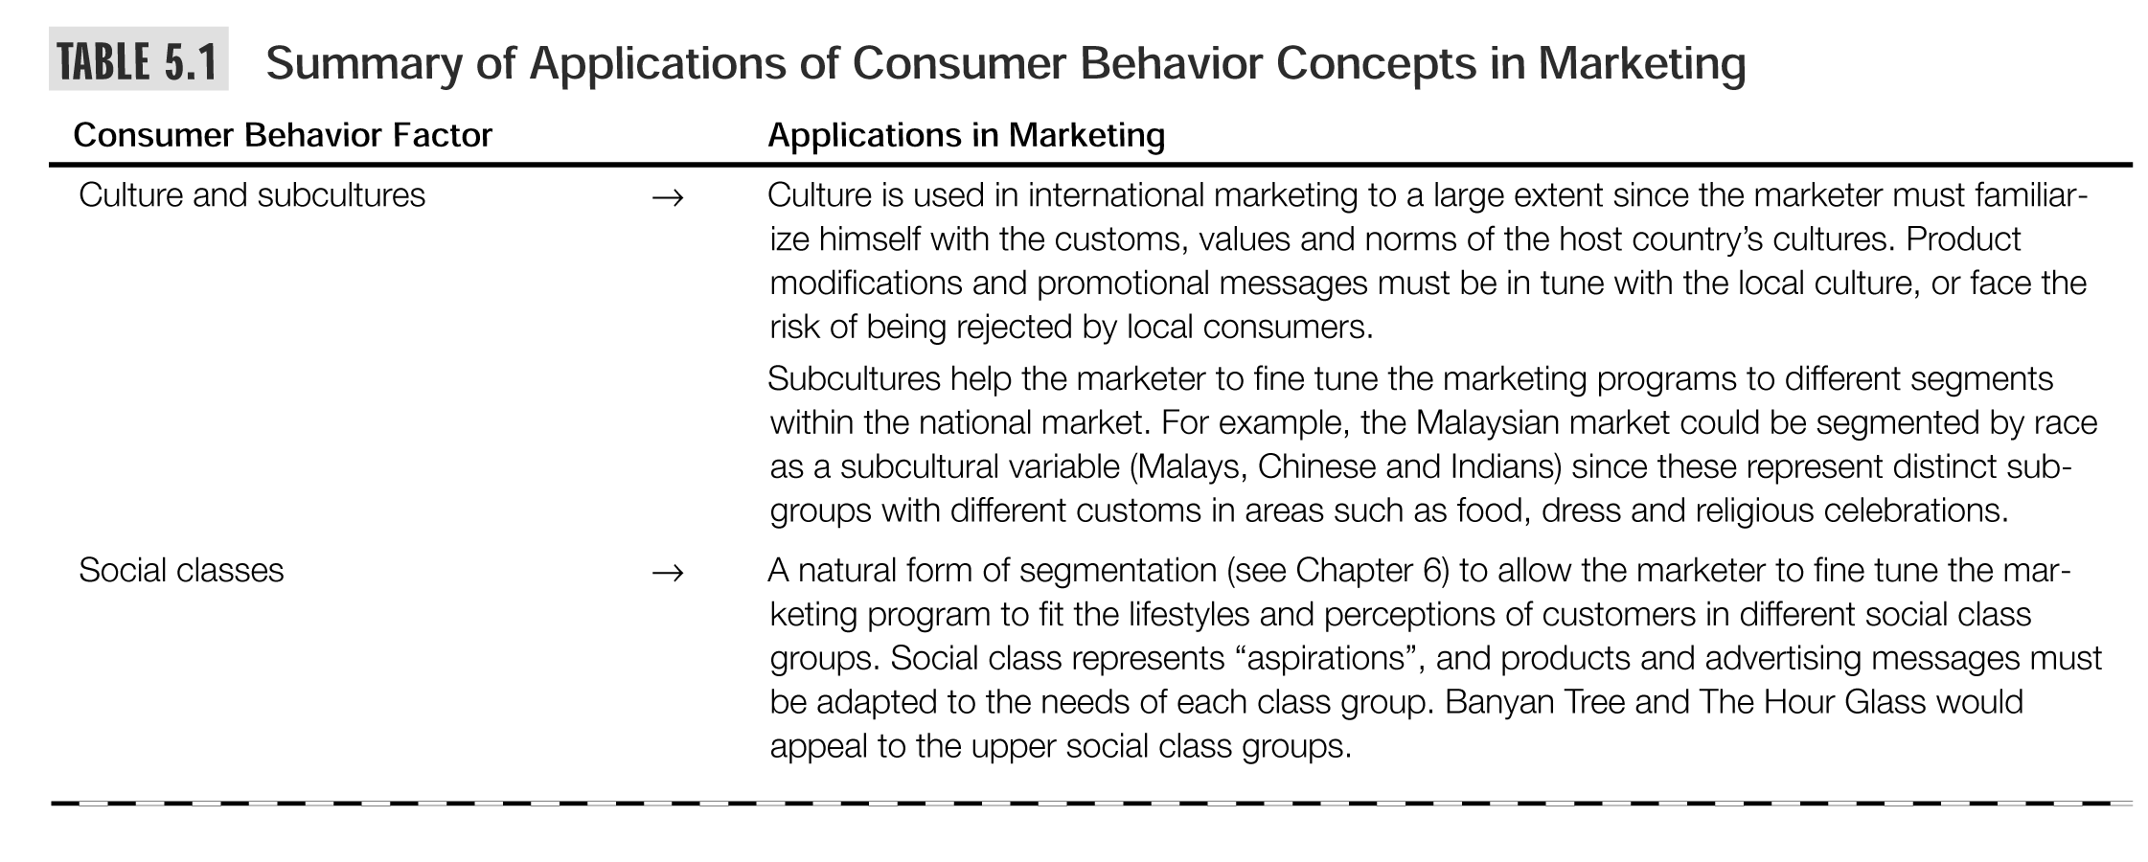

Slide 3
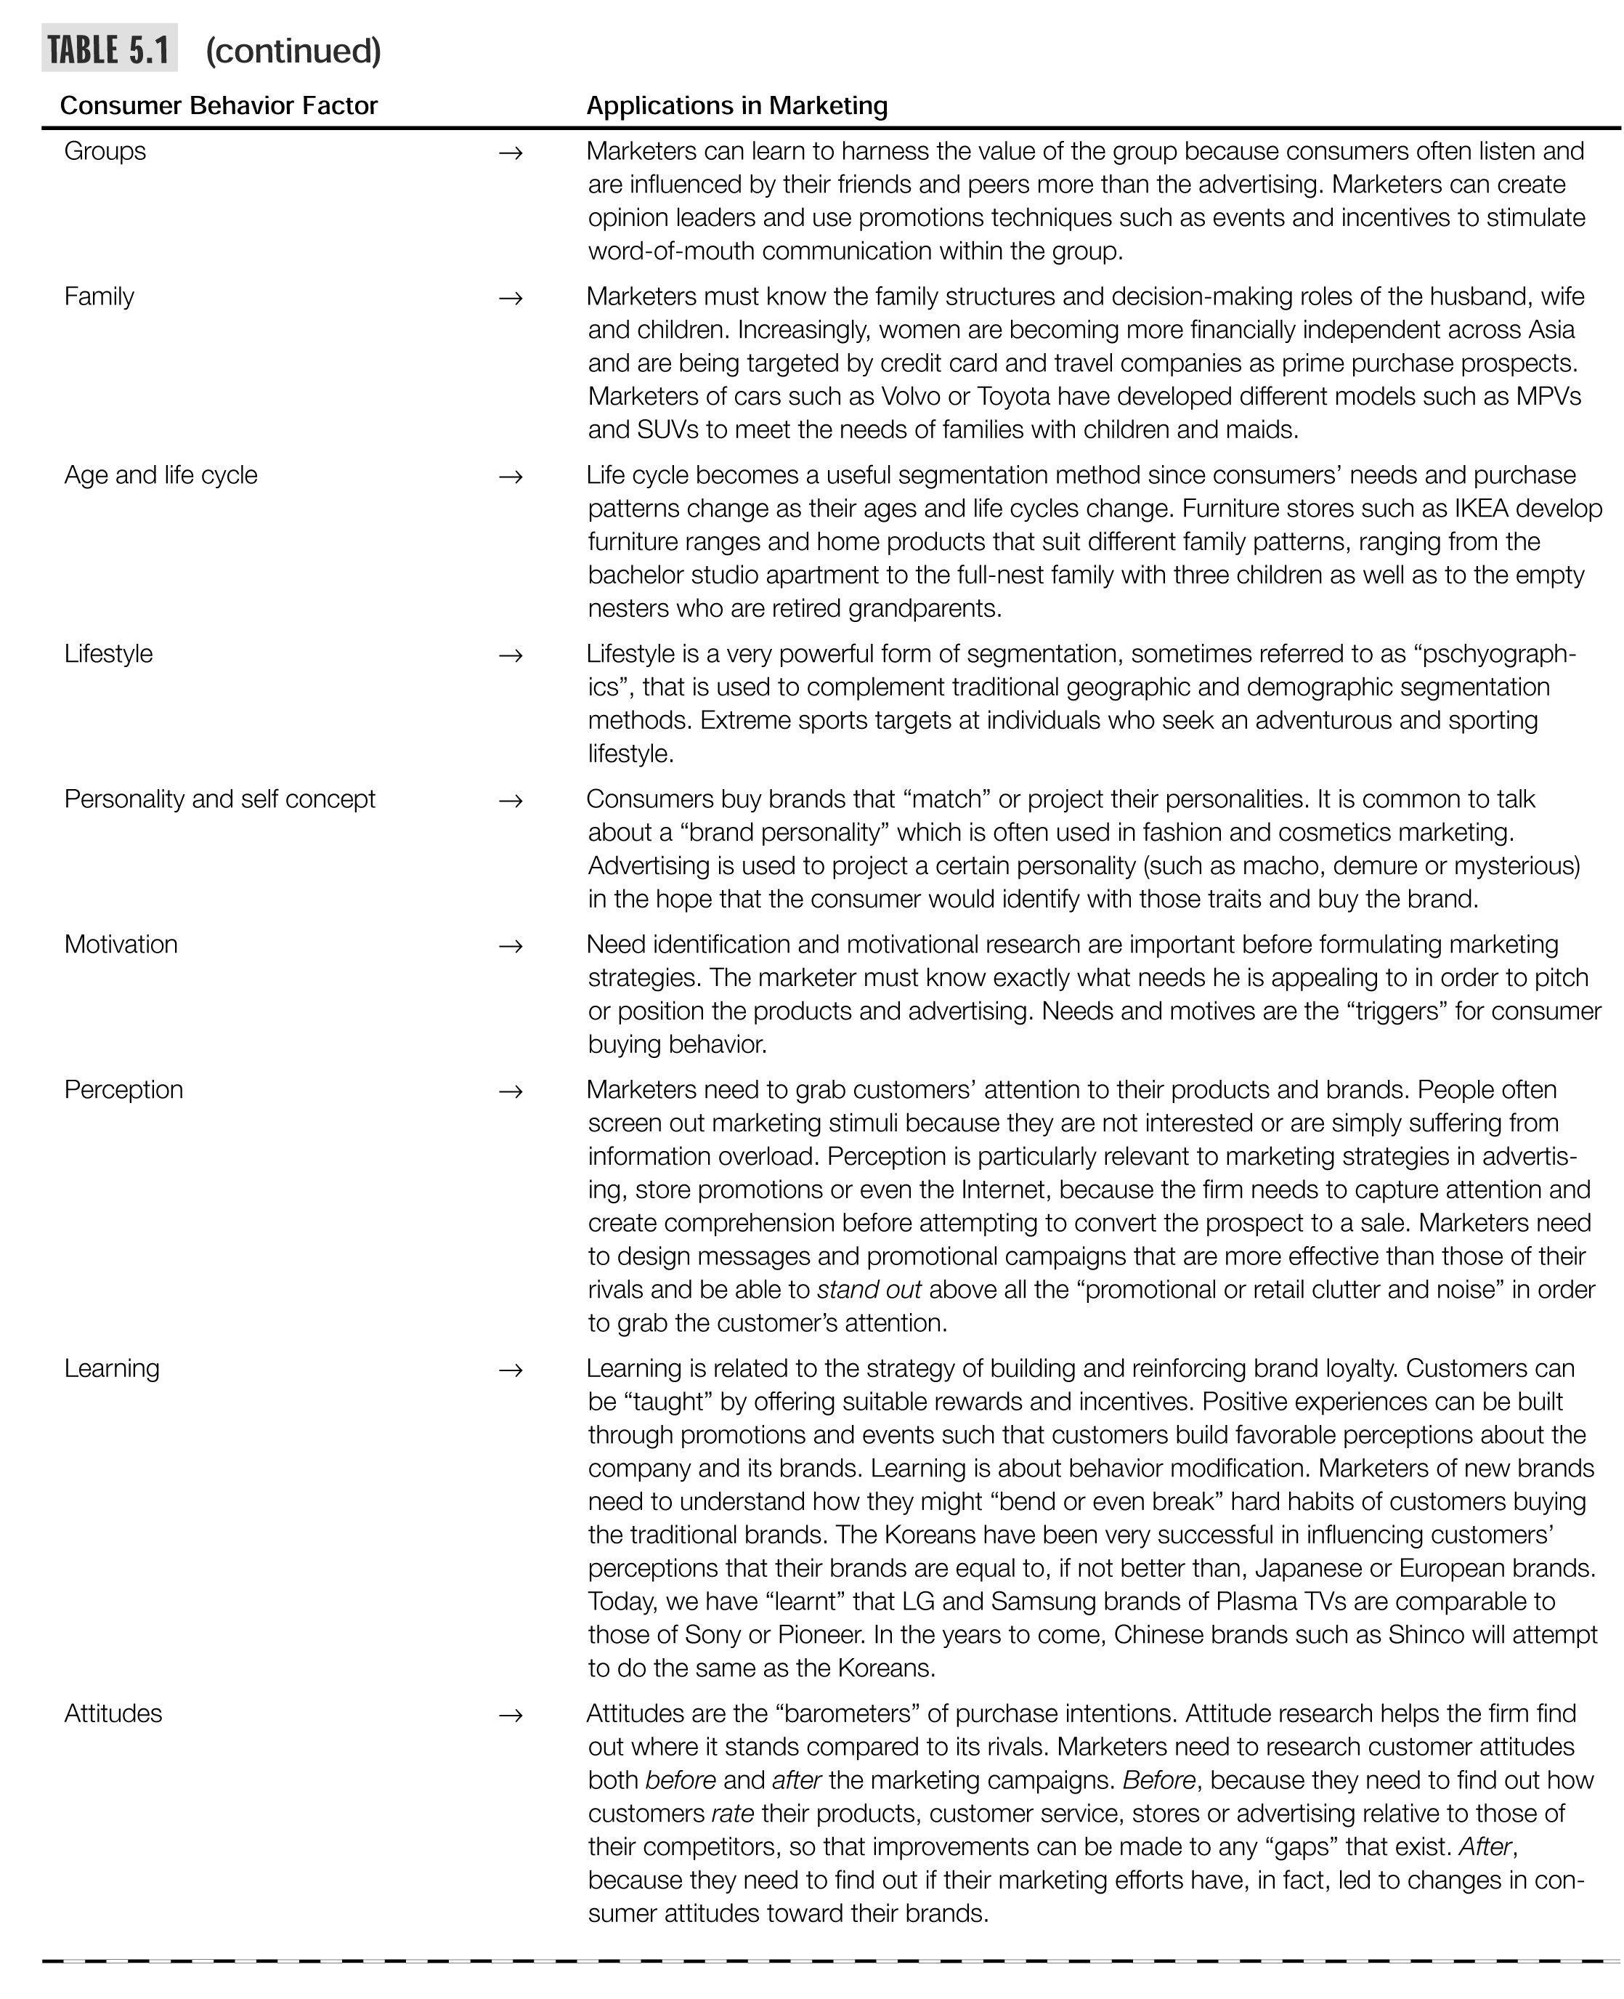

Slide 4
Linking the Buying Decision Process to Marketing Strategies
Figure 5.10

Slide 5
Business Markets &
Business Buyer Behavior
The business market is vast and involves far more dollars and items than do consumer markets.
Business buyer behavior refers to the buying behavior of the organizations that buy goods and services for use in the production of other products and services that are sold, rented, or supplied to others.

Slide 6
Business Markets
Market Structure and Demand:
  Contains far fewer but larger buyers.
  Customers are more geographically concentrated.
  Business demand is derived from consumer demand.
Nature of the Buying Unit:
  Business purchases involve more decision participants.
  Business buying involves a more professional purchasing effort.

Slide 7
Types of Decisions and the Decision Process
Business buyers usually face
more complex buying decisions.
Business buying process
tends to be more formalized.
Buyers and sellers are much
more dependent on each other.

Slide 8
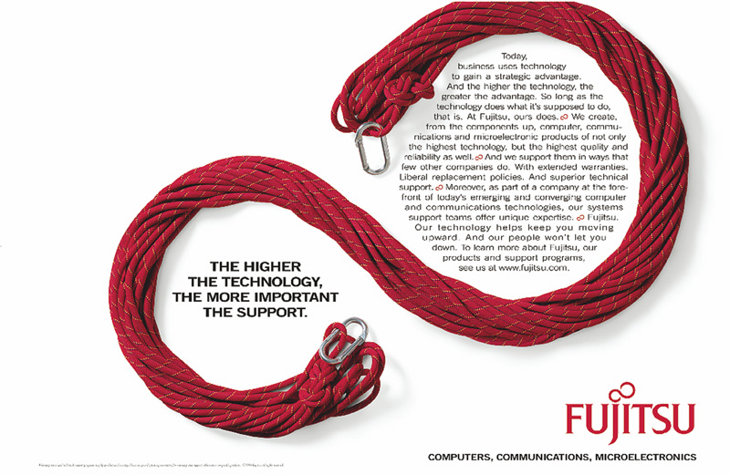
Business Markets
B2B marketers often roll up their sleeves and partner with customers to jointly create solutions. Here, Fujitsu promises, “Our technology will keep you moving upward, and our people won’t let you down.”

Slide 9
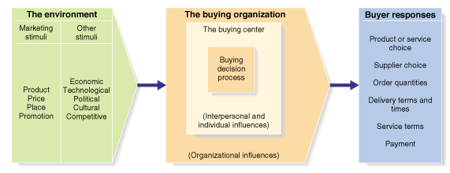
A Model of Business Buyer Behavior
Figure 5.13

Slide 10
Major Types of Buying Situations
Straight Rebuy
The buyer routinely reorders
something without any
modifications.
Modified Rebuy
The buyer wants to modify
product specifications,
prices, terms, or suppliers.
New Task
The buyer purchases a
product or service for the
first time.

Slide 11
Participants in the Business Buying Process
Decision-making unit of a buying organization is called its buying center.
Not a fixed and formally identified unit.
Membership will vary for different products and buying situations.
Buying Center Members:
  Users
  Deciders
  Influencers
  Buyers
  Gatekeepers

Slide 12
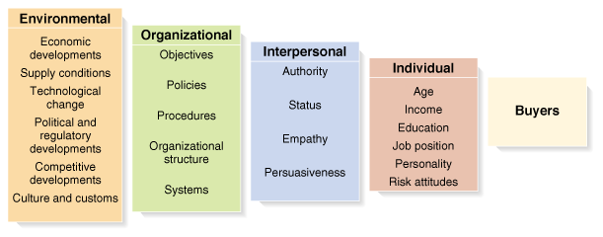
Major Influences on Business Buyer Behavior
Figure 5.14

Slide 13
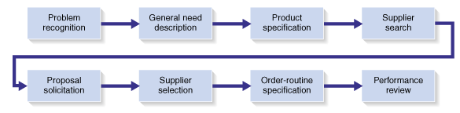
Stages in the Business Buying Process
Figure 5.15

Slide 14
e-Procurement
Advantages for buyers:
  Access to new suppliers
  Lowers purchasing costs
  Hastens order processing and delivery
Advantages for vendors:
  Share information with customers
  Sell products and services
  Provide customer support services
  Maintain ongoing customer relationships

Slide 15
Rest Stop: Reviewing the Concepts
Describe the consumer market and the major factors that influence consumer buyer behavior.
Identify and discuss the stages in the buyer decision process.
Describe the adoption and diffusion process for new products.
Define the business market and identify the major factors that influence business buyer behavior.
List and define the steps in the business buying decision process.

