Slide 1
population
EE463 Globalization and international development
Faculty of economics
Thammasat university

Slide 2
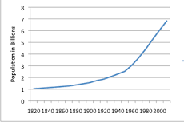
World population, 1820-2010
World population in 1820 was 1 billion
Milestones:
- 2 billion in 1930 (110 years)
- 3 billion in 1960 (30 years)
4 billion in 1975 (15 years)
5 billion in 1987 (12 years)
6 billion in 1999 (12 years)
7 billion in 2011 (12 years)

Slide 3
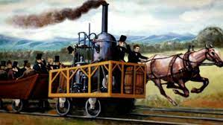

World trends since industrial revolution
Growth in food supply worldwide, improvements in health and technological progress has led to the following outcomes:
Decrease in death rates and infant mortality
Increase in life expectancy
Increased population growth
On the other hand, war, famine, natural disasters and pandemics at times have slowed population growth

Slide 4
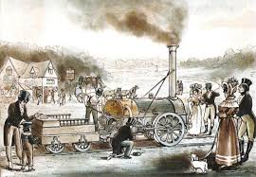
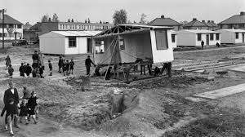
Impetus to population growth
Industrial revolution: Innovations in transportation and agriculture in Western Europe further expanded population carrying capacity in the core countries and their colonies
Post World War II: Reconstruction, political stability and disease control led to significant decrease in death rates and increase in population growth
1960s onwards: High population growth rates in developing countries with improvements in food supply (green revolution) and technological innovations

Slide 5
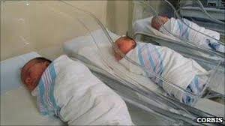

The demographic transition
Stage 1: High birth rate, high death rate; no net population increase
Stage 2: Death rate declining more quickly than birth rate; due to improved nutrition and availability of food supplies; net population increase
Stage 3: Declining birth rate and declining death rate: small net population increase
Stage 4: Birth rates are declining faster than death rates: population growth close to 0
World population will continue to grow, but the rate of growth has slowed as fertility rates will decline in the future

Slide 6
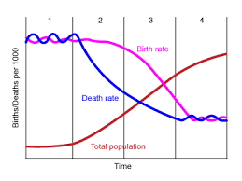
Graph of demographic transition

Slide 7
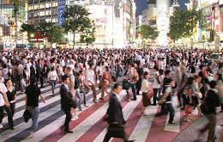
Population trends
Industrialized countries are mostly in stages 3 and 4 (mostly Western countries, Japan, South Korea and Taiwan). Fertility rates will continue to fall and with an aging population, the crude death rate is expected to rise. Therefore these countries will experience near zero or negative population growth in the future. Population growth if ever, will be attributable to immigration
Developing countries are in stages 1 and 2. (mostly Africa, Latin America and Middle East). It is expected that fertility rates will remain high and death rates will continue to decline.
East Asia (China, Southeast Asia) is between stages 2 and 3.

Slide 8

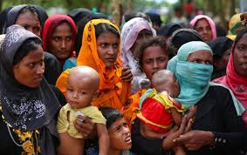
The demographic future
With even modest population growth rates, the world population will continue to grow
With a population growth rate of 1.2% per year, world population will reach 11 billion by 2050 and 26 billion by 2100.
However the trend is unlikely to happen in the future, as fertility rates may decline

Slide 9
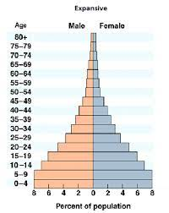
Population pyramid
A population pyramid is useful tool to understand the age and sex composition of a country at a given time
It uses a paired bar chart showing the number of males and females in each age group and indicates a population's age-sex composition
The shape of the pyramid can indicate whether the population is expanding (young and growing), constrictive (elderly and shrinking) or stationary (little or no population growth)
A country’s population pyramid can change over time

Slide 10
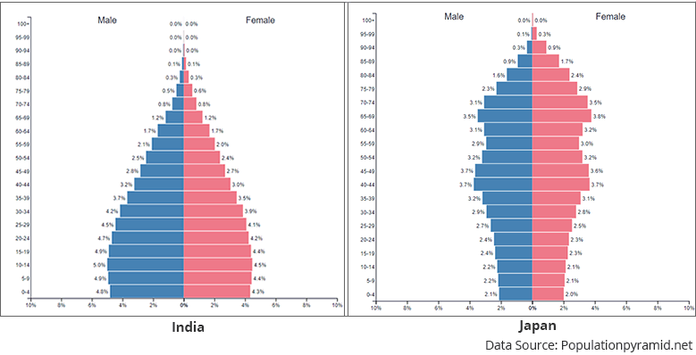
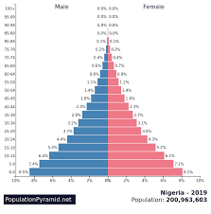
Population pyramid – comparisons
India
Japan
Nigeria

Slide 11
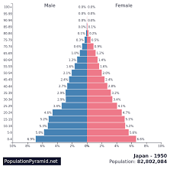
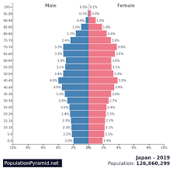
Population pyramid – japan 1950-2019
1950
2019

Slide 12
Issues on population
Although the population growth rate worldwide is declining, the population is still growing
It is expected that within the next 40 years, the world population will increase by another 2 billion, mostly in developing countries
The age distribution of the world’s population will be shifting; there will be more elderly people and fewer children
In Asia, 6.7 percent of the population were elderly (2010) in 2050 it is expected to increase to 17.3 percent
In China, because of its one family-one child policy the elderly population is expected to increase from 8.3 percent (2010) to 23.3 percent in 2050

Slide 13
Issues on population
In countries where population growth rate is near zero or negative, financing pensions/retirement is becoming a serious problem, as there are less younger people are available to finance the pension of retirees
With a higher percentage of the elderly, there is greater demand for elderly care
In countries where the birth rate is still high, the youth will struggle with issues of unemployment

Slide 14
summary
The 20th century has witnessed a significant change in demographics, whereby the population grew from less than 2 billion to 6 billion people.
The driving force behind population increases is the demographic transition, particularly in the developing countries. Improvements in nutrition, medical knowledge and public health has led to a decline in the death rate
There has been significant variation across countries and regions. In advanced countries, population growth is near zero and some even have negative growth. This is because fertility rates have gone down
Despite declining growth rate of the world population, the 21st century will still face challenges. In particular, the shift in the age composition will mean that there will be a greater percentage of the elderly population

