Slide 1
EE401 Political Economy
Chapter 2 Pre-capitalist Society and Absolutist Political Institution
ii. Mercantilism and Absolute Monarchy
Ploy Thammapiranon 2/2017
BE, Thammasat University

Slide 2
1. Mercantilism and its Policies
1.1 What is Mercantilism?
The strength of a nation depends on its ‘wealth’.
Form of wealth = precious metal
Accumulation of gold and silver.
Sources of gold:
  Domestic mining; conquering countries with gold mines.
  Foreign trade settled in gold.

Slide 3
1. Mercantilism and its Policies
1.2 Mercantilist policies
Internal trade does not generate wealth.
  Internal profits cancel out.
Policy goal is to maximize trade surplus.
  To maximize exports; minimize imports → maximize gold
  3) Promote domestic industries for exports.
  Exports of manufactured goods.
Discourage exports of agricultural products and raw materials.
  Low prices of food and materials.
  Low wages and production cost.

Slide 4
1. Mercantilism and its Policies
1.2 Mercantilist policies
Restriction on imports of manufactured goods .
Allow imports of food and raw materials not available at home.
Prohibition of gold exports.
Promotion of monopolies, franchises, leases, concessions, patents.
  to prevent competition and price cutting.
  control of prices and wage rates.
  detailed regulations on product characteristics
  subsidies to state franchises for exports.

Slide 5
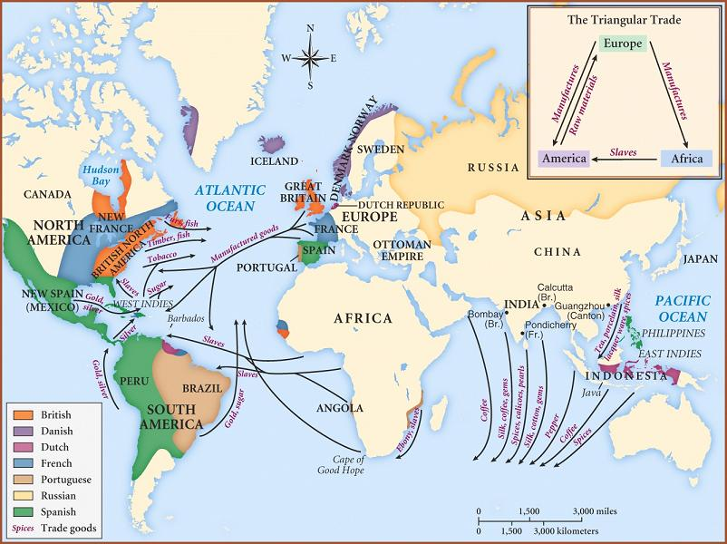

Slide 6
2. Criticisms of Mercantilism
Precious metal is ‘wealth’?
  Wealth as a stock of ‘gold’?
  Perpetual accumulation of gold?
  What is ‘wealth’?
    economic well-being of population
    amount of goods available
    flow of annual output

Slide 7
2. Criticisms of Mercantilism
Purpose of money is exchange.
  Perpetual hoarding of money is meaningless.
Wealth is generated in circulation only?
  Buying cheap and selling dear?
Production is the source of wealth.
  Circulation moves things from producers to consumers
Lack of understanding of the relationship between money and the price level.
  An increase in money without an increase in goods result in higher prices.

Slide 8
2. Criticisms of Mercantilism
The Quantity Theory of Money (Locke, Hume)
Ex: M = 100; Q = 500; P = 1; V = 5
MV = PQ
Quantity of money
Velocity of money
Average price level
Amount of goods
M V = P Q

Slide 9
2. Criticisms of Mercantilism
Perpetual trade surplus is impossible
  The price-specie flow mechanism (Ricardo).
money supply
trade
surplus
gold inflow
trade surplus disappears
exports
imports
domestic price

Slide 10
2. Criticisms of Mercantilism
Trade is not a ‘zero-sum game’.
  Trade restriction results in reduction in trade volume between countries.
  Trade gives mutual benefits between countries.
    The doctrine of comparative advantage (Ricardo)
    Anyone can benefit from trade.

Slide 11
2. Criticisms of Mercantilism
Cpmparative Advantage (Ricardo)
Unit labor cost
England specializes in cloth:
  produces 110/100 = 1.1 cloth and exchanges for 1.1 wine.
Portugal specializes in wine:
  produces 90/80 = 1.125 wine and exchanges for 1.125 cloth.
More products for both to consume
 | Cloth | Wine
England | 100 | 110
Portugal | 90 | 80
Exchange rate: 1 cloth = 1 wine

Slide 12
3. Social effects of Mercantilism
Domestic monopolies
  Stagnant economy and lack of innovation
  Cronyism, patronism, corruption.
  High prices of manufactures
Depressed agriculture
  High taxes on agricultural products and farm income.
  Low agricultural prices
  Poverty in the countryside.

Slide 13
3. Social effects of Mercantilism
Low wages and poor working condition.
Decline in international trade.
  Colonialism to create ‘sphere of influence’.
  Frequent wars between countries.
The sovereign is rich, but people are poor.
The new capitalist class against monopolies by the monarchy and merchants.
  The rise of the market system and pluralist political institutions --- political revolution.

Slide 14
4. Politics of Mercantilism
Mercantilism is the policy of absolute monarchy and nationalism.
  Extractive economic institutions and political absolutism.
  To enrich the monarch by extracting most of the surplus from trade and industry through monopolized trades.
  Suppression of technology progress to preserve the power of the monarchy.

Slide 15
5. Mercantilist decays and legacies
5.1 Mercantilist decays
Mercantilism in England was abandoned after Glorious Revolution of 1688.
Mercantilism in France was abolished by the French Revolution of 1789.
Mercantilism in most of Western Europe was abolished during late c.18 – early c.19
Mercantilism and absolute monarchy in Central and Eastern Europe existed until WWI.

Slide 16
5. Mercantilist decays and legacies
5.2 Mercantilist legacies
Economic nationalism:
still widespread among the media, governments, academics, NGOs.
International trade is a ‘dog-eat-dog’ situation.
A trade deficit is ‘bad and harmful’.
A perpetual trade surplus is desirable.
Large trade surplus is the same thing as ‘social well-being’.

Slide 17
5. Mercantilist decays and legacies
5.2 Mercantilist legacies
Trade Protectionism:
Government must protect domestic producers for ‘national interest’.
Competition is bad; domestic producers must ‘cooperate’ to dominate domestic and foreign markets.
Discrimination against foreign imports and foreign capital as these are harmful.
Domestic producers are more important than consumers.

Slide 18
5. Mercantilist decays and legacies
5.2 Mercantilist legacies
Trade Protectionism:
Government must protect domestic producers for ‘national interest’.
Competition is bad; domestic producers must ‘cooperate’ to dominate domestic and foreign markets.
Discrimination against foreign imports and foreign capital as these are harmful.
Domestic producers are more important than consumers.

Slide 19
5. Mercantilist decays and legacies
5.2 Mercantilist legacies
Thailand follows protectionist policies since 1960s.
  Import-substitution industrialization policy.
Industries with high protection rates.
    Construction materials, cement, iron and steel, petrochemicals, agricultural products.
    Banking, insurance, real estates.
Trend is to gradually reduce tariff rates.
Still the highest tariff rates in Southeast Asia.

