Slide 1
International trade
EE361 ECONOMIES of CLMV
Faculty of economics
Thammasat university

Slide 2
definitions
Globalization. The increasing integration of national economies into the international economy
Global value chains. Production is broken into activities and tasks carried out in different countries; strategies of multinational corporations positioning their manufacturing assets in order to lower costs and maximize new market opportunities
Trade protectionism. Government policies that restrict international trade in order to help domestic industries, such as tariffs, non-tariff barriers and quotas

Slide 3
definitions
Primary commodities. Products derived from all extractive occupations, such as agriculture produce, forest products, mining, and fisheries. These are vulnerable to price fluctuations
Current account. Portion of a country’s balance of payment that reflects the market value of exports and imports
Capital account: Portion of a country’s balance of payment that reflects the volume of loans, grants and foreign direct investment that flow into and out of the country
Current account:
exports – imports
Capital account:
money in – money out

Slide 4
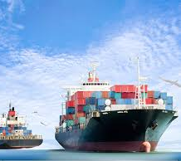
overview
World trade has become increasingly linked through expanded international trade and portfolio investments (international loans, purchase of stock, and foreign direct investment
Growth of foreign aid has been decreasing; on the other hand, private capital flows and remittances have been increasing
Developing countries are trading more and more, among themselves as well as with developed countries

Slide 5
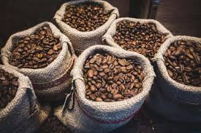
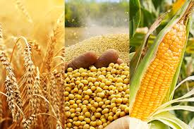
Globalization of trade
In a global economy, no nation is self-sufficient; nations trade, sell, and acquire what they needs
Increased trade creates more business opportunities, rapid growth of knowledge and efficiency gains
It also raises concerns of inequality across and within countries
Because of interdependencies, countries become more vulnerable to changes in capital flows

Slide 6
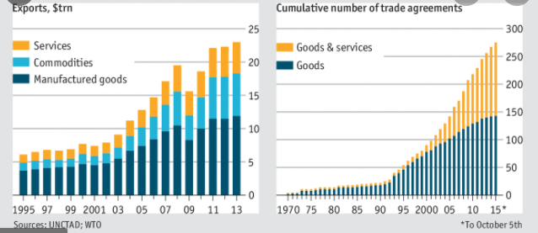
Volume of world Trade, 1995-2013

Slide 7
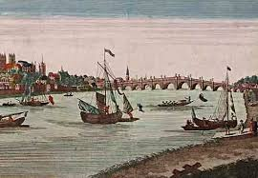
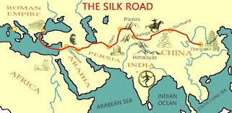
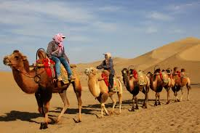
Developments in international trade
Silk road: an ancient overland route linking China and the West
Mercantilism: an economic policy designed to maximize exports and minimize imports through imperialism, colonialism

Slide 8
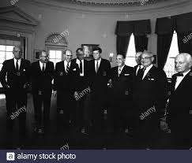
Developments in international trade
Rise of global trade: world becomes more integrated, leading to a global economy and global economic policymaking
1947: establishment of General Agreement on Trade and Tariffs (GATT)
1995: establishment of World Trade Organization (WTO); replaced GATT

Slide 9
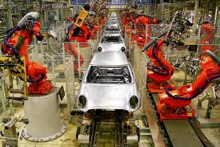
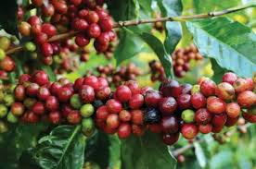
issues in international trade
Successes in export-oriented policies (South Korea, Taiwan, Hong Kong and Singapore), but also failures
Countries that largely rely on primary commodity exports face unstable/suppressed prices, making them export dependent
Dualistic farming structures: Capital intensive farms exist side by side with low productivity small holder farms. Export earnings are unlikely to equally benefit both groups

Slide 10

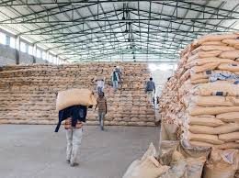
issues in international trade
Export dependence: some countries are dependent on oil exports (some countries earning over 80% of exports from oil); others depend on tourism or primary commodities
Many developing countries depend on imports of materials, machinery, capital goods and other consumer products. Excessive imports creates problems of balance of payment and trade deficits
Severe deficits on current and capital accounts depletion of international monetary reserves, currency instability and slowdown in economic growth

Slide 11
Trade and development
International trade affects the rate how quickly the economy grows), structure (changes in key economic sectors), and character (trends and patterns) of economic growth.
Trade alters the distribution of income and wealth within a country and among different countries; it may benefit some groups while leaving other groups out)
Trade can help a country to achieve its development objectives (reducing poverty, ensuring environmental sustainability, promoting social inclusiveness)
The outcome of trade efforts/activities, however will depend on what the country exports and imports, the balance of payments, what policies are in place, government institutions and role of the private sector.

Slide 12
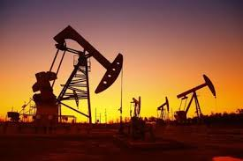
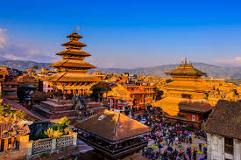
Trade and development
A developing county may or may not determine how much it trades or which products or services it sell; this will depend on international demand, availability of outputs, production capacity, technological know-how and trade restrictions)
Countries could adopt an outward-looking (export orientation) or inward-looking policy (import substitution), or both

Slide 13
Free Trade: Benefits and disadvantages
In theory, free trade promotes economic efficiencies and optimal resource allocation; countries trade based on their comparative advantage
However like perfect competition, free trade does not exist in practice; countries operate on imperfect competition unequal trade and different levels of technological know-how
Since many developing countries are dependent on one or a few commodity exports (oil, coffee), there is a risk of facing falling prices in the long run and unstable prices in the short run
Countries that have diversified sources of income are less susceptible to economic downturns

