Slide 1
Chapter 4: Securities Markets: Organization and Operation
Analysis of Investments &
Management of Portfolios
10TH EDITION
Reilly & Brown

Slide 2
What Is A Market?
Basic Concepts
  It brings buyers and sellers together to aid in the transfer of goods and services
  It does not need to have a physical location
  The market does not necessarily have to own the goods and services
  It can deal in any variety of goods and services
  Both buyers and sellers benefit from the market

Slide 3
What Is A Market?
Characteristics of a Good Market
  Availability of past transaction information
    must be timely and accurate
  Liquidity
    Marketability
    Price continuity
    Depth
  Low transaction costs: Internal efficiency
  Rapid adjustment of prices to new information: External efficiency

Slide 4
What Is A Market?
Decimal Pricing
  Prior to the initiation of changes in late 2000 that were completed in early 2001, common stocks in the United States were always quoted in fractions
  Advantages
    Easy understanding and comparison
    Bid-ask spread is reduced, lower transaction costs
    More competitive US markets
  The number of transaction has increased significantly while the average transaction size has reduced

Slide 5
What Is A Market?
Primary markets
  Market where new securities are sold and funds go to issuing unit
Secondary markets
  Market where outstanding securities are bought and sold by investors. The issuing unit does not receive any funds in a secondary market transaction

Slide 6
Primary Capital Markets
Government Bond Issues
  Treasury Bills: Negotiable, non-interest bearing securities with original maturities of one year or less
  Treasury Notes: Original maturities of 2 to 10 years
  Treasury Bonds: Original maturities of more than 10 years
  The sales of these bills, notes, and bonds are conducted through the Federal Reserve System auctions

Slide 7
Primary Capital Markets
Municipal Bond Issues
  Sold by three methods
    Competitive bid
    Negotiation
    Private placement
  Underwriters sell the bonds to investors
    Origination
    Risk-bearing
    Distribution

Slide 8
Primary Capital Markets
Corporate Bond and Stock Issues
  Corporate bond issues are almost always sold through a negotiated arrangement with an investment banking firm that maintains a relationship with the issuing firm.
  New Stock Issues
    Seasoned new issues: New shares offered by firms that already have stock outstanding
    Initial public offerings (IPOs): A firm selling its common stock to the public for the first time
    These new issues are typically underwritten by investment bankers

Slide 9
The Underwriting Function
The investment banker purchases the entire issue from the issuer and resells the security to the investing public.
The firm charges a commission for providing this service.
For municipal bonds, the underwriting function is performed by both investment banking firms and commercial banks
The underwriting organization structure (Exhibit 4.1)

Slide 10
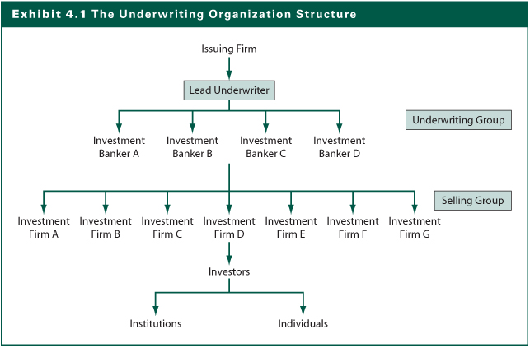
Exhibit 4.1

Slide 11
Relationships with Investment Bankers
Negotiated
  Most common
  Full services of underwriter
Competitive bids
  Corporation specifies securities offered
  Lower costs
  Reduced services of underwriter
Best-efforts
  Investment banker acts as broker

Slide 12
Introduction of Rule 415
Allows firms to register securities and sell them piecemeal over the next two years
Referred to as shelf registrations
Great flexibility
Reduces registration fees and expenses
Allows requesting competitive bids from several investment banking firms
Mostly used for bond sales

Slide 13
Private Placements and Rule 144A
Rule 144A allows corporations—including non-U.S. firms—to place securities privately with large, sophisticated institutional investors without extensive registration documents.
These securities can subsequently be traded among large sophisticated investors.
Lower issuing costs than public offering.
Currently, more than 85% of high-yield bonds are issued as 144A issues.

Slide 14
Secondary Financial Markets
Why Secondary Financial Markets Are Important?
  Provides liquidity to investors who acquire securities in the primary market
  Results in lower required returns than if issuers had to compensate for lower liquidity
  Helps determine market pricing for new issues

Slide 15
Secondary Financial Markets
Why Secondary Financial Markets Are Important?
  Provides liquidity to investors who acquire securities in the primary market
  Results in lower required returns than if issuers had to compensate for lower liquidity
  Helps determine market pricing for new issues

Slide 16
Secondary Bond Market
Secondary market for U.S. government and municipal bonds
  U.S. government bonds traded by bond dealers
  Banks and investment firms make up municipal market makers
Secondary corporate bond market
  Traded through an OTC market
  Limited trading in corporate bonds compared to the fairly active trading in government bonds

Slide 17
Secondary Equity Markets
Basic Trading Systems
  Pure Auction Market: Buyers and sellers submit bid-and-ask prices (buy and sell orders) for a given stock to a central location where the orders are matched by a broker who does not own the stock but acts as a facilitating agent (It is also known as order-driven market)
  Dealer Market: Individual dealers provide liquidity for investors by buying and selling the shares of stock for themselves (as known as quote-driven market)

Slide 18
Secondary Equity Markets
Call Versus Continuous Markets
  Call markets trade individual stocks at specified times to gather all orders and determine a single price to satisfy the most orders
  Used for opening prices on NYSE if orders build up overnight or after trading is suspended
  In a continuous market, trades occur at any time the market is open

Slide 19
Secondary Equity Markets Classification
Primary Listing Markets
  NYSE, AMEX, Tokyo, and LSE
Regional Markets
  Chicago, San Francisco, Boston, Osaka, Nagoya, Dublin, Cincinnati
Third Market Dealers/Brokers
  Madoff Investment Securities, Knight Trading Group, Jefferies Group, ITG
Alternative Trading Systems
  Electronic Communications Networks (ECNs)
  Electronic Crossing Systems (ECSs)
See Exhibit 4.3

Slide 20
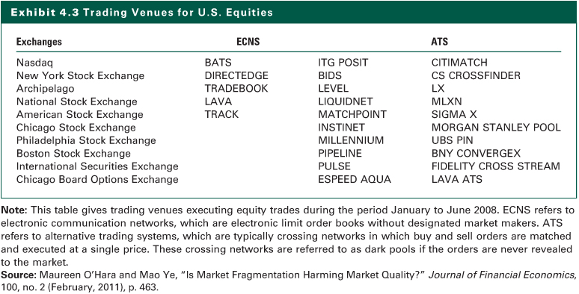
Exhibit 4.3

Slide 21
New York Stock Exchange (NYSE)
Largest organized securities market in the United States
Established in 1817, but dates back to the 1792 Buttonwood Agreement by 24 brokers
At the end of 2010, approximately 2,850 companies with securities listed on NYSE
Total market value nearly $14 trillion
2010 average daily volume of about 3.5 billion shares.

Slide 22
American Stock Exchange (AMEX)
Traded unlisted stocks at the corner of Wall Street in as the Outdoor Curb Market in 1910
Historically, it had an emphasis on foreign securities and warrants
Merged with the NASDAQ IN 1998 but in 2005 NASDAQ sold the AMEX back to its members.
The AMEX was finally acquired by the NYSE in 2007.

Slide 23
Global Stock Exchanges
The major markets are Tokyo Stock Exchange, London Stock Exchange, Frankfurt Stock Exchange, and Paris Bourse.
Trend toward consolidations or affiliations that will provide more liquidity and greater economies of scale to support the technology required by investors.
The existence of the strong international exchanges has made possible a global equity market wherein stocks that have a global constituency can be traded around the world continuously, creating the global 24-hour market.

Slide 24
The NASDAQ Market (NMS)
Historically known as the over-the-counter market
Largest segment of the U.S. secondary market in terms of number of issues
It is a dealer market and trades electronically
Lenient requirements for listing on the NASDAQ NMS
More than 2800 issues are actively traded on the NASDAQ NMS and almost 700 on the NASDAQ Small-Cap Market (SCM)
Any stock can be traded on the NASDAQ market as long as there are dealers willing to make a market

Slide 25
Other NASDAQ Market Segments
The NASDAQ Small-Cap Market (SCM)
  Initial listing requirements consider the same factors as the NMS but are generally about one-half to one-third of the values as those on NMS. As of early 2011, there were about 700 stocks listed in the NASDAQ small-cap segment.
The NASDAQ OTC Electronic Bulletin Board
  For smaller stocks sponsored by NASD dealers. As of late 2011, there were about 3,400 stocks.
The National Quotation Bureau Pink Sheets
  Reports the smallest publicly traded stocks in U.S.

Slide 26
Regional Exchanges
They provide trading facilities for local companies not large enough to qualify for listing on one of the national exchanges
Listing requirements are typically less stringent than the national exchanges
Regional exchanges list firms that also list in one of the national exchanges to give local brokers who are not members of a national exchange access to these securities
In the U.S., the Chicago, Pacific, and PBW exchanges account for 90 percent of all regional exchange volume

Slide 27
The Third Market
It refers to the market where dealers and brokers who trade shares that are listed on an exchange away from the exchange.
Third market dealers typically display their quotes on the NASDAQ InterMarket system.
It competes with trades on exchange.
The third market may be open when exchange is closed or trading suspended.
Mostly well known stocks
  GM, IBM, AT&T, Xerox

Slide 28
Alternative Trading Systems
These are nontraditional, computerized trading systems that compete with or supplement dealer markets and traditional exchanges
The most well-known ATSs are Electronic Communication Networks (ECNs) and the Electronic Crossing Systems (ECSs)
The trading of exchange-listed stocks using one of these ATSs has become the fourth market

Slide 29
Major Types of Orders
Market Orders
  Buy or sell at the best current price
  Provides immediate liquidity
Limit Orders
  Order specifies the buy or sell price
  Time specifications for order may vary: Instantaneous “fill or kill”, part of a day, a full day, several days, a week, a month, or good until canceled (GTC)

Slide 30
Major Types of Orders
Special Orders
  Stop Loss Order
    A conditional market order to sell stock if it drops to a given price
    Does not guarantee price you will get upon sale
    Market disruptions can cancel such orders
  Stop Buy Order
    A conditional market order to buy stock if it increases to a specified price
    Investor who sold short may want to limit loss if stock increases in price
Margin Transactions and Short Sales

Slide 31
Margin Transactions
On any type order, instead of paying 100% cash, investors can borrow a portion of the transaction and use the stock as collateral
Interest rate on the money borrowed is normally 1.50% above the bank rate, referred to as the call money rate.
Changes in stock price change the total market value of the stock bought and affect the investor’s equity position in the stock

Slide 32
Margin Transactions
Margin Requirement
  The initial margin requirement is set by the Federal Reserve at 50%, although individual investment firms can require higher percentages
  Maintenance Margin
    Required proportion of equity to stock after purchase
    Protects broker if stock price declines
    Minimum requirement is 25%
    Margin call on undermargined account to meet margin requirement
    If margin call is not met, the stock will be sold to pay off the loan

Slide 33
Margin Transactions
Suppose you bought 200 shares of a $50 stock and borrowed the maximum amount of money given an initial margin requirement of 50%. If the stock price increase to $60 per share, what will be your equity position in the stock?
Total stock value: $12,000
Less amount borrowed: - $5,000
Equity amount: $7,000
Equity position (%): $7,000/$12,000 = 58%

Slide 34
Margin Transactions
What would be your percentage return if the price reaches $60 in the earlier example? If the maintenance margin is 25%, what is the margin call price?
Return on your margin account:
  Stock return: ($60-$50)/$50=20%
  Your return: ($12,000- $5,000)/$5,000 =40%
Margin call price (P):
  Equity position: 200P-$5,000
  Percentage margin : (200P-$5,000)/200P
  At margin call: (200P-$5,000)/200P=25%
  Solving for P, P=$33.33

Slide 35
Short Sales
Short sales
  Sell overpriced stock that you don’t own and purchase it back later (hopefully at a lower price)
  Borrow the stock from another investor (through your broker)
  Must pay any dividends to lender
  Margin requirements apply

Slide 36
Margin Transactions
You believe that the stock of Cara Corporation is overpriced and decide to sell 1,000 shares short at $80. You have posted 50% margin as required. If the stock price drops to $70 per share, what will be the percentage margin on your account?
The Value of Your Equity
  Sales of the stock: $8,000
  Money deposited: +$4,000
  The Value of the stock owed: -1000P
Percentage Margin
($8,000+$4,000-1000P)/1000P
= ($8,000+$4,000-1000 x $70)/1000 x $70=71%

Slide 37
Exchange Market Makers
They are referred to as specialist or designated market makers (DMM)
A specialist is a member of the exchange who applies to the exchange to be assigned stocks to handle (usually 10-15)
The specialist has two major functions:
  As broker to match buyers and sellers
  As dealer to maintain fair and orderly market

Slide 38
New Trading Systems
On the NYSE
  Super Dot
    Electronic order-routing system
    Member firms transmit market and limit orders in NYSE securities to trading posts or firm’s booth
    Report of execution returned electronically
    85% of NYSE market orders enter through Super DOT system
  Display Book
    Electronic workstation that keeps track of all limit orders and incoming market orders, including incoming Super Dot limit orders

Slide 39
New Trading Systems
  Opening Automated Report Service (OARS)
    Pre-opening market orders for Super Dot system
    OARS automatically and continuously pairs buy and sell orders
    Presents imbalance to the specialist prior to the opening of a stock
    Helps determine opening price and potential need for preopening call market

Slide 40
New Trading Systems
  Market-Order Processing
    Super Dot’s postopening market order system is designed to accept member firms’ postopening market orders up to 3 million shares
    Rapid execution and reporting of market orders
  Limit-Order Processing
    Electronically files orders to be executed when and if a specific price is reached
    Updates the Specialist’s Display Book
    Good-until-cancelled orders that are not executed are stored until executed or cancelled

Slide 41
New Trading Systems
On NASDAQ
  Small Order Execution System
    Market makers receiving SOES orders must honor their bids for automatic executions up to 1,000 shares
  SelectNet
    SelectNet is an order-routing and execution service for institutional investors

Slide 42
Exchange Merger Mania
Two Major Reasons
  The trend toward portfolios that are diversified both between countries (globally) and among asset classes
  The economics of high technology trading
Some Past Mergers
  NYSE
    Acquired Archipelago Holdings Co. and became a publicly traded entity, the NYSE Group, Inc. in 2006
    In 2007, merged with Euronext NV which itself was the product of earlier mergers of several European exchanges

Slide 43
Exchange Merger Mania
  NASDAQ
    Acquired the Instinet Group, an ECN and became a public company
    Acquired the Philadelphia Stock Exchange and OMX, an ECN
  CME
    The Chicago Mercantile Exchange (CME) Holding went public in 2006, and the Chicago Board of Trade (CBT) subsequently went public.
    In late 2007 these two exchanges merged to CME
  London
    Acquired the Borsa Italiana in 2007
    Acquired the Toronto Exchange (TMX Group) in early 2011.
Present and Future

Slide 44
Exchange Merger Mania
Present and Future
  There will be a few global holding companies that own global exchanges for stocks, bonds, and derivatives.
  Examples
    German Stock Exchange (Deutsche Borse) and the NYSE announced a potential merger in early 2011
    The NASDAQ and the Intercontinental Exchange (ICE) came out with a competing bid for the NYSE
    The potential merger between the Singapore Stock Exchange (SGX) and the Australian Stock Exchange (ASX)

Slide 45
The Internet Investments Online
http://finance.yahoo.com
http://finance.lycos.com
http://www.sec.gov
http://www.nyse.com
http://www.nasdaq.com
http://www.amex.com
http://www.etrade.com
http://www.schwab.com
http://www.ml.com
http://www.fibv.com
http://www.internationalist.com/business/stocks
http://biz.yahoo.com/ifc
http://www.wall-street.com/foreign.html

