Slide 1

BA 291 – Marketing
By Aj. Parichat Jantori

Slide 2
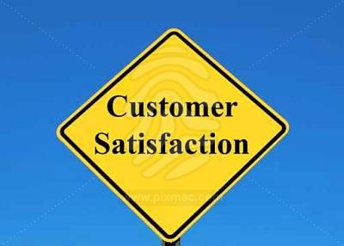

Marketing
Marketing: A process of planning and executing the conception, distribution, promotion, and pricing of ideas, goods, services, organizations, and event to create relationships that satisfy individual and organizational objectives.
Notes:
Marketing is not just selling and advertising, it is a systematic approach to satisfy customes --- repurchase (word of the mouth)

Slide 3
Benefits of marketing
Social & economic
Boost economic
Business organization
raise revenues
Customer
Increase product varieties
Intensiver competition – therefore higher quality goods at lower price
Income distribution and increase employement
Main business task

Slide 4
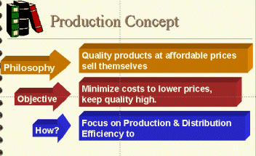
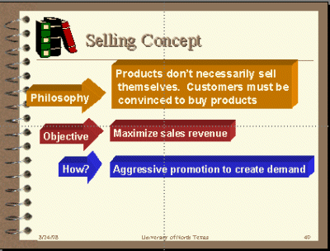
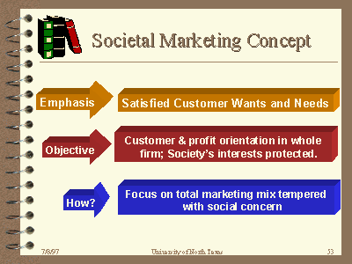
Evolution of marketing concept

Slide 5

Functions of marketing
Buying
Selling
Transporting
Storing
Grading
Financing
Marketing research
Risk taking

Slide 6
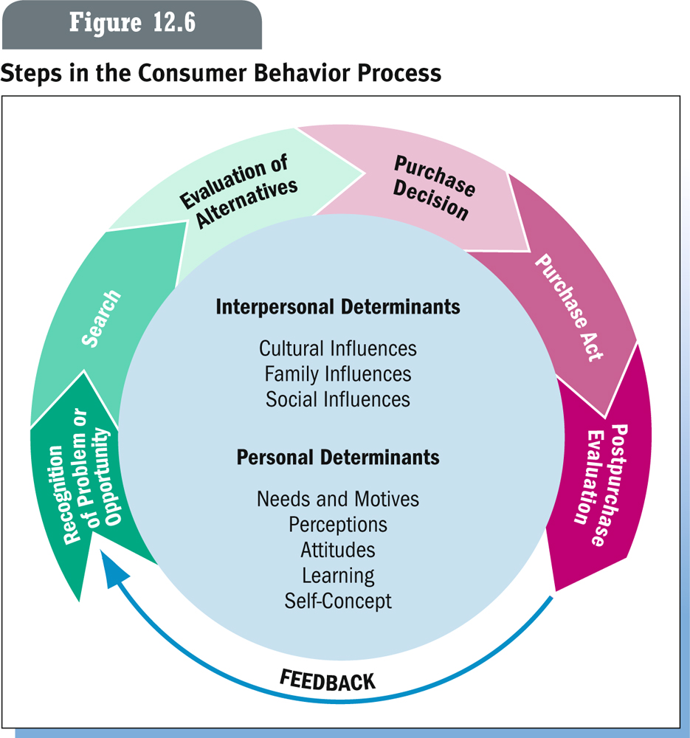
Customer behavior

Slide 7
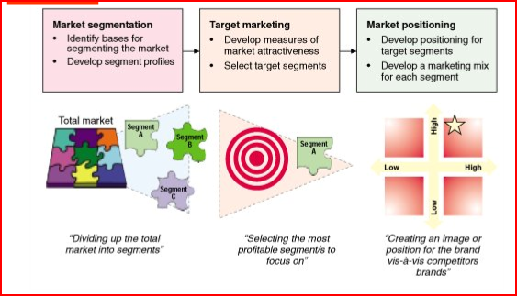
STP marketing

Slide 8
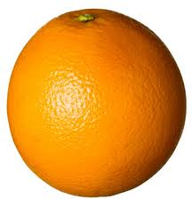
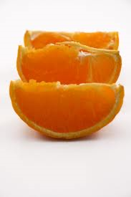
Market Segmentation
Market Segmentation: A strategy whereby a firm divides the total market into groups of people who have relatively similar product needs

Slide 9
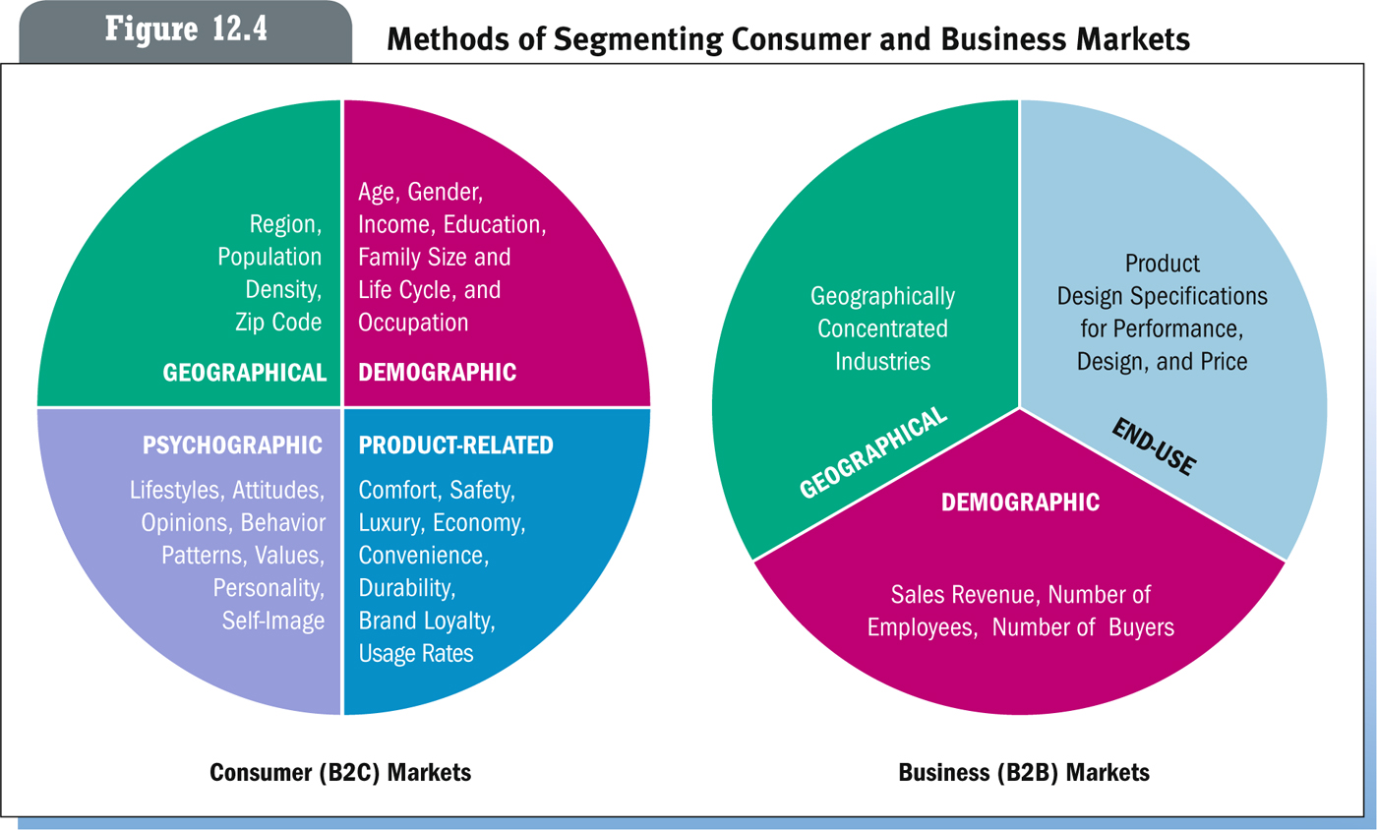
Market segmentation methods

Slide 10
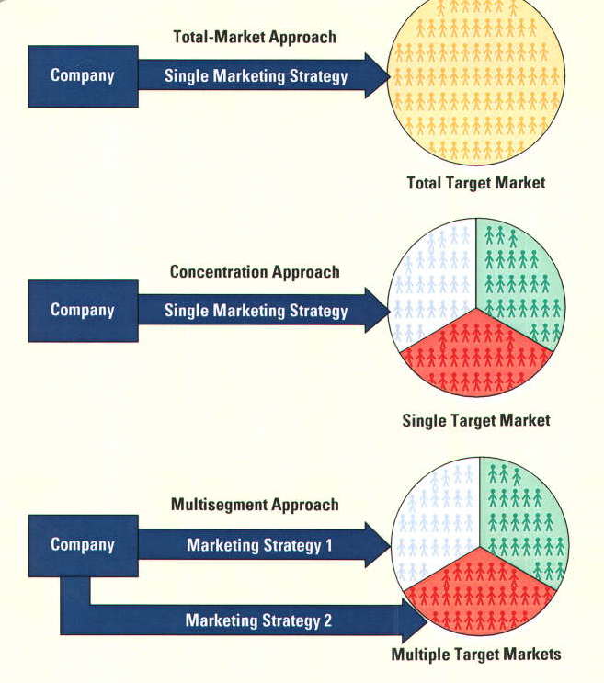
Target market selection
Target Market – very specific group of consumers that a company focuses its marketing efforts to

Slide 11
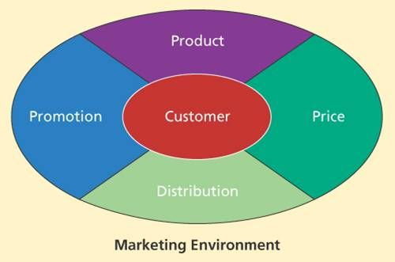
Marketing Mix

Slide 12
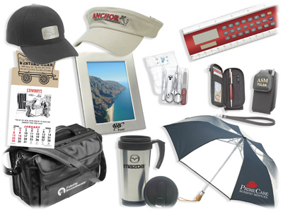
Product
Anything that can be offered to a market for attention, acquisition, use or consumption
Products can be:
  Physical Products
  Services
  Persons
  Places
  Organizations
  Ideas
  Combinations of the above

Slide 13
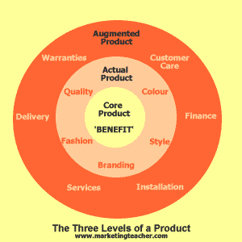
Levels of product

Slide 14
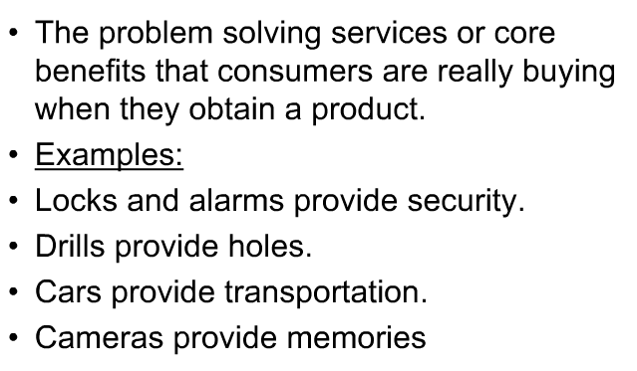
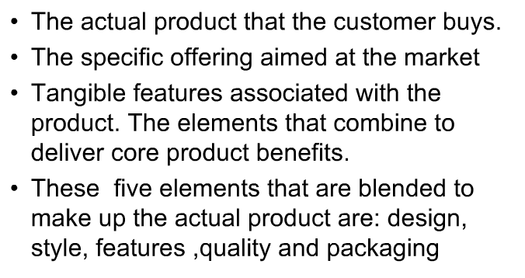
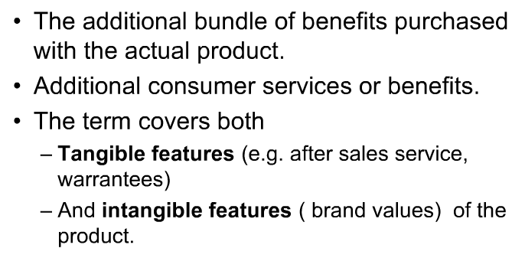
Levels of product
Core Product
Actual Product
Augmented Product

Slide 15
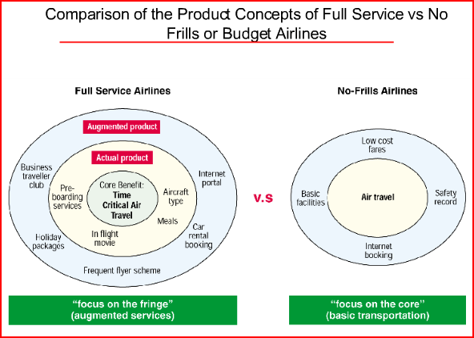
Levels of product

Slide 16
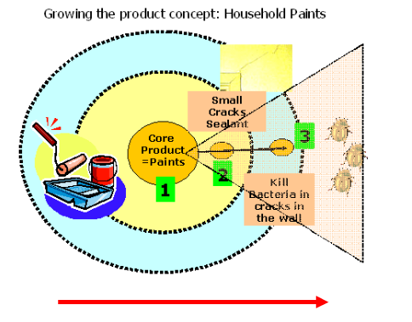
Levels of product

Slide 17
Classifications of products
Consumer products: Merchandise or other item of common or daily use, ordinarily bought by individuals or households for private consumption. See also consumer goods.
Industrial products: Machinery, manufacturing plants, materials, and other goods or component parts for use or consumption by other industries or firms.
Materials and parts
  Capital items
  Supplies and services

Slide 18
Classifications of consumer products
Convenience Products
Buy frequently & immediately
Low priced
Many purchase locations
Includes:
  Staple goods
  Impulse goods
  Emergency goods
Shopping Products
Buy less frequently
Gather product information
Fewer purchase locations
Compare for:
  Suitability & Quality
  Price & Style
Specialty Products
Special purchase efforts
Unique characteristics
Brand identification
Few purchase locations
Unsought Products
New innovations
Products consumers don’t
want to think about
Require much advertising &
personal selling

Slide 19
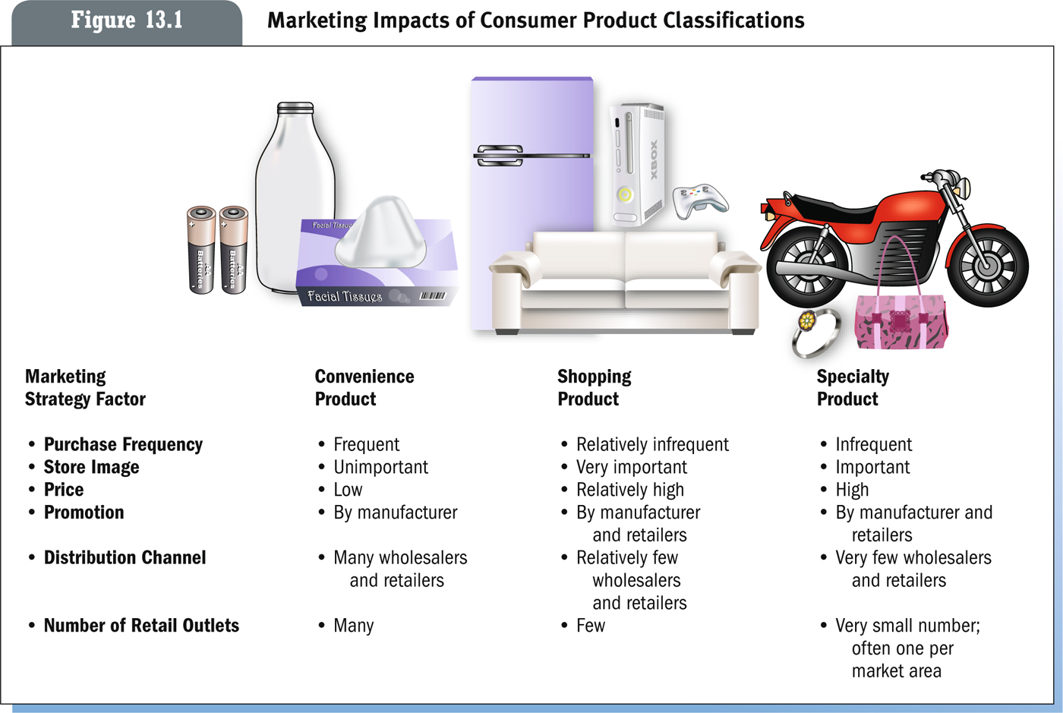
Marketing impacts of consumer product

Slide 20
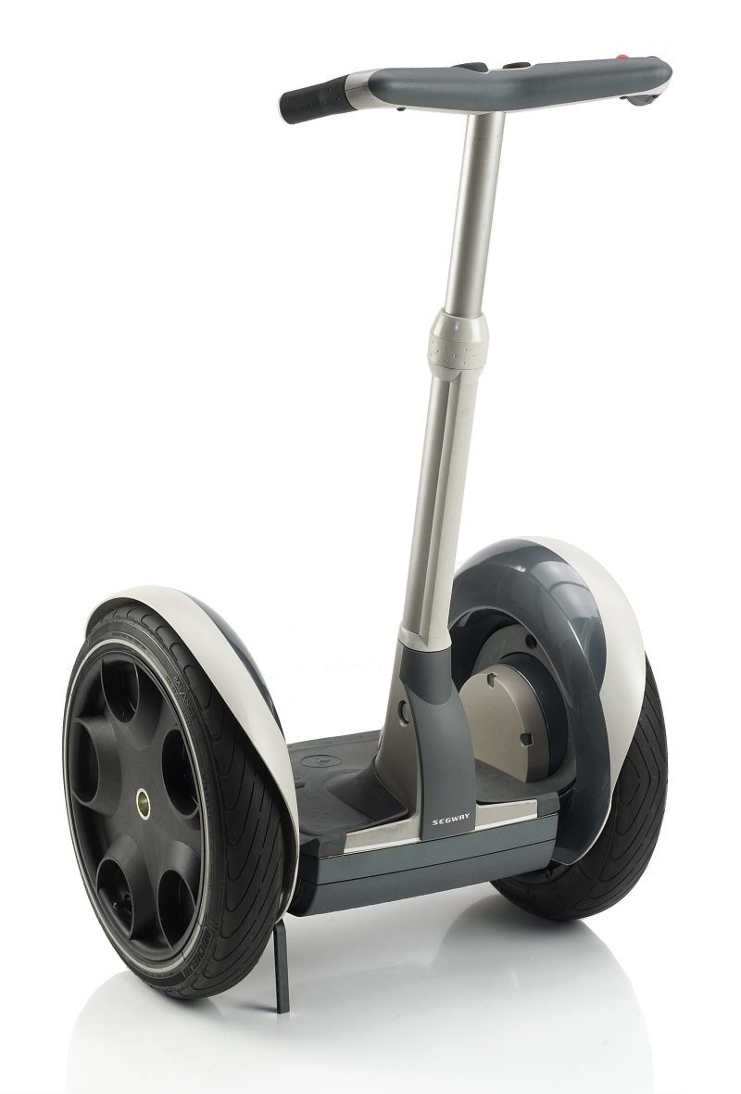
Product development
- New to the world product
Idea development
Idea screening
Business analysis
Product development
Test marketing
Commercialization
Notes:
http://www.cardesignonline.com/design/modelling/clay-modelling.php
http://www.cardesignonline.com/design/modelling/clay-modelling.php
http://www.auto-news.de/erlkoenige/anzeige_BMW-1er-erwischt-Hier-faehrt-der-brandneue-Kompakte-spazieren_id_27683
http://www.motorline.cc/autowelt/index.php/article=149577/=Autowelt_-_ERWISCHT__Der_neue_Mini_Crossman_-

Slide 21

Product development
- Improve, add features, functions

Slide 22
Product development
Add product line
Increase product mix: the total composite of products offered by a particular organization, consists of both product lines and individual products
Product mix width:
  Number of different product lines carried by company
Product mix depth:
  Number of different versions of each product in the line
Notes:
The product mix of a company, which is generally defined as the total composite of products offered by a particular organization, consists of both product lines and individual products. A product line is a group of products within the product mix that are closely related, either because they function in a similar manner, are sold to the same customer groups, are marketed through the same types of outlets, or fall within given price ranges. A product is a distinct unit within the product line that is distinguishable by size, price, appearance, or some other attribute. For example, all the courses a university offers constitute its product mix; courses in the marketing department constitute a product line; and the basic marketing course is a product item. Product decisions at these three levels are generally of two types: those that involve width (variety) and depth (assortment) of the product line and those that involve changes in the product mix occur over time.
The depth (assortment) of the product mix refers to the number of product items offered

Slide 23
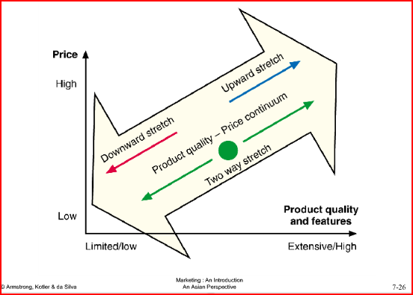
Product line stretching

Slide 24
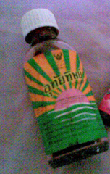
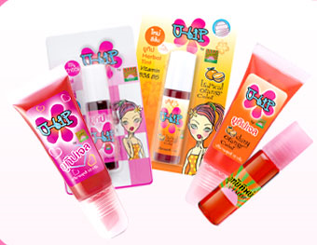
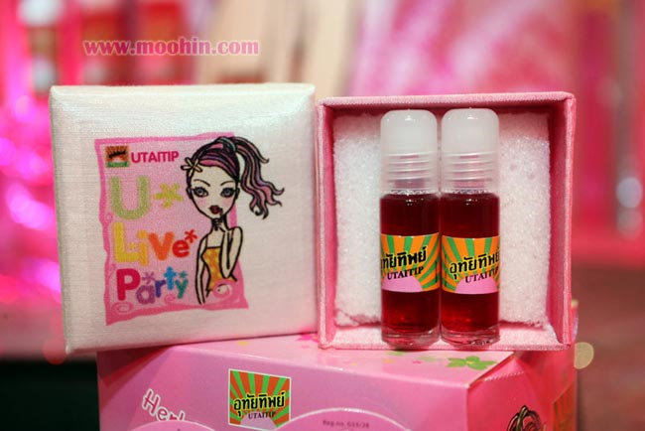
Product development
- Product repositioning: arranging for a product or brand to occupy some other clear and distinctive position in the market and in the minds of target consumers than that which it presently occupies

Slide 25
Identifying Products
Product Attributes: quality (level of performance, consistency), differentiated features, style, design
Branding: sign, symbol, color, word, logo or a combination of these
Packaging: packaging concept, element, product safety, environment concern
Labeling: identify, describe ingredient, instructions, promote
Product support: services, after sale service

Slide 26
Branding
Branding Strategy
Brand equity: added valuethat a widely resprected, highly successful name gives to a product in the marketplace.
Brands with strong equity have many competitive advantages:
  High consumer awareness
  Strong brand loyalty
  Helps when introducing new products
  Less susceptible to price competition

Slide 27
Brand elements
Brand
names
URLs
Slogans
Elements
Logos
Characters
Symbols
Notes:
Brand element criteria
Memorable
Meaningful
Likeability
Transferable
Adaptable
Protectible

Slide 28
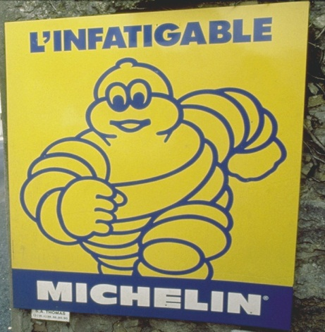


Brand element criteria
Desirable qualities for a brand name
Include:
It should be easy to pronounce,
recognize and remember
It should suggest product benefits and qualities
It should distinctive
It should extendable
It should easily translate into foreign languages
It should be capable of registration and legal protection

Slide 29
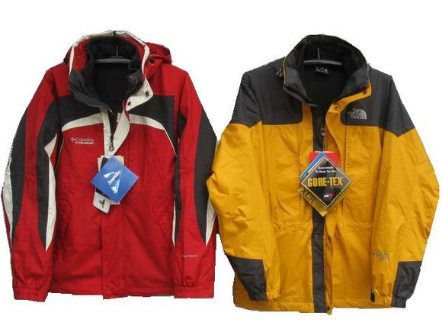

Brand Sponsorship
Manufacturer brands
Private (store) brands
Licensed brands
Co-branding
Family brands

Slide 30
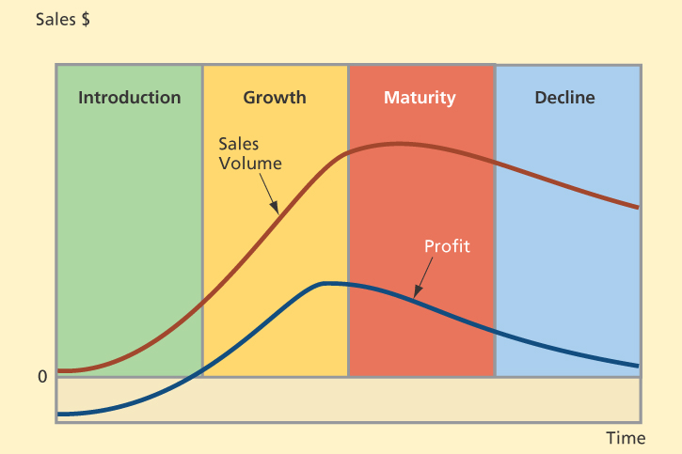
Product Life Cycle

Slide 31
Product Life Cycle
Introduction stage – firm promotes demand for its new offering, informs the market about it, gives free samples to entice consumers to make a trial purchase, and explains its features, uses, and benefits.
Growth stage - sales climb quickly as new customers join early users who are repurchasing the item. Company begins to earn profits on the new product.
Maturity stage - industry sales eventually reach a saturation level at which further expansion is difficult.
Decline stage - sales fall and profits decline.

Slide 32
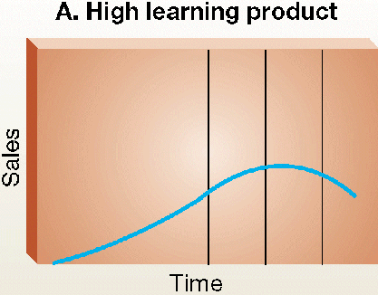
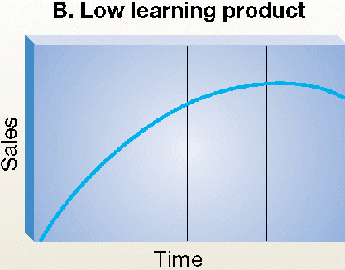
Product life cycle
Significant education of the customer is required.
Extended introductory period
Sales begin immediately
Little learning is required by the consumer
Benefits of purchase are readily understood

Slide 33
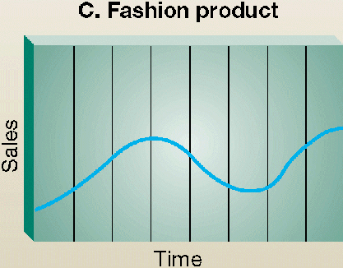
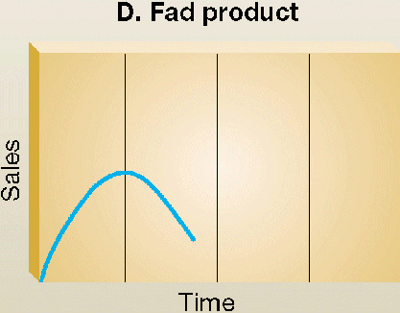
Product life cycle
Most often appear in women’s and men’s clothing styles.
Length of the cycles may be years or decades
Rapid sales on introduction
Equally rapid decline.
Often novelties and have a short life cycle.

Slide 34
Pricing strategy
price is the amount of money charged for a product or service
price is the sum of all the values that consumers exchange for the benefits of having or using the product or service
Major consideration in setting price
Customer perceptions of value
Other internal and external considerations
  Nature of the market and demand
  Competitors’ strategies and prices
Product costs

Slide 35
Pricing method
Cost-plus pricing
  - Adding a standard markup to the cost of the product
Break-even pricing
- pricing technique use to determine the minimum sales volume of a product must generate at the certain price level to cover the cost
Target-return pricing
- Set the price to achieve a target return-on-investment (ROI)

Slide 36
Setting Price Level (new products)
Skimming Pricing
Setting an intentionally high price relative to the prices of competing products.
Helps marketers set a price that distinguishes a firm’s high-end product from those of competitors.
Helps a firm recover its product development costs before competitors enter the field.
Penetration Pricing
Setting a low price as a major marketing weapon.
Often used with new products.
Notes:
When to Use skimming price:
Product’s quality and image must support its higher price.
Costs of low volume cannot be so high they cancel the advantage of charging more.
Competitors should not be able to enter market easily and undercut the price.
When to Use penetration:
Market is highly price sensitive so a low price produces more growth.
Costs must fall as sales volume increases.
Need to keep competition out or effects are only temporary.

Slide 37
Pricing strategies
By-Product Pricing
  Pricing low-value by-products to get rid of them (e.g., animal manure from zoo).
Product Bundle Pricing
  Pricing bundles of products sold together (software, monitor, PC, and printer).
Cash rebates, discount and allowance pricing (cash, quantity)
Segmented Pricing
Selling a product or service at two or more prices, where the difference in prices is not based on differences in costs

Slide 38
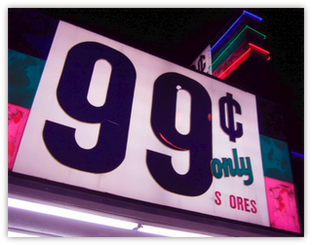
Pricing strategies
Psychological pricing
Consumers usually perceive higher-priced products as having higher quality (symbolic/ prestige pricing)
People will buy more of a product for 9.99 (Odd pricing)
Loss leader

Slide 39
Place (Distribution)
Distribution decisions involve modes of transportation, warehousing, inventory control, order processing and selection of marketing channels.
Distribution channel: path through which products – and legal ownership of them – flow from producer to consumers or business users
Marketing intermediary (middleman) is a business firm that moves goods between producers and consumers or business users.

Slide 40
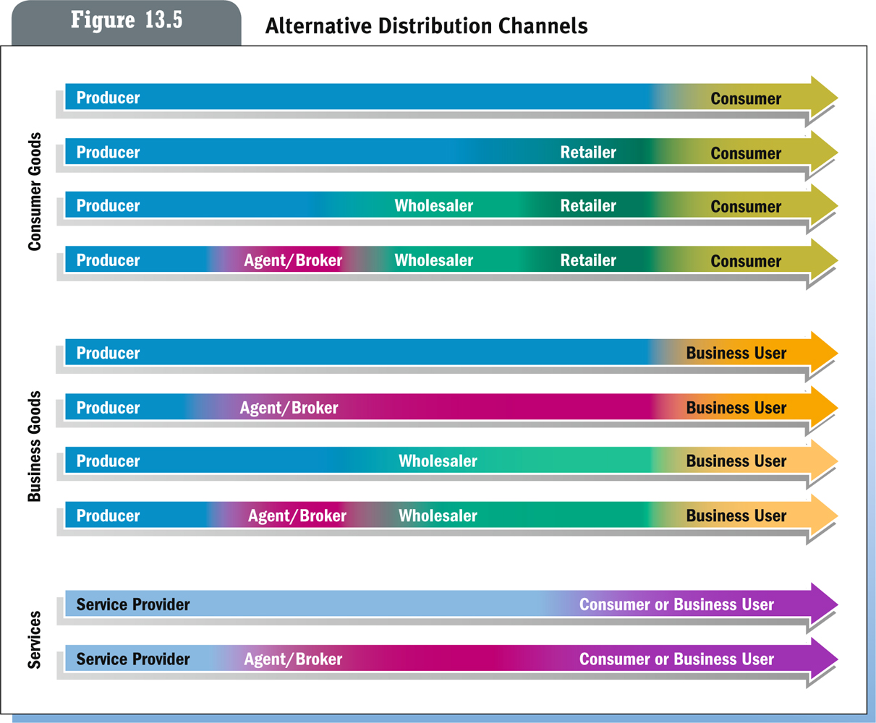
Distribution channels
Notes:
The number of intermediary levels indicates the length of a marketing channel.
Direct Channels
Indirect Channels
Producers lose more control and face greater channel complexity as additional channel levels are added.
Direct Distribution
Direct contact between producer and customer.
Most common in B2B markets.
Often found in the marketing of relatively expensive, complex products that may require demonstrations.
Internet is helping companies distribute directly to consumer market.
Distribution Channels Using Marketing Intermediaries
Producers distribute products through wholesalers and retailers.
Inexpensive products sold to thousands of consumers in widely scattered locations.
Lowers costs of goods to consumers by creating market utility.

Slide 41
Intensity of market coverage
Intensive distribution
  Makes a product available in as many outlets as possible
Selective distribution
  Uses only a small proportion of all available outlets to expose products
Exclusive distribution
  Exists when a manufacturer gives a middleman the sole right to sell a product in a defined geographic territory

Slide 42
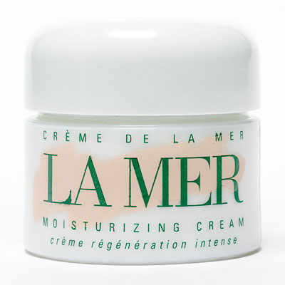
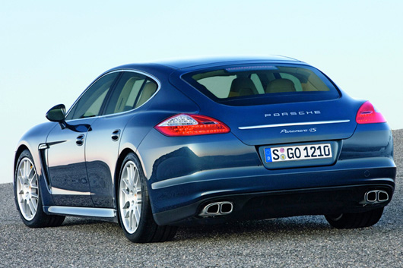

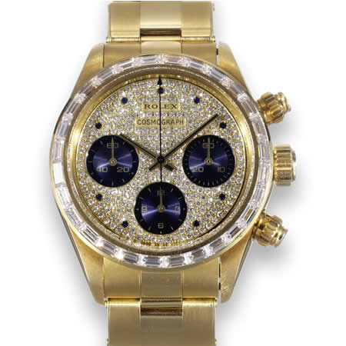



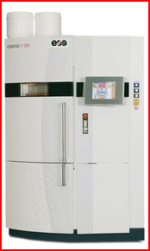




Slide 43

Promotion strategy
  Integrated marketing communications (IMC)
  The integrating and coordinating the company’s many communication channels to deliver a clear, consistent, and compelling message about the organization and its products.
Marketers must understand each promotion tool when shaping the marketing communications mix.
Notes:
Integrated marketing communication is
the integration by the company of its communication channels to deliver a clear, consistent, and compelling message about the organization and its brands.
Integrated marketing communication calls for recognizing all contact points (brand contact) where the customer may encounter the company and its brands.
Integrated marketing communication calls for recognizing all contact points (brand contact) where the customer may encounter the company and its brands.

Slide 44
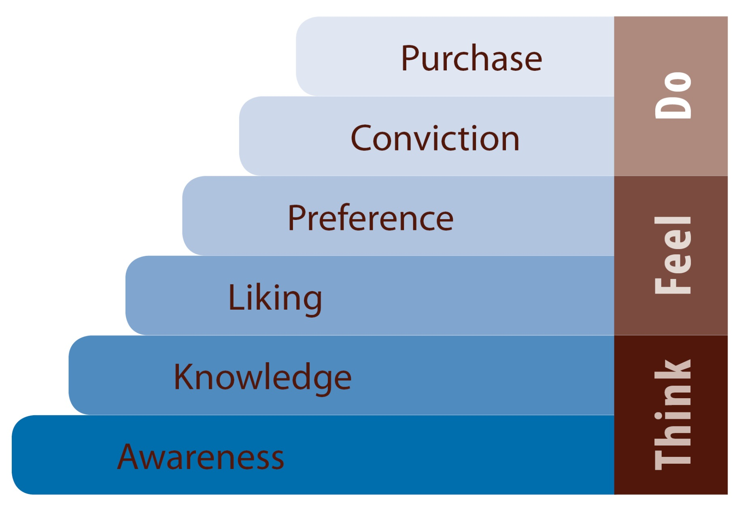
Hierarchie of effect model of communication process
Notes:
http://www.youtube.com/watch?v=pD9P2J0E_BU
http://www.youtube.com/watch?v=AlncW35MWSw
http://www.youtube.com/watch?v=vilUhBhNnQc
http://www.youtube.com/watch?v=pB7nDL4TZOk
http://www.youtube.com/watch?v=jrcAuoMNAHY
http://www.youtube.com/watch?v=HLd4jIDagwQ
http://www.youtube.com/watch?v=StCy9p_78Ok&feature=related

Slide 45
7 Ms of Marketing Communication
Market: Target group
Mission: Objectives
Message: Content, Structure, Format, Source
Media: Personal, Non-Personal
Money (Marketing Budget)
Mix (Promotion Mix)
Measurement

Slide 46
Promotion
The promotion mix is the specific blend of advertising, sales promotion, public relations, personal selling, and direct-marketing tools that the company uses to persuasively communicate customer value and build customer relationships.
Major Promotion Tools
  Advertising.
  Sales promotion.
  Public relations.
  Personal selling.
  Direct marketing

Slide 47
The Promotion Mix
Advertising is any paid form of non-personal presentation and promotion of ideas, goods, or services by an identified sponsor.
  Broadcast
  Print
  Internet
  Outdoor

Slide 48

The Promotion Mix
Sales promotion is the short-term incentives to encourage the purchase or sale of a product or service.
  Discounts
  Coupons
  Displays
  Demonstrations

Slide 49

The Promotion Mix
Public relations involves building good relations with the company’s various publics by obtaining favorable publicity, building up a good corporate image, and handling or heading off unfavorable rumors, stories, and events.
  Press releases
  Sponsorships
  Special events
  Web pages

Slide 50

The Promotion Mix
Personal selling is the personal presentation by the firm’s sales force for the purpose of making sales and building customer relationships.
  Sales presentations
  Trade shows
  Incentive programs

Slide 51
The Promotion Mix
Direct marketing involves making direct connections with carefully targeted individual consumers to both obtain an immediate response and cultivate lasting customer relationships – by using direct mail, telephone, direct-response television, e-mail, and the Internet to communicate directly with specific consumers.
    Catalog
    Telemarketing
    Kiosks

Slide 52
Setting promotion budget
Affordable budget method sets the budget at an affordable level.
  Ignores the effects of promotion on sales
Percentage-of-sales method sets the budget at a certain percentage of current or forecasted sales or unit sales price.
  Easy to use and helps management think about the relationship between promotion, selling price, and profit per unit
  Wrongly views sales as the cause than the result of promotion

Slide 53
Setting promotion budget
Competitive-parity method sets the budget to match competitor outlays.
  Represents industry standards
  Avoids promotion wars
Objective-and-task method sets the budget based on what the firm wants to accomplish with promotion and includes
  Defining promotion objectives
  Determining tasks to achieve the objectives
  Estimating costs

Slide 54
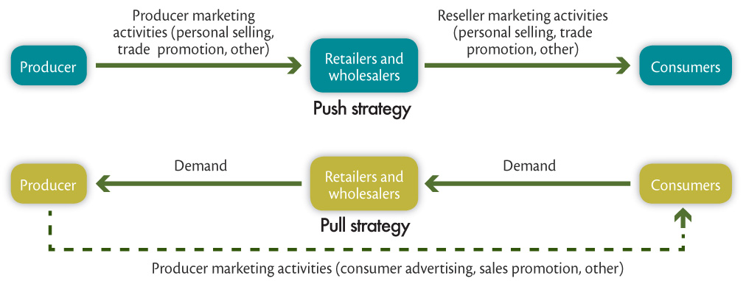
Promotion Mix Strategies
Push strategy involves pushing the product to the consumers by inducing channel members to carry the product and promote it to final consumers.
  Used by B2B companies

Slide 55
Promotion Mix Strategies
Pull strategy is when the producer directs its marketing activities toward the final consumers to induce them to buy the product and create demand from channel members.
  Used by B2C companies

