Slide 1

D
BI 201/BA 291 Business Ethics and Social Responsibility
by Parichat Jantori

Slide 2

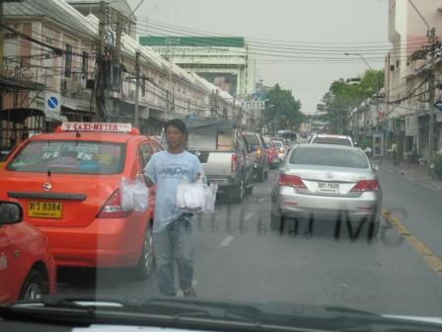
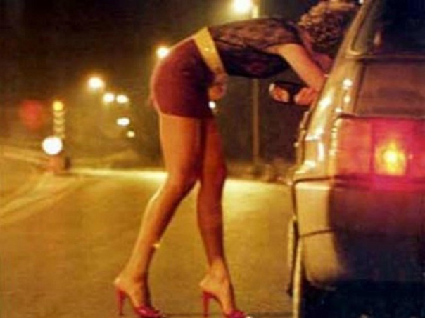
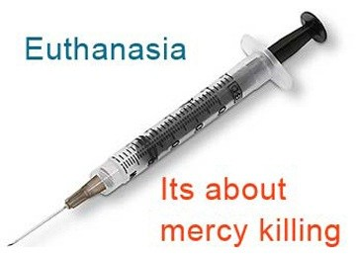
Laws and Ethics

Slide 3
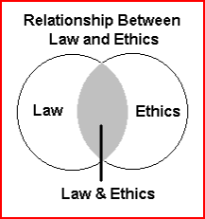
Laws and Ethics
In some instances, law and ethics overlap and what is perceived as unethical is also illegal. In other situations, they do not overlap.

Slide 4
Laws and Ethics
Ethics are rules of conduct. Laws are rules developed by governments in order to provide balance in society and protection to its citizens.
Ethics comes from people’s awareness of what is right and wrong. Laws are enforced by governments to its people.
Law is something you must obey. Ethics is how society expects you to behave.
Laws carry with them a punishment for violations , ethics does not.
Ethics comes from within a person’s moral sense and desire to preserve his self respect, laws does not.
People obey the laws in order to avoid the consequences, people behave ethically because they believe, it is a good way to do so.

Slide 5


Sexual Harassment
Verbal
Physical
Visual
Written
Notes:
http://ilaw.or.th/node/203

Slide 6

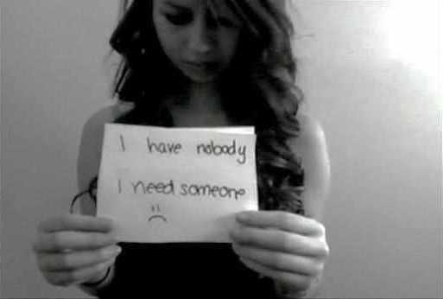

Bullying
Notes:
https://www.youtube.com/watch?v=ej7afkypUsc

Slide 7
Bullies Behavior
Spreading rumors to damage others
Blocking others communication in the workplace
Flaunting status or authority to take advantage of others
Discrediting others ideas and opinions
Use of e-mails to demean others
Insult, yelling and shouting
Using terminology to discriminate others
Taking credit for others work or ideas
Notes:
https://www.youtube.com/watch?v=ej7afkypUsc

Slide 8
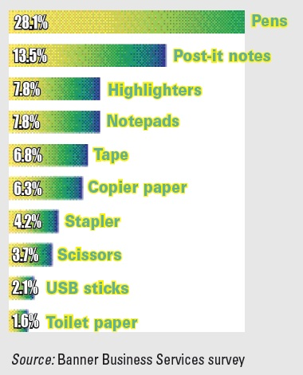
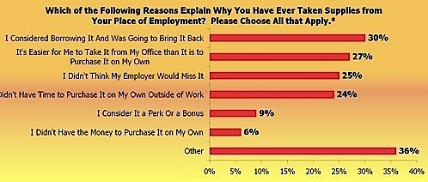
Stealing Office Supplies
Notes:
http://ilaw.or.th/node/203

Slide 9
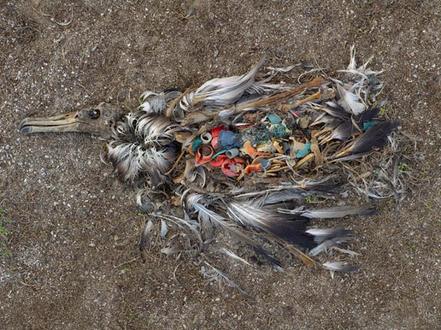
Up to 90% of seabirds have plastic in their guts

Slide 10
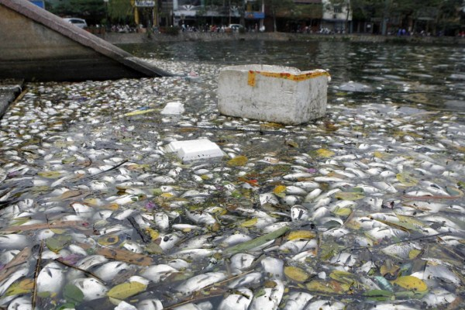
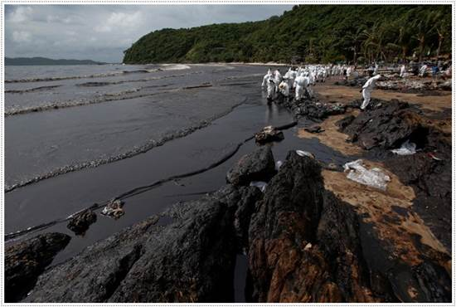

Slide 11


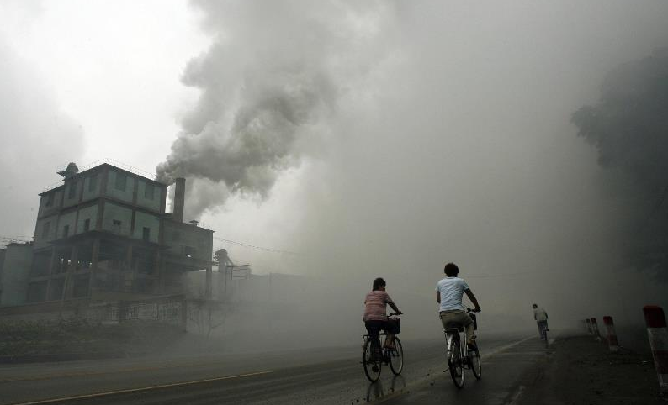
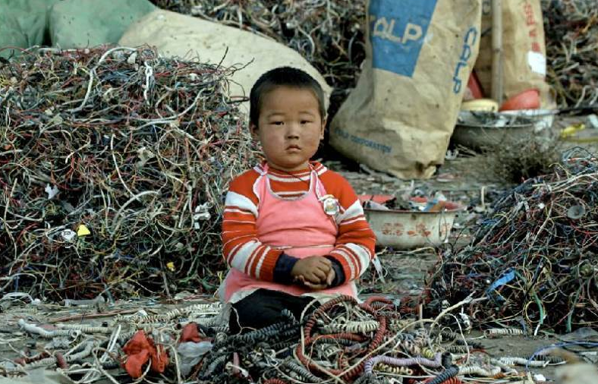

Slide 12
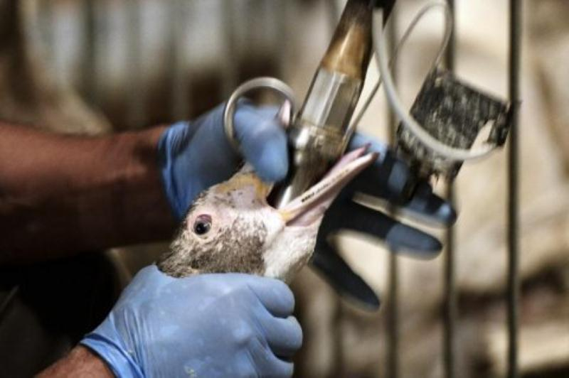
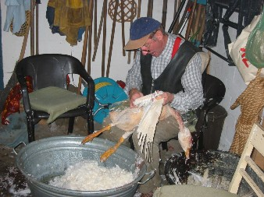

Slide 13

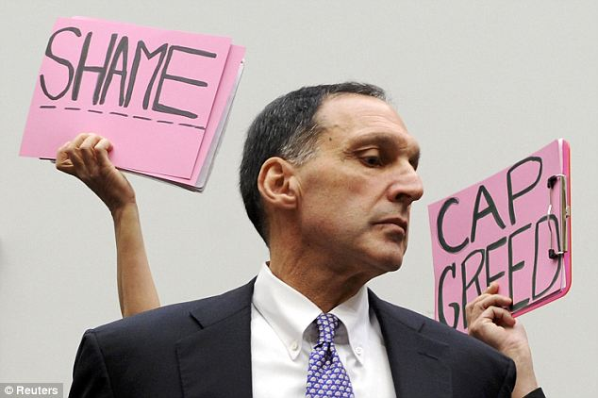
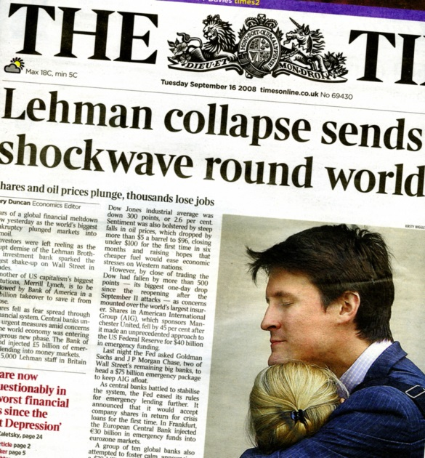
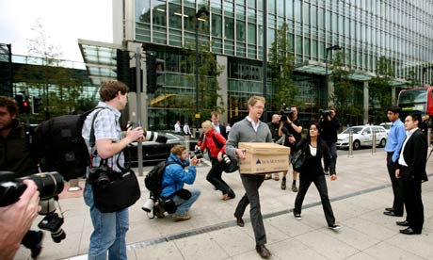

Slide 14


Slide 15
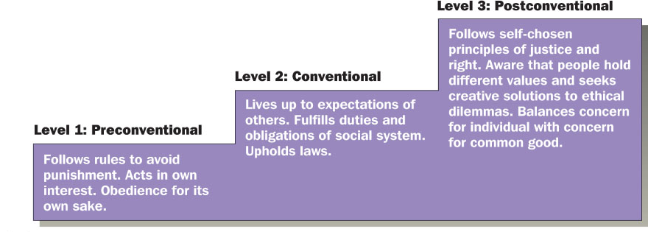
Factors affecting Ethical behavior
Individual factors
Individual knowledge
Level of personal moral development
Social factors
Cultural norms
Coworkers
Significant others
Presence of “Opportunity”
Notes:
http://en.wikipedia.org/wiki/Lawrence_Kohlberg's_stages_of_moral_development

Slide 16
Business costs of Ethical Failures
Level 1: Government fines and penalty
Level 2: Administrative and audit. Legal and Investigative, Remedial education, Corrective actions, Government Oversight
Level 3: Customer defections, Loss of reputation, Employee cynicism, lost employee morale, employee turnover, government cynicism, government regulation.

Slide 17
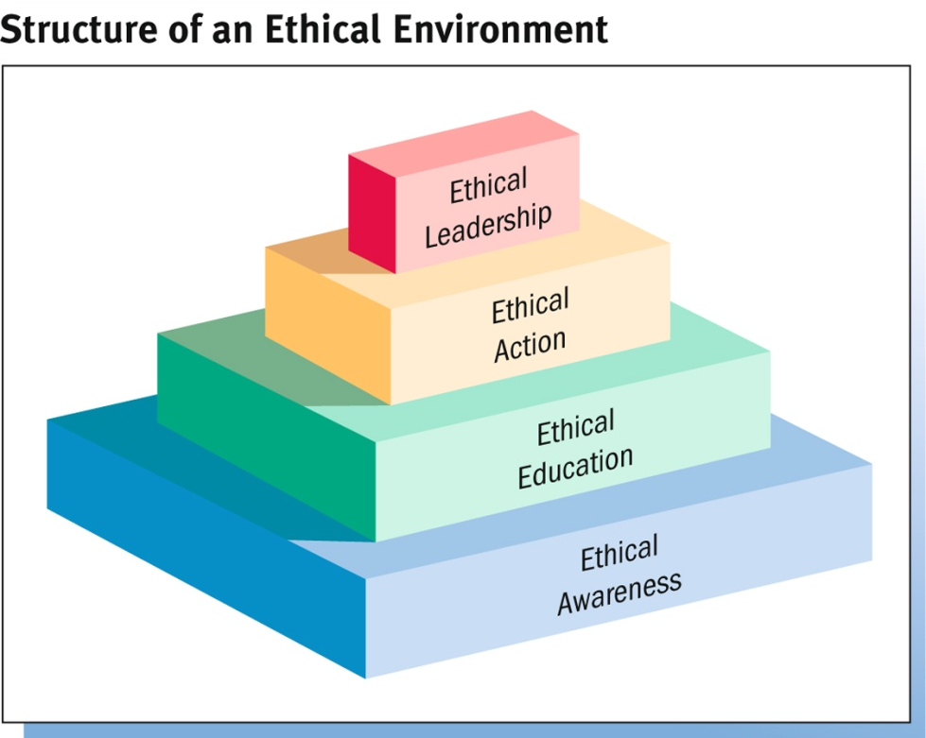
Building Ethical Environment
Ethical Awareness
Code of Conduct : Formal statement that defines how the organization expects and requires employees to resolve ethical questions
Ethical Education
Codes of conduct cannot detail a solution for every ethical situation, so corporations provide training in ethical reasoning.
Ethical Action
Helping employees recognize and reason through ethical problems and turning them into ethical actions.
Ethical Leadership
Executives must demonstrate ethical behavior in their actions.

Slide 18
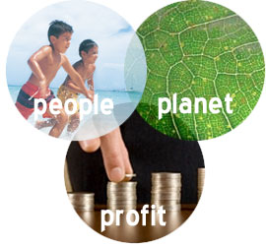
Corporate Social Responsibility
CSR – A concept whereby companies integrate social and environment concern in their business operations and in their interaction with their stakeholders on a voluntary basis.
"The idea is to balance the needs of people, the planet and the company's profits to create long-term share-holder value."

Slide 19
Triple Bottom Line
People" pertains to fair and beneficial business practices toward labor and the community and region in which a corporation conducts its business.
"Planet" refers to sustainable environmental practices, do no harm and minimize environmental impact, reduces its ecological footprint, carefully managing its consumption of energy and non-renewables and reducing manufacturing waste
"Profit" is the economic value created by the organization after deducting the cost of all inputs.

Slide 20
Arguments for Increased Social Responsibility
“Business must do more than simply seek profits”
Because business is part of our society, it cannot ignore social issues.
Business has the technical, financial and managerial resources needed to tackle today’s complex social issues.
By helping resolve social issues, business can create a more stable environment for long-term profitability.
Socially responsible decision making by firms can prevent increased government intervention, which could force businesses to do what they fail to do voluntarily.

Slide 21
What is your own argument?

Slide 22
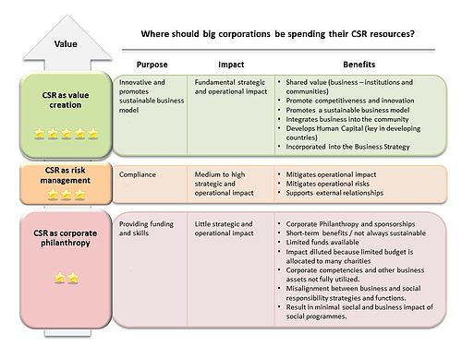
CSR Approach
Strategic CSR
Responsive CSR
Philanthropy

Slide 23
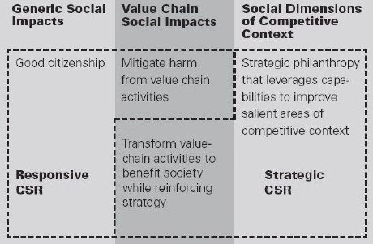
CSR Approach

Slide 24
CSR Approach
Corporate philanthropy is the widespread business practice of donating money, goods, and services to charitable causes.
Responsive CSR depends on being a good corporate citizen and addressing every social harm that a business creates. Responsive CSR aims to mitigate adverse or anticipated adverse effects from the business activity, essentially from company operations.
Strategic CSR moves beyond good corporate citizenship and mitigating harmful value chain impacts to mount a small number of initiatives whose social and business benefits are large and distinctive.

Slide 25

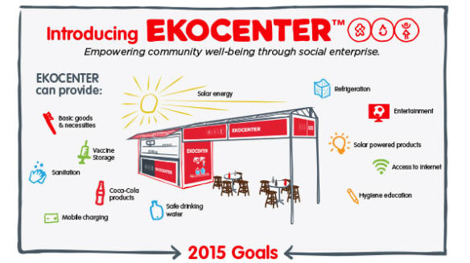

Examples
Patagonia
Starbucks
Nike
Coca Cola
Samsung
IKEA
SCG
Notes:
http://www.hrcsrnetwork.com/2013/10/csr-strategic-csr-michael-e-porter.html

Slide 26
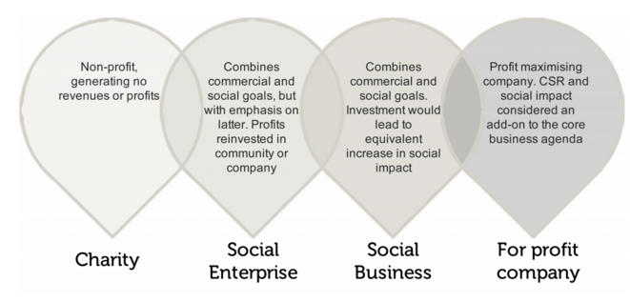
Social Enterprise
Notes:
http://www.thesedge.org/whats-new/22-awesome-social-enterprise-business-ideas
http://www.puihappy.com/knowleage/230-social-enterprise3.html
http://www.change.org/th

Slide 27


Social Enterprise
Change.org
Grameen Bank
Playpumps
Homeless Magazine
Doi Tong
Klong Din So
Notes:
http://www.thesedge.org/whats-new/22-awesome-social-enterprise-business-ideas
http://www.puihappy.com/knowleage/230-social-enterprise3.html
http://www.change.org/th

Slide 28

Social Enterprise
Notes:
http://www.thesedge.org/whats-new/22-awesome-social-enterprise-business-ideas
http://www.puihappy.com/knowleage/230-social-enterprise3.html
http://www.change.org/th

Slide 29
Benefits from CSR
Increase market share
Strengthen brand positioning
Improve corporate image
Increase ability to attract and retain employees
Decrease operating cost
Increase appeal to investors and financial analysts

Slide 30
Benefits from CSR
88% of consumers said they were more likely to buy from a company that supports and engages in activities to improve society”
(UK Small Business Consortium)
“2,215 workers around the globe, found that employees are more likely to be “proud” of their company if it’s engaged in good corporate behavior”
“Employees are more likely to decide to work for companies that are environmentally responsible”
“Employees are more likely to accept lower pay or a small role in an organization with sound corporate reputation”
(Kelleyservices, 2010)

Slide 31
Fundamental of CSR
1. Affordability
2. Sustainability
3. Relevance to Business Process
4. Differentiate

