Slide 1

INTEGRATED BRAND COMMUNICATION
Massimiliano La Franca

Slide 2

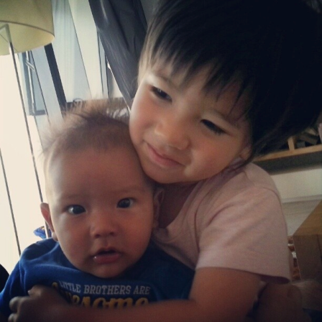
Let’s get to know each other…
Born in Italy, adopted by UK and married to a Thai
Actor, musician, marketer and planner
New hubby, new daddy

Slide 3

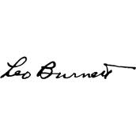


My over 12 years marketing experience

Slide 4









Some things we’ve done in Thailand in the past 4 years

Slide 5
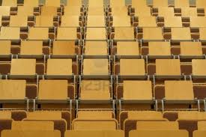
few words about you…?

Slide 6
Exercise
5 mins to talk to someone you don’t know
Tell them your name and one thing why we all should remember you
Everyone presents the other person with the name and the one thing
Suggestions
Think something memorable
Listen

Slide 7
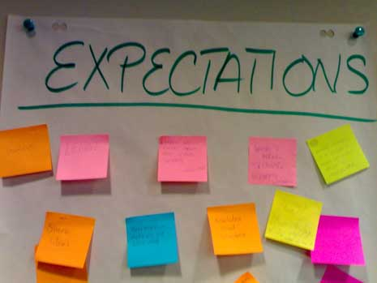

Slide 8
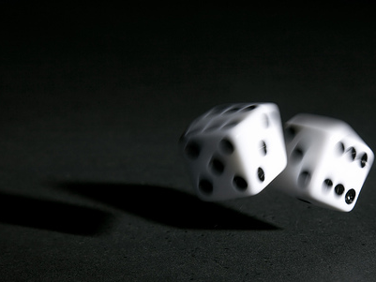
Few basic rules…

Slide 9

Participation

Slide 10
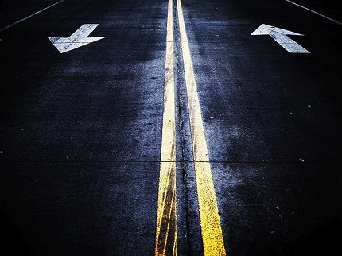
2 ways conversations

Slide 11
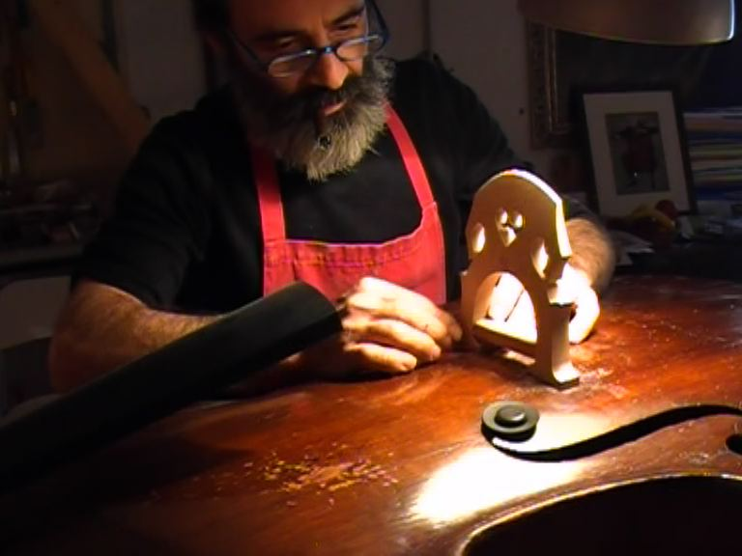
Workshops not lectures

Slide 12

Our plan
Frame communication within the big picture
The phases of communication development
  Planning and strategic development
  Communication development - executions
  Judging and testing communication
Case studies and work on a specific project
Social media: how it works and why is it important
Exam

Slide 13
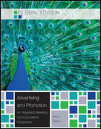
Our reference
Advertising and Promotion: An Integrated Marketing Communications Perspective, Global Edition 9th
G. BELCH – M. BELCH

Slide 14
Evaluation: let’s make it clear…
Participation and case study presentation (25%)
Mid term exam (25%)
Final exam (50%)

Slide 15
One word on evaluation
Participation: SPEAK UP or I won’t know if you’re alive!
Case study: let’s get our hands dirty…
Mid-term and final written evaluation: I’m not interested in “memory test”, I’m interested in students who want to understand some useful concept and play with them…but it doesn’t mean is going to be easy
Final result will be based on Practice (Participation and Case Study) and Theory (written exams)

Slide 16
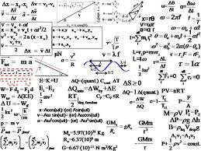
This is not marketing

Slide 17
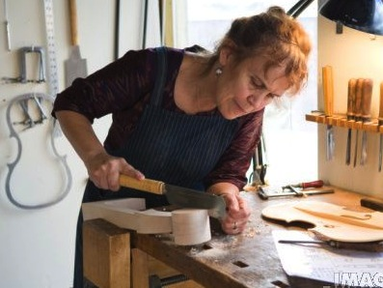
It looks much more like this…

Slide 18
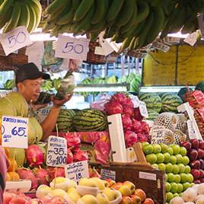
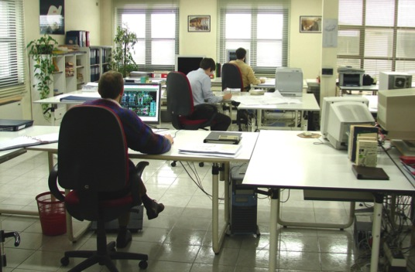
Marketing
Office-ing

Slide 19
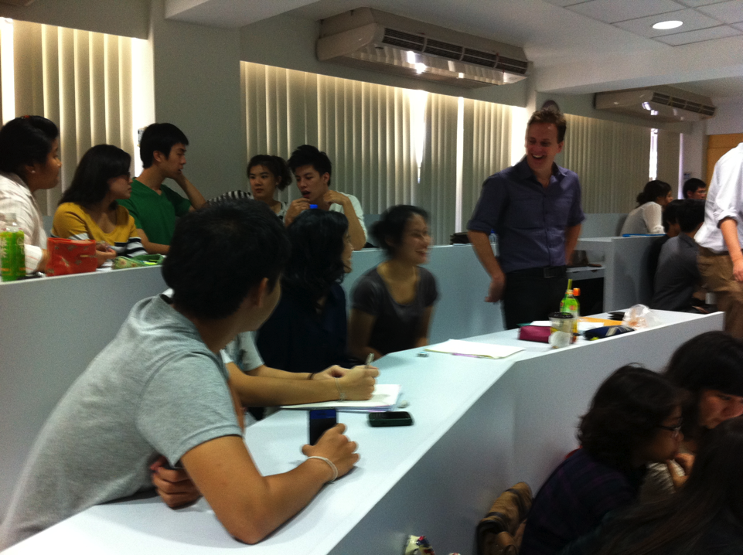
Learning from previous experiences @ Thammasat:
Start and finish on time
Small work groups
Examples and real cases
External speakers
Upload charts in advance
…most importantly..

Slide 20
Let’s start from the very big picture…

Slide 21
The context
promotion
marketing
business

Slide 22
The big picture
Business: the core activities of a company (trade of goods, services or both to consumers)
Marketing: it is an integrated process through which companies build strong customer relationship and create value for their customers and for themselves (Kotler)
Promotion: one of the activities of the marketing mix
Notes:
Integrated: what?
Relationship: what kind of?
Value: why? In what way?

Slide 23
?
How many P’s in marketing mix?

Slide 24
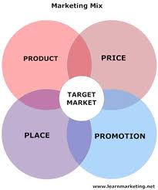
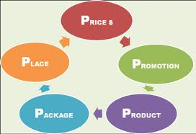
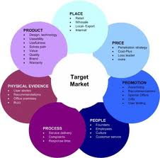
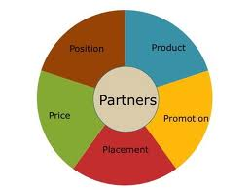

Slide 25

Promotion
Is one of the ‘unknown’ number of P’s
A mean to an end
A tool that can be used to convince consumers
A tool that can be used to influence behaviors

Slide 26
So when we talk…
Business: we talk sales, producing and selling products or services, turnover, profit, margins…
Marketing: we talk activities to launch new products or services, to increase consumption of existing ones…
Promotion: we talk promoting sales by generating awareness of products, convince people to try, change existing behaviors, give price incentives…

Slide 27
Many touch points under “promotion”
Promotion
Advertising
Social media
Direct mktg
PR
Brand activation
Sales Promo
…
We will mainly talk about “communication”

Slide 28
This course’s focus: integrated communication
How it works
How agencies develop strategies
How agencies create executions

Slide 29
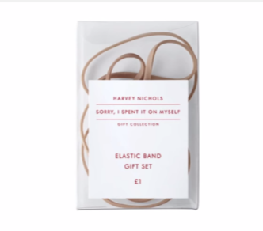
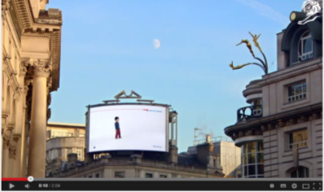
What do I mean with Integrated Communication?
https://www.youtube.com/watch?v=1c9FS5Myn4k
https://www.youtube.com/watch?v=AXlVZZgYNms&list=PL4D7dI66ZkaiaW_BwQXePp3Spvx60FXmt

Slide 30
Integrated Communication: what is it, how does it work and why?

Slide 31
What is it?
Communication* (kəˌmyo͞oniˈkāSHən): the activity of conveying information
When it comes to brand communication it is the act through which a brand shares info about itself or its products/services with the intention of influencing the behaviors of specific target groups (from stakeholders to shoppers)
In this course we will mainly talk about consumers behaviors and how to influence them through integrated brand communication
* from the Latin word "communis“ - to share

Slide 32
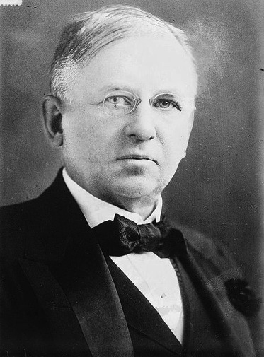
Half the money I spend on advertising is wasted; the trouble is I don't know which half.
John Wanamaker (July 11, 1838 – December 12, 1922) was a United States merchant, religious leader, civic and political figure, considered by some to be the father of modern advertising and a "pioneer in marketing.”

Slide 33

Integrated communication?
Integration of the brand communication channels in order to provide a more impactful, consistent and compelling message about the brand or its products

Slide 34
Why?

Slide 35
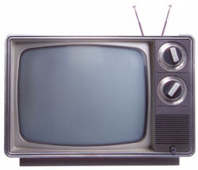
The world is changing…
fast.
From one way entertainment.

Slide 36
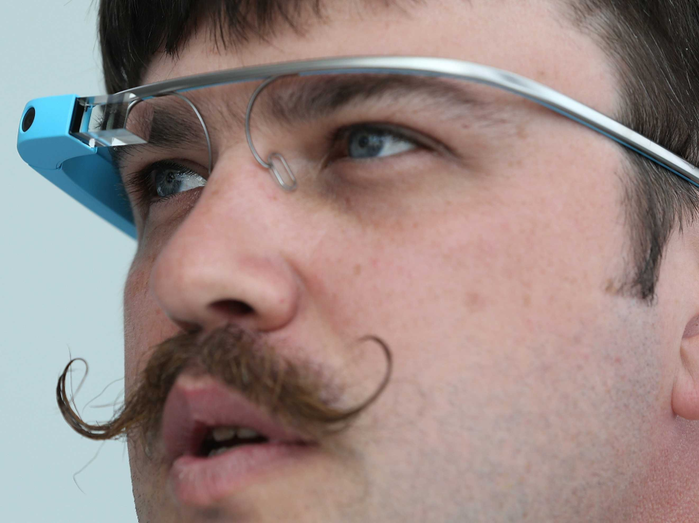
More sophisticated consumers
3

Slide 37
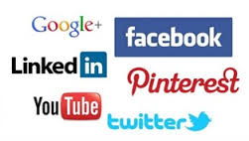
Choice is with people (media, timings, who they connect with…)

Slide 38
More and more crowded channels and less attention.

Slide 39
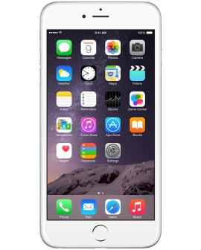
How did you buy your mobile?
Online opinions
Social networking
Feedback and Bloggers
Word of mouth
Brand experiences
Branded conversations
Notes:
How did I buy my car?
Blogs
Word of mouth
Expert Friends opinion
What I see in the streets
Corporate Website
A bit of TVC (!)

Slide 40



From advertising to stories that influence
Desperados
is great!
I like
Desperados

Slide 41
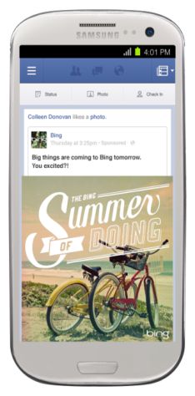
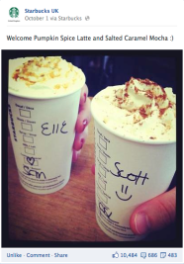
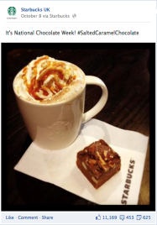
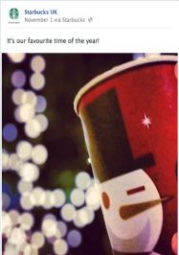
Starbucks – moments of connection

Slide 42

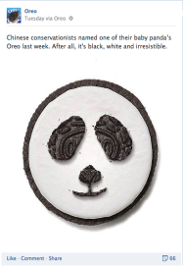
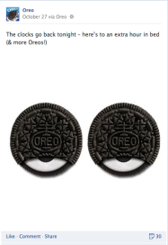
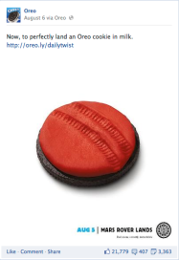
Oreos – celebrate the kid in you

Slide 43


We have changed from…
Why
should I
care?
Why
should I
share?

Slide 44
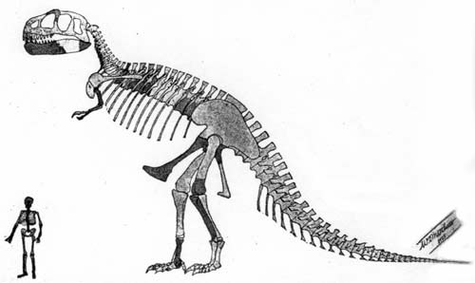
Brands need to change today or
face the consequence of being extinct.

Slide 45

Brands who will succeed are those who create believers, not consumers
Like a rock-band… not people who buy a record, but fans who live and breath the band, do what the band does, behave as the band ambassador…

Slide 46
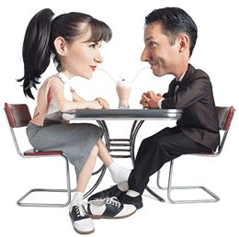
To be able to do this brands need to establish ‘conversations’ with people in all relevant channels…
…different from bombarding target consumers with commercials

Slide 47
Summary
2 ways conversations
Multi-channels
Listen…

