Slide 1


“Brand Manager for Luxury Brand”
MK 312 Brand Management
By Ajarn Suwalya K.
October 26, 2020

Slide 2
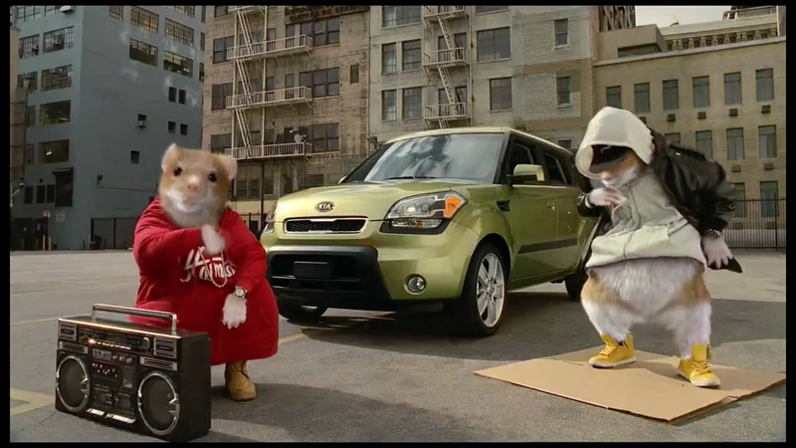
Sawasdee Krup…Ka

Slide 3
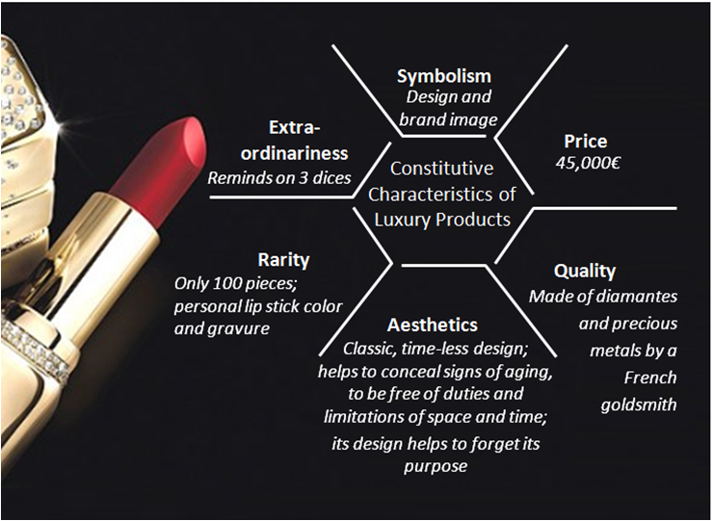
What is a Luxury Brand?
Key identifiers of luxury brands are high quality, expensive and non-essential products and services that appear to be rare, exclusive, prestigious, and authentic and offer high levels of symbolic and emotional/hedonic values through customer experiences.

Slide 4
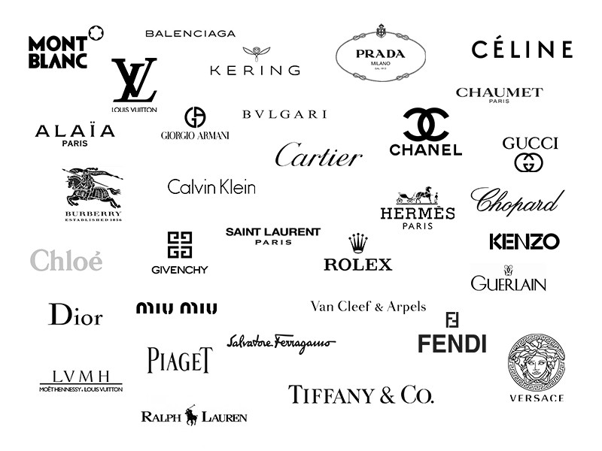

Slide 5
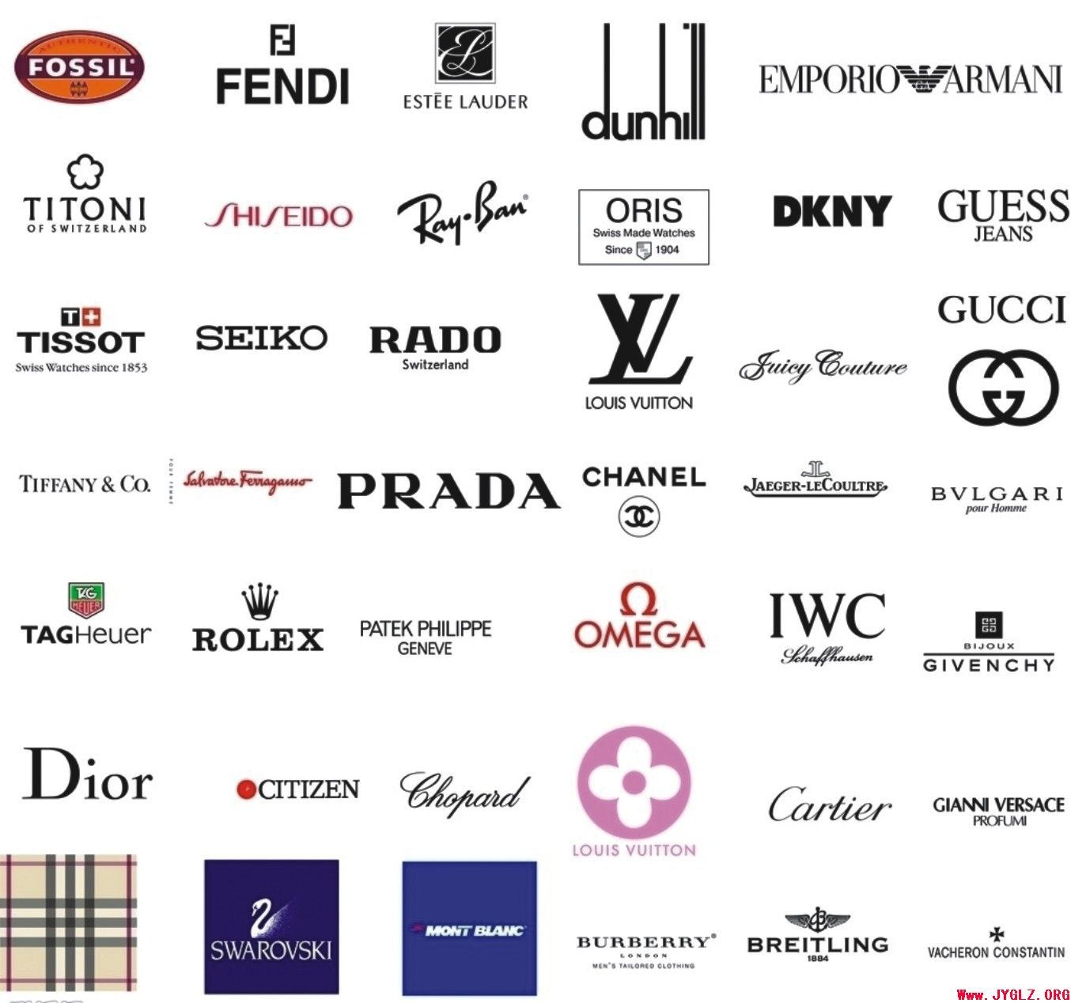

Slide 6
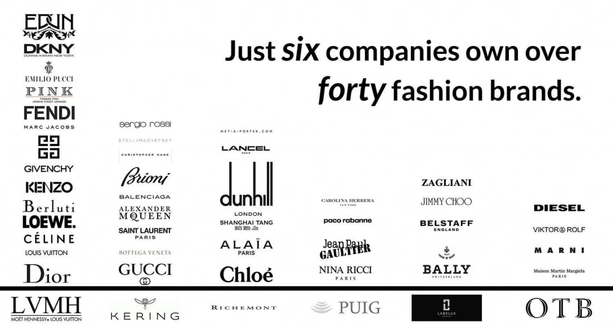

Slide 7

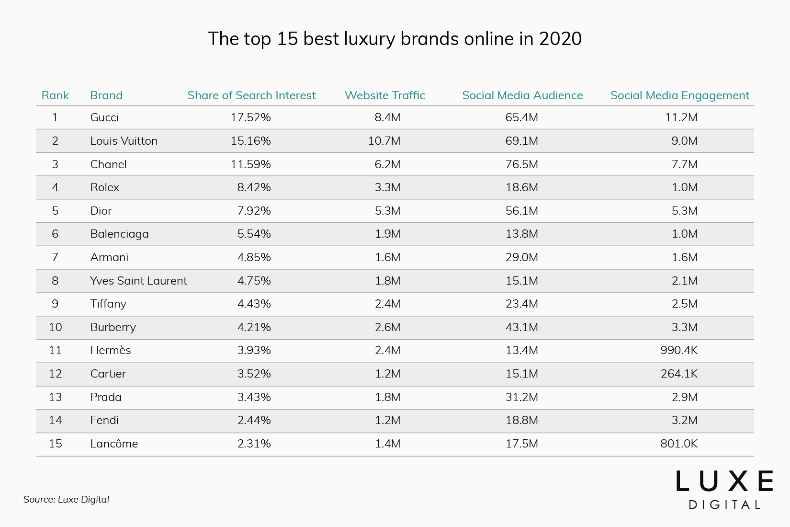

Slide 8
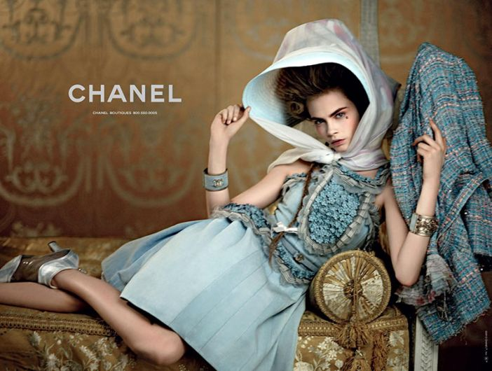

Slide 9
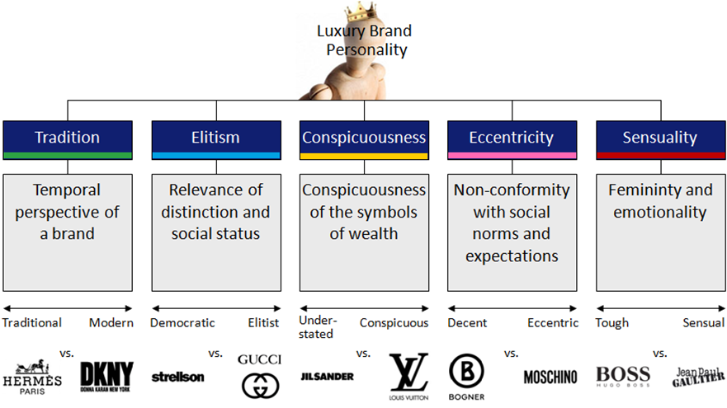

Slide 10
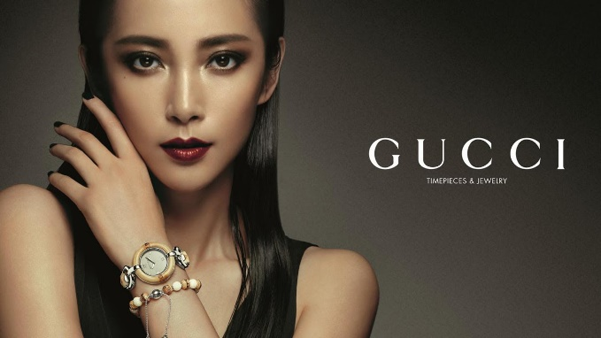
Let’s Practice – Group Assignment
“ You are Brand Manager for Luxury Brand”
Each Group will choose a Luxury Brand
Analyze the brand by using the tools/lessons you have learned in class since the beginning of the semester and research.
Also identify the weakness and strengths of the brand
As brand manager how do you propose to grow the brand further
Slides no more than 5-7 pages (excluding cover slide and appendix)
Next week presentation ( 7 mins max)
Have fun ☺

Slide 11
Kob Khun Krup…Ka

