Slide 1

MK 322 Retail Management
Chapter 11: Customer Relationship Management Part II
By Ajarn Suwalya K.

Slide 2
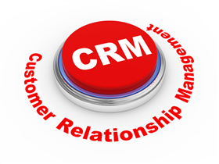
Implementing CRM Programs

Slide 3
Customer Pyramid
80-20 rule…80 percent of profits come from 20 percent of customers
Group into 2 groups – 20 percent of the customers with the highest CLV scores and the other group, the rest
Notes:
1

Slide 4
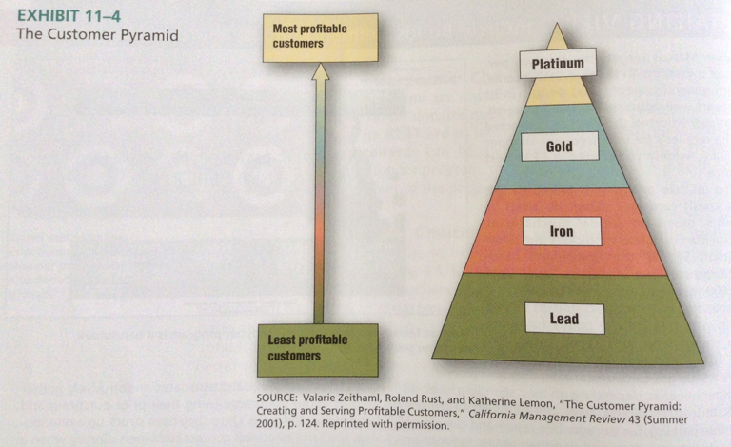
Customer Pyramid
Notes:
1

Slide 5
Platinum Segment
Composed of top 25 percent CLV
Most profitable and loyal
Are not overly concerened about pricing
Buy a lot of merchandise sold by retailer
Often place value on customer service more than price
Notes:
1

Slide 6
Gold Segment
Buy a significant amount of merchandise, but not loyal as platinum customers
Patronize some of retailers customers
Profitability less than platinum-tier since price plays a greater role in decision making
Objectives of CRM program is to move gold-tier customers to the platinum level
Notes:
1

Slide 7
Iron Segment
Purchase a moderate amount of merchandise
But their spending levels, loyalty, and profitability are not substantial enough for special treatment
Possible to move into higher tiers, but for reasons such as limited income, price sensitivity, or shared loyalties with other retailers, additional expenditures on them may not be worth it
Notes:
1

Slide 8
Lead Segment
Customers with lowest CLV
Can make negative contribution to the firm
Often demand a lot of attention,but do not buy much
Buy merchandise on sale or abuse return privileges
Cause additional problems by complaining about retailers to others
As a result retailers do not direct any attention to these customers
Notes:
1

Slide 9

Customer Retention
Personalization
Developing retail programs for small groups or individual customers is referred to 1-to-1 retailing
Notes:
1

Slide 10
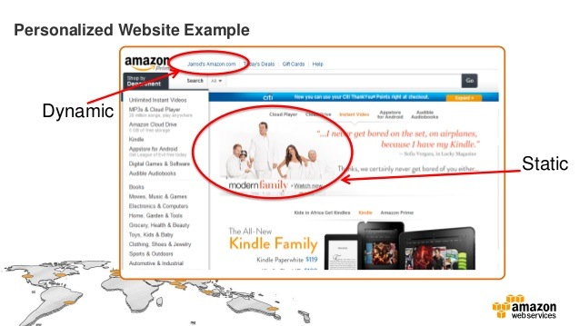
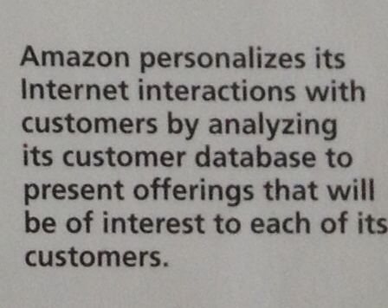
Customer Retention
Notes:
1

Slide 11
Community
A retail brand community is a group of customers who are bound together by their loyalty to a retailer and the activities the retailer sponsors and undertakers.
Community members identify themselves with other members and share a common interest and participation in activities related to the retailer
Notes:
1

Slide 12
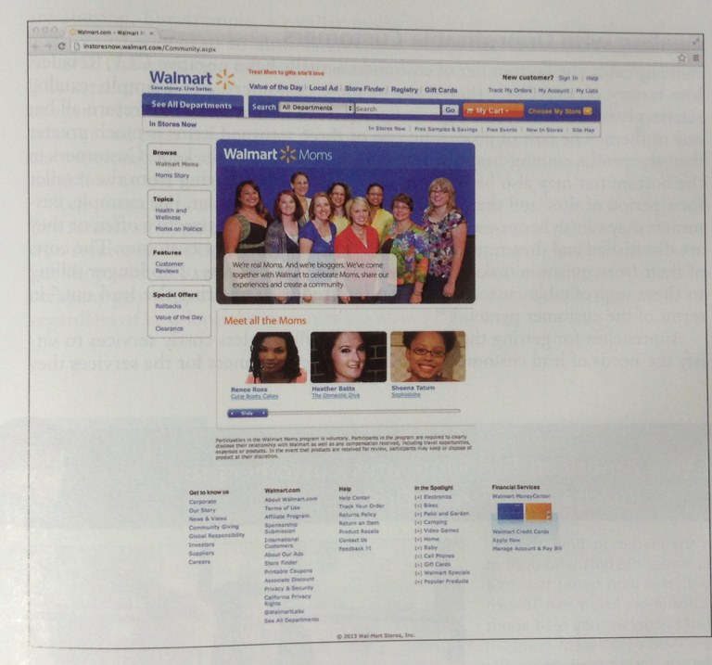
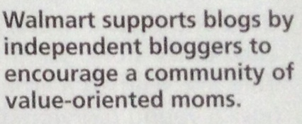
Community
Notes:
1

Slide 13
Customer Conversion:Making Good Customers into Best Customers
In context of customer pyramid, increasing the sales made to good customers can be referred to as customer alchemy- converting iron and gold customers into platinum customers
Add-on selling – offering and selling more products and services to existing customers to increase retailer's share of wallet with these customers
Good example is Amazon.com uses personalized customer information
Notes:
1

Slide 14


Customer Conversion:Making Good Customers into Best Customers
Notes:
1

Slide 15

Dealing with Unprofitable Customers
Bottom Tier has negative CLV
Retailers loose money to every sale they make
Refunds may be costly
Customers vanish to other competitors
Notes:
1

Slide 16
Dealing with Unprofitable Customers
The process of no longer selling to these profitable customers could be referred to as "getting the lead out" in terms of customer pyramid
Approaches for getting the lead out are
Offering less costly services to satisfy the needs of lead customers
Charging customers for services they are abusing
Notes:
1

Slide 17


