Slide 1
INTEGRATED BRAND COMMUNICATION
Massimiliano La Franca

Slide 2
Today we will focus on:
A. What is the Job-to-be-Done (Brand Task) and resulting marketing objective? ▲ B. What is the measurable communication objective for this Job to be Done? ▲
What insight drives this brief? ▲
Who is our target audience? ▲
A. If Briefing for a Campaign Idea: Initial recommendation on required channels to reach and engage our target and why: ▲ B. If Briefing for an Execution: What is the role of this execution within the Channel Strategy?
What do they think and do now? (in relation to our brand and its product category) ▲
What would we like them to think and do in response to the communication? ▲
What is the single most important point to communicate? ▲ Why should they believe it? ▲
Section 1: Objectives
Section 2: Insight
Section 3: Target
Section 4: Channels
Section 5: Key point

Slide 3
Key point and RTB

Slide 4
Key point
What do they think/do/feel now?
What do we want them to think/do/feel now?
Key message

Slide 5
Key point
The most important thing to say. This will change consumers’ behavior
ONE single minded message
Key message usually stems from:
  Discriminator: what’s the single most important point of difference of this brand?
  Benefit/RTB: can be both emotional or functional
  Insight: usually in the form of unmet need in a problem/solution type of communication

Slide 6



Discriminating Benefit
Discriminating Product Benefit: the unique and differentiating benefit that the brand offers
Can be rational (3 in 1, lower price, better performances)
Can be emotional (BMW joy of driving)
It directly links back to the insight
It must be relevant, unique and clear for people to understand it
It is focused and single-minded
It should be unique for our brand
RATIONAL
Antidandruff
Shampoo
RATIONAL & EMOTIONAL
Beauty drinks
EMOTIONAL
The Joy of Driving

Slide 7


Reason to believe
Reason why: rational and emotional reasons why should people believe the benefit
Can be rational (special ingredients) or emotional (directly related to the brand)
It directly links back to the benefit and the insight
Unique, relevant and believable
Sustainable in the long term
RATIONAL
Contain Collagen, Vitamins, Omega3 etc etc
EMOTIONAL
The brand supports quality

Slide 8
Key point
Why? Insight
What do they think/do/feel now?
What do we want them to think/do/feel now?
Key message
Discriminating benefit
Reason to believe

Slide 9
How does everything come together

Slide 10
How does everything come together
Campaign idea and executions
Objectives
Target
Key message
Insight
Channels
Mood & tone
To define what is the change in behaviour we want to achieve.
To define what to say, how to say it and where to say it.
The story that will achieve the behaviour change.

Slide 11
Concept

Slide 12
Concept basics
What is a concept?
A full description of a specific product or service written in consumers language and containing key information:
  Headline
  consumer insight
  discriminating benefit
  reason(s) to believe
  an image of the pack and key supporting visuals
Why do we write a concept?
To test new ideas with consumers both in qualitative and quantitative researches
To brief agencies and other business partners (communication, new product innovation)
To share ideas with stakeholders

Slide 13
Concept: the structure
A concept is mainly made by 3 key elements:
Insight
Discriminating Product Benefit
Reason why

Slide 14
Bringing all together: the concept structure
Concept Content
Peoples’ line of thoughts
Consumer insight
“Do you understand my needs? Surprise me with something of me I didn’t realized”
Discriminating benefit
Reason why
“OK, that’s interesting...
Now, who are you? What do you do for me? Why are you better than the others? Why should I believe you? “
Reprise of discriminator or ‘why you buy it’
“OK remind me quickly why should I buy you”

Slide 15
Successful Concepts
All key parts are new, relevant and unique for our brand:
  Insight: women are concerned for the beauty of their skin as it loses flexibility as they age
  Discriminating Benefit: the only drink that keep your skin young and flexible
  Reason why: is the only drink that contains the collagen
Above elements are consistently and logically linked one another
Concept is written in normal people words and are not overload with information (LESS IS MORE)
  Be simple, the grandma torture test, 30 sec test
  Avoid marketing jargons
The stimulus (concept board) is visually interesting:
  Use colors to emphasize key words,
  Use pictures to bring to life the mood and tone

Slide 16


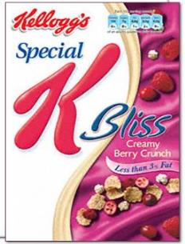
Pleasure that can enjoy anytime
The longer the day goes on, the more tempted I am to reward myself with something nice to eat.
Unfortunately, nice is often naughty and my figure often suffers!
Kellogg’s Special K Bliss are crunchy rice and wheat flakes with strawberries and smooth dark chocolate flakes.
A delicious treat served with ice cold milk, but low in calories and fat at the same time.
Spoil yourself and not your figure.

Slide 17
IDEAS AND EXECUTIONS

Slide 18
What does IMC do?
IMC aims to influence people behavior through a set of messages in different channels
Those messages assume different nature according to the problem we try to solve, the target we try to talk to and the category we are working on
This lesson is to analyze different types of messages that IMC can use

Slide 19
Ideas vs. Executions
An advertising idea can be executed in a number of different ways
  IDEA: what do we say?
  EXECUTION: how do we say it?
Keep in mind that the 2 things are different when you judge an idea
Let’s see some of the most common executions

Slide 20
The messages
Our executions will contain:
  Purely rational messages – typically for products ads
  Emotional messages – typically for brand ads
  A combination of the two

Slide 21
Rational to Build Information
Focus on the consumer’s functional need for the product or service
Emphasize features and/or the benefits or reasons for owning or using a particular brand.
Facts, learning, and the logic of persuasion.
Informative to convince consumers that their product or service has a particular attribute(s) or provides a specific benefit that satisfies their needs.
Persuade that it is the best available or does a better job of meeting consumers’ needs.
Convenience, economy, health, and sensory benefits (touch, taste, and smell)

Slide 22
Rational to Build Information
Product Feature focus on the dominant traits of the product or service
Competitive advantage direct or an indirect comparison to another brand (or brands) and usually claims superiority on one or more attributes
Favorable price makes the price offer the dominant point of the message
News some type of news or announcement about the product, service, or company dominates the ad.
Product/service popularity stress the popularity of a product or service by pointing out the number of consumers who use the brand
Example: Rexona Men https://www.youtube.com/watch?v=W0opFXE6g2k
Asda Rollback: https://www.youtube.com/watch?v=FnjzxkSQVfk

Slide 23
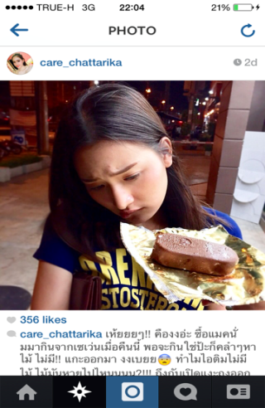
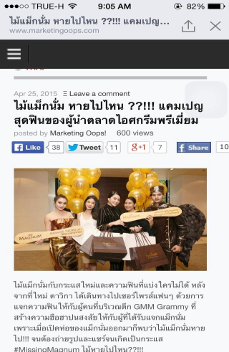

Slide 24
Emotional messages to build affinity
Emotional relate to the customers’ social and/or psychological needs for purchasing a product or service.
Many consumers’ motives for their purchase decisions are emotional, and their feelings about a brand can be more important than knowledge of its features or attributes.
Sometime emotions are used to “sell” brands that do not differ from competing brands, since rational differentiation of them is difficult
Humor, feel-good ads, sex, dream, transformation ads
Emotional communication brings to life the brand attitude

Slide 25
Sketches unsung hero

Slide 26
Combination of Rational and Emotional
Where possible IMC tries to combine emotional and rational arguments to influence people
  Emotional tend to be related to the brand and what it stands for
  Rational tend to be related to the products/services
Rational messages convince but don’t make people fall in love with the brand.
Rational needs to be there but they’re easy to copy
Emotional messages tend to capture people at more deep level

Slide 27
Let’s look at some type of executions

Slide 28
Demonstration
Designed to illustrate the key advantages of the product/ service by showing it in actual use or in some staged situation.
Demonstration executions can be very effective in convincing consumers of a product’s utility or quality and of the benefits of using the brand
Product demo are widely used in TV to demonstrate product efficacy (from dish-wash to anti-wrinkles)
Sometimes through analogies: parallel similarity is used to communicate something about the brand
Example Flora Proactiv: https://www.youtube.com/watch?v=HPuQbm6GQ0Y

Slide 29
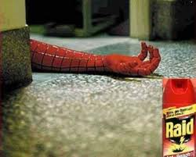

Slide 30
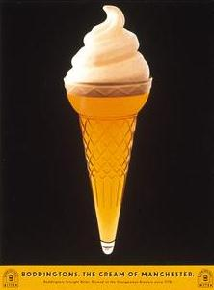
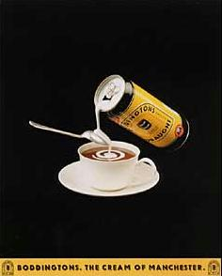

Slide 31
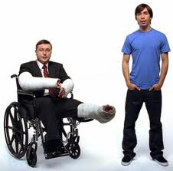
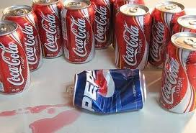
Comparison
When directly comparing 2 brands
Not allowed everywhere
Very risky as human being tend to instinctively take part of the brand that is bashed
The ones which succeeded remain very factual

Slide 32
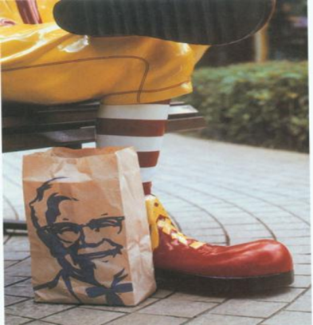

Slide 33
Mac vs PC
Coke boy

Slide 34
Other techniques
Reminder: objective is building or sustaining brand awareness (think seasonal products or small budgets)
Teasers: to build excitement about a product or brand by talking about it but without revealing the brand
  Usually used as first step of campaigns (Axe Angels) to prepare the ground for the big launch
User generated content: involve people in generating ads

Slide 35

Pre-Phase IDEA

Slide 36
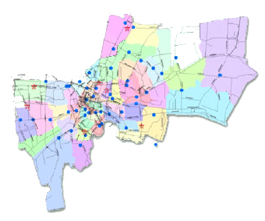
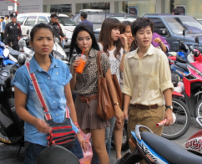
Ideas : Create curiosity by the troops of angels around Bangkok and Big Events
Central Pinklao
Jatujak Market
Wannasorn Tutor
Silom
The Mall
Siam Square
Victory Point
Thailand’s Premier league
Major ratchayothin
Seacon Square
Rain’s Concert
!?!
Workpoint Studio

Slide 37
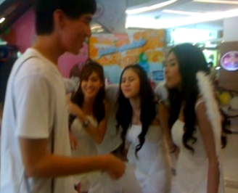
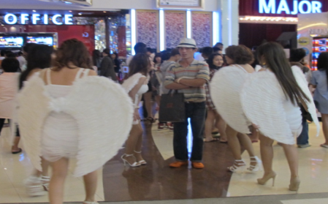
The Story line
We will release the angels everywhere and let them smell every guys that pass by saying that they are looking for the right guys.

Slide 38
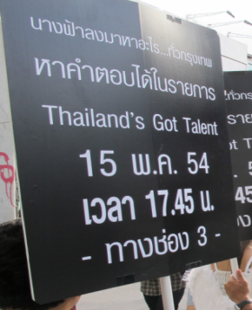


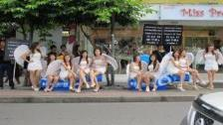

The Story line
Tease consumers to find the answer what’s the angels looking for in Thailand’s got talent.

Slide 39
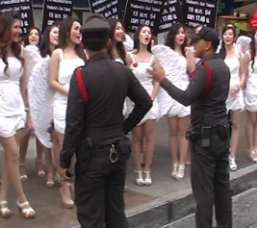
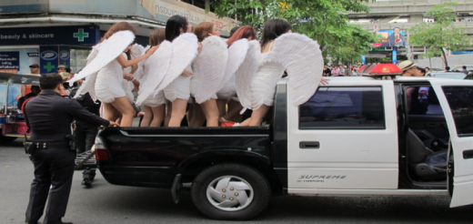
The Story line
Get the police to arrest those angels to create controversial for amplification.

Slide 40
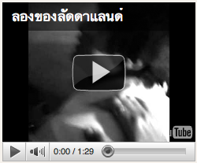
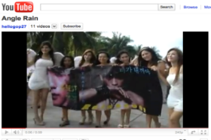
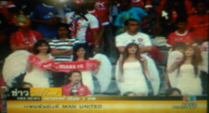
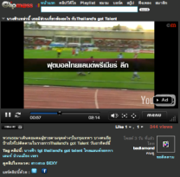
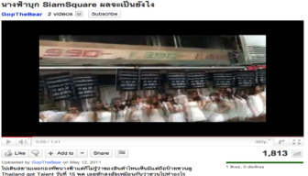
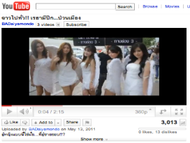
Viral clips recorded and seeded

Slide 41
Use of testimonial
Testimonial: a person who praises the product or service on the basis of his or her personal experience with it.
Most effective use real people, real customers
Credibility is critical as it is the choice of someone that the target can reflect into
Leveraging the experts in a specific field builds brands credentials

Slide 42
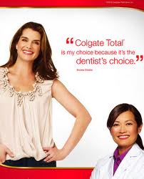

Slide 43
Use of celebrities
Create lots of attention
Best results when they fit with the brand or the product
Credibility is key: some risks here
If celebrity is too powerful there’s risk of overshadowing the product
Some of the celebs are over-used

Slide 44
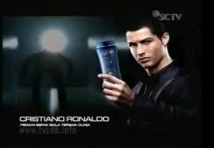
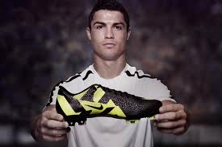


Slide 45
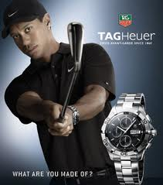
What do you do when this is you celebrity?

Slide 46
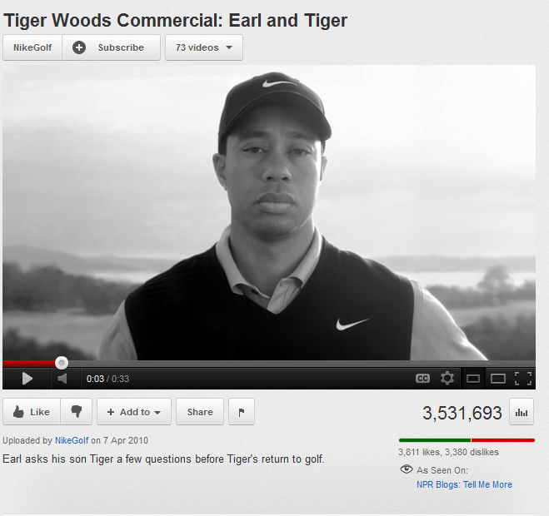
Nike…

Slide 47
Slice of life
Widely used
Presentation of a problem or conflict that consumers might face in their daily lives. The ad then shows how the product or service can resolve the problem
Often problem-solution structure
Most effective are those which are realistic or perceived as such
Often IMC uses aspirational techniques to make people dream about having a better life through the product/service

Slide 48
Why celebrities, experts, slice of life work?
When a brand is talking through IMC, we refer to it as source (encoding-decoding process)
Sources work on 3 fundamental dimensions:
Credibility: the spokesperson has enough credentials to be trusted either because used the product or because is an expert or a popular well respected person
Attractiveness: the source is attractive meaning similarity (testimonials - like me), likeability (celebrities) and familiarity (slice of life - seen many times)
Power: source has power when can administer rewards or punishment (teachers, politicians)

Slide 49
But there’s a big difference…
Credibility => Internalization is when someone adopt the point of view of the source because they think is accurate
Attractiveness => Identification is when someone adopts beliefs, attitudes, preferences of a source
Power => Compliance is when someone uniforms to the willing of the source who is believed having power
Notes:
internalization
Once the receiver internalizes an opinion or attitude, it becomes integrated into his or her belief system and may be maintained even after the source of the message is forgotten.
identification
Maintaining this position depends on the source’s continued support for the position as well as the
receiver’s continued identification with the source. If the source changes position, the
receiver may also change. Unlike internalization, identification does not usually integrate
information from an attractive source into the receiver’s belief system
Compliance
Happens only until when the source can maintain his power

Slide 50
Slice of Pop Culture
Communication borrows from easily recognized cultural experiences.
Communication uses knowledge of popular culture.
References a cinematic style or theme, a widely known television moment, another brand’s communication /marketing style, or any other well-known public event.

Slide 51
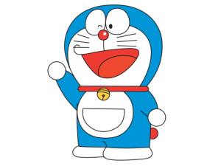
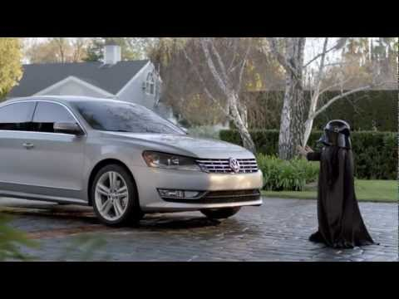

Slide 52
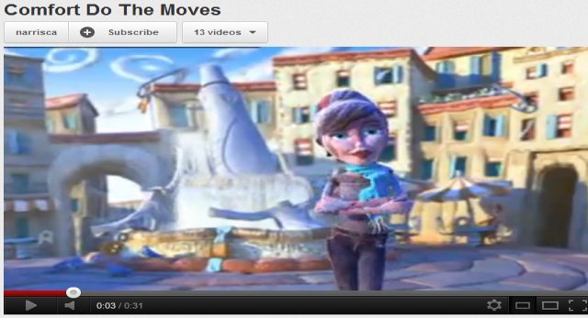
Animation
Use of animations and cartoon to send the message
Used in any kind of category, not necessarily related to kids
Can be full cartoon or mixed with real scenes

Slide 53
Print ads: some terminology
Headline: the message in the leading position
  Direct: to the point, self explaining
  Indirect: remand to body copy or need to be interpreted
Subheads: subset of the headline (often used to make long headlines readable)
Body copy: more detailed explanation in smaller fonts
Visual elements: illustration or real picture must work in sync with headline and copy
Layout: different ways to place those elements

Slide 54
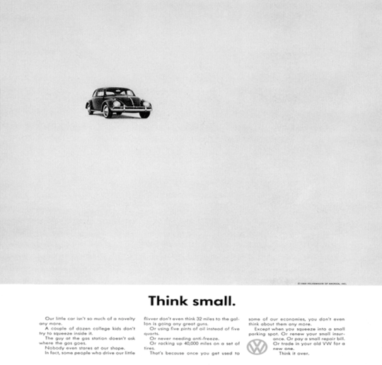

Slide 56
How is it your work coming together?

Slide 57
How does everything come together
Campaign idea and executions
Objectives
Target
Key message
Insight
Channels
Mood & tone
To define what is the change in behaviour we want to achieve.
To define what to say, how to say it and where to say it.
The story that will achieve the behaviour change.

