Slide 1
EE401 Political Economy
Chapter 3 Political Economy of Free Markets:
Adam Smith
Ploy Thammapiranon 2/2017
BE, Thammasat University

Slide 2
Political Economy of Free Markets: Adam Smith
Biography
  1.1 Background: Scottish Enlightenment
  1.2 Adam Smith
  1.3 Theory of moral sentiments
  1.4 The wealth of nations
Theories and ideas
Contributions
3.1 Smith’s vision of markets
3.2 Smith’s Theory of history
3.3 Advances in economic theory

Slide 3
1. Biography
1.1 Background: Scottish Enlightenment
Francis Hutcheson (1694-1746) Glasgow University.
Belief in progress of human and society.
  Constant human nature.
  Human changes environment which in turn affects human behavior in different times.
  Historical stages of social evolution towards progress.

Slide 4
1. Biography
1.2 Adam Smith (1723-90)
Glasgow College
Studied moral, politics and languages at Oxford
‘The Theory of Moral Sentiments’
Traveled in France and met Voltaire, Franklin, Quesnay, Turgot.
Started writing ‘The Wealth of Nations’.
Joined the Bloomsbury Group
‘An Inquiry into the Nature and Causes of the Wealth of Nations’
1737
1740-6
1759
1764
1766
1776

Slide 5
1. Biography
1.3 Theory of Moral Sentiments
Natural laws
Positive law
Natural rights
Cannot be changed but can be learned for benefits.
Govern society.
Changeable to habits, custom and values.
Must conform to natural laws.
Legislative laws created by human.
consist of property rights & rights to the products of one’s labor

Slide 6
1. Biography
1.3 Theory of Moral Sentiments
Individuals have self-interest.
  Desire to improve one’s condition.
What to hold ‘self-interest’ in check?
  How can we make moral judgments that satisfy others?
‘Sympathy:
  ability to place oneself in the position of ‘an impartial spectator’.
  A sympathetic notion of morality governs self-interest.

Slide 7
1. Biography
1.4 The Wealth of Nations
Propensities
Wealth
Wealth is the value of all goods produced in society.
Growth increases wealth.
What induces individuals to act in the way which benefits society and creates wealth?
Self-interest: the desire to improve one’s condition.
Propensity ‘to truck, barter, and exchange’.

Slide 8
2. Smith’s theories and ideas.
2.1 The system of ‘natural liberty’
2.2 Division of labor
2.3 Theory of history and stages of social development
2.4 Competitive markets
2.5 Theory of value
2.6 Theory of price
2.7 Factor-income Theory
2.8 Public policies
2.9 International Trade
2.10 Government intervention

Slide 9
2.1 The system of ‘natural liberty’
Self-interest & property rights
Economic liberty
Division of labor
Market competition
The wealth of nation = economic growth
Economic liberty:
  Liberty to pursue one’s own interest.
  Property rights and rights to produce and exchange.
Division of labor.
  Production, labor productivity and growth.
Market competition.
  Price, production costs, factor incomes.

Slide 10
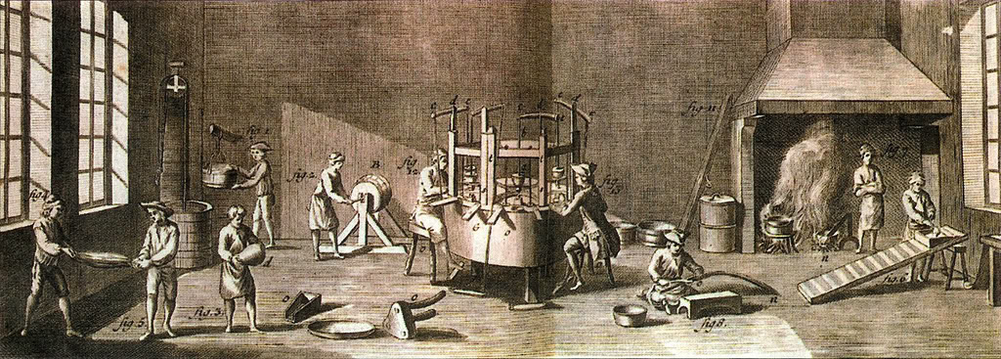
2.2 Division of labor
Division of labor in manufacture.
  Different workers perform different tasks to produce a particular product.
  Smith: a pin factory with 18 different tasks: a team of ten workers making 48,000 pins/day.
Benefits
  Increasing skills and specialization.
  Time-saving from task switching.
  Facilitating invention of machinery.
The Pin Factory, The Wealth of Nations, 1776.

Slide 11
2.2 Division of labor
Social division of labor:
  Different sectors produce different products.
The division of labor is limited by the extent of the market.
  Larger markets, higher demand, more workers, more division of labor.
  Long-distant transport expands the reach of markets and encourages growth.

Slide 12
2.3 Theory of history and stages of social development
Human society develops through four stages of development.
Each stage is characterized by increasing productivity and more sophisticated division of labor.
  Evolution of property rights → basis of different forms of government.

Slide 13
2.3 Theory of history and stages of social development
Hunter-gatherer mode of living.
Nomadic life.
Small population in families, clans, tribes.
Minimal division of labor and lowest labor productivity.
no property rights and Equal social status.
No rule of government.
i. Hunting

Slide 14
2.3 Theory of history and stages of social development
Shepherds and nomadic life.
Larger population in tribes.
Division of labor based on physical conditions and experience.
Private property: cattle, sheep, horses.
Accumulation of wealth and difference between the rich and the poor.
Initial form of government to protect property rights of the rich against the poor.
ii. Pastoral Society

Slide 15
2.3 Theory of history and stages of social development
iii. Farming
Agriculture and husbandry.
Permanent settlement in villages.
More supply of food, larger population.
Property rights on land as the most important form of ‘wealth’.
More division of labor and specialization.
More varieties of products available.
Villages and small towns for trade.
Rule of government based on land monopoly and control of labor.
More surplus to support ‘unproductive’ activities: government, armies, churches, etc.

Slide 16
2.3 Theory of history and stages of social development
iv. Commerce
Accumulation of capital and highly sophisticated division of labor.
  Property rights in capital.
  Division of labor in manufacture
    Rising population facilitated more division of labor.
    Growing towns and factories.
Money economy and trade prospered.
  Emergence of capitalist farmers.
Towns dominated by merchants and capitalists.
  Freedom of trade.
  The rise of the manufacturing system.
Increasing wealth and improving living condition.

Slide 17
2.3 Theory of history and stages of social development
The basis of social changes is the evolution of economic institutions.
  Degrees of division of labor and productivity.
  Forms of private property.
Economic institutions require corresponding political institutions.
  Private property is the basis of political power.
  Forms of government.

Slide 18
2.3 Theory of history and stages of social development
A closer look at growth in the commercial age
  Division of labor is the engine of growth.
  Division of labor requires accumulation of capital
  The constraint on growth is increasing difficulty of finding new profitable investment outlets.
Capital accumulation
Division of labor
Increase in wages-fund
Increase in productivity
Higher wages
Increase in output
Rising consumption, wealth and capitalist saving

Slide 19
2.4 Competitive markets
Extent of markets
Labor productivity
Output increases
Division of labor
Economic growth
Markets determine the degree of the division of labor.
Market competition ensures that individual self-interest will be harnessed to benefit society.
  ➔ The invisible hand of the markets.
Wealth of nations

Slide 20
2.5 Theory of value
Different goods are exchangeable against one another.
Exchange value: quantitative exchange ratio between different commodities, e.g.
1 unit of submarine = 20 units of watch = 300 units of cookie
What determines the exchange value?

Slide 21
2.5 Theory of value
Value in use: usefulness of things.
Value in exchange: exchange ratios among different commodities.
Value in use is the basis of value in exchange, but does NOT determine its magnitude.
The two are uncorrelated: Water-diamond paradox.

Slide 22
2.5 Theory of value
Value in primitive society
  Labor is the only productive resource.
  Value is determined by the quantity of labor expended in the production of the commodity --- the labor theory of value.
  Labor is not homogenous: different skills, intensities, hardship.
Value in advanced society
  Private ownership of land and accumulation of capital.
  Owners of land and capital must receive compensation (rent & profits) for the use of resources.
  Value is the sum of wages, profit, rent.

Slide 23
2.6 Theory of price
Price is the monetary expression of exchange value.
Values of all goods are expressed in the unit of the money-commodity.
Natural price is the long-run price.
  Sum of natural wage, natural profit and rent.
  Exact expression of exchange value.
Market price can be above, below or equal to the natural price.
  Determined by supply and demand.

Slide 24
2.6 Theory of price
Natural and market price in competitive market
P
Supply < Demand
Market price
Natural price = wages + profits + rent
Supply > Demand
t

Slide 25
2.6 Theory of price
market P >/< natural P
Demand >/< supply
Supply: actual availability of the goods.
Demand: consumer’s willingness and ability to pay at natural price.
Competition pushes market price towards natural price.
sector profit = natural profit
demand = supply
sector profit rate >/< natural profit rate
market P falls/rises to natural P
entrepreneurs move in/out

Slide 26
2.6 Theory of price
Long-term market adjustment
P
LMC
e
p1
g
f
p*
d
Q
q*
q1

Slide 27
2.6 Theory of price
Natural price is the center of gravitation of market price under competition.
Causes forcing market price to be above natural price over the long run.
  Trade secrets or ‘clandestine’ production techniques (monopoly of idea).
  Monopoly of special resources.
  Monopoly privileges granted by government (concessions, franchises, leases).

Slide 28
2.6 Theory of price
“The invisible hand”
Competition acts as the invisible hand which guides self-interested individuals to act in the way which also benefits society.
One must do something useful for others
in order to get what one wants.
Competition forces producers to lower cost and to supply goods at natural profits.
Buyers must pay the natural price to cover natural profit, natural wages and rent.

Slide 29
2.7 Factor-income Theory
2.7.1 Theory of wages
The wages-fund: part of capital is used as funds to maintain workers in production.
The natural wage rate is at the subsistent level which enables a worker to survive and to replace him/herself.
The market wage rate can be above the natural wage rate over time due to speed of accumulation and worker population growth.

Slide 30
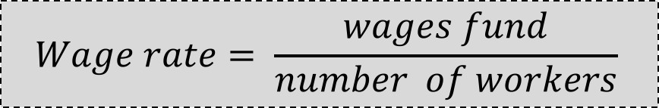
2.7 Factor-income Theory
2.7.1 Theory of wages
If the rate of accumulation and growth is higher than worker population growth:
  Wages-fund is increasing faster than workers.
  Market wages higher than natural wages over time.
  Workers’ living conditions improve (rising real wages).
  ➔ Workers benefit from
  economic growth.
Previous production and sales
Past profits and Savings
Stock of capital
Wages fund
The wage rate
Number of workers
NOTE:
$$Wage rate= \frac{wages fund}{number of workers}$$

Slide 31
2.7 Factor-income Theory
2.7.2 Profit and interest
Profit is the return to the stock of capital.
Competition lowers the market profit rate towards the natural profit rate.
Gross Profit = Compensation for loss + Surplus

Slide 32
2.7 Factor-income Theory
2.7.2 Profit and interest
Interest is subtracted from profit if the capital is borrowed.
Minimum interest rate must be enough to compensate for lenders’ losses.
The interest rate must be lower than the profit rate to maintain incentives to borrow.
High profit
More demand for borrowing
Higher interest

Slide 33
2.7 Factor-income Theory
2.7.2 Rent
Results from land monopoly by the landowners.
  The surplus over the tenant’s production cost and the natural profit.
Rent is also determined by the opportunity cost of land.

Slide 34
2.8 Public policies
Competition transforms self-interest into beneficial acts for society.
  The system of natural liberty brings harmony at the societal level.
  Market price = natural price.
  Entrepreneurs seek highest profits by minimizing costs and saving profits for reinvestment.
Minimal government interference in private lives and economic activity.

Slide 35
2.8 Public policies
“Monopoly”
  Market price above natural price
  Excess profit at the cost of society.
  Restricted output and wealth.
  Limited volume of trade.
  Restricted division of labor and productivity; retarded growth.
Self-interest becomes harmful to society.
The worst monopolies are created by government.
P
Economic rents or profits
LRMC
LRAC
A
P_{m}
E
P_{c}
B
F
D=AR
MR
Q
Q_{m}
Q_{c}

Slide 36
2.8 Public policies
“Government-created monopoly”
Collusion among producers alone is not effective for long.
Government regulations and tariffs are required to create barriers to entry.
The monopoly incumbent benefits from the restricted entry.
  The market becomes captive.
  The market price above the natural price.
  Restricted output and excess profits.

Slide 37
2.9 International Trade
Trade allows nations to specialize in producing goods which they have advantage and trade for goods from others.
The absolute advantage:
 | Product X | Product Y
Trump | 100 | 50
Putin | 25 | 75
(in unit of labor cost)
Trump produces Y.
Putin produces X.

Slide 38
2.9 International Trade
Exceptions to free trade?
Infant industries: government provides protection to domestic business until they ‘become strong and competitive’.
    They usually become politically powerful and resist the abolition of protection.
Trade retaliation against other nations’ protectionism.
    May not work and may trigger counter-retaliation.

Slide 39
2.10 Government intervention
Government intervention is harmful as it creates monopoly and distortion.
Unproductive labor of large government reduces wealth.
Large public debt results in heavy taxes which discourage investment.
Diversion of resources from productive uses to unproductive activities.
Government functions: An effective market economy requires small, but strong government.
  National defence.
  Administration of justice
  Public works and institutions not profitable for the private sector

Slide 40
3. Contributions
3.1 Smith’s vision of markets
‘The Wealth of Nations’ was the epitome of economic theory for 75 years (until Mill).
First complete system of political economy:
  Theory of value and price.
  Theory of competitive markets and monopoly.
  Theory of factor income distribution.
  Theory of international trade.
  Theory of economic growth.

Slide 41
3. Contributions
3.1 Smith’s vision of markets
First clear explanation of the functioning of markets --- a natural order of society.
  A self-regulating economy operating within a market system with minimal government.
  The system of ‘natural liberty’.
Revolutionary ideas about self-interest, the invisible hand and the common good.
Foundation of modern economics.

Slide 42
3. Contributions
3.2 Smith’s Theory of history
The basis of social changes is the evolution of economic institutions.
  Degrees of division of labor and productivity.
  Forms of private property.
Economic institutions require corresponding political institutions.
  Private property is the basis of political power.
  Forms of government.

Slide 43
3. Contributions
3.3 Advances in economic theory
National income includes goods and services.
  Smith’s productive and unproductive labor.
Demand-supply theory and marginal analysis.
Marginal productivity theory of factor incomes.
  Smith’s factor-income theory.
Theory of comparative advantage.

