Slide 1
Review of Basic Concepts
Pawin Siriprapanukul
CW Ch.2

Slide 2
Outline
Variables, constants, and parameters
Equations and identities
The real number system
The concept of sets
Relations and functions
Types of function
Functions of two or more independent variables

Slide 3
Variables, Constants, and Parameters
This is very important!!!
A variable is something whose magnitude can change
  It is usually represented by a symbol instead of a specific number
Endogenous variables are variables we want to figure out solution values from our models
Exogenous variables are variables whose values are assumed to be fixed or given (determined by forces external to the model)
A constant is a magnitude that does not change
When a constant is joined to a variable, it is often referred to as a coefficient
  It sometimes can be represented by a symbol
A constant that we do not assign a specific number to (must be represented by a symbol) is usually called a parameter

Slide 4
Variables, Constants, and Parameters:
An example
X is a variable representing amount of consumption
P is a variable representing price
We may have
X = a + bP
where a and b are parameters of the model
When we consider a consumer in a competitive market, X is endogenous and P is exogenous
When we consider the whole market, X and P are both endogenous

Slide 5
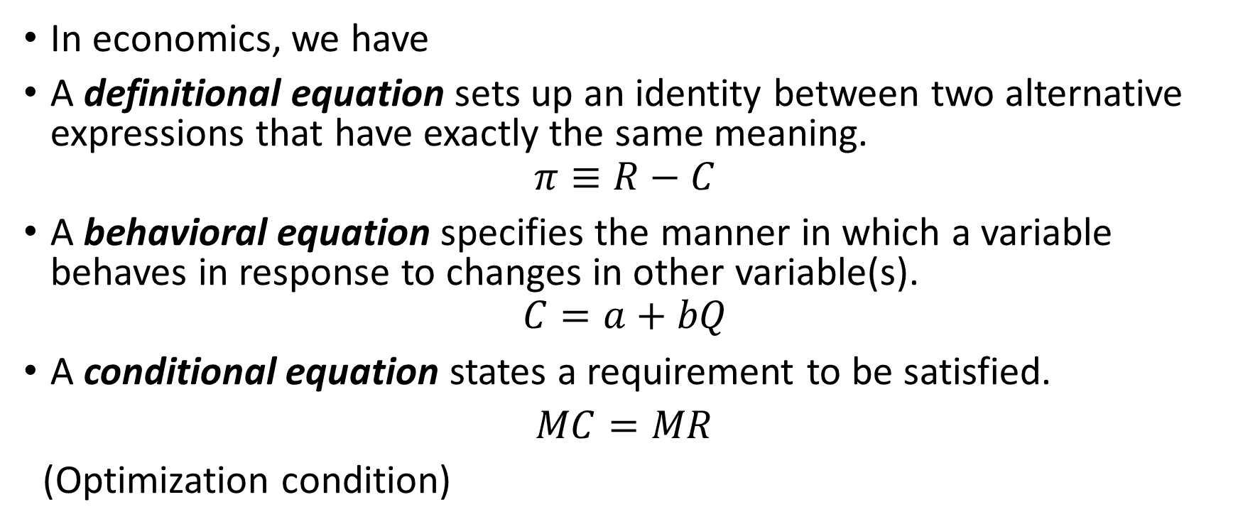
Equations and Identities
In economics, we have
A definitional equation sets up an identity between two alternative expressions that have exactly the same meaning.
$$π≡R−C$$
A behavioral equation specifies the manner in which a variable behaves in response to changes in other variable(s).
$$C=a+bQ$$
A conditional equation states a requirement to be satisfied.
$MC=MR$
(Optimization condition)

Slide 6
Real-Number System
Integers
Fractions
Rational numbers
Irrational numbers
Real numbers

Slide 7
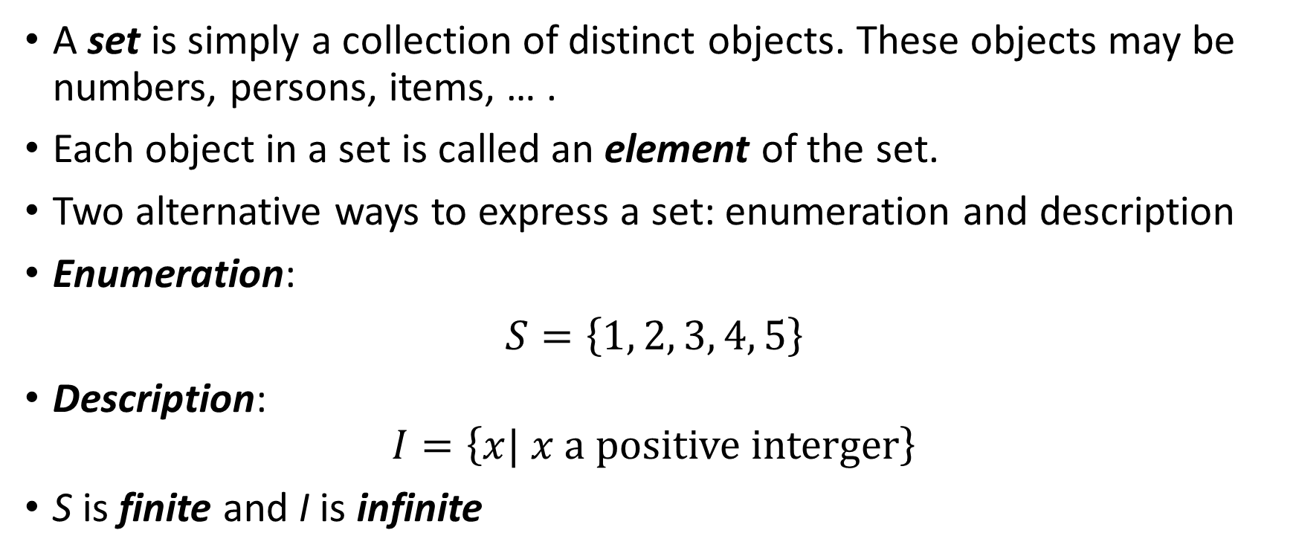
Sets
A set is simply a collection of distinct objects. These objects may be numbers, persons, items, … .
Each object in a set is called an element of the set.
Two alternative ways to express a set: enumeration and description
Enumeration:
$S=\left\{1, 2, 3, 4, 5\right\}$
Description:
$$I=\left\{x| x a positive interger\right\}$$
S is finite and I is infinite

Slide 8
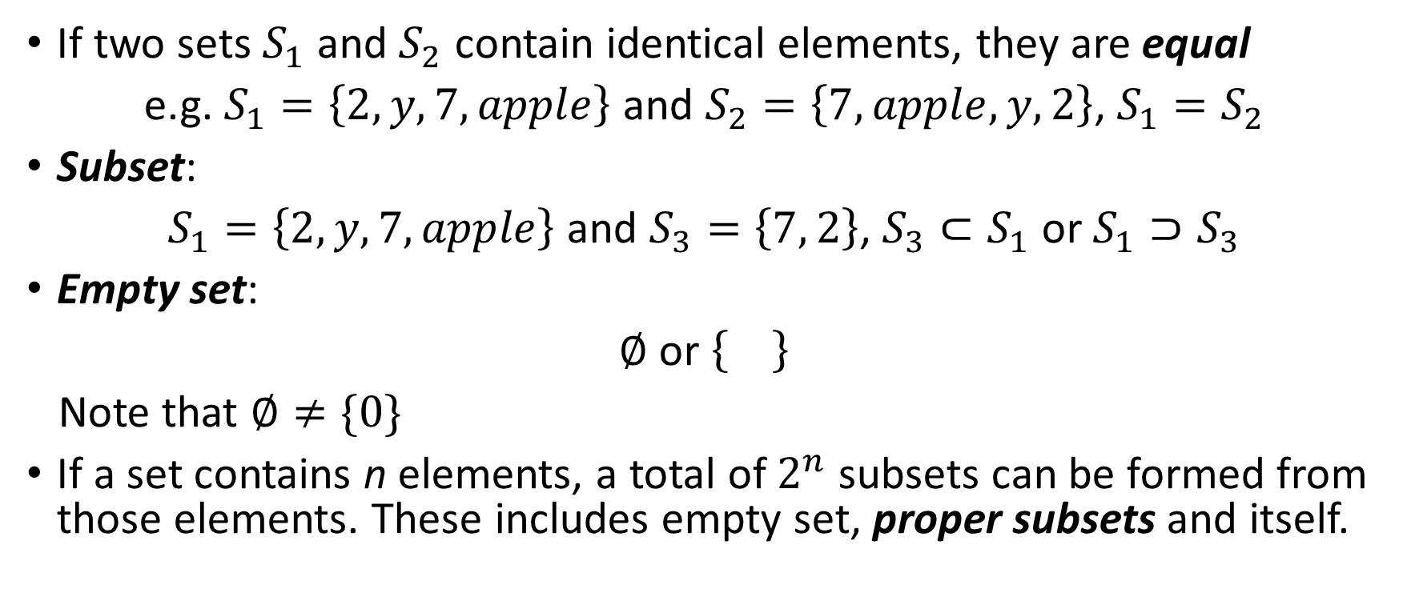
Relationships between sets
If two sets $S_{1}$ and $S_{2}$ contain identical elements, they are equal
e.g. $S_{1}=\left\{2,y,7,apple\right\}$ and $S_{2}=\left\{7,apple,y,2\right\}$, $S_{1}=S_{2}$
Subset:
$S_{1}=\left\{2,y,7,apple\right\}$ and $S_{3}=\left\{7, 2\right\}$, $S_{3}⊂S_{1}$ or $S_{1}⊃S_{3}$
Empty set:
$∅$ or
Note that $∅≠\{0\}$
If a set contains n elements, a total of $2^{n}$ subsets can be formed from those elements. These includes empty set, proper subsets and itself.

Slide 9
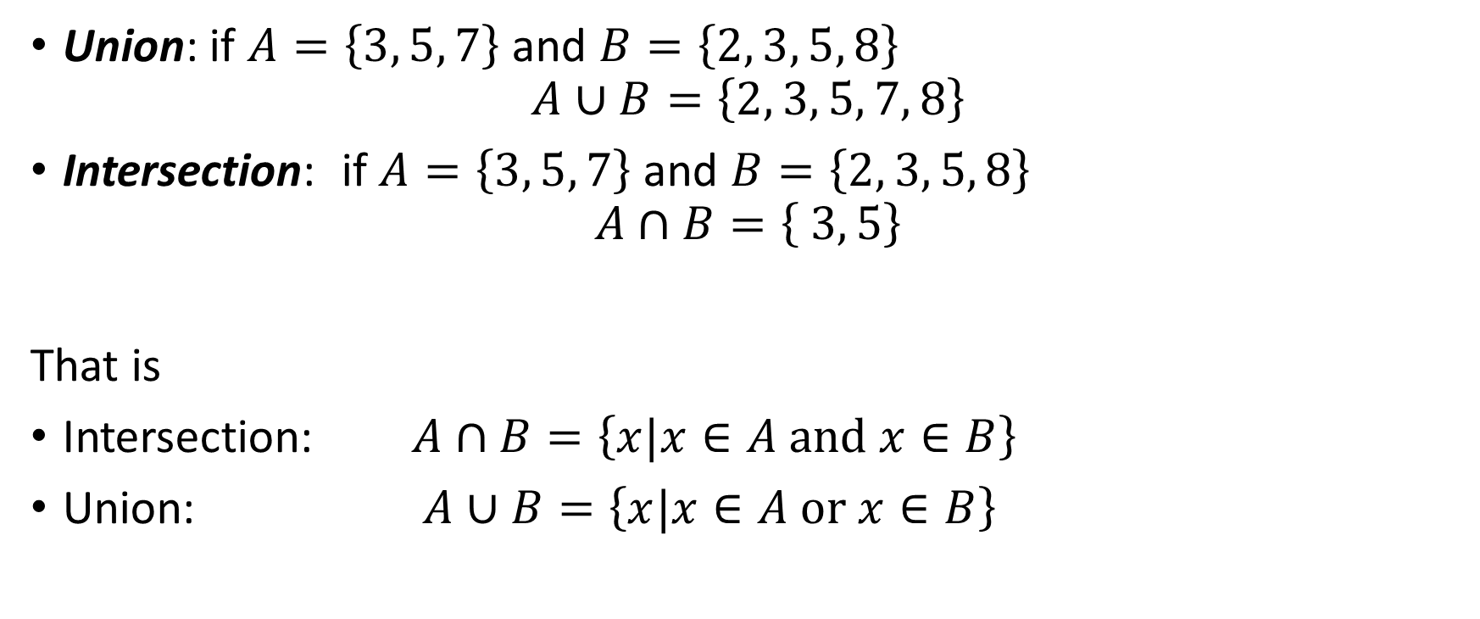
Operations of sets
Union: if $A=\left\{3, 5, 7\right\}$ and $B=\left\{2, 3, 5, 8\right\}$
$$A∪B=\left\{2, 3, 5, 7, 8\right\}$$
Intersection: if $A=\left\{3, 5, 7\right\}$ and $B=\left\{2, 3, 5, 8\right\}$
$$A∩B=\left\{ 3, 5\right\}$$
That is
Intersection: $A∩B=\left\{x|x∈A and x∈B\right\}$
Union: $A∪B=\left\{x|x∈A or x∈B\right\}$

Slide 10
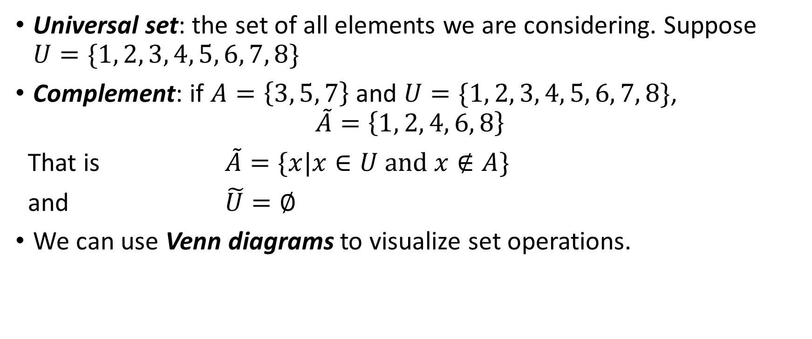
Operations of sets
Universal set: the set of all elements we are considering. Suppose $U=\{1, 2, 3, 4, 5, 6, 7, 8\}$
Complement: if $A=\left\{3, 5, 7\right\}$ and $U=\{1, 2, 3, 4, 5, 6, 7, 8\}$,
$$\tilde{A}=\left\{1, 2, 4, 6, 8\right\}$$
That is $\tilde{A}=\{x|x∈U and x∉A\}$
and $\tilde{U}=∅$
We can use Venn diagrams to visualize set operations.

Slide 11
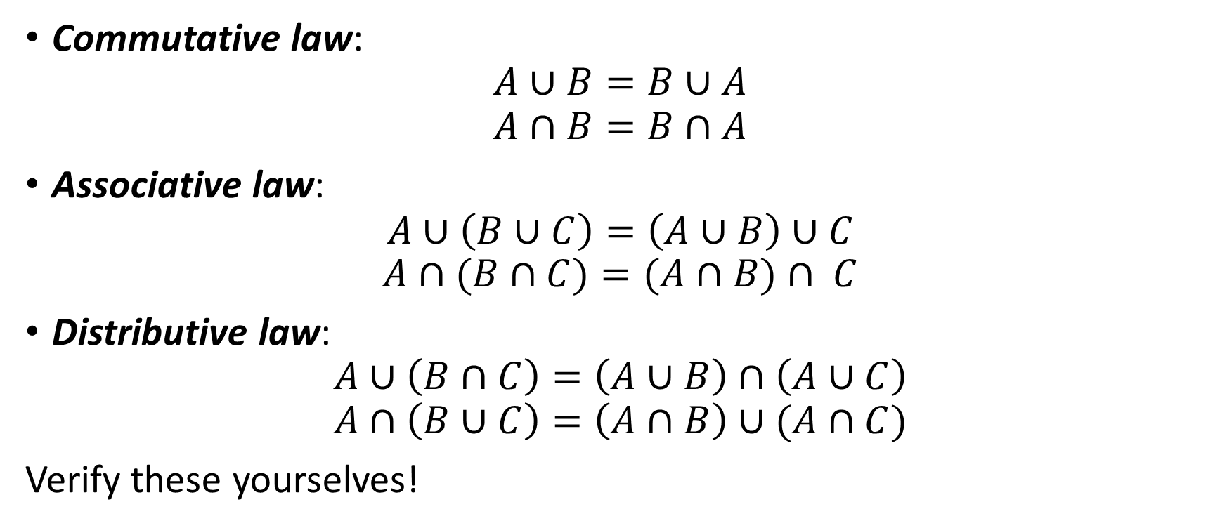
Laws of set operations
Commutative law:
$$A∪B=B∪A$$
$$A∩B=B∩A$$
Associative law:
$$A∪\left(B∪C\right)=\left(A∪B\right)∪C$$
$$A∩(B∩C)=(A∩B)∩ C$$
Distributive law:
$$A∪\left(B∩C\right)=\left(A∪B\right)∩\left(A∪C\right)$$
$$A∩\left(B∪C\right)=\left(A∩B\right)∪(A∩C)$$
Verify these yourselves!

Slide 12
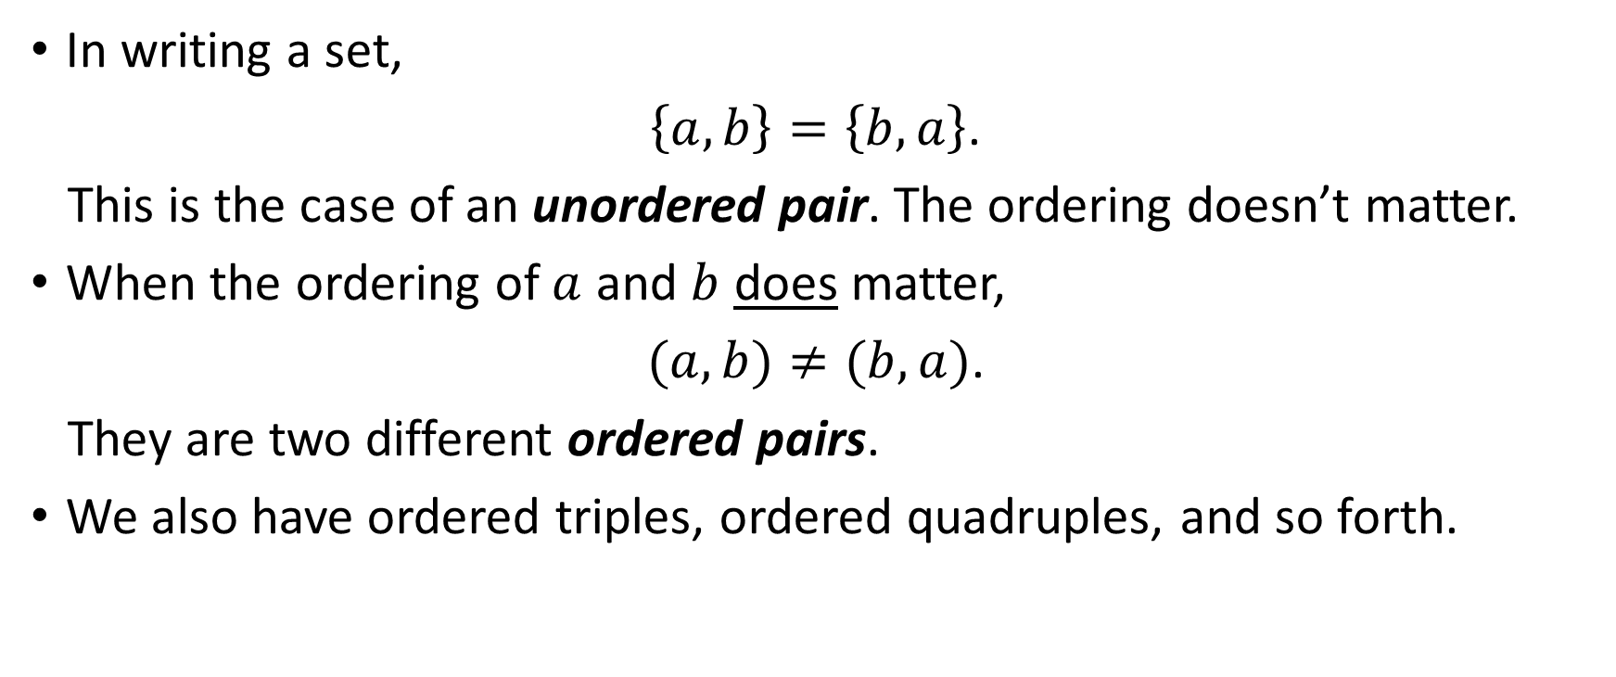
Ordered Pairs
In writing a set,
$\left\{a,b\right\}=\left\{b,a\right\}$.
This is the case of an unordered pair. The ordering doesn’t matter.
When the ordering of $a$ and $b$ does matter,
$(a,b)≠(b,a)$.
They are two different ordered pairs.
We also have ordered triples, ordered quadruples, and so forth.

Slide 13
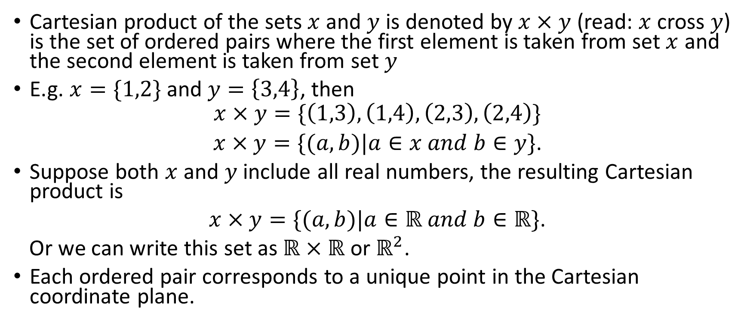
Cartesian Product
Cartesian product of the sets $x$ and $y$ is denoted by $x×y$ (read: $x$ cross $y$) is the set of ordered pairs where the first element is taken from set $x$ and the second element is taken from set $y$
E.g. $x=\{1,2\}$ and $y=\left\{3,4\right\}$, then
$$x×y=\{\left(1,3\right),\left(1,4\right),\left(2,3\right),\left(2,4\right)\}$$
$x×y=\{(a,b)|a∈x and b∈y\}$.
Suppose both $x$ and $y$ include all real numbers, the resulting Cartesian product is
$x×y=\{(a,b)|a∈ℝ and b∈ℝ\}$.
Or we can write this set as $ℝ×ℝ$ or $ℝ^{2}$.
Each ordered pair corresponds to a unique point in the Cartesian coordinate plane.

Slide 14
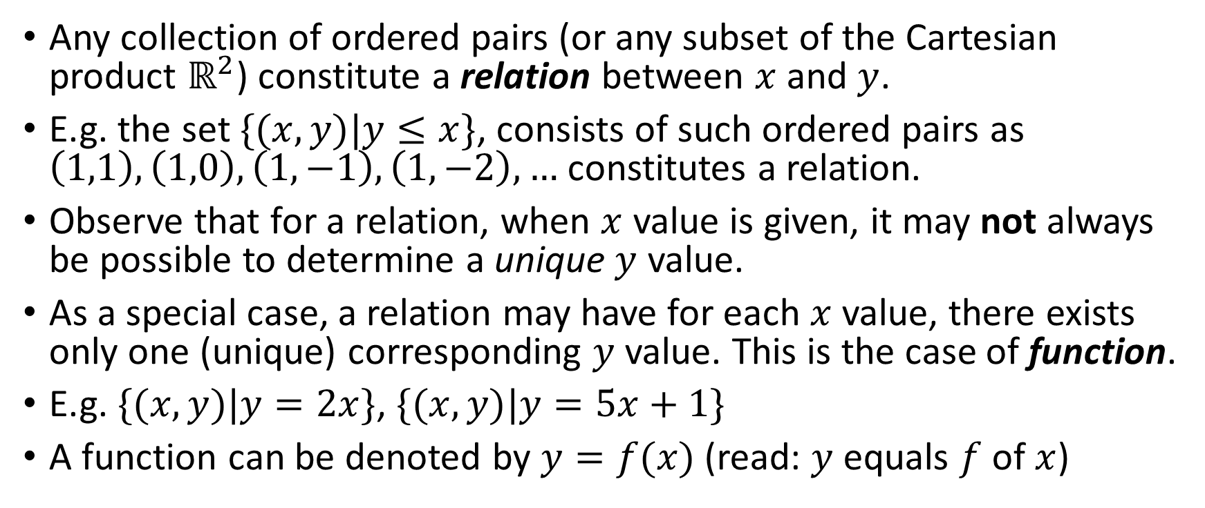
Relations and Functions
Any collection of ordered pairs (or any subset of the Cartesian product $ℝ^{2}$) constitute a relation between $x$ and $y$.
E.g. the set $\{(x,y)|y≤x\}$, consists of such ordered pairs as $\left(1,1\right), \left(1,0\right), \left(1,−1\right), \left(1,−2\right),…$ constitutes a relation.
Observe that for a relation, when $x$ value is given, it may not always be possible to determine a unique $y$ value.
As a special case, a relation may have for each $x$ value, there exists only one (unique) corresponding $y$ value. This is the case of function.
E.g. $\{(x,y)|y=2x\}$, $\{(x,y)|y=5x+1\}$
A function can be denoted by $y=f(x)$ (read: $y$ equals $f$ of $x$)

Slide 15
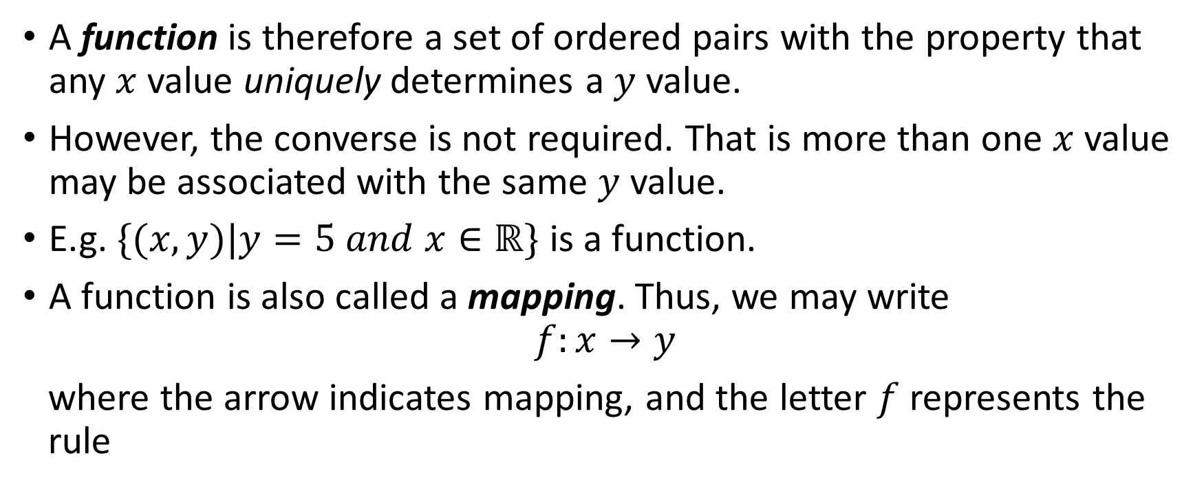
Functions
A function is therefore a set of ordered pairs with the property that any $x$ value uniquely determines a $y$ value.
However, the converse is not required. That is more than one $x$ value may be associated with the same $y$ value.
E.g. $\{(x,y)|y=5 and x∈ℝ\}$ is a function.
A function is also called a mapping. Thus, we may write
$$f:x→y$$
where the arrow indicates mapping, and the letter $f$ represents the rule

Slide 16
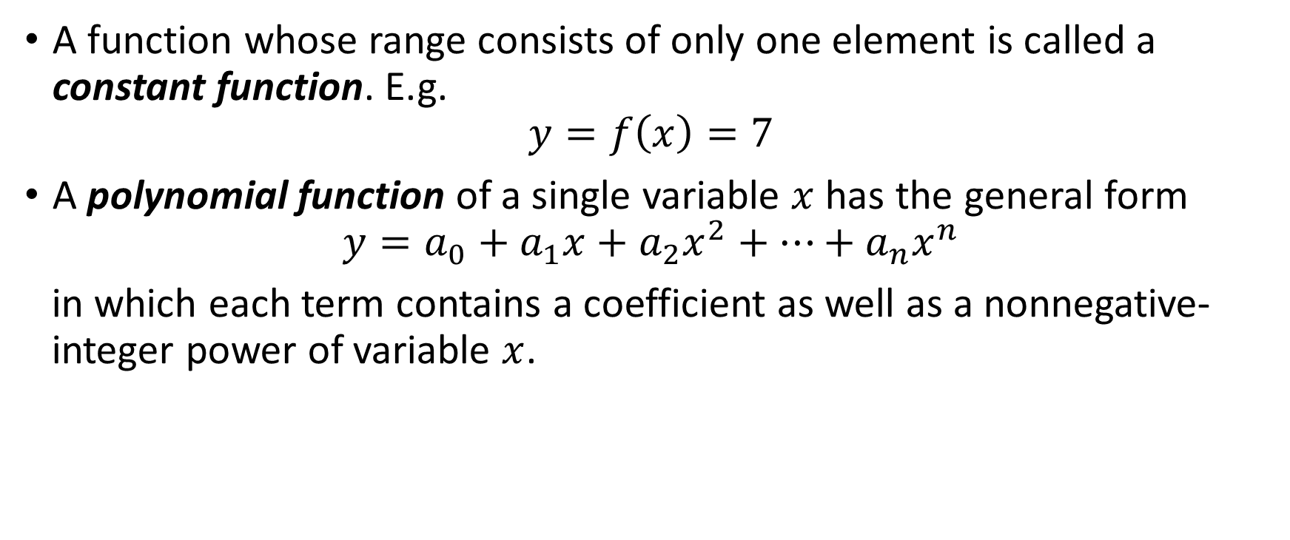
Types of Functions
A function whose range consists of only one element is called a constant function. E.g.
$$y=f\left(x\right)=7$$
A polynomial function of a single variable $x$ has the general form
$$y=a_{0}+a_{1}x+a_{2}x^{2}+…+a_{n}x^{n}$$
in which each term contains a coefficient as well as a nonnegative-integer power of variable $x$.

Slide 17
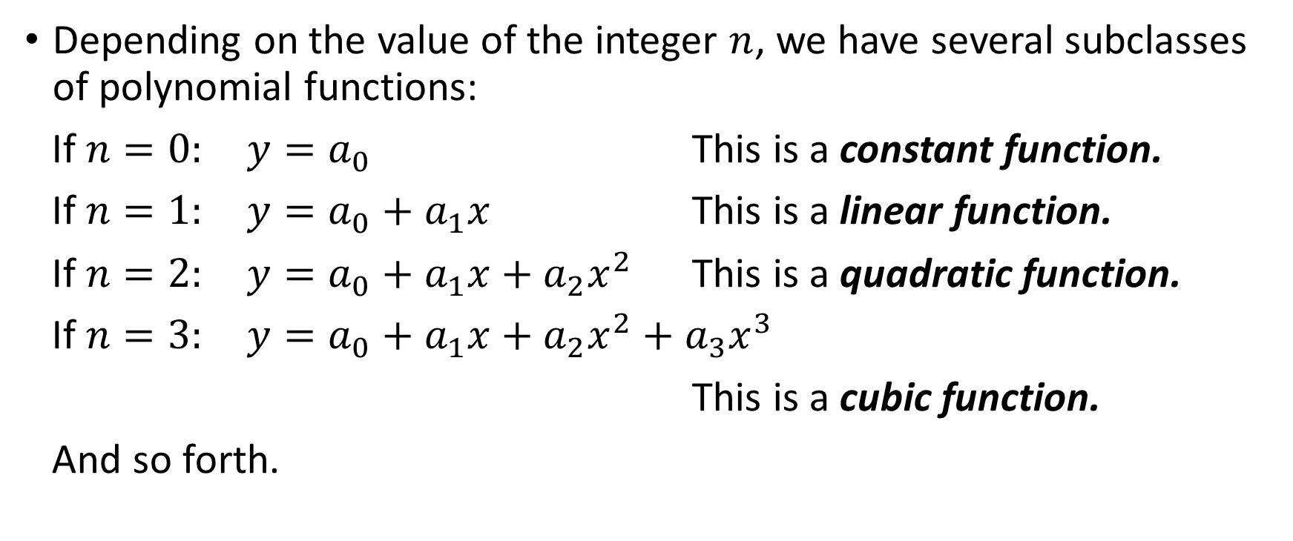
Subclasses of Polynomial Function
Depending on the value of the integer $n$, we have several subclasses of polynomial functions:
If $n=0:$ $y=a_{0}$ This is a constant function.
If $n=1:$ $y=a_{0}+a_{1}x$ This is a linear function.
If $n=2:$ $y=a_{0}+a_{1}x+a_{2}x^{2}$ This is a quadratic function.
If $n=3:$ $y=a_{0}+a_{1}x+a_{2}x^{2}+a_{3}x^{3}$
This is a cubic function.
And so forth.

Slide 18
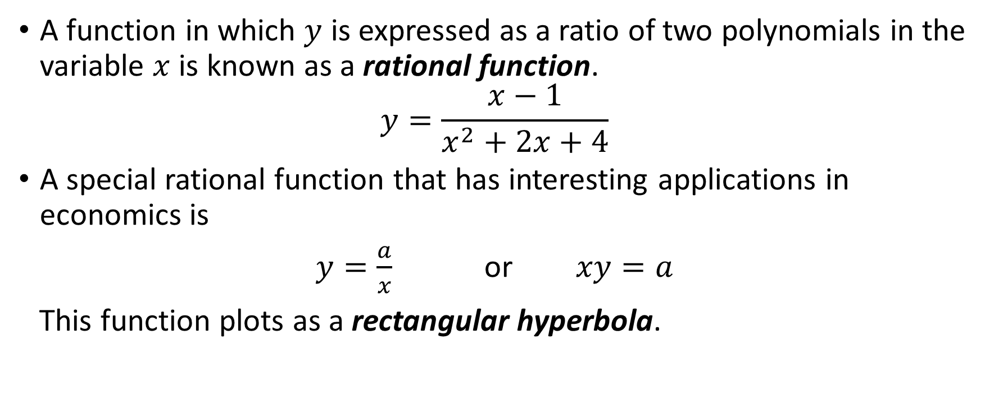
Rational Functions
A function in which $y$ is expressed as a ratio of two polynomials in the variable $x$ is known as a rational function.
$$y=\frac{x−1}{x^{2}+2x+4}$$
A special rational function that has interesting applications in economics is
$y=\frac{a}{x}$ or $xy=a$
This function plots as a rectangular hyperbola.

Slide 19
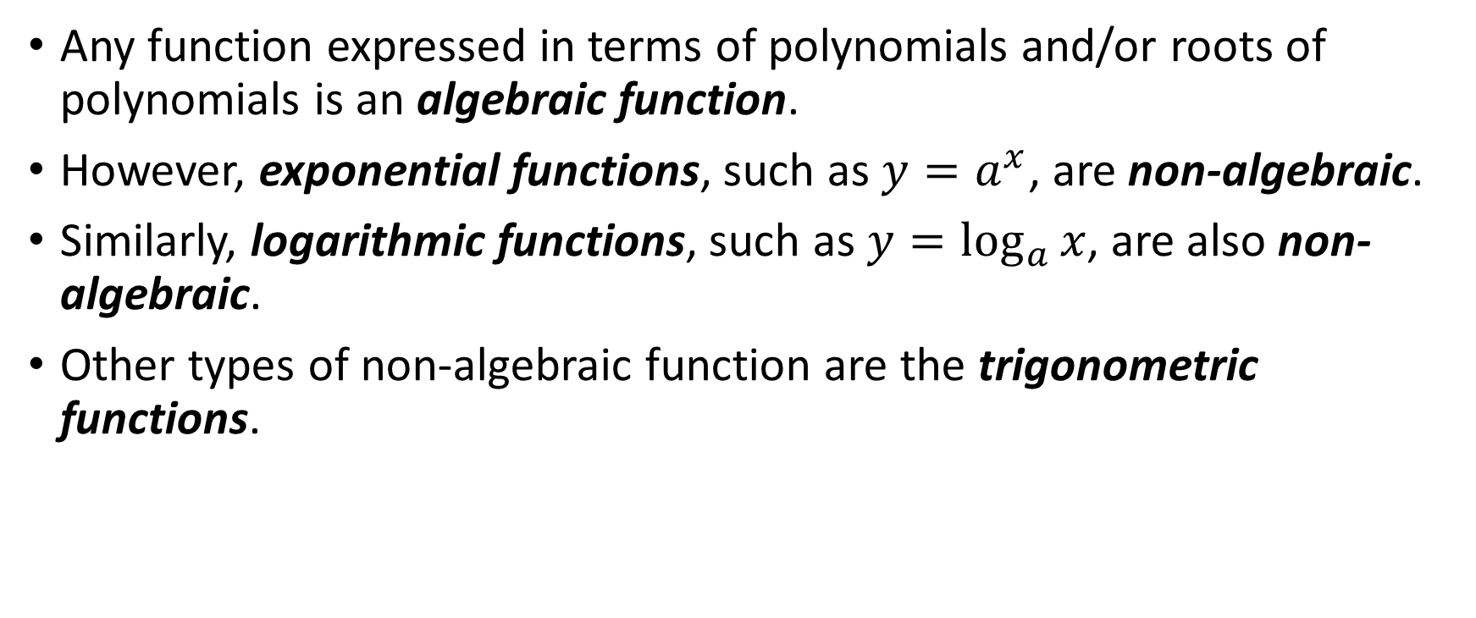
Non-algebraic Functions
Any function expressed in terms of polynomials and/or roots of polynomials is an algebraic function.
However, exponential functions, such as $y=a^{x}$, are non-algebraic.
Similarly, logarithmic functions, such as $y=\log_{a}{x}$, are also non-algebraic.
Other types of non-algebraic function are the trigonometric functions.

Slide 20
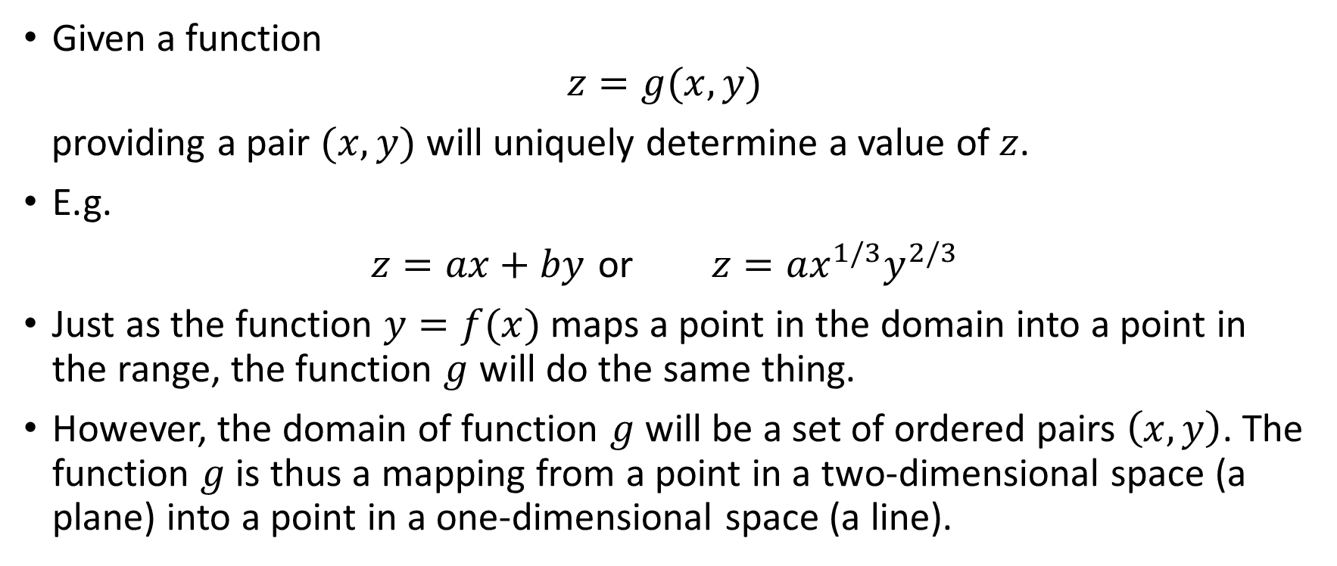
Functions of Two or More Independent Variables
Given a function
$$z=g(x,y)$$
providing a pair $(x,y)$ will uniquely determine a value of $z$.
E.g.
$z=ax+by$ or $z=ax^{1/3}y^{2/3}$
Just as the function $y=f(x)$ maps a point in the domain into a point in the range, the function $g$ will do the same thing.
However, the domain of function $g$ will be a set of ordered pairs $\left(x,y\right)$. The function $g$ is thus a mapping from a point in a two-dimensional space (a plane) into a point in a one-dimensional space (a line).

Slide 21
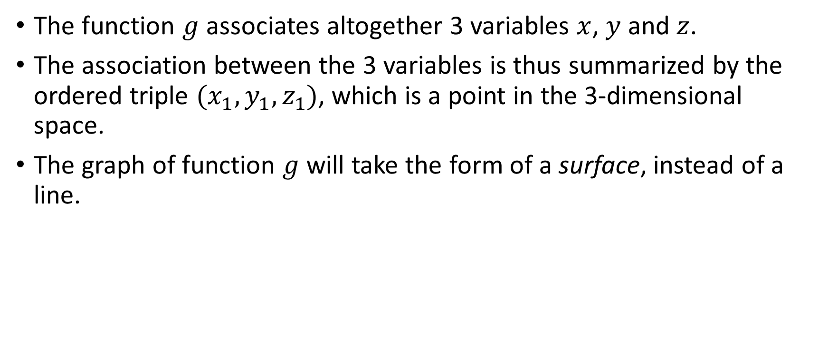
Functions of Two or More Independent Variables
The function $g$ associates altogether 3 variables $x$, $y$ and $z$.
The association between the 3 variables is thus summarized by the ordered triple $(x_{1},y_{1},z_{1})$, which is a point in the 3-dimensional space.
The graph of function $g$ will take the form of a surface, instead of a line.

Slide 22
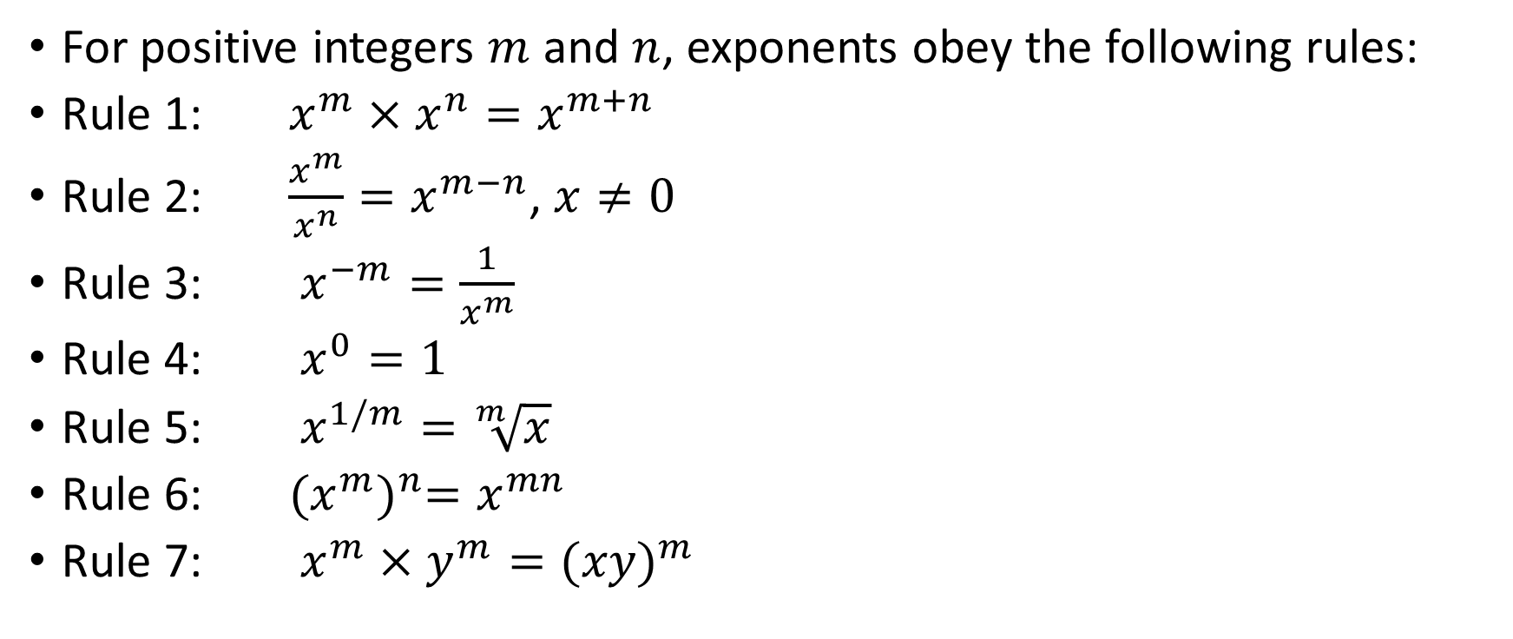
*Rules for the Exponents
For positive integers $m$ and $n$, exponents obey the following rules:
Rule 1: $x^{m}×x^{n}=x^{m+n}$
Rule 2: $\frac{x^{m}}{x^{n}}=x^{m−n}$, $x≠0$
Rule 3: $x^{−m}=\frac{1}{x^{m}}$
Rule 4: $x^{0}=1$
Rule 5: $x^{1/m}=\sqrt[m]{x}$
Rule 6: ${(x^{m})}^{n}=x^{mn}$
Rule 7: $x^{m}×y^{m}={(xy)}^{m}$

Slide 23
Assignment #1
Exercise 2.4 No. 2, 4
Exercise 2.5 No. 1, 3, 4, 5, 6

