Slide 1
CHAPTER 2
Early Trade Theories and
the Classical Trade Theory

Slide 2
Trade Theories
Mercantilism
Classical Trade Theory
- Absolute advantage concept
- Comparative advantage concept
Neo-Classic Trade Theory
Heckscher-Ohlin Theory
Alternative Theories

Slide 3
2.1 Mercantilism
A collection of economic thought in Europe during the period between 1500 and 1750.
Philosophy
“A country’s wealth is measured by its holdings of precious metals (specie)”

Slide 4
2.1 Mercantilism
Trade is a Zero-sum game: One country’s gain is at the expense of another
Need strong government to regulate the economy
    Government policy to discourage importation and encourage exportation
    Exchange of precious metals regulation, policy to discourage exportation of specie
    Close regulation of production
    Controls of labor through craft guild and ensure low wage
Paradox of mercantilism
“To be rich, a country needed to have a lot of poor people”

Slide 5
The Challenge to Mercantilism
In early 1700s, questions began to emerge regarding the logic of mercantilism
David Hume’s challenge: The price specie flow mechanism
Adam Smith challenge: Absolute advantage
In 18th century
David Ricardo: Comparative advantage
Book: “The Principles of Political Economy and Taxation”
Classical Trade Theory

Slide 6
David Hume’s mercantilism challenge (1975)
--- the price specie flow mechanism
Key argument: maintaining a trade surplus forever is impossible.

Slide 7
David Hume’s mercantilism challenge (1975)
--- the price specie flow mechanism
Trade Deficit (Exports < Imports)
Reduce amount of gold accumulated (net outflow of specie)
Decrease in Money Supply
Decrease in prices and wages
Increase ability to export, Import tends to decrease
Reduce trade deficits until Exports = Imports

Slide 8
Adam Smith’s mercantilism challenge
--- Absolute advantage and laissez faire
The national wealth depends on its productive capacity
Growth in productive capacity is fostered in free market
Self-interest leads individuals to specialize in and exchange goods based on their own special abilities
Countries should specialize in and export those commodities in which they had an absolute advantage
If countries trade according to this principle, all will gain from trade (trade will be mutually beneficial)
Trade is a positive-sum game

Slide 9
2.2 Classical Trade Theory
2.2.1 Three key terms you needs to know
Direction of Trade or Pattern of Trade --- each country should export which product and import which product
Terms of Trade --- The rate to trade products between countries or import and export price--- commonly know as relative price
Gains from Trade

Slide 10
2.2 Classical Trade Theory
2.2.1 Three key terms you needs to know
Pattern of Trade --- What goods and services a country trades, with whom, and in what direction
Terms of Trade --- The rate to trade goods between countries or import and export price--- commonly know as relative price
Gains from Trade

Slide 11
2.2 Classical Trade Theory
2.2.2 Related principle
Adam Smith
The Principle of Absolute Advantage
The Principle of Comparative Advantage
----constant opportunity cost case-----
David Ricardo

Slide 12
2.3 Principle of absolute advantage—Adam Smith
International trade based on different technology
2.3.1 Assumptions
2 countries, 2 goods
1 factor of production, labor
In each country, all labor has the same qualifications
Constant units of labor required to produce one unit of a final good
Price and cost of each good produced depends on units of labor required to produce the good

Slide 13
2.3.2 Concept
2.3 Principle of absolute advantage
Each country should produce a good it has absolute advantage (can produce efficiently). Then countries should export those goods in which they can produce efficiently, and import those which they cannot
Division of labor between countries
Each country gains from trade

Slide 14
Principle of absolute advantage
The country will have absolute advantage in production of a good under the following condition
To produce the same amount of good
Country A uses factor of productions _______than Country B
Country A has absolute advantage in production of that good

Slide 15
Principle of absolute advantage
The country will have absolute advantage in production of a good under the following condition
From the same amount of factors of production
Amount of the good that Country A can produce _______than Country B
Country A has absolute advantage in production of that good

Slide 16
Example 1(Principle of Absolute Advantage) --- Table 1
Unit of labor used to produce 1 unit of good
shirt (good X)
watch, (good Y)
Thailand (country A)
3
XA
6
YA
USA (country B)
8
XB
2
YB

Slide 17
Example 1 (Principle of Absolute Advantage)
Unit of labor used to produce 1 unit of good
Price ratios in Autarky
shirt (good X)
watch, (good Y)
Thailand (country A)
3
XA
6
YA
USA (country B)
8
XB
2
YB
In Autarky (without international trade) both countries will produce both goods if consumers demand both Shirts and Watches

Slide 18
Example 1 (Principle of Absolute Advantage) --- Table 2
Output from 24 units of labor in each country
shirt (good X)
watch, (good Y)
Thailand (country A)
8
4
USA (country B)
3
12

Slide 19
Gains from Trade under Principle of Absolute Advantage) --- Table 1
Unit of labor used to produce 1 unit of good
shirt (good X)
watch, (good Y)
Thailand (country A)
3
XA
6
YA
USA (country B)
8
XB
2
YB
Observation 1
If Thailand uses all units of labor to produce shirts
If USA uses all units of labor to produce watches
 | Shirt | Watch
Thailand
USA
World
The world has better welfare (more products produced)

Slide 20
Gains from Trade under Principle of Absolute Advantage --- Table 1
Unit of labor used to produce 1 unit of good
shirt (good X)
watch, (good Y)
Thailand (country A)
3
XA
6
YA
USA (country B)
8
XB
2
YB
Observation 2
If the rate of good exchange is 1 unit of watch for 1 unit of shirt or 1X : 1Y
Thailand (Country A) benefits from trade because
Thailand can acquire 1 unit of watch for a cost of ___ units of labor
instead of ___ units of labor for the production at home
USA (Country B) benefits from trade because
USA can acquire 1 unit of shirt for a cost of ___ units of labor
instead of ___ units of labor for the production at home

Slide 21
Gains from Trade under Principle of Absolute Advantage --- Table 1
Unit of labor used to produce 1 unit of good
shirt (good X)
watch, (good Y)
Thailand (country A)
3
XA
6
YA
USA (country B)
8
XB
2
YB
Observation 3
If the rate of good exchange is 1 unit of watch for 1 unit of shirt or 1X : 1Y
Thailand
Produce 1 more unit of shirt
Production of watch
Exchange that 1 unit of shirt with watch from USA
Get ___ unit of watch
Thailand benefits from trade =
USA
Produce 1 more unit of watch
Production of shirt
Exchange that 1 unit of watch with shirt from Thailand
Get ___unit of shirt
Thailand benefits from trade =

Slide 22
Example 2 (Principle of Absolute Advantage) --- Table 3
Unit of labor used to produce 1 unit of good
shirt (good X)
watch, (good Y)
Thailand (country A)
12
XA
24
YA
USA (country B)
4
XB
3
YB

Slide 23
Limits to Adam Smith’s Absolute Advantage principle
If one country has an absolute advantage in the production of both (or all) goods, Smith would say that that country cannot gain from trade.
But David Ricardo’s Principle of Comparative Advantage (1817) took Smith’s work farther: even in the above example, trade can be mutually beneficial!

Slide 24
2.4 Principle of comparative advantage—David Ricardo
Adam Smith’s absolute advantage and David Ricardo’s comparative advantage emphasizes on International trade based on different technology
2.4.1 Assumptions (similar to absolute advantage assumptions)
2 countries, 2 goods
1 factor of production, labor
In each country, all labor has the same qualifications
Constant units of labor required to produce one unit of a final good (fixed technology in each country although the technology can differ between them)
The relative value of commodity is based solely its relative labor content ---- see explanation later

Slide 25
2.4 Principle of comparative advantage---David Ricardo
2.4.1 Assumptions (similar to absolute advantage assumptions)
Fixed endowment of resource (labor)
Factor of production (labor) mobile internally, immobile internationally
Full employment
Perfect competition in good market
No government intervention
No transportation cost

Slide 26
2.4.2 Concept of Principle of Comparative Advantage
Unit of labor used to produce 1 unit of good
Good X
Good Y
Country A
XA
YA
Country B
XB
YB
Compared to Country B, Country A has relative units of labor used in the production of Good X less than Good Y
If
XA
YA
XB
YB

Slide 27
Example 2 (Principle of Comparative Advantage) --- Table 3
Unit of labor used to produce 1 unit of good
shirt (good X)
watch, (good Y)
Thailand (country A)
12
XA
24
YA
USA (country B)
4
XB
3
YB

Slide 28
Example 2 (Principle of Comparative Advantage) --- Table 3
Unit of labor used to produce 1 unit of good
shirt (good X)
watch, (good Y)
Thailand (country A)
12
XA
24
YA
USA (country B)
4
XB
3
YB
Note
USA has absolute advantage in shirt (good X) and watch (good Y) production
To produce shirt (X) USA (B) has advantage over Thailand
To produce watch (Y) USA (B) has advantage over Thailand

Slide 29
Gains from Trade under Principle of Absolute Advantage) --- Table 3
Unit of labor used to produce 1 unit of good
shirt (good X)
watch, (good Y)
Thailand (country A)
12
XA
24
YA
USA (country B)
4
XB
3
YB
Observation 1
If Thailand uses all units of labor to produce shirts
If USA uses all units of labor to produce watches
 | Shirt | Watch
Thailand
USA
World
The world has better welfare (more products produced)

Slide 30
Gains from Trade under Principle of Comparative Advantage --- Table 3
Unit of labor used to produce 1 unit of good
shirt (good X)
watch, (good Y)
Thailand (country A)
12
XA
24
YA
USA (country B)
4
XB
3
YB
Observation 2
Comparative advantage does not imply Absolute advantage
Absolute advantage does not imply Comparative advantage
If the rate of good exchange is 1 unit of watch for 1 unit of shirt or 1X : 1Y
Thailand
Produce 1 more unit of shirt
Production of watch
Exchange that 1 unit of shirt with watch from USA
Get ___ unit of watch
Thailand benefits from trade =
USA
Produce 1 more unit of watch
Production of shirt
Exchange that 1 unit of watch with shirt from Thailand
Get ___unit of shirt
Thailand benefits from trade =

Slide 31
2.4 Extension of the classical trade model
The classical model in monetary term
Multiple commodities case

Slide 32
The classical model in monetary term ----Example 3
Country | Wage for 1 unit of labor | Shirt (good X) |  | Watch (good Y)
 |  | Unit of labor required | Cost of labor | Unit of labor required | Cost of labor
Thailand (A) | 200 Baht | 4 |  | 10
USA (B) | 40 $ | 3 |  | 6
Exchange rate: 40 Baht per 1 dollar
1 Baht = (1/40) dollar = 0.025

Slide 33
The classical model in monetary term ----Example 3
Country | Wage for 1 unit of labor | Shirt (good X) |  | Watch (good Y)
 |  | Unit of labor required | Cost of labor | Unit of labor required | Cost of labor
Thailand (A) | 200 Baht | 4 |  | 10
USA (B) | 40 $ | 3 |  | 6
800 Baht
2,000 Baht
= 800*0.025 =20 $
= 2,000*0.025 = 50 $
120 $
240 $
Exchange rate: 40 Baht per 1 dollar
1 Baht = (1/40) dollar = 0.025
Export condition under monetary unit
Cost of producing good X in A (Cost X_{A}) VS Cost of producing good X in B (Cost X_{B})
Cost of producing good Y in A (Cost Y_{A}) VS Cost of producing good Y in B (Cost Y_{B})
Cost X_{A} < Cost X_{B}
Cost Y_{A} > Cost Y_{B}

Slide 34
The classical model in monetary term ----Example 3
If
W_{A} = wage rate in A
W_{B} =wage rate in B
Labor X_{A} = Unit of labor used to produce good X in A
Labor X_{B} = Unit of labor used to produce good X in B
e_{A,B} = Exchange rate of 1 unit of currency in A = ….unit of currency in B
In this case 1 Baht = ….dollars
Therefore, factors affecting export include

Slide 35
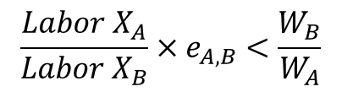
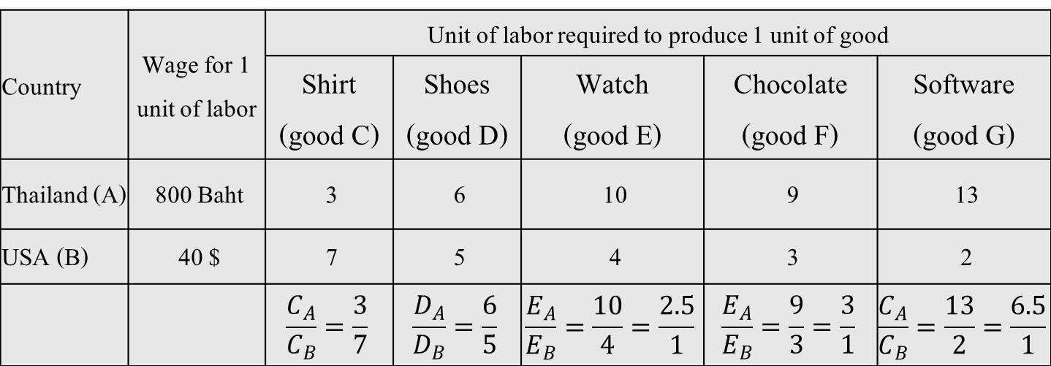
The classical model in multiple commodities case----Example 4
Country | Wage for 1 unit of labor | Unit of labor required to produce 1 unit of good
 |  | Shirt (good C) | Shoes (good D) | Watch (good E) | Chocolate (good F) | Software (good G)
Thailand (A) | 800 Baht | 3 | 6 | 10 | 9 | 13
USA (B) | 40 $ | 7 | 5 | 4 | 3 | 2
 |  | $$\frac{C_{A}}{C_{B}}=\frac{3}{7}$$ | $$\frac{D_{A}}{D_{B}}=\frac{6}{5}$$ | $$\frac{E_{A}}{E_{B}}=\frac{10}{4}=\frac{2.5}{1}$$ | $$\frac{E_{A}}{E_{B}}=\frac{9}{3}=\frac{3}{1}$$ | $$\frac{C_{A}}{C_{B}}=\frac{13}{2}=\frac{6.5}{1}$$
Exchange rate: 40 Baht per 1 dollar
1 Baht = (1/40) dollar = 0.025
Export condition under monetary unit
$$\frac{Labor X_{A}}{Labor X_{B}}×e_{A,B}<\frac{W_{B}}{W_{A}}$$
Country A should export Good X

Slide 36
2.5 Test of classical trade model
G.D.A. MacDougall (1951) in an article “British and American Exports: A Study Suggested by the Theory of Comparative Costs”
Employed 1937 data on US and UK export of 25 commodities to other countries

Slide 37
MacDougall’s classical trade model test
Suppose we consider 1 product: Good X
U.S. has advantage on the production of good X
Note:
represents 1 US$ = … UK £

Slide 38
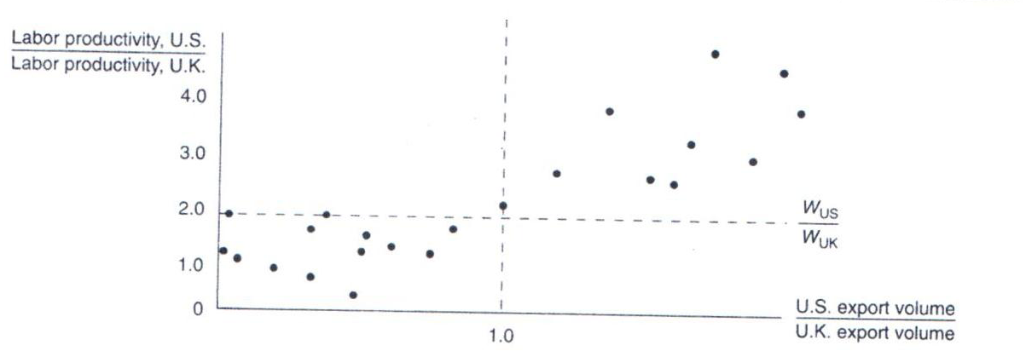
MacDougall’s classical trade model test
Empirical results support Classical Trade Theory prediction
Stern (1962), Balassa (1963), Golub (1996) and many other studies try to test Classical Trade Theory

Slide 39
2.6 Explanation of Classical trade model by Neo-Classic tools
Concept of Opportunity cost and Production possibility frontier
In each country economy, the increase in production of one product imply the decrease in the production of another product.
Classic assumes constant opportunity cost

Slide 40
2.6.1 Example 3 (Principle of Comparative Advantage) --- Table 4
Unit of labor used to produce 1 unit of good
shirt (good X)
watch, (good Y)
Thailand (country A)
3
XA
6
YA
USA (country B)
8
XB
2
YB
Compared to USA (Country B), Thailand (Country A) has relative units of labor used in the production of Shirt (Good X) less than Watch (Good Y)
__________has comparative advantage in _______ production
__________has comparative advantage in _______ production
Thailand exports shirt and USA exports watch

Slide 41
2.6.1 Example 3 (Principle of Comparative Advantage) --- Table 4
Unit of labor used to produce 1 unit of good
shirt (good X)
watch, (good Y)
Thailand (country A)
3
XA
6
YA
USA (country B)
8
XB
2
YB
Opportunity cost of production of shirt (X) in Thailand (A) = _____ unit of Y
Opportunity cost of production of shirt (X) in USA (B) = _____ unit of Y
Opportunity cost of production of shirt (X) in Thailand (A) ______ than USA
__________has comparative advantage in _______ production
__________has comparative advantage in _______ production

Slide 42
2.6.1 Example 3 (Principle of Comparative Advantage) --- Table 4
Unit of labor used to produce 1 unit of good
shirt (good X)
watch, (good Y)
Thailand (country A)
3
XA
6
YA
USA (country B)
8
XB
2
YB
Opportunity cost of production of watch (Y) in Thailand (A) = _____ unit of X
Opportunity cost of production of watch (Y) in USA (B) = _________unit of X
Opportunity cost of production of watch (Y) in Thailand (A) ______ than USA
__________has comparative advantage in _______ production
__________has comparative advantage in _______ production

Slide 43
2.6.2 PPC and Relative Price --- under constant opportunity cost case
Concept of Opportunity cost and Production possibility frontier (PPC)
In each country economy, the increase in production of one product imply the decrease in the production of another product.
Classic assumes constant opportunity cost

Slide 44
Review PPC under constant opportunity cost case ----- production side
Good Y
Good X

Slide 45
Review Indifference Curve (IC) and budget line---Consumption side
Good Y
Good X

Slide 46
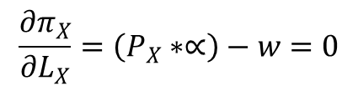
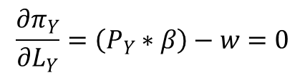











If production functions of good X and good Y are
$$X=∝L_{X}$$
$$Y=βL_{Y}$$
$$∝={MP}_{L}^{X}=Marginal Product of Labor to produce good X$$
$$β={MP}_{L}^{Y}=Marginal Product of Labor to produce good Y$$
$$π_{X}=(P_{X}∗X)−(w∗L_{X})$$
$$π_{Y}=(P_{Y}∗{βL}_{Y})−(w∗L_{Y})$$
$$π_{X}=(P_{X}∗∝L_{X})−(w∗L_{X})$$
$$π_{Y}=(P_{Y}∗{βL}_{Y})−(w∗L_{Y})$$
$$\frac{{∂π}_{X}}{∂L_{X}}=\left(P_{X}∗∝\right)−w=0$$
$$\frac{{∂π}_{Y}}{∂L_{Y}}=\left(P_{Y}∗β\right)−w=0$$
$$\left(P_{X}∗∝\right)=w$$
$$\left(P_{Y}∗β\right)=w$$
$$P_{X}∗{MP}_{L}^{X}=w$$
$$P_{Y}∗{MP}_{L}^{Y}=w$$
$$P_{X}∗{MP}_{L}^{X}=w=P_{Y}∗{MP}_{L}^{Y}$$

Slide 47



If production functions of good X and good Y are
$$X=∝L_{X}$$
$$Y=βL_{Y}$$
$$∝={MP}_{L}^{X}=Marginal Product of Labor to produce good X$$
$$β={MP}_{L}^{Y}=Marginal Product of Labor to produce good Y$$
$$P_{X}∗{MP}_{L}^{X}=w=P_{Y}∗{MP}_{L}^{Y}$$

Slide 48
2.6.3 Gains from trade under constant cost case
watch (Y)
watch (Y)
16
12
8
6
4
4
0
0
3
J
12
4
8
16
shirt (X)
shirt (X)
Thailand (A)
USA (B)
From Example 3, Table 4
If the endowment of labor in Thailand = 36 units
the endowment of labor in USA = 32 units

Slide 49
2.6.3 Gains from trade under constant cost case
shirt (X)
12
3
OB
16
12
watch (Y)
watch (Y)
16
OA
12
shirt (X)

Slide 50
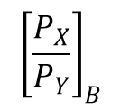
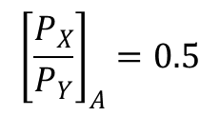
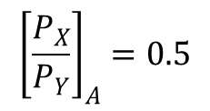
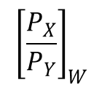
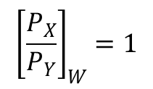

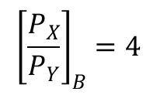

USA gains from trade more than Thailand
$${\left[\frac{P_{X}}{P_{Y}}\right]}_{A}=0.5$$
$${\left[\frac{P_{X}}{P_{Y}}\right]}_{B}=4$$
$${\left[\frac{P_{X}}{P_{Y}}\right]}_{W}=1$$
$${\left[\frac{P_{X}}{P_{Y}}\right]}_{W}$$
is closer to
$${\left[\frac{P_{X}}{P_{Y}}\right]}_{A}=0.5$$
than
$${\left[\frac{P_{X}}{P_{Y}}\right]}_{B}$$
Country A gains from trade less. Country B gains from trade more
Note that
$$\frac{P_{X}}{P_{Y}}$$
to be high because
Country A wants
the country can sell good X at high price and buy good Y at low price
Country B wants
$$\frac{P_{X}}{P_{Y}}$$
to be low because
the country can sell good Y at high price and buy good X at low price

Slide 51
Homework ---- Table 5
Unit of labor used to produce 1 unit of good
good X
good Y
Country A)
18
XA
12
YA
Country B)
3
XB
4
YB
Suppose
The endowment of labor in country A = 180 units
The endowment of labor in country A = 144 units
Before trade
country A consumes X = 6 units
country B consumes X = 24 units
Terms of trade is 1X : 1Y
After trade
country A consumes X = 22 units
Question: From the above situation, use neo-classical tools to explain
Source of comparative advantage and pattern of trade
Gains from trade

