Slide 1
Economy of vietnam
EE361 ECONOMIES of CLMV
Faculty of economics
Thammasat university

Slide 2
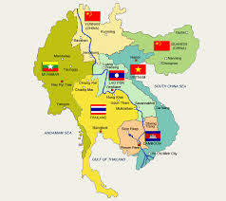
Vietnam within the Greater Mekong Subregion
 | 2000 | 2018
Population | 79.9 million | 96.5 million
GDP per capita | $390 | $2,715
Under 5 mortality (per 100,000 births) | 29.7 | 20.4
Infant mortality (per 100,000 births) | 23.4 | 16.3
Primary education attainment | 85% | 99%
Poverty rate | 32.1% | 15.0%

Slide 3
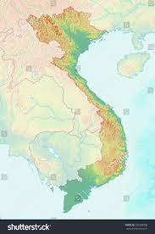
Hanoi
geography
Land area: 331,000 square km
Vietnam occupies a narrow strip of land spanning from the border with PR China in the north to the South China sea in the south
The northern and central highland areas are mountainous; most of the large cities are along the coastal areas
Only 23% of the land area is arable, mostly around the Red river delta in the north, the coastal area along the east, and the Mekong river delta in the south
Haiphong
Thanh Hoa
Danang
Nha Trang
Bien Hoa
Ho Chi Minh City
Can Tho

Slide 4
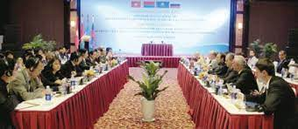
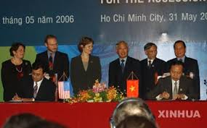
Economic Milestones
2000: Vietnam signs the bilateral trade agreement with the United States which provides for "normal trade relations" (NTR) status of Vietnamese goods in the US market
2001: the Communist Party approves a 10-year economic plan that enhanced the role of the private sector, while reaffirming the primacy of the state
2006: the World Trade Organization approves Vietnam's accession to the organization
2015: Vietnam joins the ASEAN Economic Community

Slide 5
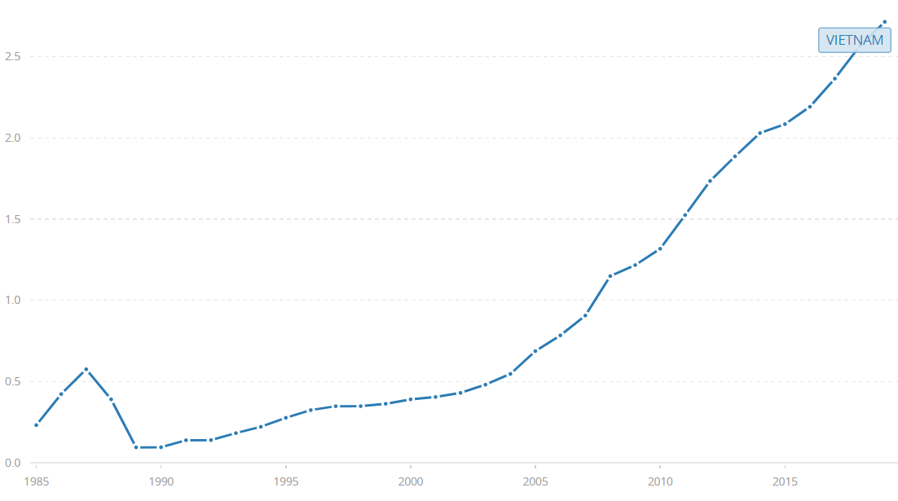
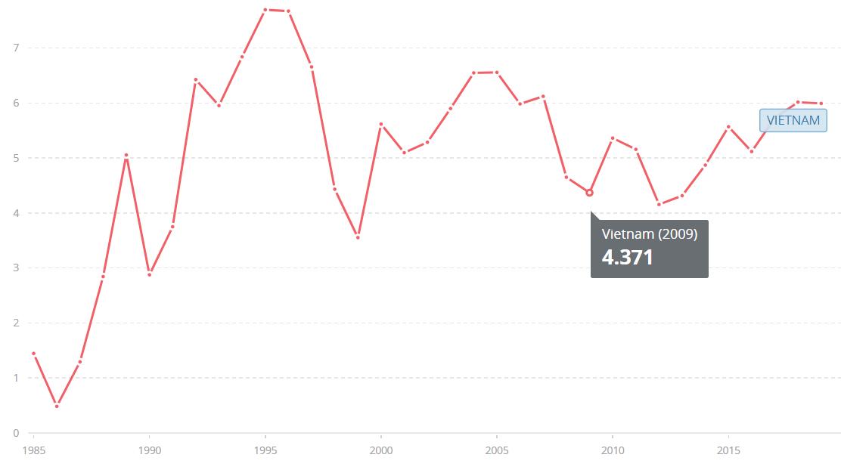
economy
Thirty years after the launch of the economic reforms (Doi Moi), Vietnam is considered a development success story—marked by remarkable poverty reduction and dynamic economic growth
Vietnam reached middle-income status in 2009 and has achieved most of the Millennium Development Goals set for 2015
Vietnam has shifted from a centrally planned market-based economy and has been become integrated and connected to the global economy
GDP per capita, 1985-2015
GDP growth 1985-2015

Slide 6
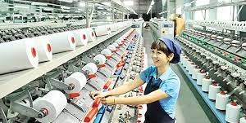
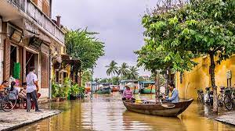
economy
Vietnam’s rapid economic growth is driven by
exports which capitalized on bilateral free trade agreements along with enterprises’ resilience and rapid adaptation in global trade
manufacturing; mainly textiles, processed food, furniture, plastics and paper
agriculture; mainly rice and agricultural crops, fisheries, forest products, which contributed to 14% of total GDP
tourism; in 2016 tourist arrivals topped 10 million

Slide 7
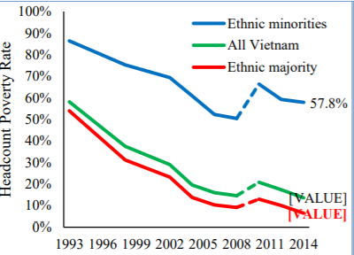
Poverty reduction
Vietnam has achieved tremendous poverty reduction. The proportion of the population living below the national poverty line reached 13.5% percent in 2014 from 60% in 1993
Based on these figures, more than 40 million people escaped poverty over the last thirty years
However poverty reduction for ethnic minorities has been slower than the national average

Slide 8
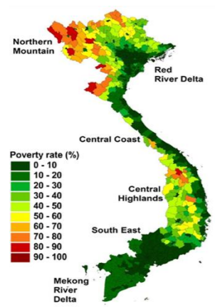
Poverty reduction
Vietnam’s success in reducing poverty comes largely from rapid economic growth that created more and better jobs
Government investments have significantly improved service delivery, education, and public infrastructure, facilitating growth and broad-based participation in the economy
The majority of the poor and the near-poor live in rural areas; poverty is concentrated among ethnic minorities, living in the northern and central mountains

Slide 9
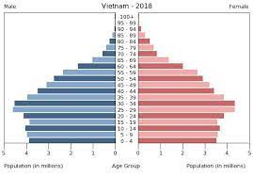
Population and demographics
Vietnam is experiencing rapid demographic and social change. From about 60 million in 1986, Vietnam’s population reached 79.9 million in 2000 and currently is currently 96.5 million
70 percent of the population is under 35 years of age, with a life expectancy of close to 73 years
The population is rapidly aging; the share of people 65 years and older is projected to more than double by 2035, from 7% to 15%

Slide 10
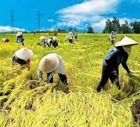
agriculture
Vietnam's main agricultural crops are rice, cassava, maize and sweet potatoes. Rice con-sumption in Vietnam reached 21.5 million metric tons, ranking it fifth place in the world
The transformation from an agrarian economy to labor-intensive manufacturing and services has created 15 million jobs over the past 20 years
Agriculture employs about half the labor force, but the sector needs to be modernized. The pace of agriculture growth has slowed, from 4.5% a year in 1994–2000 to 2.6% in 2008–13.

Slide 11
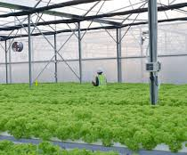
agriculture
Rural citizens earning a higher share of income from non-agriculture enterprises and non-agriculture wages are more likely to be non-poor
Higher agriculture growth will require focusing on new drivers of growth, including agricultural innovation; inclusive value chain development, quality, and value addition; higher land market efficiency; greater sustainability of farm production and climate change resilience; and more efficient water use

Slide 12
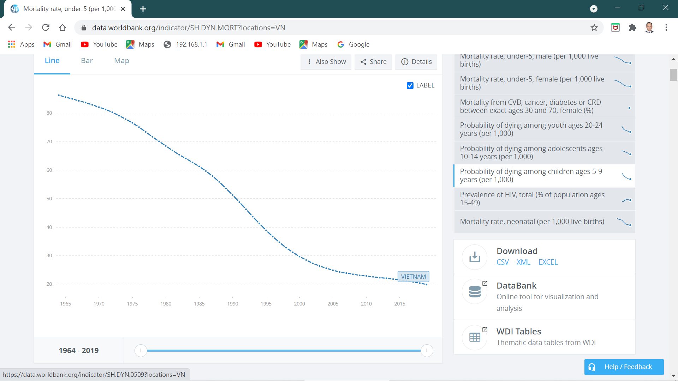
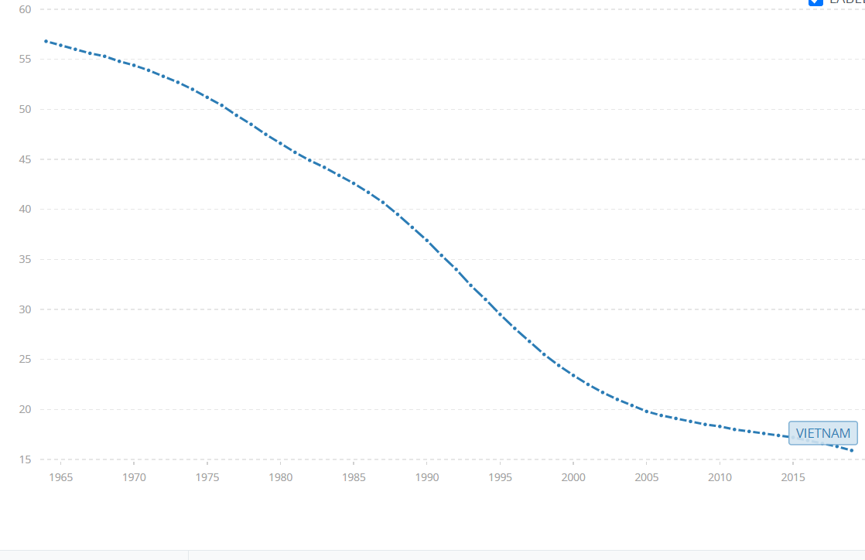
Human development
Investments in health and education during the past 30 years enabled Vietnam to achieve substantial progress in providing access to infrastructure and basic services
Today Vietnamese are far healthier and educated compared to 20 years ago
Service coverage and learning outcomes are high and equitably achieved in primary school
Under-5 mortality rate, 1980-2018
Infant mortality rate, 1980-2018

Slide 13

Human development — education
Improved education has enabled Vietnamese to obtain better jobs; however as the economy develops and becomes increasingly sophisticated and integrates further into the global economy, new and varied skills are needed to contribute to a changing economy
Development of the domestic private sector will also require innovation

Slide 14
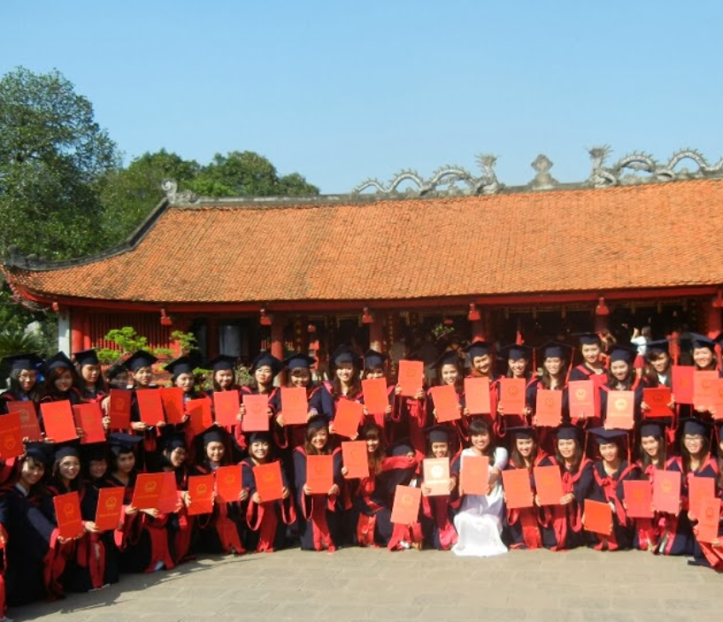
Human development — education
Educational reforms undertaken in Vietnam:
Improved teaching quality, requiring higher education instructors to hold masters or doctoral degrees
Labor force development through large-scale investments in applied, employment-geared training
Requirement for students to be enrolled in applied programs
Secondary education system reforms: high school grad exams and university admissions

Slide 15
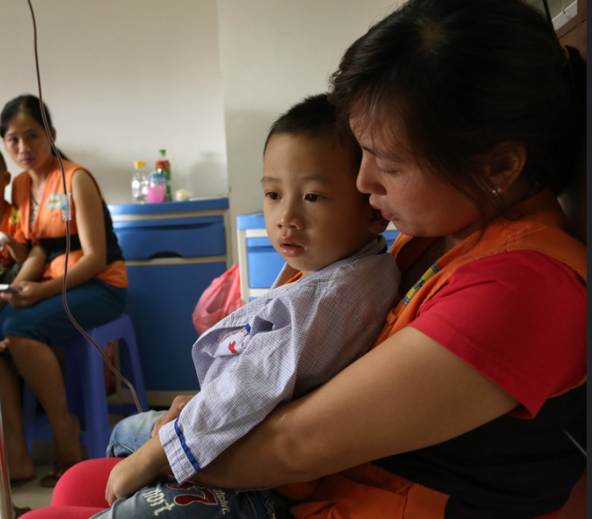
Human development — health
From 2000 to 2018, infant mortality rate decreased from 29.7 to 20.4 per 1,000 live births; stunting decreased from 61% to 23%
While health insurance coverage has increased to 81% of the population, one-third of those living in the bottom 40% are still not covered
A major policy challenge facing the health system is to achieve universal health coverage and access to affordable quality services, particularly for ethnic minority groups

Slide 16
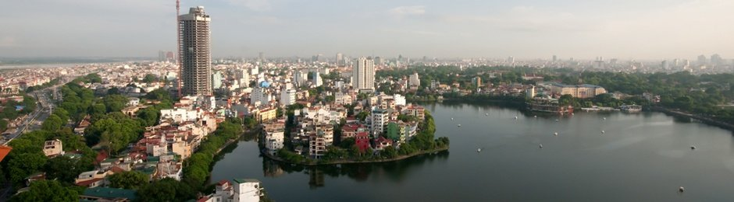
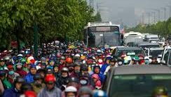
Urban development
Over the past 30 years, Vietnam has undergone an extensive urban transformation; substantial advances have been made in providing basic services and access to infrastructure
Traffic congestion in and around urban areas and along the connecting national highway systems exacerbates cargo movement, causing delays and is becoming a major concern
Access to clean water and sanitation services in urban areas is above 90%; access to electricity is 99%

Slide 17
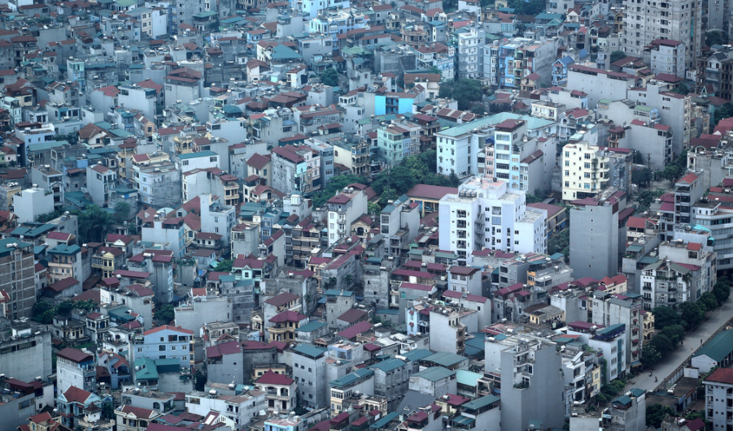
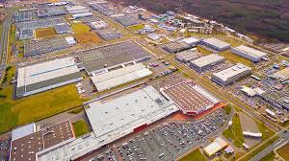
Urban development
Migration to cities present rural households with non-farm opportunities, thereby diversifying their income sources from agriculture
Economic clusters in Vietnam, in the form of industrial parks or special economic zones, have been developed around major urban areas, seaports, airports and main economic corridors; their success, measured in terms of investments attracted and employment generated, is affected by connectivity, along with other factors

Slide 18
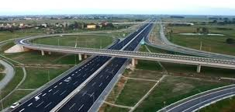
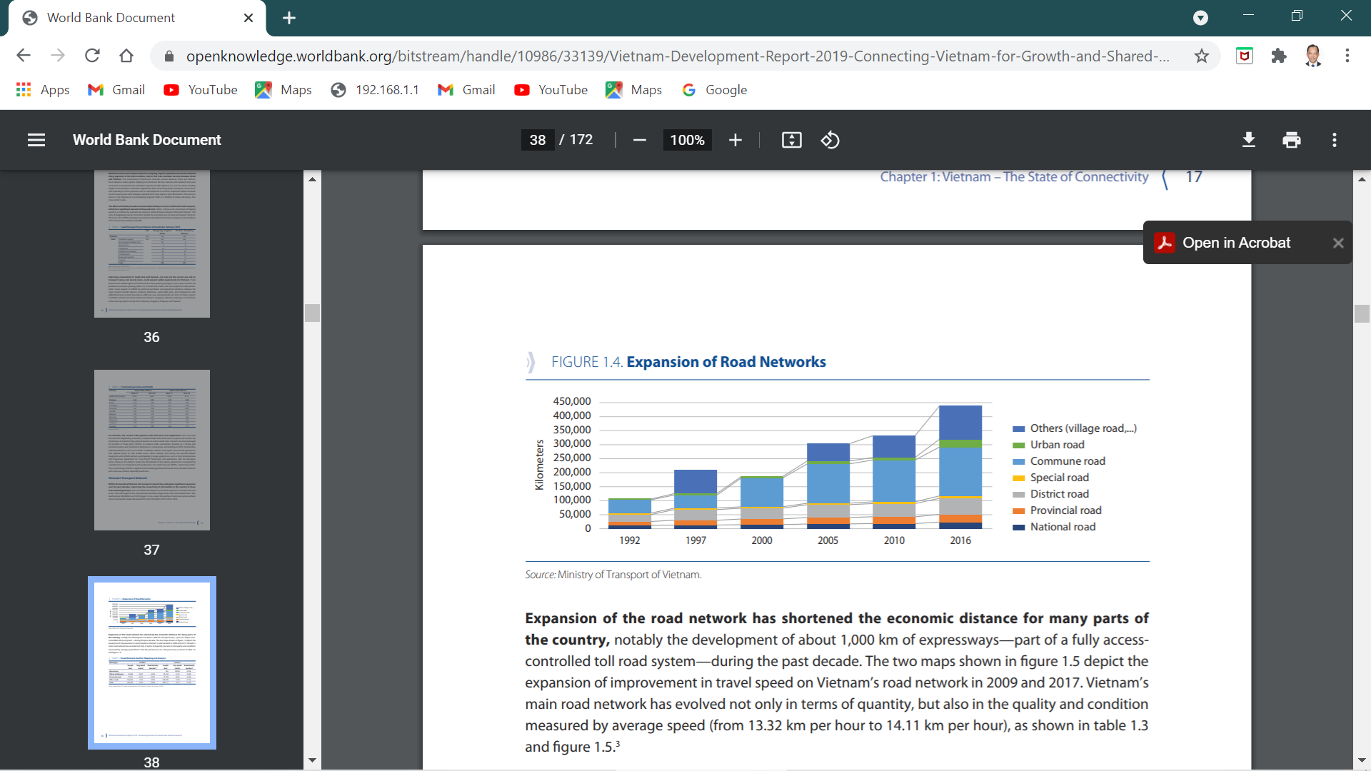
transport
Vietnam’s transport network has expanded significantly; the total length of the road network, excluding village roads, reached over 300,000 km, including about 1,000 km of expressways that are fully access-controlled toll road systems
Vietnam’s extensive transport network is exposed to various hazards, including landslide, fluvial (river) flooding, typhoon, and flash flooding, all of which are increasing in intensity and frequency due to climate change

Slide 19
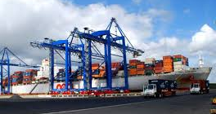
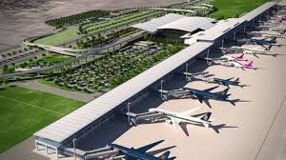
transport
Vietnam has an extensive network of natural waterways, including nearly 16,000 km of managed navigable routes carrying significant traffic around the Red River and Mekong Delta areas
The seaport system includes 45 ports and nearly 200 terminals; maritime cargo has continued to increase, both international and domestic
Vietnam’s aviation sector has seen rapid growth in the recent years, with its air freight growing at an average rate of 10.8% per year from 2009 to 2017

Slide 20
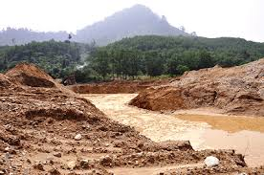
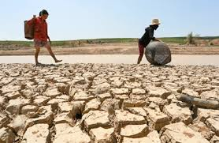
environment
Vietnam’s rapid growth has resulted in negative impacts on the environment and natural resources; electricity consumption has tripled over the past decade
Over the past two decades, Vietnam has emerged as the fastest growing per-capita greenhouse gas emitters in the world, growing at 5% annually
Vietnam’s population and economy is highly vulnerable to climate change impacts and natural disasters, given the narrow coastline

Slide 21

summary
In responding to changing global and domestic conditions, Vietnam has embarked on four key structural changes:
from central planning to market-based economy
from agrarian to manufacturing and services
from rural to urban spatial change
from a closed to an export-driven economy
Continued development and growth and ability to respond to development challenges will require structural changes

Slide 22
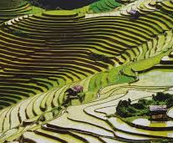
summary
Vietnam will also have to ensure environmentally sustainable practices and address climate threats, promote equity and social inclusion, reduce poverty among marginalized groups, particularly ethnic minorities and provide services for an increasingly urban as well as aging middle class population
Vietnam’s high economic growth rates will likely to be sustained if built on increased productivity growth; this will require strengthening the competitiveness of the private sector

Slide 23


