Slide 1
Introduction to psychology
Methods of therapy

Slide 2
Agendas
Psychotherapy
Insight Therapies
Behaviour Therapies
Biomedical Therapies

Slide 3
Psychotherapy
A systematic interaction between a therapist and a client
that uses psychological principles to influence the client’s thoughts, feelings, or behavior
to help them overcome psychological disorders, adjust to problems in living, or develop as an individual

Slide 4
History
Asylums
  Warehouse not a treatment
Mental Hospitals
  Get treatment
Community Health Care Movement
  Patients live in the community

Slide 5
Three Major Approaches to Therapy:
  Insight (personal understanding)
  Behavior (maladaptive behaviors)
  Biomedical (mental illness and medical treatments, such as drugs)
Eclectic Approach: an approach to psychotherapy that, depending on the client’s problems, uses techniques from various forms of therapy

Slide 6
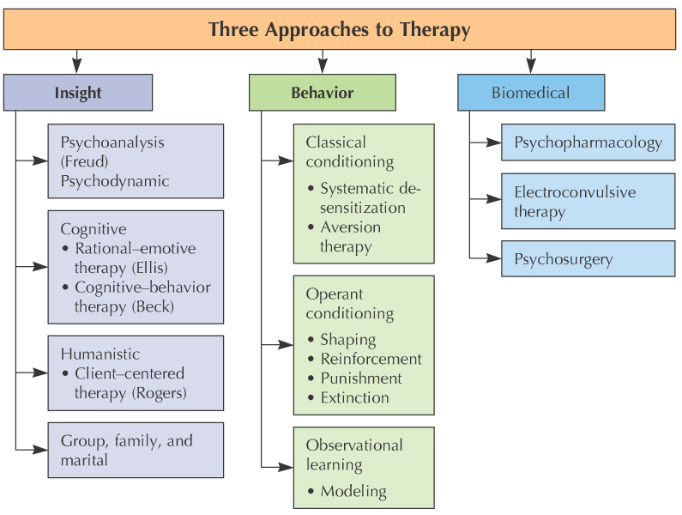

Slide 7
Psychoanalytical Perspective
Psychoanalysis

Slide 8
Insight Therapies: Psychoanalysis/Psychodynamic
Psychoanalysis: Freudian therapy designed to bring unconscious conflicts into consciousness

Slide 9
Psychoanalysis
Catharsis: A release of pent up emotions associated with unconscious thoughts and memories.

Slide 10
Insight Therapies: Psychoanalyis/Psychodynamic
Five Major Techniques of Psychoanalysis:
Free association talk about any topic that comes to mind.
Dream analysis the analyst’s noting supposed dream meanings in order to promote insight
Analyzing resistance blocking from consciousness of anxiety-laden material
Analyzing transference the patient’s transfer to the analyst of emotions linked with other relationships e.g. love or hatred for a parent
Interpretation the analyst’s noting supposed dream meanings, resistances, and other significant behaviors in order to promote insight

Slide 11
Insight Therapies: Psychoanalysis/Psychodynamic
Evaluation of psychoanalysis: Limited applicability and lack of scientific credibility
Psychodynamic Therapy: briefer, more directive, and more modern form of psychoanalysis that focuses on conscious processes and current problems

Slide 12
Cognitive Perspectives
Rational-Emotive Behavioural Therapy (REBT)
Cognitive Therapy (CT)

Slide 13
Insight Therapies: Cognitive
Cognitive Therapy: focuses on faulty thinking and beliefs
  Improvement comes from insight into negative self-talk (unrealistic things a person has been telling himself or herself)
  Cognitive Restructuring (process of changing destructive thoughts or inappropriate interpretations)

Slide 14
Insight Therapies: Cognitive (Continued)
Two Major Cognitive Therapies:
Albert Ellis’s Rational-Emotive Behavior Therapy (REBT)
Aaron Beck’s Cognitive Therapy

Slide 15
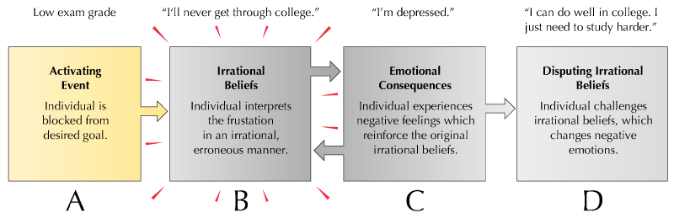
Ellis’s Rational-Emotive Behavior Therapy (REBT): eliminates self-defeating beliefs through rational examination

Slide 16
Cognitive Therapy
Beck’s Cognitive Therapy: confronts and changes behaviors associated with destructive cognitions
Depressive Thinking Patterns:
  selective perception
  overgeneralization
  magnification
  all-or-nothing thinking

Slide 17
Evaluation of cognitive therapy:
Pro: Considerable success with a range of problems
Con: Criticized for overemphasizing rationality, ignoring unconscious dynamics, minimizing importance of the past, etc.

Slide 18
Humanistic Perspectives
Client-centred Therapy
Gestalt Therapy

Slide 19
Insight Therapies: Humanistic
Humanistic therapy: Maximizes personal growth through affective restructuring (emotional readjustment)
Key assumption: People with problems are suffering from a blockage or disruption of their normal growth potential, which leads to a defective self-concept.

Slide 20
Client-Centered Therapy
Rogers’s Client-Centered Therapy: emphasizes client’s natural tendency to become healthy and productive
Techniques include:
  Empathy Recognize client’s feelings, experiences from their point of view
  Unconditional positive regard Accepting the value of another person, but not everything they do.
  Genuineness Openness and honesty in responding to the client.
  Active listening -empathic listening in which the listener echoes, restates, and clarifies

Slide 21
Gestalt Therapy
Gestalt therapy (Fritz Perls)
  Assumes people disown parts of themselves that were rejected (like client-centered therapy)
  Tries to integrate conflicting parts of the personality through directive methods to help clients perceive their whole self.
    No denial, repression, but make choices, and accept responsibility for them.
    Dialogue, playing the projection, I take responsibility, body language

Slide 22
Evaluation of humanistic therapy:
Pro: Evidence for success
Con: Basic tenets, such as self-actualization, difficult to test scientifically

Slide 23
Behavioural/ Learning Perspectives
Behaviour Therapy

Slide 24
Behaviour Therapy
Behaviour Therapy: group of techniques based on learning principles used to change maladaptive behaviors
Three foundations of behavior therapy:
  Classical conditioning
  Operant conditioning
  Observational learning

Slide 25
Classical Conditioning
Systematic Desensitization: gradual process of extinguishing a learned fear (or phobia) by working through a hierarchy of fearful stimuli while remaining relaxed

Slide 26
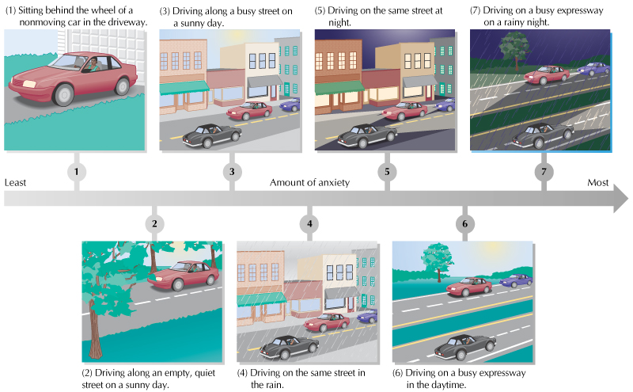

Slide 27
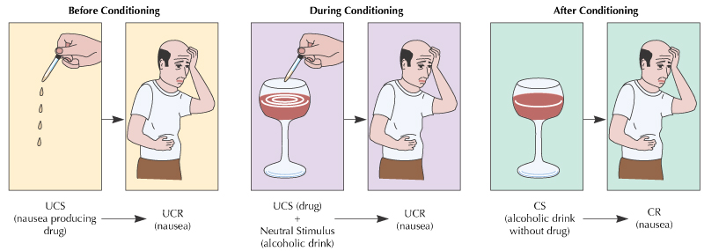
Classical Conditioning
  Aversion Therapy: pairing an aversive (unpleasant) stimulus with
  a maladaptive behavior

Slide 28
Operant Conditioning
Operant Conditioning Techniques Used to INCREASE Adaptive Behaviors:
Shaping--successive approximations of target behavior are rewarded (includes role-playing, behavior rehearsal, assertiveness training)
Tokens: symbolic rewards used to immediately reinforce desired behavior

Slide 29
Operant Conditioning
Operant Conditioning Techniques Used to DECREASE Maladaptive Behaviors:
Extinction: withdrawal of attention
Punishment: adding or taking away something (e.g., time-out)

Slide 30
Observational Learning
Modeling: watching and imitating models that demonstrate desirable behaviors
Participant Modeling: combining live modeling with direct and gradual practice

Slide 31
Evaluation of behavior therapies:
Pro: Strong evidence for success with a wide range of problems
Con: Questioned and criticized for generalizability and ethics

Slide 32
Group, Family, and Marital Therapies
Group Therapy: a number of people meet together to work toward therapeutic goals
Family and Marital Therapies: work to change maladaptive family and couple interaction patterns

Slide 33
Biological Perspectives

Slide 34
Biomedical Therapies
Biomedical Therapy: uses physiological interventions, such as drugs, to reduce or alleviate symptoms of psychological disorders
Three forms of biomedical therapy:
  Psychopharmacology
  Electroconvulsive therapy (ECT)
  Psychosurgery

Slide 35
Psychopharmacology
Four major categories of drugs:
Antianxiety (increases relaxation, reduces anxiety and muscle tension)
Antipsychotic (treats hallucinations and other symptoms of psychosis)
Mood Stabilizer (treats manic episodes and depression)
Antidepressant (treats symptoms of depression)

Slide 36
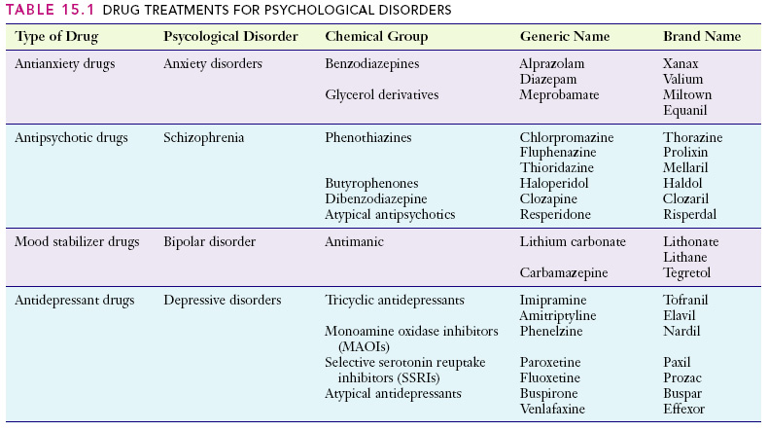

Slide 37
Biomedical Therapies (Continued)
Electroconvulsive Therapy (ECT): based on passing electrical current through the brain and used when other methods have not been successful
Psychosurgery: operative procedures on the brain designed to relieve severe mental symptoms that have not responded to other forms of treatment

