Slide 1
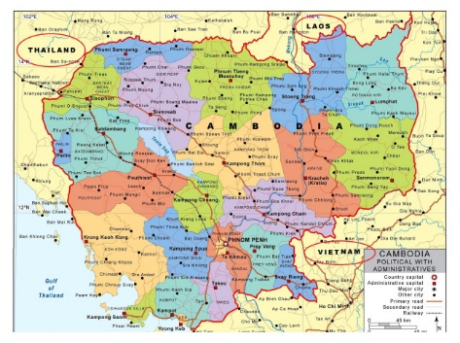
Map of Cambodia
Cambodia

Slide 2
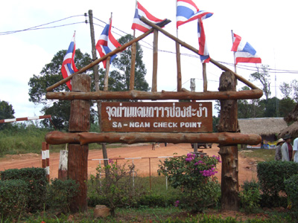
Chong Sa-ngam

Slide 3
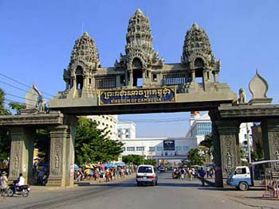
Aranyapathet

Slide 4
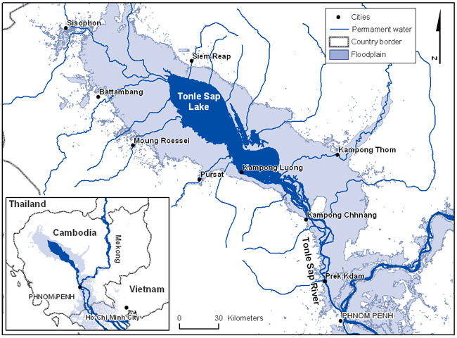
Tonle Sap Map

Slide 5
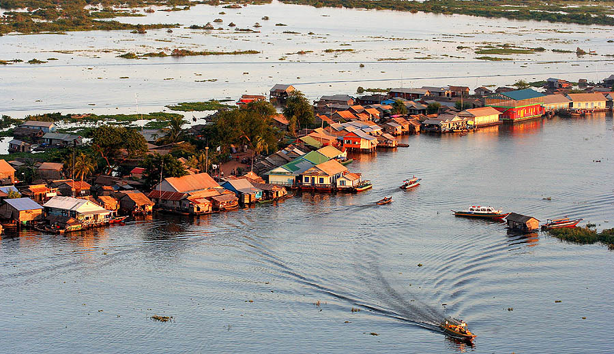
Water Dwelling: Tonle Sap, Cambodia

Slide 6
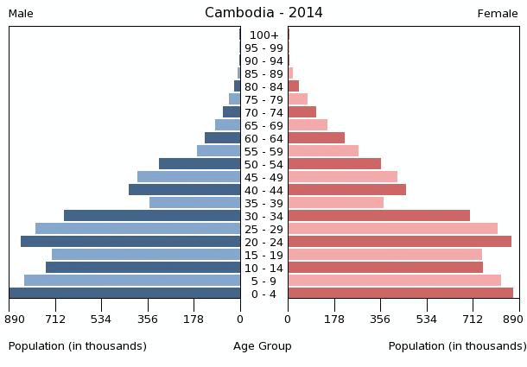
population

Slide 7
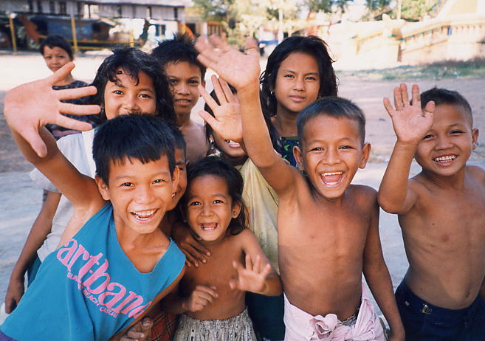
Cambodian Youth

Slide 8
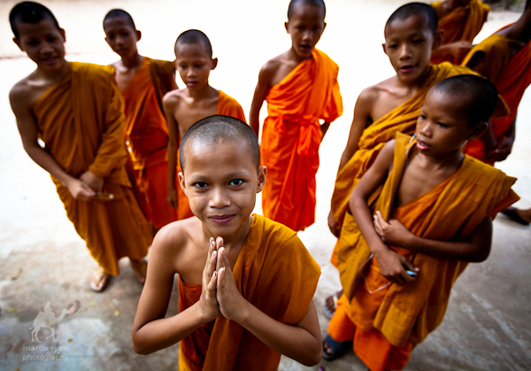
Buddhism

Slide 9
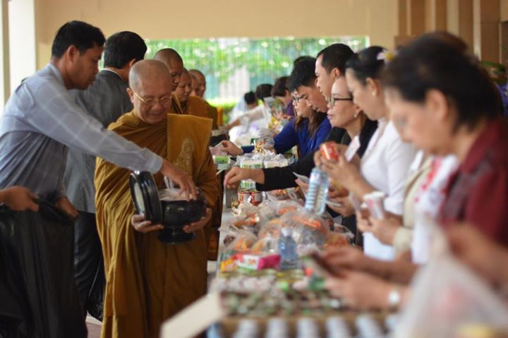
Cambodia Buddhism Dhammayuttika Samdech Bua Kri

Slide 10
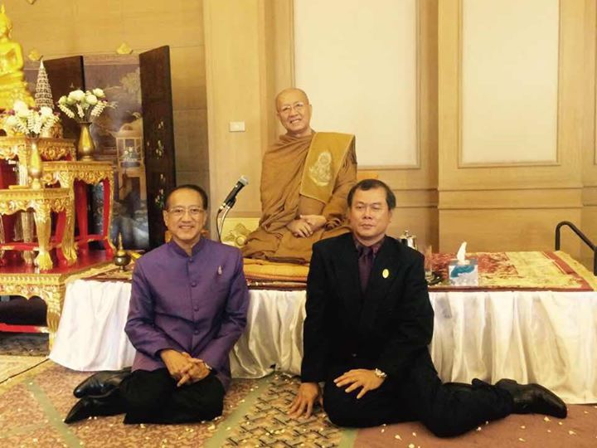
Cambodia Buddhism Dhammayuttika Samdech Bua Kri

Slide 11
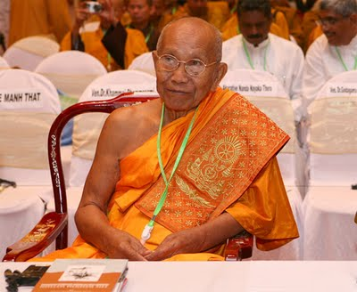
Cambodia Buddhism Mananikaya
Samdech Thep Vong

Slide 12
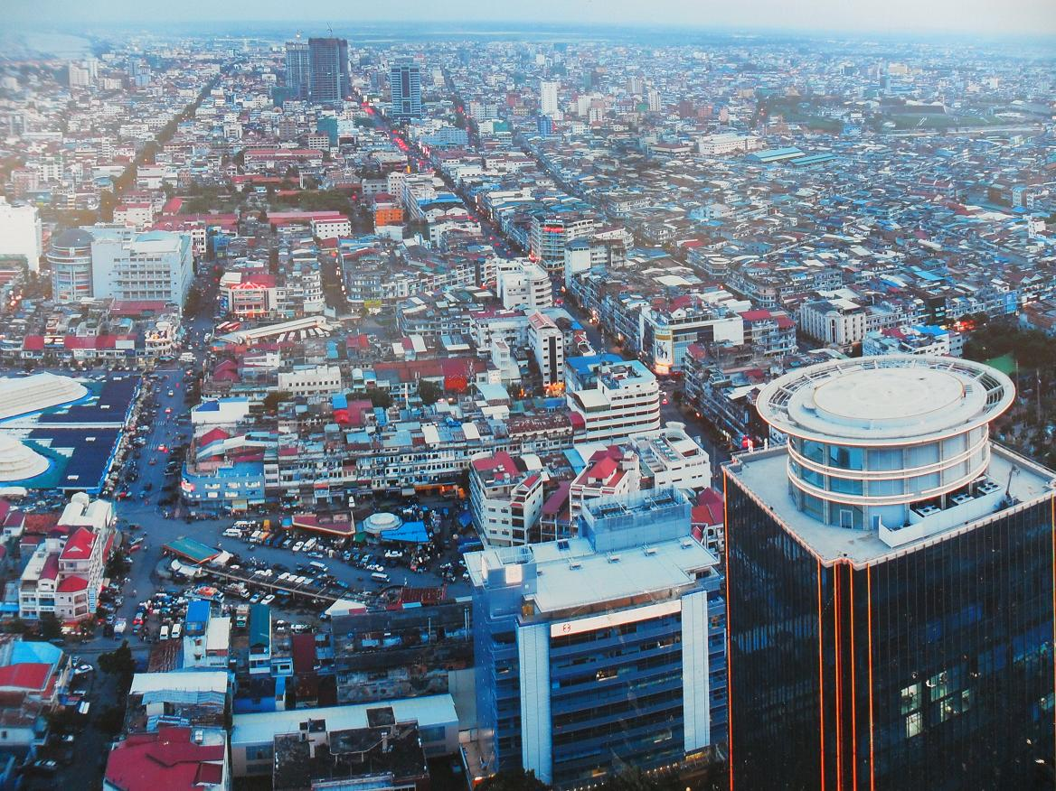
Cambodia Economy - city growth

Slide 13
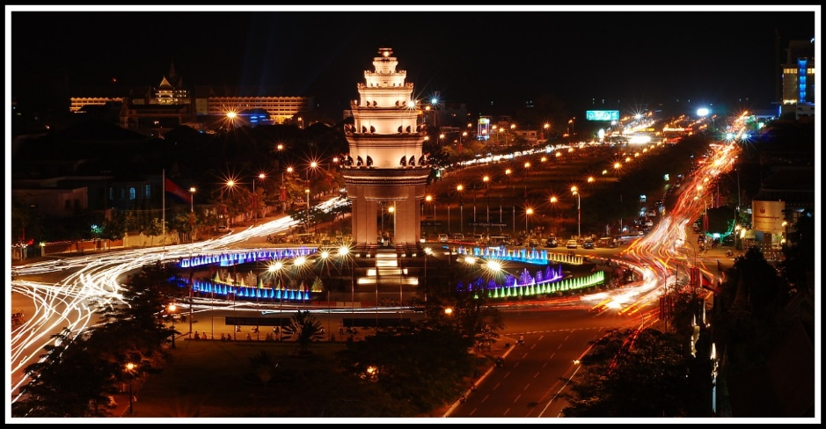
Cambodia Economy - city growth

Slide 14
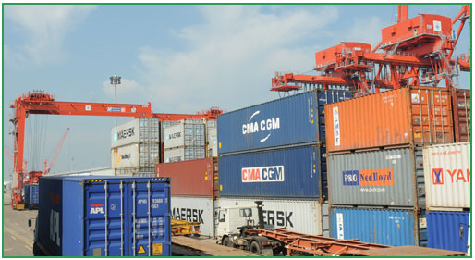
Cambodia Economy - Export Sihanoukville

Slide 15
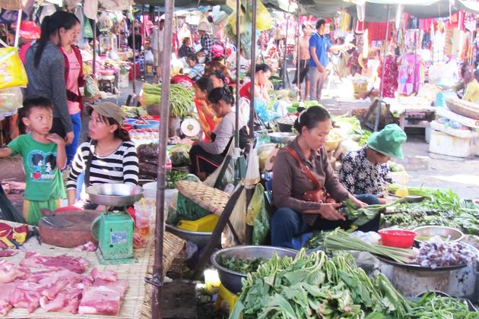
Cambodia Economy

Slide 16
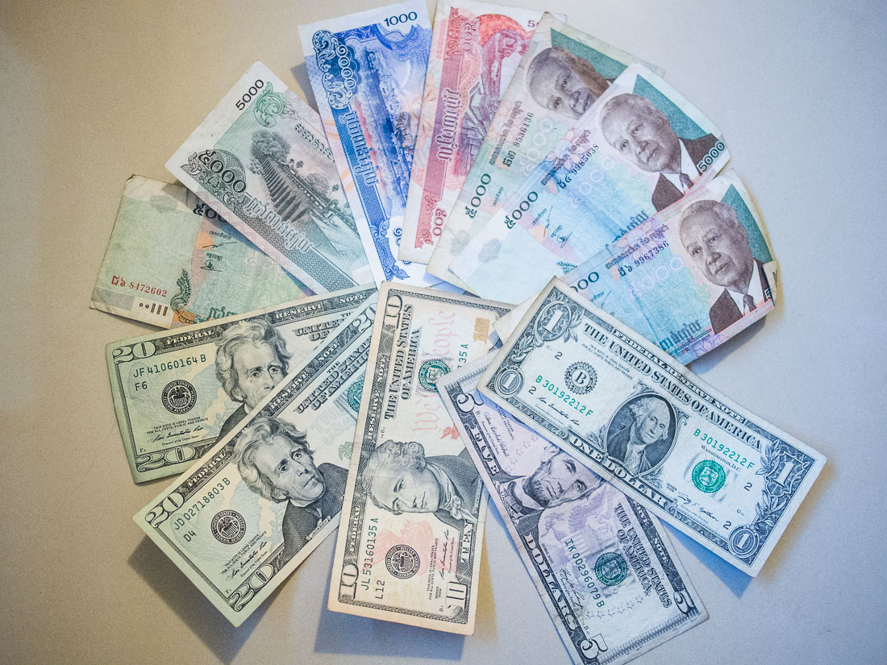
Khmer money

Slide 17
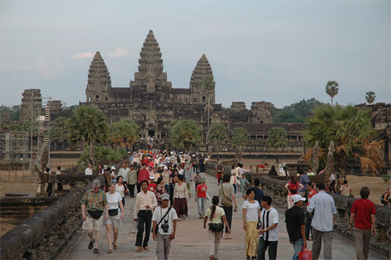
Tourism: Angkor Wat

Slide 18
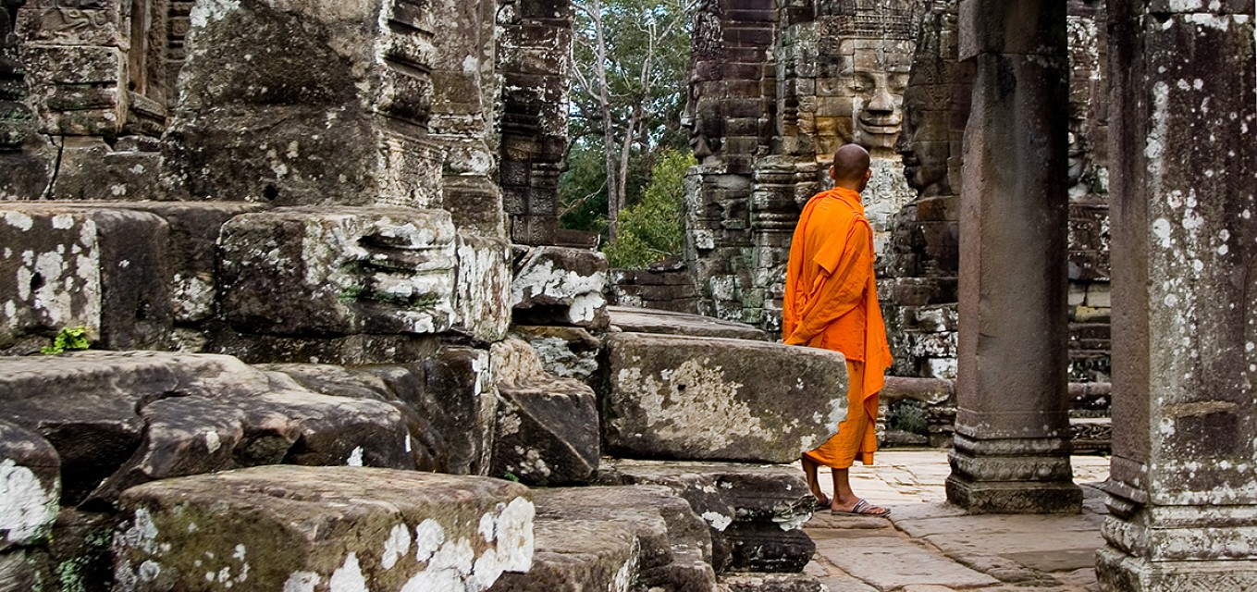
Tourism: Bayon Temple

Slide 19
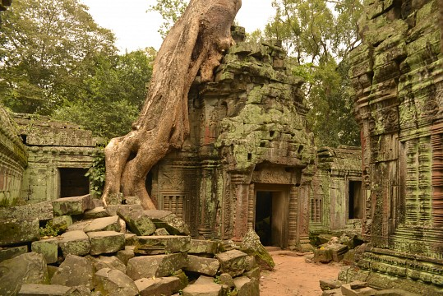
Tourism: Taprom Temple

Slide 20
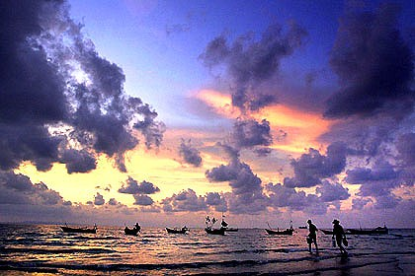
Tourism: Sihanoukville

Slide 21
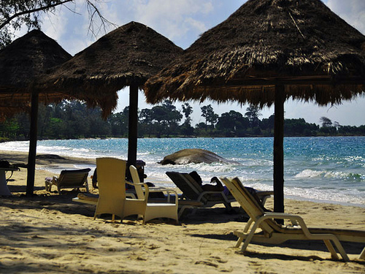
Tourism Seaside

Slide 22
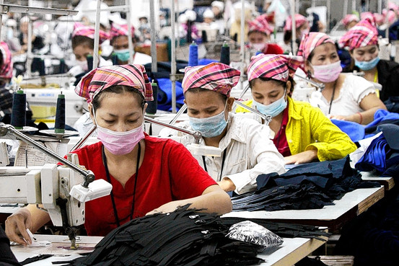
Cambodia Economy - garment factory

Slide 23
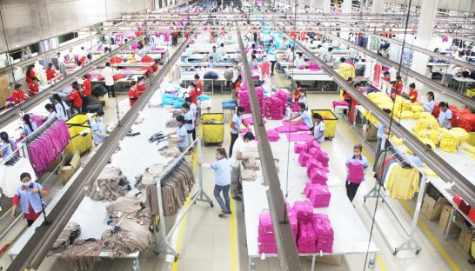
Cambodia Economy - garment factory

Slide 24
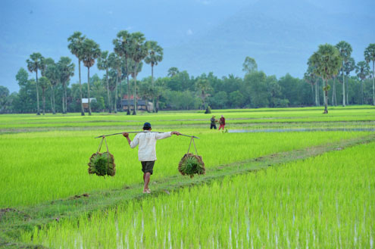
Agriculture: rice

Slide 25

Agriculture: rice export award

Slide 26
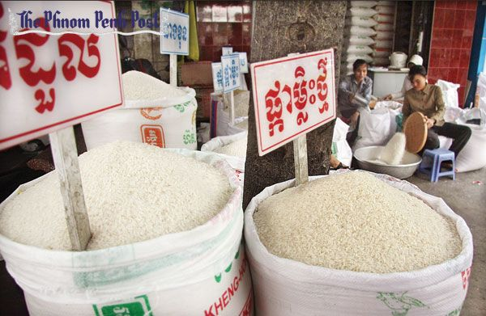
Agriculture: rice export

Slide 27
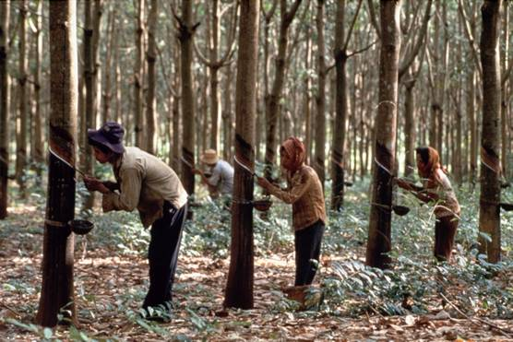
Agriculture: rubber

Slide 28
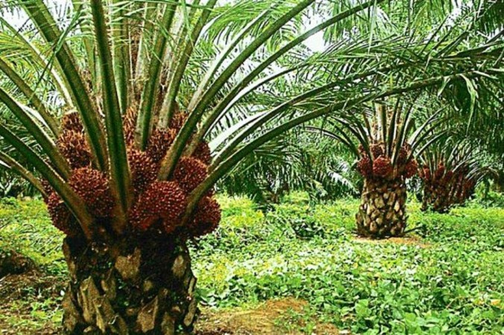
Agriculture: Palm

Slide 29
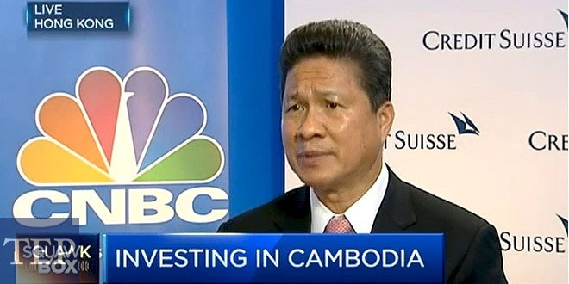
Investment in Cambodia: Sun Chanthol

Slide 30

Investment in Cambodia: CDC

Slide 31
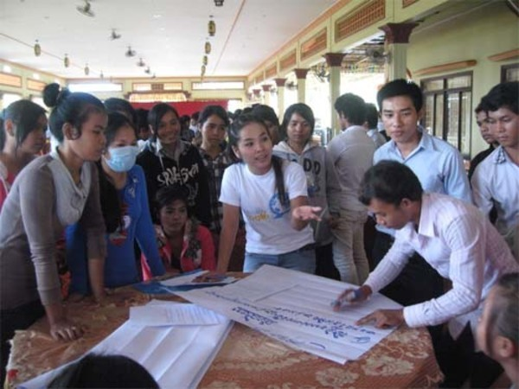
Work Force: Cambodian youth

Slide 32
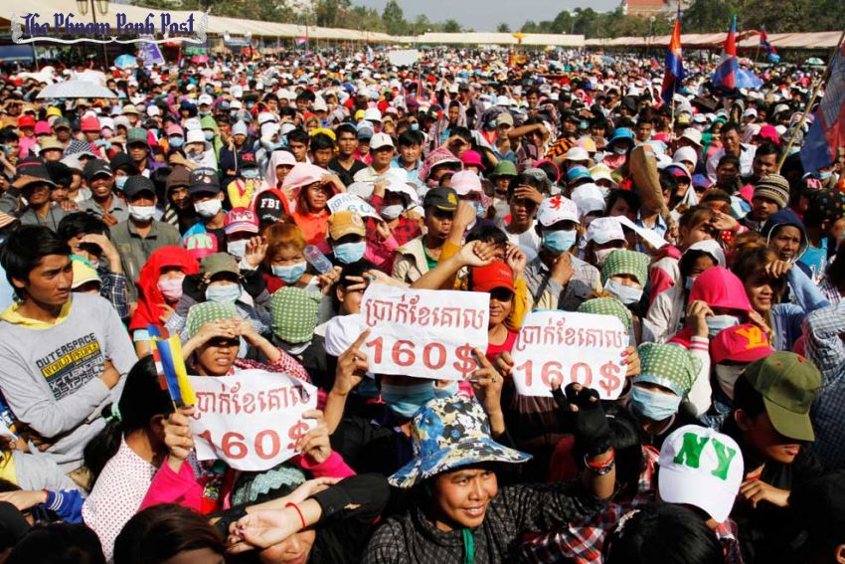
Garment worker strike

Slide 33
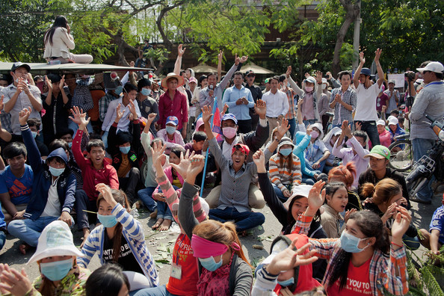
Garment worker strike

Slide 34
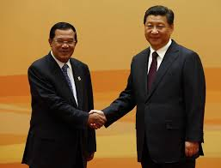
Foreign investment: Chinese PM with PMHS

Slide 35
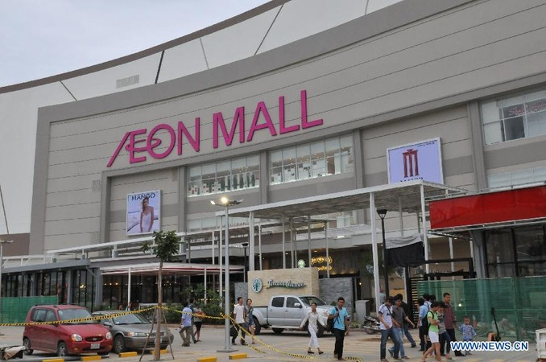
Foreign investment: Japan

Slide 36
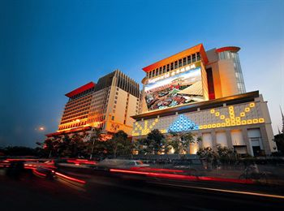
Foreign investment: Nnaga World Malaysia

Slide 37
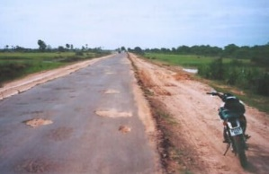
Infrastructure: Roads

Slide 38
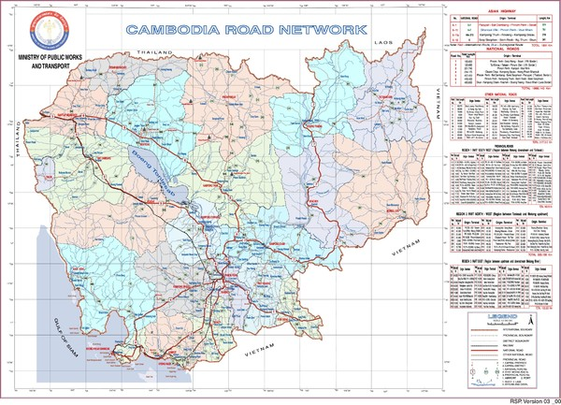
Roads Map

Slide 39
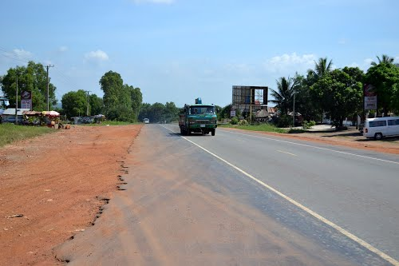
Infrastructure: Road no.4

Slide 40
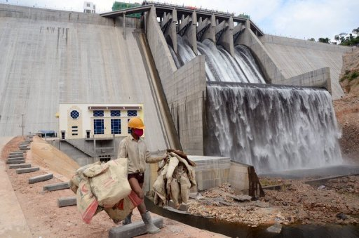
Hydro Dams

Slide 41
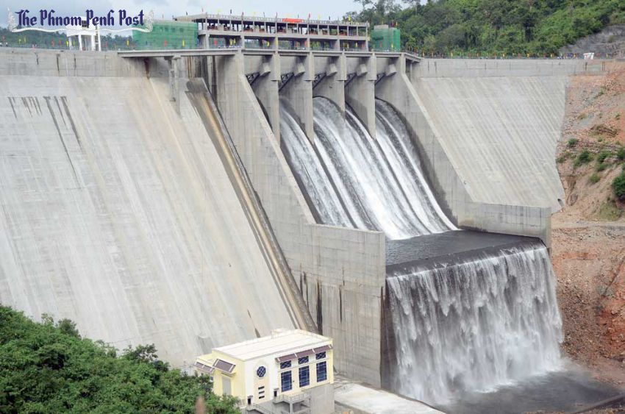
Hydro Dams

Slide 42
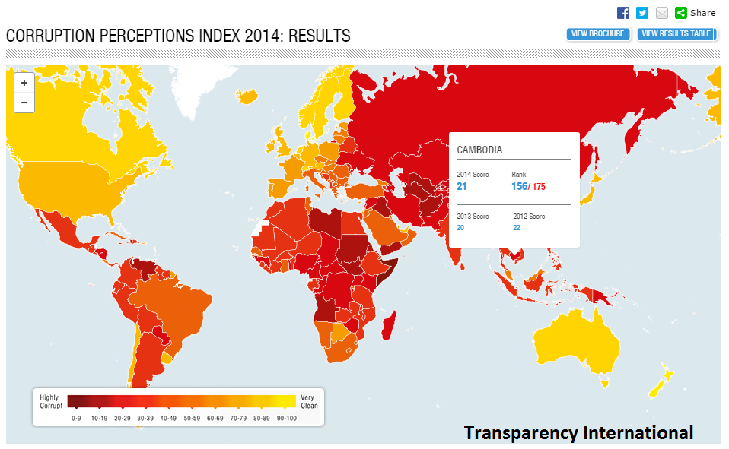
Corruption

Slide 43
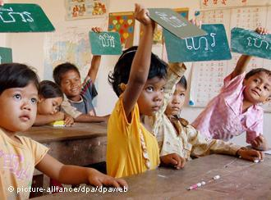
Education in Cambodia

Slide 44
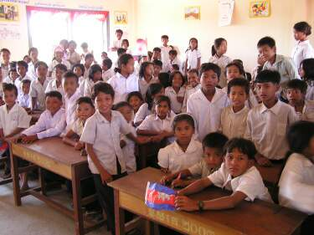
Education in Cambodia

Slide 45
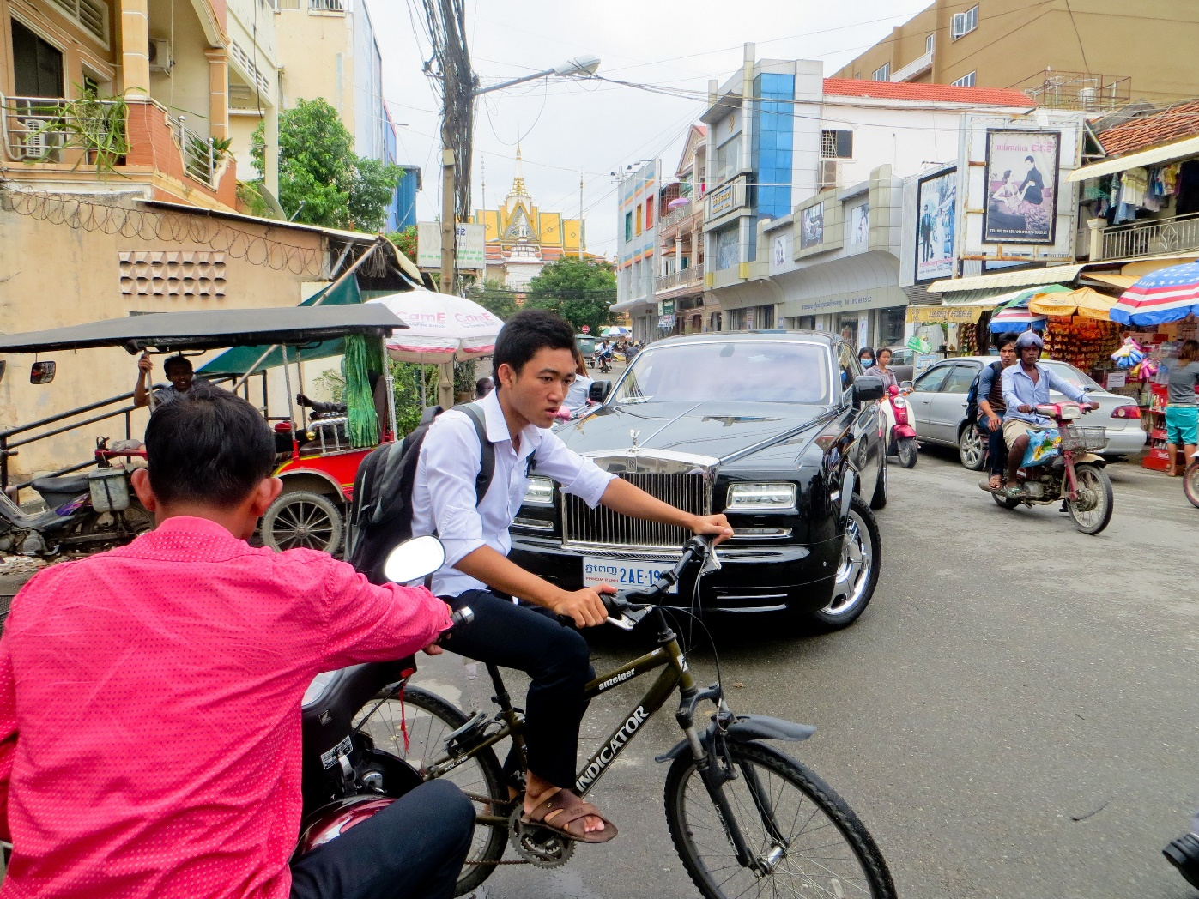
Social Inequality - Rolls Royce in PP

Slide 46
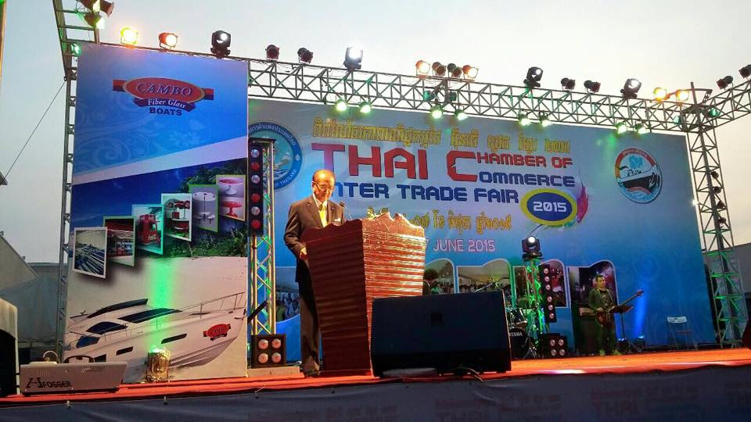
Thai Trade Fair

Slide 47
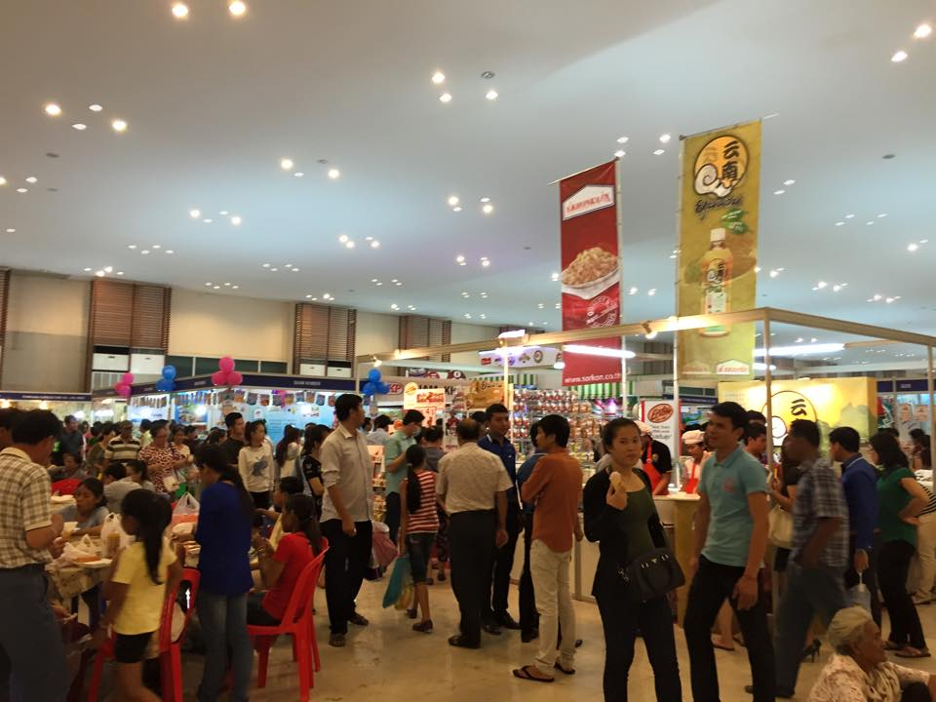
Thai Trade Fair

Slide 48

CP

Slide 49

TCC

Slide 50

TCC Charoen

Slide 51

SCG

Slide 52
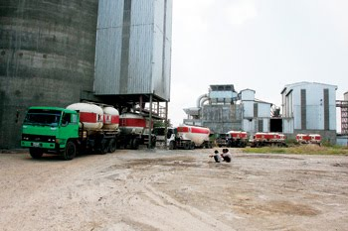
K-Cement SCG

Slide 53

Siam City Cement

Slide 54
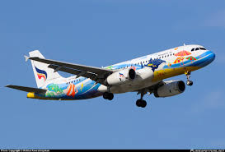
Bangkok Airways

Slide 55
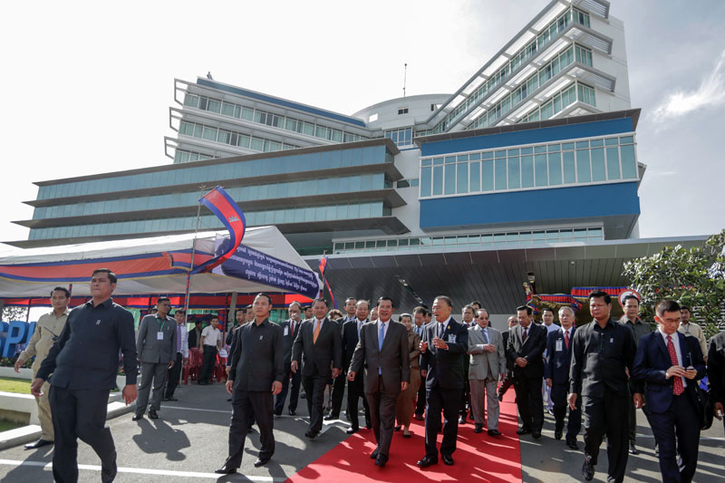
Royal Phnom Penh Hospital

Slide 56
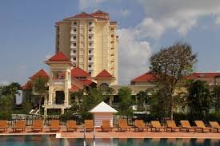
Sofitel

Slide 57

TV5 Cambodia

Slide 58
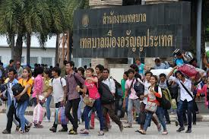
Migrant workers

Slide 59

Migrant workers

Slide 60

Migrant workers

Slide 61

Migrant worker registration in Thailand

Slide 62

Cambodia family

Slide 63

mobile phone usage

Slide 64

moblie phone usage

Slide 65

motorcycle

Slide 66

motorcycle

Slide 67

motorcycle

Slide 68

motorcycle

Slide 69

motorcycle

Slide 70

motorcycle

Slide 71

Thai drama

Slide 72

Thai drama

Slide 73

Thai drama

Slide 74

Thai drama

Slide 75

Food

Slide 76

food

Slide 77

food

Slide 78

food

Slide 79

food

