Slide 1

Industrial Policy:
Can We Go Beyond an Unproductive Confrontation?
Ha-Joon Chang
Faculty of Economics,
University of Cambridge

Slide 2

Ha Joon Chang
born in Seoul, South Korea, on 7 October, 1963
came to the UK as a graduate student at the Faculty of Economics and Politics, University of Cambridge in 1986
Earned PhD in 1992
have been teaching economics at the Faculty of Economics (as it is called now) and the Development Studies programme at the University of Cambridge since 1990

Slide 3
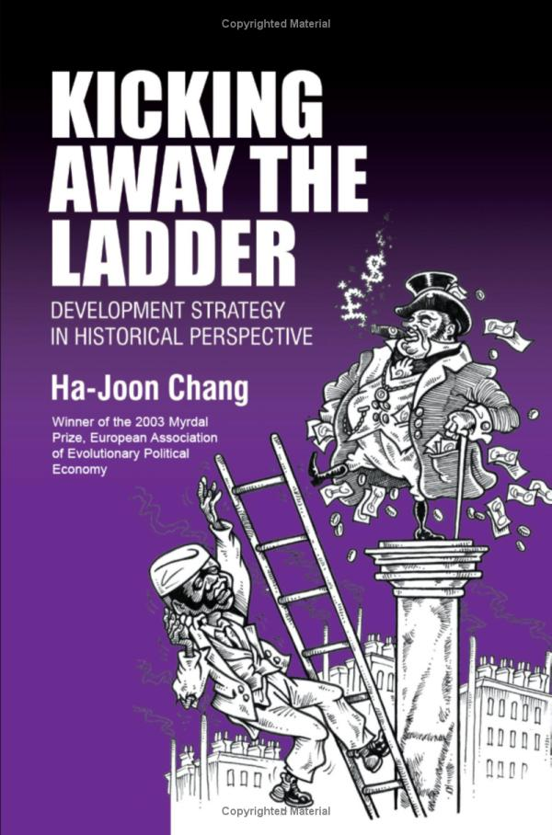
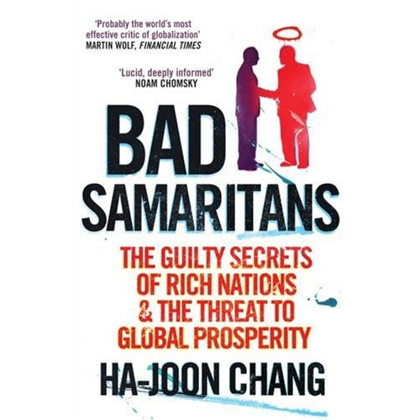
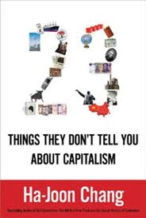
Kicking away the ladder- picture
Examples of his books

Slide 4
Main Ideas
Explores both sides of the industrial policy debate, revealing its successes and failures
Examines many of the key issues in the debate, including
    (1) whether targeting particular industries is a desirable industrial policy
    (2) whether the state can ever beat the market
    (3) implementation issues
    (4) performance indicators, emphasizing the importance of exports
    (5) the need to combine free trade, export promotion, and infant industry protection
Discusses the evolution and current changes in global rules of trade and investment.

Slide 5
The Industrial Policy Debate:
Conceptual Issues and Neglected Facts
Industrial policy,” the majority of us do not mean any policy that affects industry, but a particular type of policy that affects industries
Selective industrial policy or targeting— a policy that deliberately favors particular industries over others, against market signals, usually to enhance efficiency and promote productivity growth

Slide 6
The Industrial Policy Debate:
Conceptual Issues and Neglected Facts
The modern debate on industrial policy started in the late 1970s, with the rise of Japan. Japan was the first country used the term “industrial policy” (sangyo seisaku) to mean selective industrial policy
By the late 1980s, it came to be widely accepted that strong industrial policy was also practiced in Korea; Taiwan, China; and (in a very different way) Singapore; which had until then been thought to be free trade, free market economies
In the early days of the debate on industrial policy in East Asia, some denied its very existence

Slide 7

East Asian Industrial Policy I
coordination of complementary investments (Big Push)
coordination of competing investments through entry regulation, “investment cartels”, and (in declining industries) negotiated capacity cuts
policies to ensure scale economies (e.g., licensing conditional upon production scale, emphasis on the infant industries starting to export from early on, state-mediated mergers and acquisitions)
regulation on technology imports (e.g., screening for overly obsolete technologies, cap on technology licensing royalties)

Slide 8
East Asian Industrial Policy II
regulation on foreign direct investment (e.g., entry and ownership restrictions, performance requirements on local contents technology transfer, export)
mandatory worker training (for firms above a certain size)
the state acting as a venture capitalist
export promotion (e.g., export subsidies, export loan guarantees, marketing help from the state trading agency)
government rationing of foreign exchanges, with top priority going to capital goods imports (especially for export industries)

Slide 9
East Asian Industrial Policy III
The widespread use of industrial policy in East Asia does not mean that it was the cause of the ‘miracle’
It is possible that these countries could have grown even faster, had they not used industrial policy
– It may be that industrial policy is bad for growth but that there were country-specific “countervailing forces” that cancelled out the harmful effects of market-distorting industrial policy
• However, the counterfactual is implausible (there are counteractuals and there are counterfactuals)
– No country has ever grown at higher rate than what the East Asian countries managed during the ‘miracle’ years, industrial policy or not
No convincing ‘countervailing forces’ story (culture, Japanese colonialism, Cold War politics, etc.)

Slide 10
Industrial Policy beyond East Asia I
Successful industrial policy experiences in the late 20th century are not confined to East Asia
– national industrial policies in France, Finland, Norway, and Austria
– regional industrial policies in Italy and Germany;
– industrial policy under another name in the US through government R&D funding
• between the 1950s and the 1980s, the US federal government financed anywhere between 47% and 65% of national R&D spending, as against around 20% in Japan and Korea and around 30% in Europe)

Slide 11
Industrial Policy beyond East Asia II
In the 19th and the early 20th centuries, all of today’s rich countries, except for the Netherlands pre-WWI Switzerland, practised protectionism and other forms of industrial policy (subsidies, state ownership, regulation on FDI)
– Interestingly, Britain and the US – the supposed homes of free trade – had the world’s highest levels of tariff protection during their respective catch-up periods

Slide 12
Table 1. Average Tariff Rates on Manufactured Products for Selected Developed Countries in Their Early Stages of Development
(weighted average; in percentages of value)¹
 | 1820² | 1875² | 1913 | 1925 | 1931 | 1950
Austria³ | R | 15-20 | 18 | 16 | 24 | 18
Belgium⁴ | 6-8 | 9-10 | 9 | 15 | 14 | 11
Canada⁵ | 5 | 15 | n.a. | 23 | 28 | 17
Denmark | 25-35 | 15-20 | 14 | 10 | n.a. | 3
France | R | 12-15 | 20 | 21 | 30 | 18
Germany⁶ | 8-12 | 4-6 | 13 | 20 | 21 | 26
Italy | n.a. | 8-10 | 18 | 22 | 46 | 25
Japan⁷ | R | 5 | 30 | n.a. | n.a. | n.a.
Netherlands⁴ | 6-8 | 3-5 | 4 | 6 | n.a. | 11
Russia | R | 15-20 | 84 | R | R | R
Spain | R | 15-20 | 41 | 41 | 63 | n.a.
Sweden | R | 3-5 | 20 | 16 | 21 | 9
Switzerland | 8-12 | 4-6 | 9 | 14 | 19 | n.a.
United Kingdom | 45-55 | 0 | 0 | 5 | n.a. | 23
United States | 35-45 | 40-50 | 44 | 37 | 48 | 14

Slide 13
Industrial Policy beyond East Asia III
Developing countries had best growth performance when they used industrial policy more extensively
– They grew much faster during the ‘bad old days’ of import substitution in the 1960s and the 1970s than during the ‘age of imperialism’ or during the more recent neo-liberal period, when they used less or no industrial policy
Annual per capita GDP growth rates | ‘Bad Old Days’ 1960-80 (%) | ‘Brave New World’ 1980-2009 (%)
All Developing Countries | 3.0 | 2.6
Latin America & Caribbean | 3.1 | 1.1
Sub-Saharan Africa | 1.6 | 0.2

Slide 14
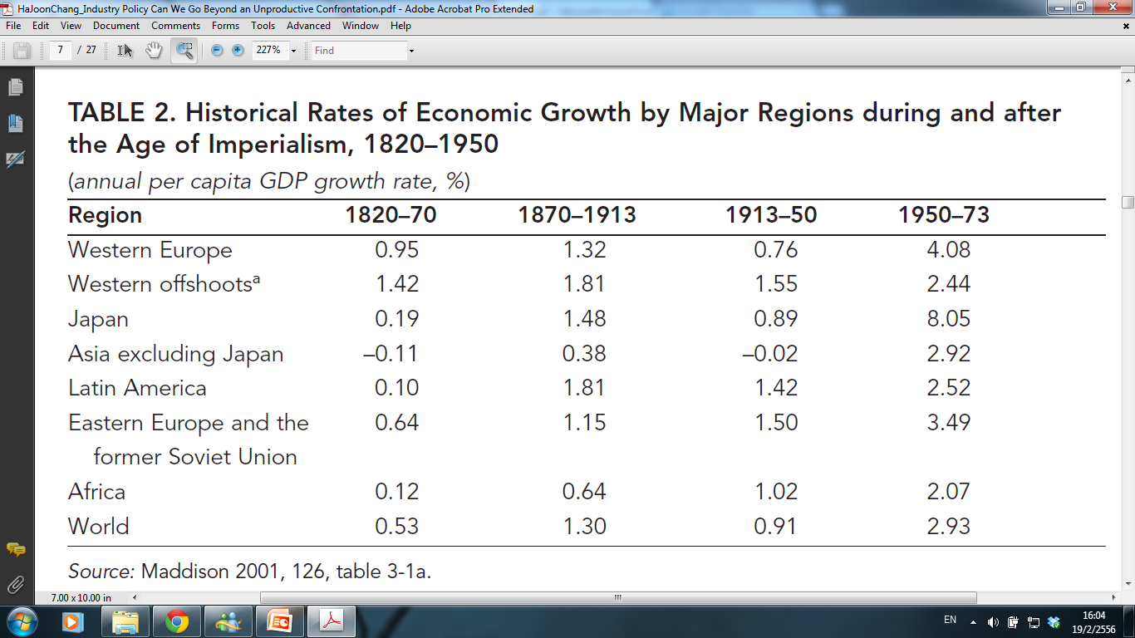

Slide 15
Industrial Policy beyond East Asia IV
If industrial policy was not confined to East Asia in the late-20th century, it becomes even more difficult to downplay its role in East Asia by resorting to some region- and time-specific “countervailing forces”
Given the history of today’s rich countries, a good industrial policy may be a necessary, although not sufficient, condition for economic development
If industrial policy is so bad, how is it that in every era, the fastest growing economies happen to be those with a strong industrial policy – Britain during the mid-18th century and mid-19th century, the US, Germany, and Sweden during the late 19th and the early 20th century, East Asia, France, Finland, Norway, and Austria in the late 20th century, and China today

Slide 16
Lessons from the Debate - Overview
Does targeting work? (‘picking winners’)
Can the state “beat the market”?
Political economy questions
Bureaucratic capabilities problem
Performance measurement
The role of export
Changing global environment
Further issues (productive capability-building, adjustment costs) – not discussed in this paper, but see the references in the paper

Slide 17
Targeting
In a world with scarce resources, targeting is inevitable.
In such a world, every policy choice you make, however “general” it may look, has discriminatory effects that amount to targeting
– no such thing as R&D subsidies that supports all industries equally or “general” engineers or infrastructure that benefit every industry
Moreover, it is not true that less targeted policies are necessarily better (cf. social policy)
The debate should not be on whether we should target, but how to target well

Slide 18
Can State “Beat the Market”?
The state has frequently beaten the market.
– e.g., Japanese auto industry, Korea’s POSCO, Brazil’s EMBRAER
More importantly, many (although not all) of the “superior” decisions made by the state were made not because the government officials were omniscient or cleverer than businessmen but because they could look at things from a systemic and long-term, rather than sectional and short-term, point of view.
Therefore, instead of debating whether the state can beat the market, we should be debating how to improve the quality of state decisions.

Slide 19

Political Economy Questions I
Successful industrial policy requires right “political” conditions
  – the commitment of the leadership to economic development, the coherence of the state machinery, and the ability of the state to discipline the recipients of its supports
When considering the political realities of developing countries, it seems difficult to imagine how industrial policy, even if it were “correct”, can be implemented well in a developing country
But we should not let the best be the enemy of the good
In the real world, successful countries are the ones that have managed to find “good enough” solutions to their political economy problems and went on to implement policies, rather than sitting around bemoaning the imperfect nature of their political system

Slide 20
Political Economy Questions II
In order to take the debate forward, we have to improve our understanding of issues like:
  (i) how effective political visions can be formed and deployed to inspire various individuals and groups to act in a concerted manner
  (ii) how to build nations and communities out of groups that may have very long history of hostility and mistrust
  (iii) how to work out social pacts and build lasting collations behind them
  (iv) how to partially accept but improve the customs and organisational routines in the bureaucracy
  (v) how to minimise socially harmful lobbying and bribing while maximising the flows of information between the states and the private sector

Slide 21
Bureaucratic Capabilities I
No basis for the assumption that industrial policy is more difficult than other policies
Industrial policy does not require sophisticated knowledge of economics, as often believed
  – The industrial policy-makers of East Asia were not economists (lawyers in Japan and Korea, engineers in Taiwan and China today), and what little economics they knew was usually the “wrong” kind – Marx, the German Historical School, Schumpeter
• High-quality bureaucracies are not as impossible to build as people think
  – France, Korea and Taiwan in the post-WWII period

Slide 22
Bureaucratic Capabilities II
There is also “learning-by-doing” in policy
  – Without trying out “difficult” policies, capabilities cannot be improved
The fact that something is “difficult” cannot be a reason not to recommend it
  – After all, developing countries are routinely told to adopt “best practice” or “global standard” institutions used by the richest countries, when many of them clearly do not have the capabilities to effectively run such institutions

Slide 23

Performance Measurement
Performance targets clearly specified and the reporting requirements announced at the outset
The targets should be set in consultation with the business community
Targets need to be revised along the way, but too much flexibility should be avoided, as government flexibility can be abused by lobbying groups
Where possible, export performance should be given a high status as a performance measure, as they are far less open to manipulation
Policy-makers need to pay more attention to the trends in performance indicators, rather than their absolute levels at any give point of time

Slide 24
Export-related Policies I
Economic development is impossible without good export performance
But, saying that export is the key to economic development is not to say that developing countries should have free trade
Export success requires significant industrial policy even for comparative advantage-conforming industries, as export markets have high fixed costs of entry, which smaller firms and farmers may not be able to bear

Slide 25
Export-related Policies II
Direct export subsidies (but banned by the WTO, except for the LDCs)
State marketing help (JETRO, KOTRA, the Danish agricultural marketing boards in the early 20th Century
Risk-sharing through loan guarantees for exporters and insurance for payment defaults
Help with meeting quality standards through export product quality control, advice on sanitary and phythosanitary requirements, subsidised extension services
Indirect help through legal and financial supports for co-operative arrangements

Slide 26
Changing Global Environment I
Changes in global business environment
  – Increasing importance of FDI
  – Increasing industrial concentration
Changes in global rules of trade and investment
  – WTO
  – Bilateral trade and investment agreements

Slide 27
Changing Global Environment II
Importance of FDI has increased, but not as dramatically as is often claimed.
Industrial policy (e.g., performance requirements) not as important for FDI decision as market factors (size, growth), infrastructure, quality of labour
Business concentration has increased, but it goes up and down.
“Chopping up” of value chains can open new opportunities.

Slide 28
Changing Global Environment III
WTO rules not as restrictive as believed.
  – Tariffs allowed
  – Emergency tariffs (sectoral surge, overall BOP problems)
  – Subsidies for environment, agriculture, R&D, regional policies, and (for LDCs) export allowed de jure or de facto
  – TRIPS constraining but not for older technologies
  – TRIMS constraining but performance requirements for local labour, technology transfer, R&D, etc. allowed
Bigger constraints are aid/loan conditionalities and bilateral/regional trade/investment agreements
All these rules are ‘man-made’ and can be changed if deemed necessary

Slide 29
“Futile Debates”?
Too much focus on “grand” things, like the Big Push, when much of real-life policy has been about “boring” things (e.g., getting the production scale right, export marketing)
Some theoretical issues that both the proponents and the opponents consider to be critical actually dissolve into thin air, once looked at closely (e.g., targeting)
Many proponents of industrial policy do not fully appreciate how critical export is for the success of industrial policy, while many opponents do not fully appreciate how export success also requires industrial policy
We often let sensible worries (e.g., political economy, bureaucratic capabilities) degenerate into a recommendation for inaction, letting the best become the enemy of the good
Real life success stories were often based on “good enough” compromises, rather than perfect solutions

Slide 30
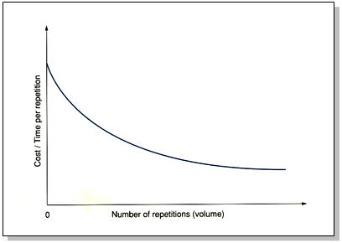
Learning Curves Effect

Slide 31
Infant Industry
price
S_{D}
S_{D}*
B
P_{O}
S_{F}*
A
C
F
P_{W}
S_{F}
E
Q
0
X_{P}
X_{Q}
X_{D}

Slide 32
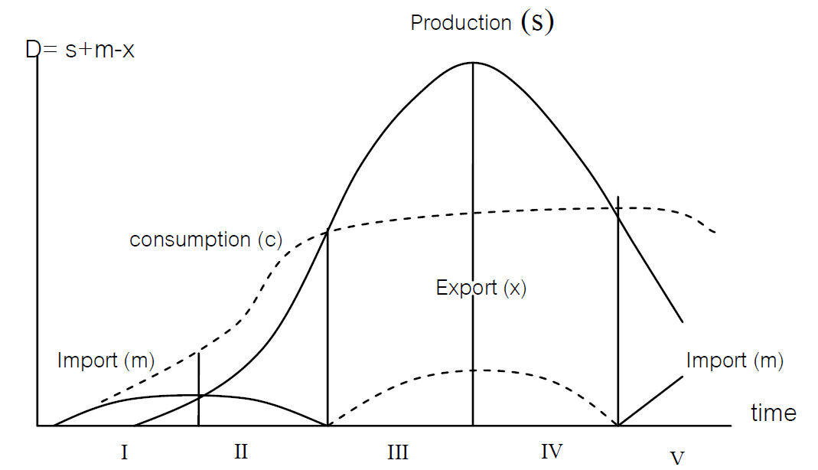

Slide 33
Process of Economic Policy Formulation
Super - Structure
Supply
- Power Elites
- Economic
Advisors
- Technocrats
- Political
Parties
- Parliament
Demand
- Interest Group
- People
- Mass Media
- Economists
- NGOs and Social
Movements
Economic Policy Market
World Capitalism

Slide 34
Industrial Policy:
Can We Go Beyond an Unproductive Confrontation?
Ha-Joon Chang
Faculty of Economics,
University of Cambridge

