Slide 1
Urban development in CLMV
EE463 Globalization and international development
Faculty of economics
Thammasat university

Slide 2
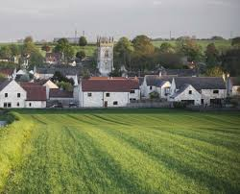
The Rural transition in clmv
Although CLMV countries are agriculture-based and most of the population live in rural areas, there is a gradual shift from farm work to non-farm activities
Labor productivity is relatively low
Rural residents are engaged in farm and more often, in non-farm activities. The rapid rural diversification and agriculture transformation has implications on urban development and urban-rural linkages

Slide 3
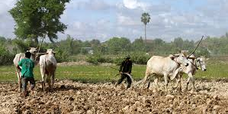
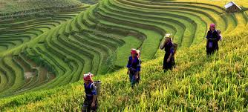
The Rural transition in clmv
With increasing urbanization, CLMV is making the transition from land abundance to land scarcity. This stems from ongoing developments:
Where land is abundant, the soil is of poor quality and difficult to develop; and therefore unutilized; much of fertile land area has been utilized
Improved transportation has increased mobility of people and access to once remote areas

Slide 4
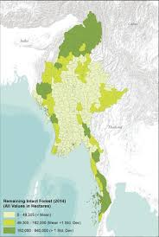
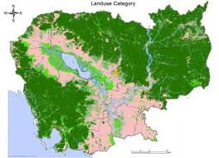
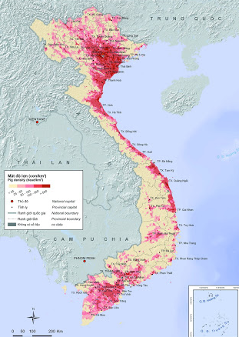
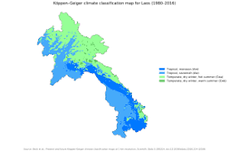
Arable land in Cambodia, Lao PDR, Myanmar and Viet Nam

Slide 5
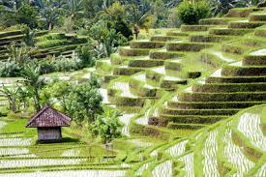
The Rural transition in clmv
Social change, particularly among the young population is occurring because of advancements in communication and more widespread education; thereby raising expectations
Farming is no longer attractive for many rural residents; opportunities for non-farm work has become an alternative to farming

Slide 6
Types of non-farm work
Household type | Occupation | Skills and capital | Entry | Strategy
Landless farmers | Petty trading Basket weaving Garbage picking Construction | Unskilled, little or no capital required | Relatively easy entry | Survival
Middle income households | Transport services Food stall operator Factory work Construction | Some skills required, little or no capital required | Contracts required | Consolidation and some accumulation
Rich households | Large scale trade Taxi/bus ownership |  | Skills, entrepreneurship and considerable capital required | Accumulation

Slide 7
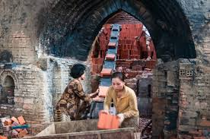
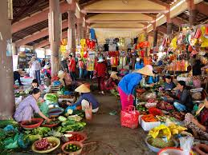
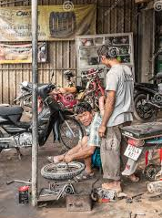
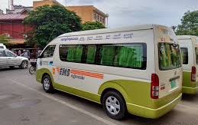
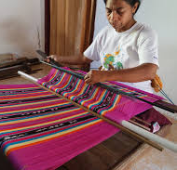
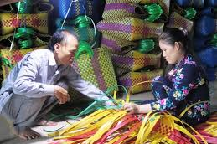

Slide 8
Characteristics of urbanization in clmv
Urbanization parallels economic growth in CLMV
Economic development | Urban development
1980s period of economic and political reforms; shift from state-led to market based approach | - increased diversification of rural employment; more non-farm activities
1990s opening up of economies to outside world gradual inflow of foreign aid improvements in road transportation | more job opportunities in urban areas Increased mobility and rural-urban migration
2000s Further sector reforms, development of special economic zones, increased foreign direct investment, easement of cross-border movements, rise in tourism | Increased urban-rural linkages Improved urban infrastructure and services Increased congestion, environmental pollution

Slide 9
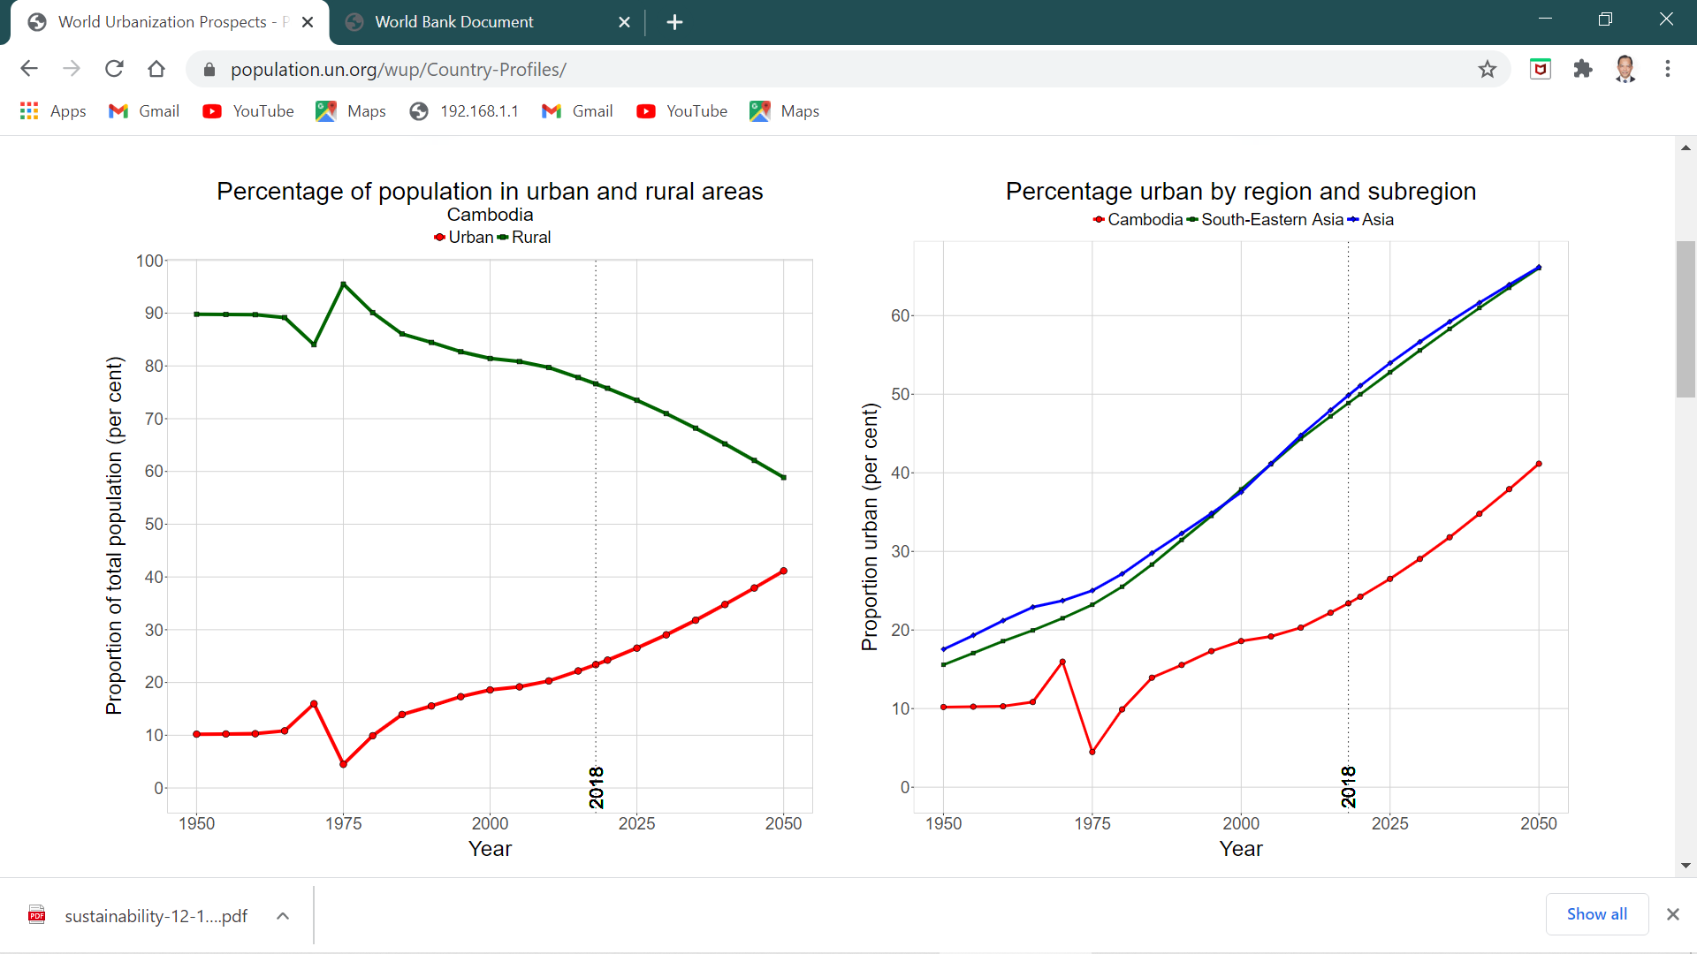
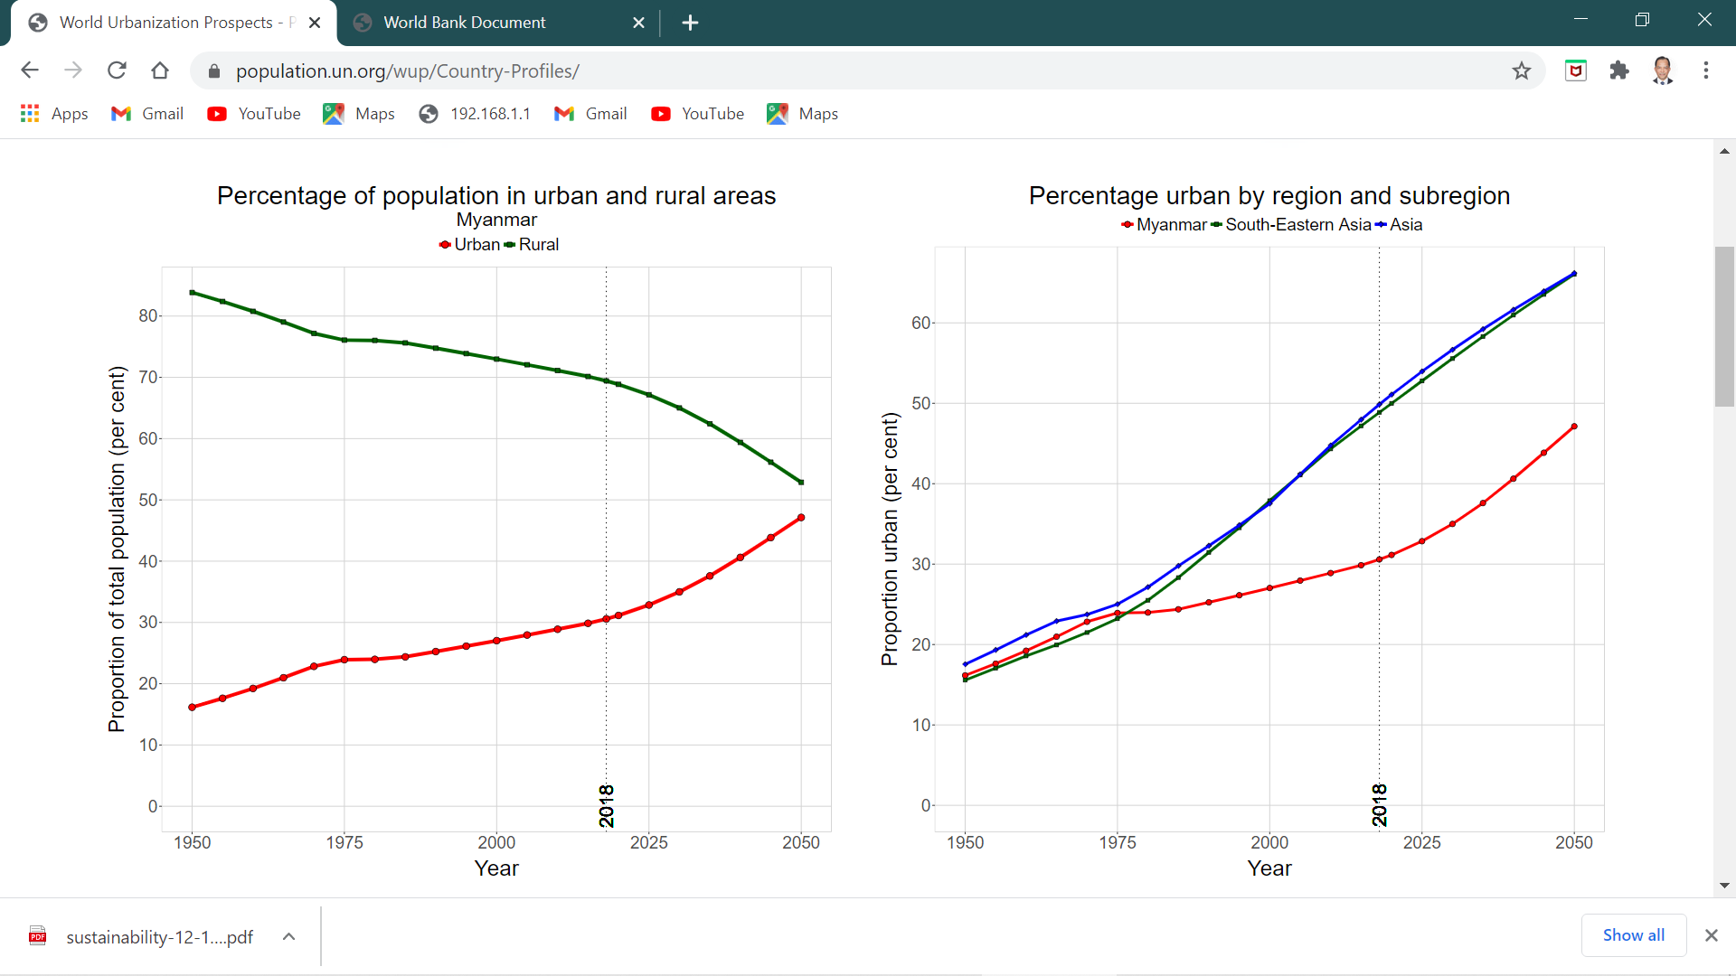
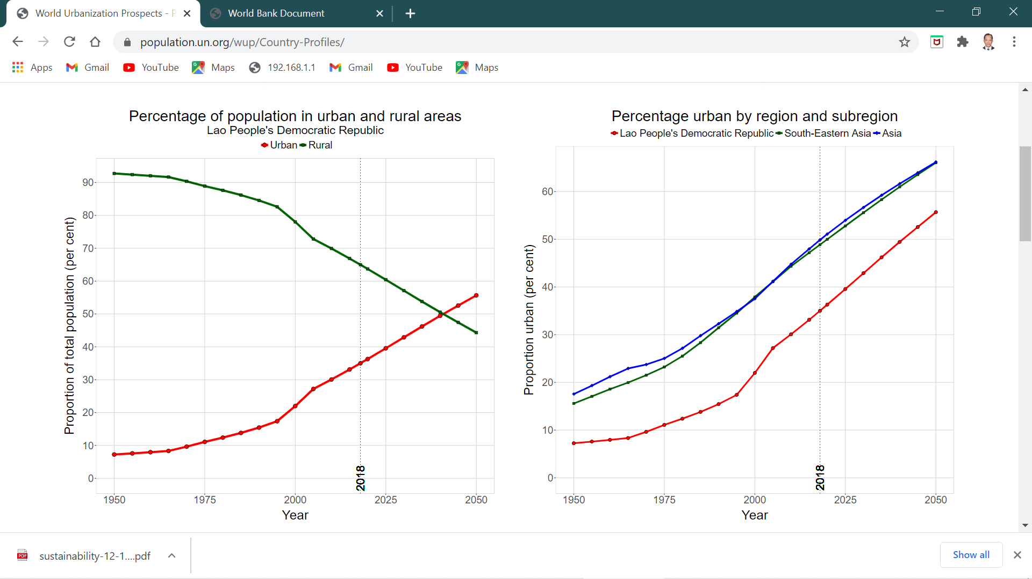
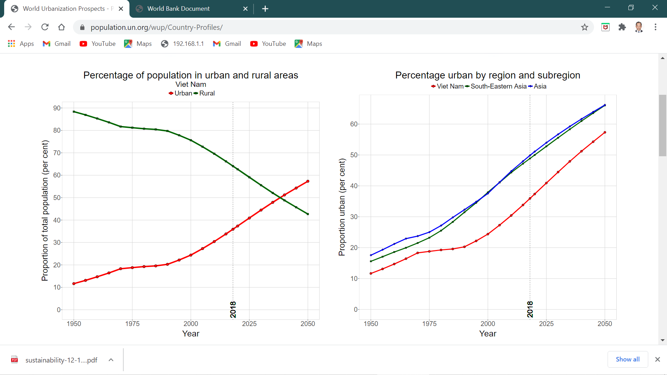
URBAN GROWTH IN CLMV 2018
Country | % urban | % rural
Cambodia | 22% | 78%
Lao PDR | 35% | 65%
Myanmar | 30% | 70%
Viet Nam | 35% | 65%
Camboda
Myanmar
Lao PDR
Viet Nam

Slide 10
DIAGRAM OF URBAN-RURAL LINKAGES
creation of non-farm employment
5
increased/diversified production
3
agricultural production/output
1
Urban
market, capital
Rural
land, labor
2
agricultural inputs
4
increased investment
6
technology transfer and innovation
Based on Douglass (1998) and Satterthwaite and Tacoli (2003)

Slide 11
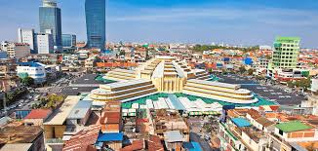
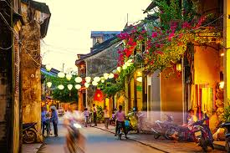
Patterns of urbanization in clmv
Continued dominance of primary cities. The largest cities in CLMV will continue to grow as these are the centers of finance, business and administration. With more migration and the need to expand, cities will annex more land in the outlying districts. Problems of infrastructure and urban services will increase
Development of small and medium towns as potential engines of growthas markets for agricultural goods to their surrounding areas, employment and links between rural and regional markets

Slide 12
Patterns of urbanization in clmv
Increased urban-rural linkages. As agriculture will still paly a major role in the economy of CLMV countries, urban-rural links will intensify well in the future.
Emerging urban growth centers. Several types of towns are expected to grow quickly while others will decline. Among towns that have the potential to grow quickly are border towns, towns along economic corridors, tourist towns and towns that serve as logistics centers and special economic zones

Slide 13
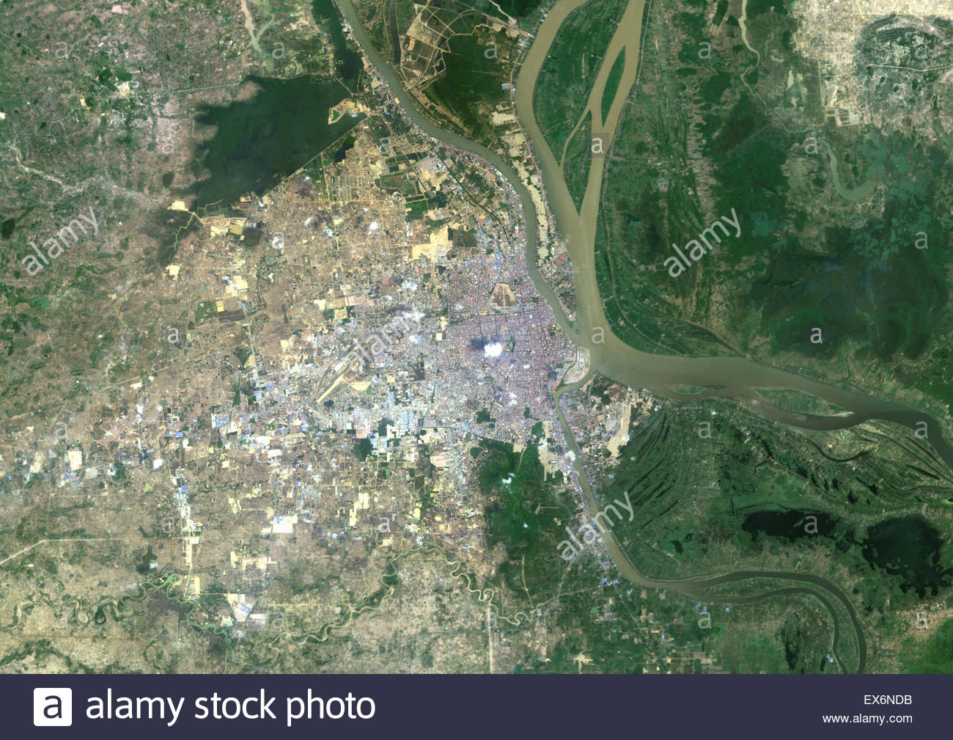
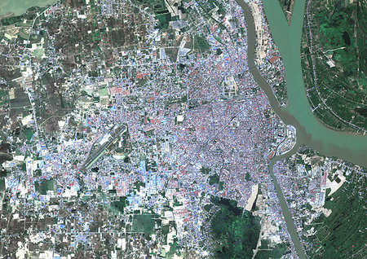
Built-UP area of Phnom Penh, 2001-2015
2001
2015

Slide 14
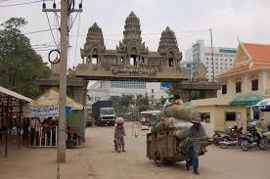
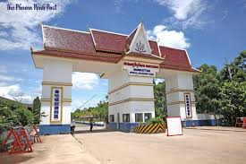
Emerging urban growth centers
Border towns
Increased inter regional trade and improvements in transportation have created opportunities for the development of border towns. Examples:
Savannakhet-Mukdahan,
Lao Bao-Dansavanh (Laos-Viet Nam)
Mae Sot-Myawaddy (Thailand-Myanmar)
Poipet-Aranyaprathet (Cambodia-Thailand)
Bavet-Moc Bai (Cambodia-Viet Nam)
Lao Cai-Hekou (Viet Nam-China)

Slide 15
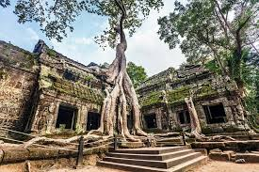
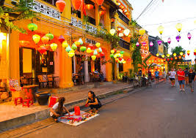
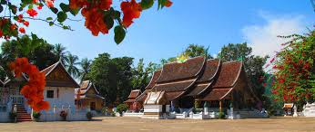
Emerging urban growth centers
Tourism-based towns
With improved connectivity and transportation, ease of access, relative security and more disposable incomes, intra-regional tourism has transformed various historical and cultural sites into tourist areas. These include:
Siem Reap and Sihanoukville (Cambodia)
Hoi An, Hue, Nha Trang (Viet Nam)
Luang Prabang and Pakse (Lao PDR)
Mandalay and Bagan (Myanmar)

Slide 16

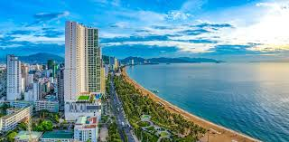
Emerging urban growth centers
Towns and cities along economic corridors
Some towns are strategically located along economic corridors. With the benefits of investments in commerce, transport, and other infrastructure, these towns have potential to accelerate economic growth. Examples:
Savannakhet, Luang Prabang, Pakse (Lao PDR)
Battambang, Bavet, Poipet (Cambodia)
Da Nang, Thanh Hoa, Nha Trang (Viet Nam)
Mandalay, Bagan (Myanmar)

Slide 17
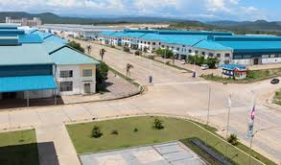
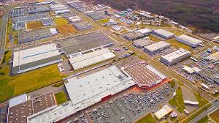
Emerging urban growth centers
Special economic zones
Foreign direct investment has played an important role in accelerating development of special economic zones. Normally the government would provide land, infrastructure and a combination of tax breaks, labor regulations and other incentives to attract private sector. SEZs not only provide employment opportunities but also stimulate other investments and entrepreneurial activities through capital, technology and market access

Slide 18
conclusion
Urbanization is inevitable and will continue into the future as rural-urban migration accelerates in CLMV countries.
Major economic growth will be in urban areas with economies of scale and concentration of economic activities occurring in cities. However growth will vary across cities, depending on infrastructure investments, human resource capacity and ability to attract private sector investments
Urban growth follows economic growth; however government capacity will need improvement to address issue of uncontrolled growth

Slide 19


