Slide 1
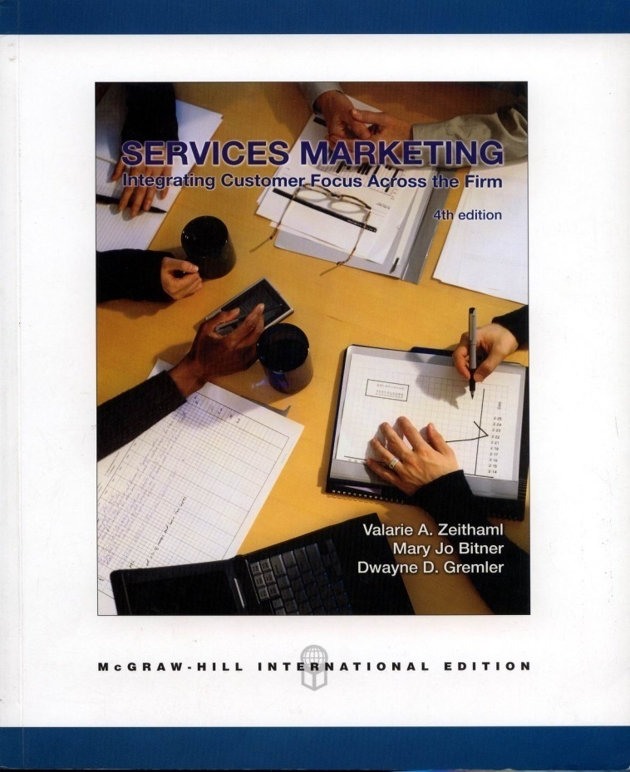
Chapter 4: Customer Expectations of Service
MK 324/352
Ajarn Suwalya K.

Slide 2
This chapter’s objective are to
1. Recognize that customers hold different types of expectations for service performance.
2. Discuss the sources of customer expectations of service, including those that are controllable and uncontrollable by marketers.
3. Acknowledge that the types and sources of expectations are similar for end consumers and business customers, for pure service and product-related service, for experienced customers and inexperienced customers.
4. Delineate the most important current issues surrounding customer expectations.

Slide 3
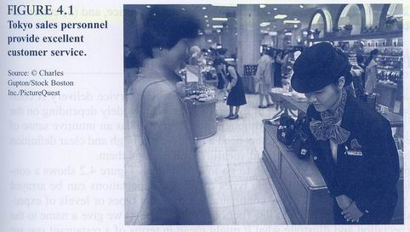
Figure 4.1 pg. 81

Slide 4

Expected Service: Levels of Expectations
The highest can be termed desired service: the level of service the customer hopes to receive – the “ wished for” level of performance.
We call the threshold level of acceptable service adequate service- the level of service the customer will accept.
- Following World Trade Center disaster

Slide 5
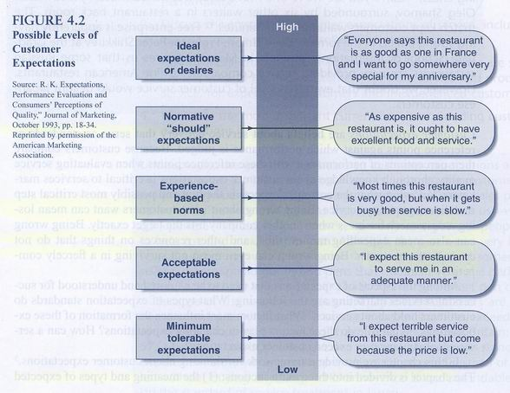
Figure 4.2

Slide 6
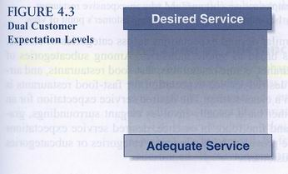
Figure 4.3

Slide 7

Levels of Expectations
Levels or Expectations are why two organizations in the same business can offer far different levels of service and still keep customers happy.
It is why McDonald’s can extend excellent industrialized service with few employees per customer and why an expensive restaurant with many tuxedoed waiters may be unable to do as well from the customer’s point of view

Slide 8
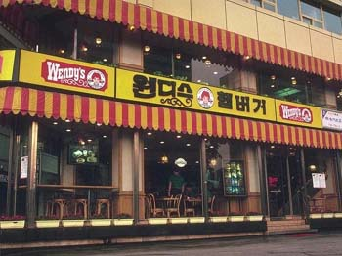
Levels of Expectations
Customers hold similar desired expectations across categories of service.
Among subcategories of restaurants are expensive restaurants, ethnic restaurants, fast-food restaurants and airport restaurants.
Global Feature pg. 84-85

Slide 9

The Zone of Tolerance
The extent to which customers recognize and are willing to accept this variation is called the zone of tolerance.
If the service drops below adequate service – minimum level considered acceptable – customers will be frustrated and their satisfaction with the company with the company will be undermined.
If service performance is higher than the zone of tolerance at the top of the end- where performance exceeds desired service- customers will be very pleased and probably quite surprised as well.

Slide 10
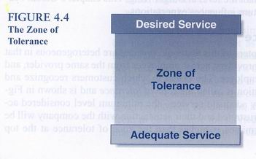
Figure 4.4

Slide 11

The Zone of Tolerance
Different Customers Possess Different Zones of Tolerance
Zones of Tolerance Vary for Service Dimensions
  Customers’ tolerance zones also vary for different service attributes or dimensions.
  The more important the factor, the narrower the zone of tolerance is likely to be.

Slide 12
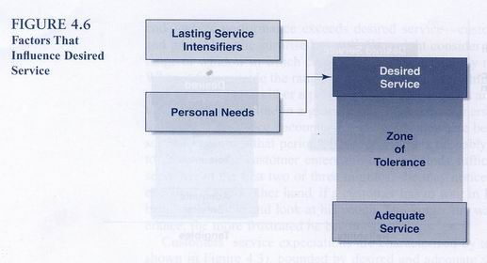
Figure 4.6

Slide 13

The Zone of Tolerance
Zones of Tolerance Vary for Service Dimensions
  In general, customers are likely to be less tolerant about unreliable services (broken promises or service errors) than other service deficiencies, which means that they have higher expectations for this factor.

Slide 14

The Zone of Tolerance
Zones of Tolerance Vary for Service Dimensions
  In addition to higher expectations for the most important service dimensions and attributes, customers are likely to be less willing to relax these expectations than those for less important factors, making the zone of tolerance for the most important service dimension smaller and the desired and adequate service levels higher.

Slide 15
The Zone of Tolerance
In summary we can express boundaries of customer expectations of service with two different levels of expectations: desired service and adequate service.
The desired service level is less subject to change than adequate service level.
A zone of tolerance separates these 2 levels.
  This zone of tolerance varies across customers and expands or contracts with the same customer.

Slide 16
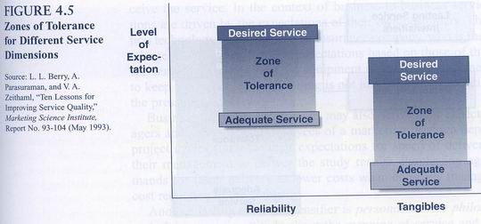
Figure 4.5

Slide 17
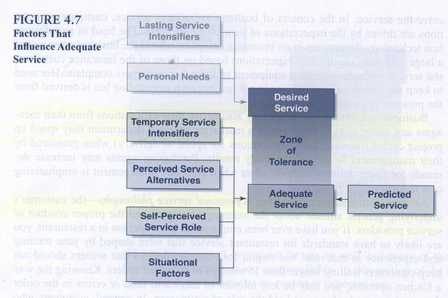
Figure 4.7

Slide 18

Factors that Influence Customer Expectations of Service
Sources of Desired Service Expectations
  The two largest influences on desired service level are personal needs and philosophies about service.
  Personal needs are those states or conditions essential to the physical or psychological well-being of the customer, are pivotal factors that shape what customers desire in service.

Slide 19
Factors that Influence Customer Expectations of Service
Sources of Desired Service Expectations
  Lasting service intensifiers are individual, stable factors that lead the customer to a heightened sensitivity to service.
  One of the most important of these factors can be called derived service expectations, which occur when customer expectations are driven by another person or group of people.

Slide 20

Factors that Influence Customer Expectations of Service
Sources of Desired Service Expectations
  Business to business customers may also derive their expectations from their managers and supervisors.
    Employees of a marketing research department may speed up project cycles (increase their expectations for speed of delivery) when pressured by their management to deliver the study results.

Slide 21
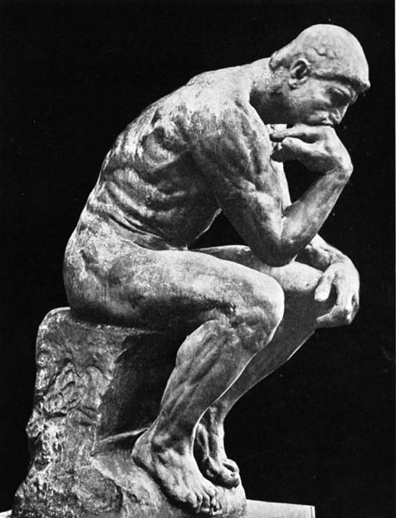
Factors that Influence Customer Expectations of Service
Sources of Desired Service Expectations
  Another lasting service intensifier is personal service philosophy – the customer’s underlying generic attitude about the meaning of service philosophy- the customer’s underlying generic attitude about the meaning of service and the proper conduct of service providers.

Slide 22

A different set of determinants affects adequate Service
    1. Temporary service intensifiers consists of short-term, individual factors that make a customer more aware of the need for service.
    Personal emergency situations in which service is urgently needed (such as an accident and the need for automobile insurance or a breakdown in office equipment during a busy period raise the level of adequate service expectation, particularly the level of responsiveness required and considered acceptable.

Slide 23

A different set of determinants affects adequate Service
    Problems with the initial service can also lead to heightened expectations. Performing a service right the first time is very important because customers value service reliability above all other dimensions. If the service fails in the recovery phase, fixing it right the second time(that is) being reliable in service recovery, is even more critical that it was the first time.

Slide 24

A different set of determinants affects adequate Service
    2. Perceived service alternatives are other providers for whom the customer can obtain the service. If customers have multiple service providers to choose from, or if they can provide the service themselves (such as lawn care or personal grooming), their levels of adequate service are higher than those of customers who believe it is not possible to get better service elsewhere.
    It is important that service marketers fully understand the complete set of options that customers view as perceived alternatives.
    Technology Spotlight pg.91

Slide 25

A different set of determinants affects adequate Service
    3. A third factor affecting the level of adequate service is the customer’s self-perceived service role.
    We define this as customer perceptions of the degree to which customers exert an influence on the level of service they receive. In other words, customer expectations are partly shaped by how well they believe they are performing their own roles in service delivery.
    Ex. A customer wants rare meat but gets other will be dissatisfied. The customer’s active participation in the service also affects this factor.

Slide 26

A different set of determinants affects adequate Service
4. The final factor is predicted service. The level of service that customers believe they are likely to get. This type of service expectation can be viewed as predications made by customers about what is likely to happen during an impending transaction or exchange.

Slide 27

A different set of determinants affects adequate Service
    Predicted service is typically an estimate or calculation of the service that a customer will receive in an individual transaction rather than in the overall relationship with a service provider.
    Whereas desired and adequate service expectations are global assessments comprising many individual service transactions, predicted service is almost always an estimate of what will happen in the next service encounter or transaction that the customer experiences.

Slide 28
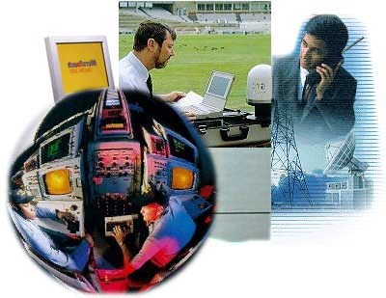
Factors that Influence Customer Expectations of Service
Sources of Both Desired and Predicated Service Expectations:
When consumers are interested in purchasing services, they are likely to seek or take in information from several different sources.

Slide 29
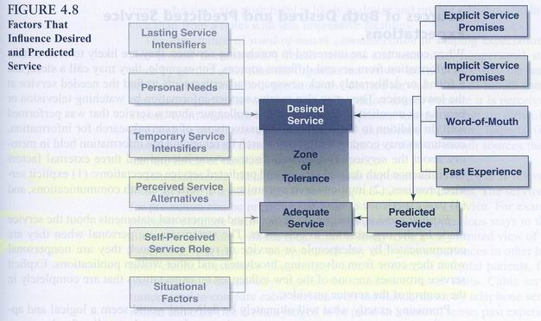
Figure 4.8

Slide 30
Sources of Both Desired and Predicated Service Expectations:
  This section discusses one internal and three external factors that influence both desired service and predicted service expectations:
    1. Explicit service promises
    2. Implicit service promises
    3. Word-of-mouth communications
    4. Past experience

Slide 31

Factors that Influence Customer Expectations of Service
Explicit service promises are personal and nonpersonal statements about the service made by the organization to customers.
The statements are PERSONAL when they are communicated by salespeople or service or repair personnel;
They are NON PERSONAL when they come from advertising, brochures, and other written publications.
Explicit service promises are one of the few influences one expectations that are completely in the control of the service provider.

Slide 32

Factors that Influence Customer Expectations of Service
Implicit service promises are service-related cues other than explicit promises that lead to influences about what the service should and will be like.
These quality cues are dominated by price and tangibles associated with the service. In general, the higher the price and the more impressive the tangibles, the more a customer will expect from the service.

Slide 33
Factors that Influence Customer Expectations of Service
The importance of word-of-mouth- communication in shaping expectations of service is well documented.
These personal and sometimes nonpersonal statements made by other parties other than the organization convey to customers what the service will be like and influence both predicted and desired service.
Word-of-mouth communication carries particular weight as an information source because it is perceived as unbiased.

Slide 34

Factors that Influence Customer Expectations of Service
Past experience:
the customer’s previous exposure to service that is relevant to the focal service, is another force in shaping predictions and desires.

Slide 35
Issues Involving Customer Service Expectations
Five most frequently asked questions about customer expectations:
  1. What does a service marketer do if customer expectations are “unrealistic”?
  2. Should a company try to delight the customer?
  3. How does a company exceed customer service expectations?
  4. Do customer Service Expectation Continually Escalate.
  5. How does a Service Company Stay Ahead of Competition in Meeting Customer Expectations.

Slide 36

What Does Service Marketer Do If Customer Expectations Are “Unrealistic”?
“Simply put, customers expect service companies to do what they are supposed to do. They expect fundamentals, not fanciness; performance, not empty promises.”
Customers want service to be delivered as promised. They want planes to take off on time, hotel rooms to be clean, fod to be hot and service providers to show up when scheduled.
Unfortunately, many service customers are disappointed and let down by companies’ inability to meet these basic service expectations.

Slide 37

Should a Company Try to Delight the Customer?
Some management consultants urge service companies to “delight” customers to gain a competitive advantage.
The delight they refer to is a profoundly positive emotional state that results from having one’s expectations exceeded to a surprising degree.
One Author describes the type of service that results in delight as “positively outrageous service” which is unexpected, random, extraordinary, and disproportionately positive.

Slide 38

Homework
Individual Homework:
- One page only- please map out Figure 4.8 and give examples by filling out data from your own experiences
Group Homework
- Develop a questionnaire for your project in both Thai and English.
Due next week – both to be collected

Slide 39
Figure 4.8

