Slide 1
The political Economy of East Asian Trade

Slide 2
Outline
What are the main characteristics of East Asian trade?
Why did they develop?
What trade policies have East Asian nations adopted and why?

Slide 3
Trade Patterns in East Asia
Before economic crisis
  Rapid expansion in trade
  Growth rate of 11.5 percent per year compared to world growth rate of 5 percent per year
  Figure 8.1
  Share of world merchandise export increases 82.1 time from 1960-2005.
  Japan export increased by 146.9.
  Four tigers by 429.9.
  ASEAN 4 by 123.6.
  China by 296.4.

Slide 4
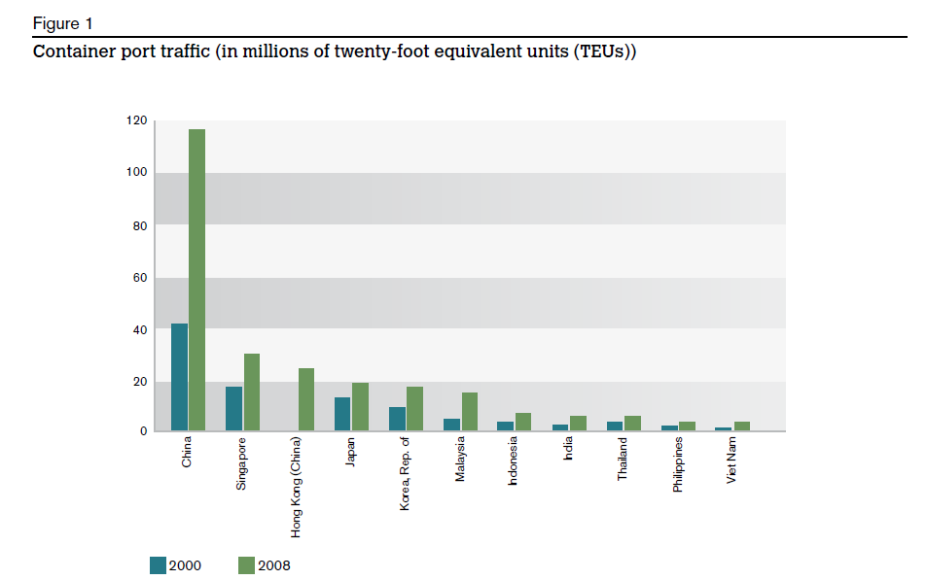
Trade Patterns

Slide 5
Recent Data

Slide 6
Structural Change in Trade
Agriculture and Resource
Labor Intensive
Capital Intensive
Technological Intensive
Innovation
Taiwan
  1950s mainly exported tropical products
  1960-1970s: textile, cloth, shoes. umbrella, etc.
  Share of manufacturing exports was 78.6.
  In 1980s, share changed to 90.8
  Now, Foxconn

Slide 7
Trade Surplus and Creditor position
Current account surplus with balance of payment deficits
Japan
The four tigers
The ASEAN
China in 2005

Slide 8
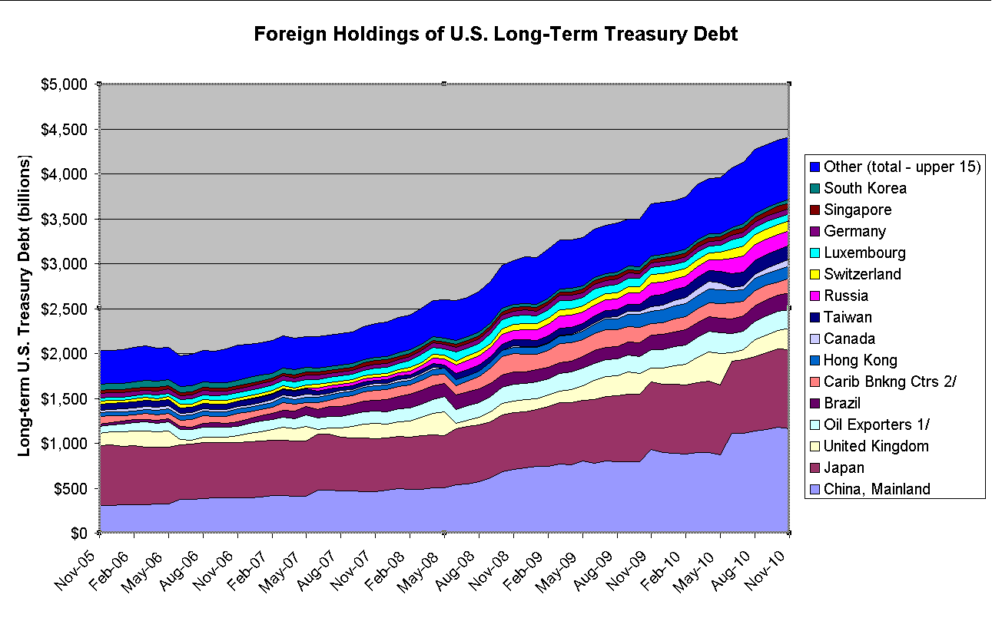

Slide 9
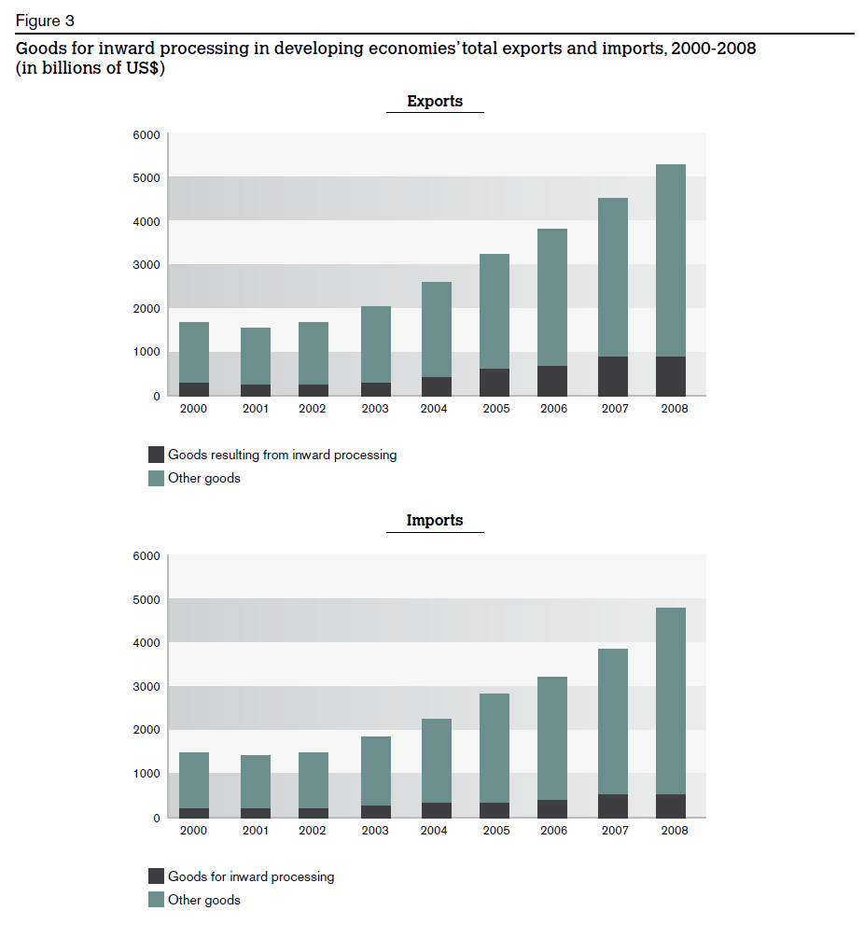
Greater Regional Interdependence

Slide 10
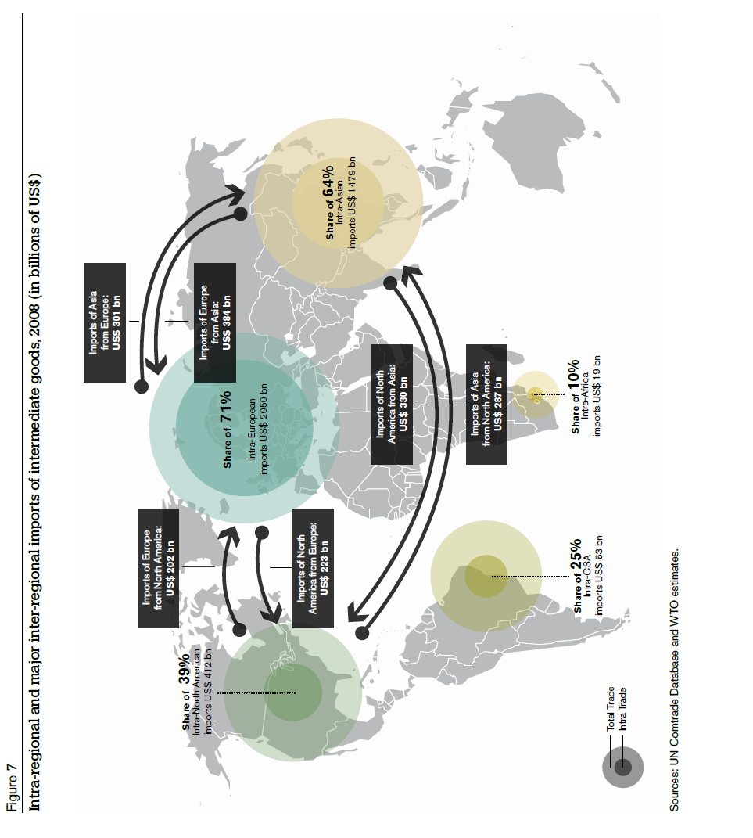
Global Interdependence

Slide 11
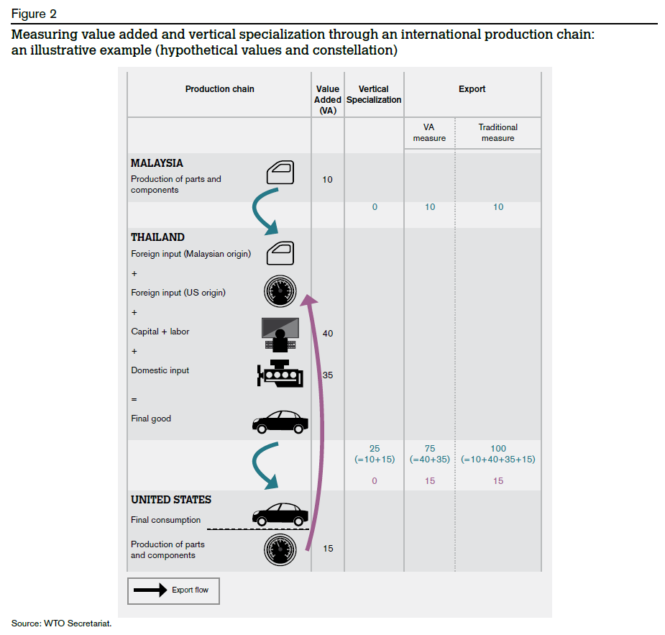

Slide 12
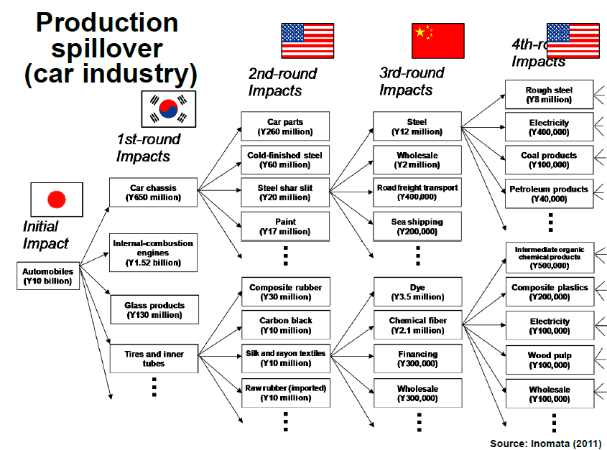

Slide 13
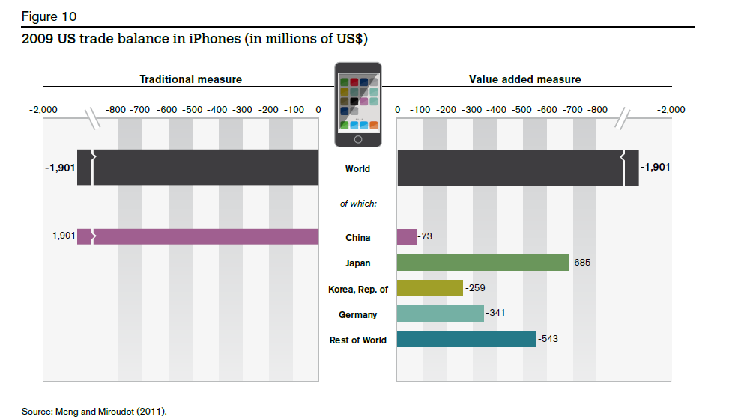

Slide 14
Greater Regional Trade Independence
http://www.youtube.com/watch?v=9-1ht2OrG2Y
http://www.hankooktire.com/global/about-hankook-tire/company/global-network.html
http://global.yokohamatire.net/worldwide/index.html
How the iPhone Widens the United States Trade Deficit

Slide 15
East Asian Trading Strategies
Import Substitution
Export Promotion
Trade Liberalization
Mixed
Positioning in the Global Value Chains

Slide 16
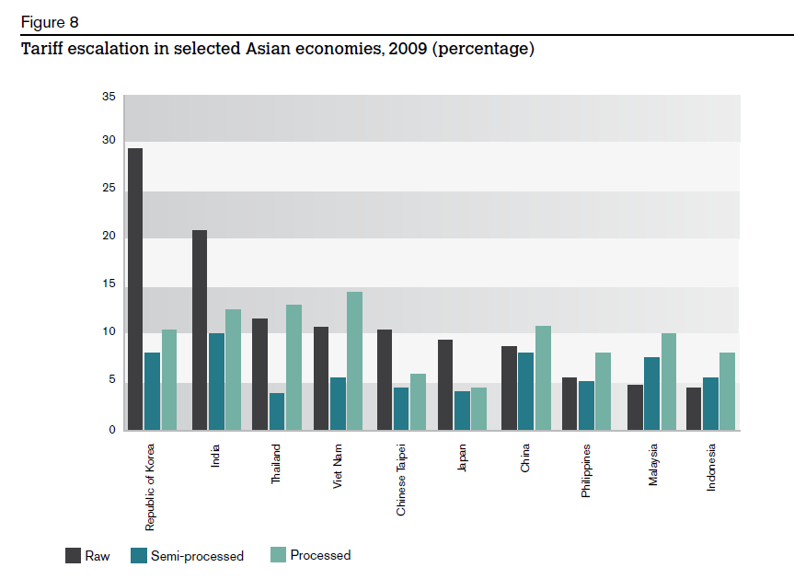

Slide 17
Facing the World
Managing Trade Disputes
Global Rules, Asian Plays
East Asian Trade Regionalism
Domestic Political Economy of Trade

Slide 18
Managing Trade Disputes
Thailand has imposed anti-dumping duties on the import of alloy-added high-carbon wire rod from China for a period of five years beginning Saturday May 17.
The International Trade Commission (ITC) ruled last week that South Korean companies are “dumping” steel pipes, tubes and fittings used by oil companies – known formally as oil country tubular goods (OCTG) – into the U.S. market. “Dumping” means selling for below-market prices in an effort to put competitors out of business. This is a big deal for the U.S.-based steel industry.

Slide 19
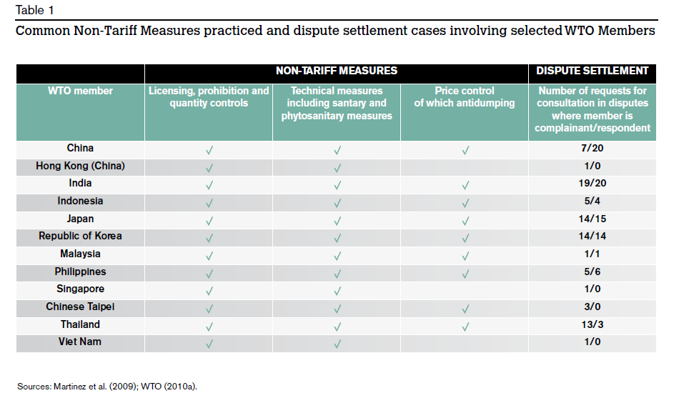
Global Rules, Asian Plays

Slide 20
East Asian Trade Regionalism
Two major trade agreements, the Trans-Pacific Partnership (TPP) and the Regional Comprehensive Economic Partnership (RCEP), stand to define the parameters of economic integration in Asia, arguably the world’s most dynamic region. While the TPP and RCEP are frequently described as rival trading blocs led by the United States and China respectively, we should look beyond this easy characterization to explore the complex dynamics among these mega trade agreements.
https://www.youtube.com/watch?v=X12h5ln_wNg

Slide 21
Domestic Political Economy of Trade
Dual strategy policy
Japan
  http://www.japantimes.co.jp/opinion/2014/01/28/commentary/japan-commentary/abes-deceptive-rice-reform/#.VFkLn_mUd_c
Thailand
  The Finance Ministry will close the rice-pledging scheme's account on Nov 13 but whether the loss will exceed 700 billion baht depends on how to book lost grain.
South Korea
  http://corporate.ford.com/doc/fta_chronology.pdf

Slide 22
Domestic Political Economy of Trade
“We have abolished gentan, a feat many said could not be accomplished by our Liberal Democratic Party.” Gentan refers to the government’s decades-old policy of curtailing rice production by encouraging farmers to reduce the acreage of their rice paddies in exchange for subsidy payments.

Slide 23
Domestic Political Economy of Trade
A preliminary decision to raise subsidies for planting rice for use as animal feed from the current ¥80,000 per 10 ares (1,000 sq. meters) to ¥100,000 met strong opposition from legislators representing Akita, Miyazaki and other farming prefectures. The amount of subsidies was eventually raised to ¥105,000 per 10 ares.

Slide 24
Domestic Political Economy of Trade
As if these measures were not enough to protect farmers, the Ministry of Agriculture, Forestry and Fisheries raised the government’s purchase of rice produced in fiscal 2013 for strategic emergency reserves from the original plan of 200,000 tons to 246,000 tons.

