Slide 1


Behaviors of Thai rural voters :
are they really passive?

Slide 2
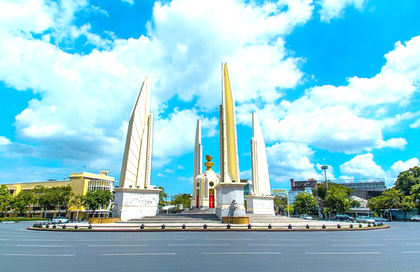

Elections in Thailand
national of Thailand
over 18 years old
registered ninety days before the election at his constituency.
Notes:
pop

Slide 3
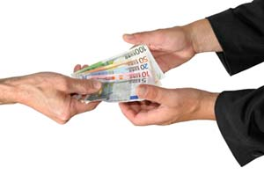
The meaning of ‘Passive in Voter’
You don't look for facts about the candidates, other than their party affiliation. You retain some information but use it only to reinforce your existing beliefs.
This strategy maintains mental consistency. You give little or no consideration to alternatives. Your vote is basically a standing decision.
Party identification is your primary driver, but you also consider factors such as the incumbent's performance and your impressions of the candidates.
Notes:
ni

Slide 4

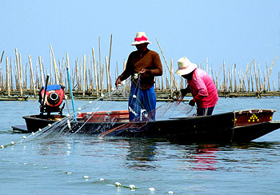
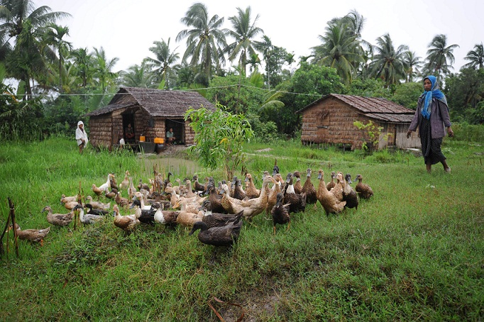
Behavior of rural Thai People
Area that is located outside towns and cities.
Low population density and small settlements
Most of population are working in agricultural sector, fishery and animal farming.
They have the deep relationship among the family member and their neighborhoods.
Most of them are Lacking of education hence they rely on the supernatural power.
Notes:
ฟ้า แปลมาให้จบ กับ เอาfactorที่ทำมาใส่ด้วย

Slide 5

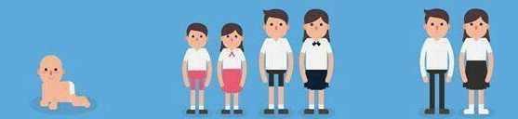
The factors
Of
passive voters
Human behavior
  Tend to do what we are familiar with such as taking action from family.
  Tend to do what majority do rather than trust our own belief because it “safe”
  Tend to do what only have impact themselve
Political Situation
  Bored of an unstable of political situation
  A lot of news about corruption and votes buying.
  Lack of faith in political system
Condition and Profile of candidate
  The civilians have a good relationship with the candidate or they are relatives.
  Dislike the candidate that from other party or dislike another party.
  Used to get the stuffs or things from candidate.
  Used to have a kind of patron-client relationship among civilians and candidate.
Education
Thailand is set to fall to the bottom of the pile of southeastern Asian countries
  Inadequate funding>> lack of good equipments to use.
  Huge class sizes .
  Lack of qualified teachers
  Students have no critical self-thinking skills. Low guidance on voting and democracy.

Slide 6
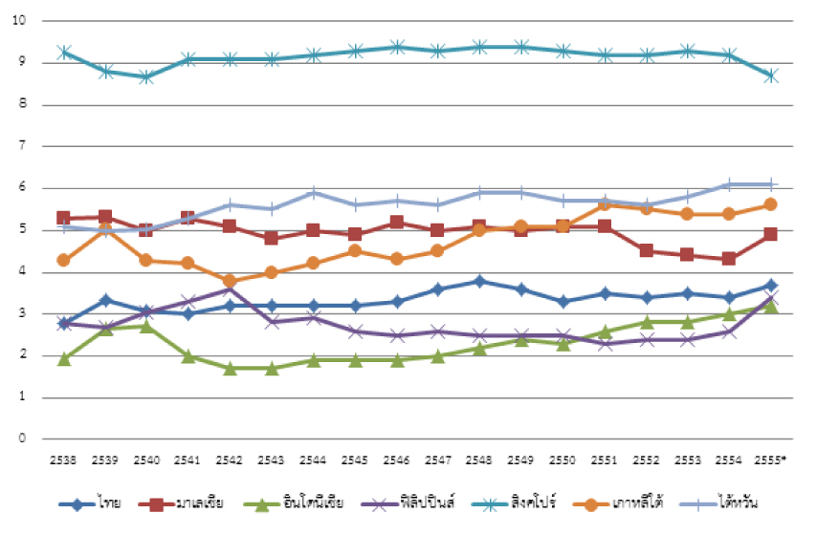
The factors
Of
passive voter
Economy
According to research of World Bank, in 2014, Poverty in Thailand has declined but distribution remains unequal
Poverty is primarily a rural phenomenon
People undertake any chances that run into them to get money including selling their vote
Market Failures
market run by itself is not work because of the corruption that harm the market and causes the failure
arise by an asymmetric information between the voters and the candidates

Slide 7
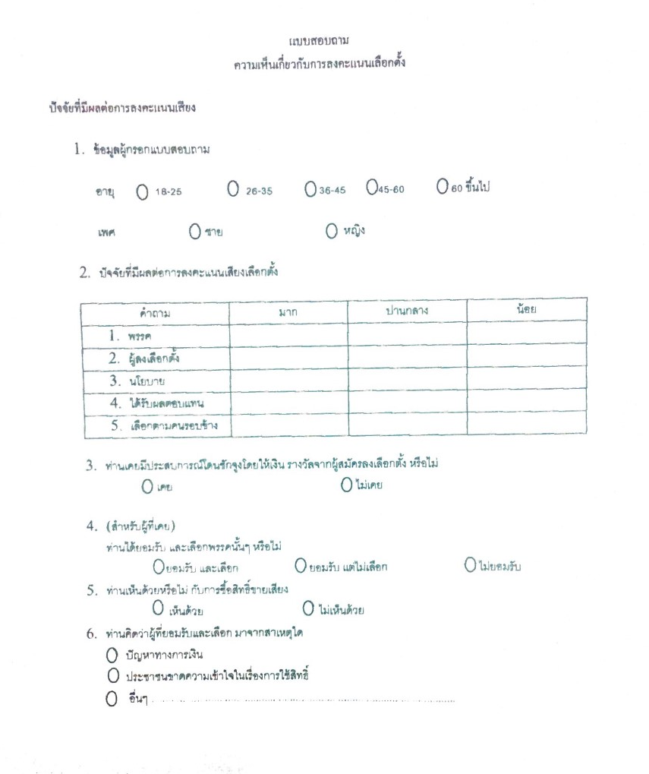
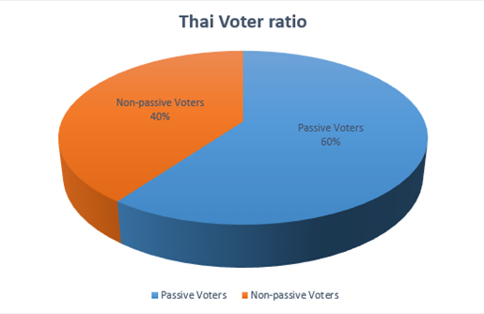
Percentage of passive voter per total thai rural

Slide 8
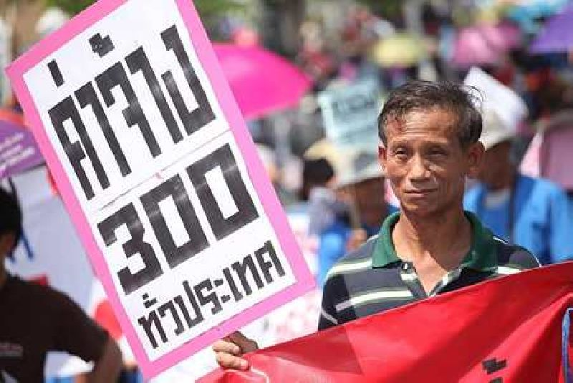
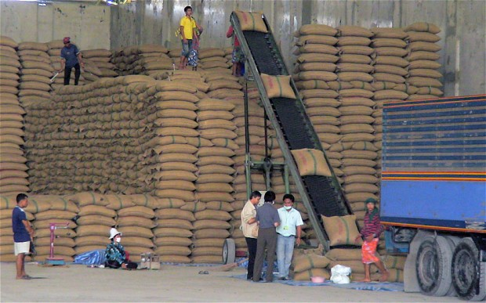
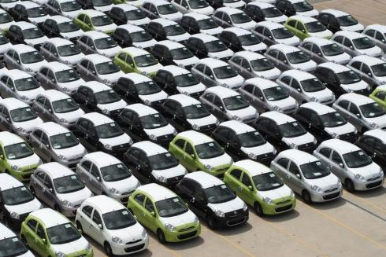

Event Yingluck
There are 4 policy that would gain most of the vote
The floor wage : 300 baht per day
Rice subsidy scheme
The first-car tax scheme
The undergraduate salary : at least 15,000 baht
Notes:
The tactic that this politic use is they will use policy that will attract people in every class of household.
1. 1.This policy can attract the labor class it seems to be very great to them but if we look to the impact of its, the cost of living will be higher too because producer will increase the price since their barring higher cost.
2. 2. It attracts the farmer, however it only benefit to the big farmer who already rich. But the farmer who did not consider to this sequence definitely vote for this politic.
3. 3. Attract the urban people, the impact is that people who use this scheme may cannot pay off their debt and the producer will face the over stock problem.
4. 4. Middle class, the government officer would benefit in this policy and it do not help the people who really need help since the government officer already have a stable job and government cannot hire all the undergraduate people so they would be unemployed.
According to the impact we can see that it seem to be like a cycle
When people have a bad condition of living they would find the politic that provide them the solution by does not look to the detail

Slide 9
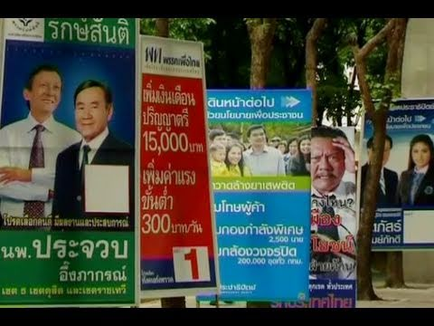

Slide 10
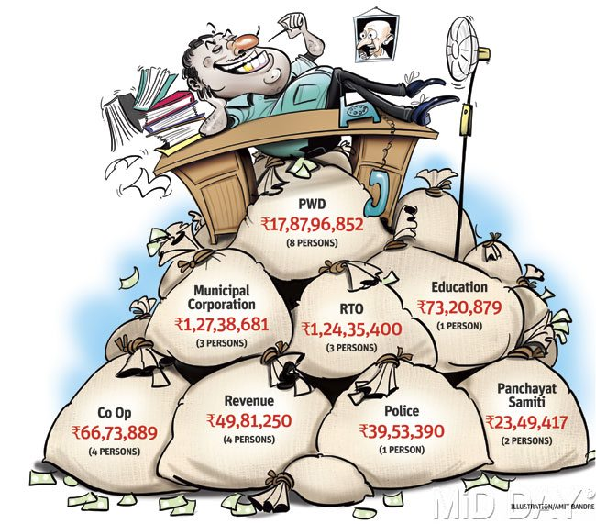
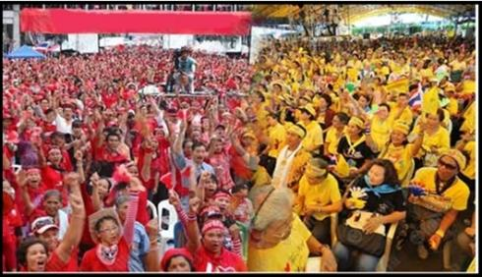
Impacts from passive voters
Inappropriate leaders
Incompetent leaders
Can not complete their policy in practical
Unable to solve the problem
Corruption
Political instability
Lack of incentive from international private investment
Ineffective projects
Protest
Create disagreement in the country
Affect tourism
Dropped in Thai baht
Create financial problem
Notes:
minnnie

Slide 11
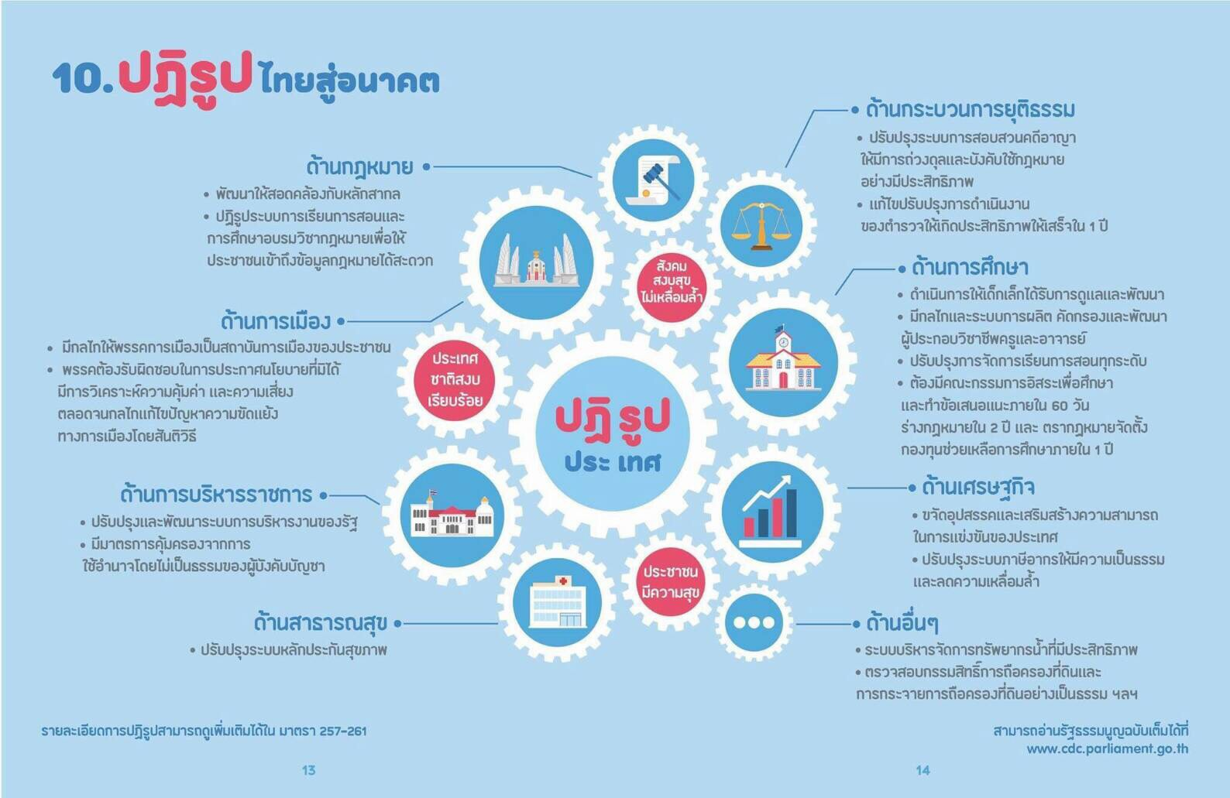
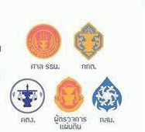
Solutions
*education
-Teacher should be required basic qualifications to teach.
-increase in teacher salaries.
-The ministry should focus on teacher’s advice.
-focus more on the knowledge rathan uniform and encourage students to have own opinion and not afraid to express to the public
Help people to have appropriate amount of income.
-Provide the social welfare
-Government should provide personnel to inform about the process of the election and how to use your right efficiently
Economy
Increasing the potential and ability of people to have more chances and ways to work
Group them to be a community which they will be stronger enough to negotiate with others
Improve social welfare
Arrange the natural resources such as land and water to be fair and equal
*Corruption
-build up people’s confidence about the transparency of election process and related organization.
-The nation’s budget will not be efficient as long as there is no serious regulations both during the election and duty
Market Failures
Encourage people to notice or do not easily believe on the propaganda

Slide 12
conclusion
Thai Rural
-far from infrastructure and convenience
-poorer education compare to urban
-working in agricultural sector, fishery and animal farming.
-deep relationship with family.
Factor >>> passive voter
-lack of critical self-thinking skills
-working condition that lead to low income living
-tend to take family’s action rather their self interest.
Thai rural are passive voters
However

