Slide 1

MK 333/326 Group Assignment 10:
Chapter 12
Topic: Modes of Foreign Market Entry
Each group is to create maximum 2 pages power point slide presentation and research on the different modes of foreign entries for your project country. Please give company names, specific examples.
Please design the one page by using graphs, charts, visuals to make one page interesting ka. Due next class on April 29, 2021
Notes:
1

Slide 2

Alternative Market-Entry Strategies 1 of 5
Four broad modes of foreign market entry
  Exporting
  Contractual agreements
  Strategic alliances
  Direct foreign investment

Slide 3
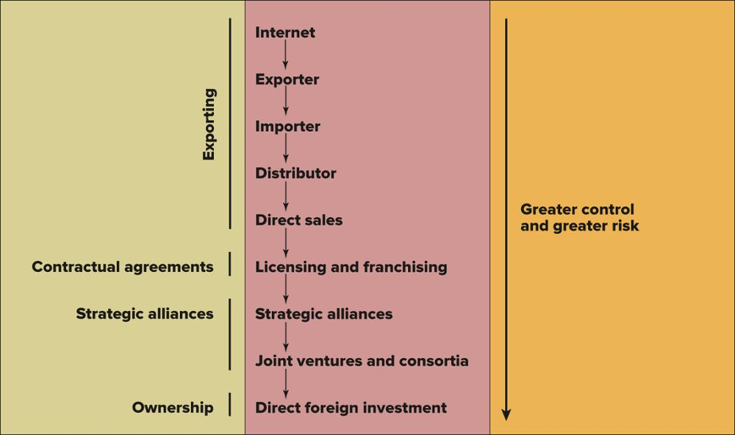
Exhibit 12.2 Alternative Market-Entry Strategies
Companies most often begin with modest export involvement. As sales revenues grow, the firms often proceed through the steps shown toward direct foreign investment.

