Slide 1
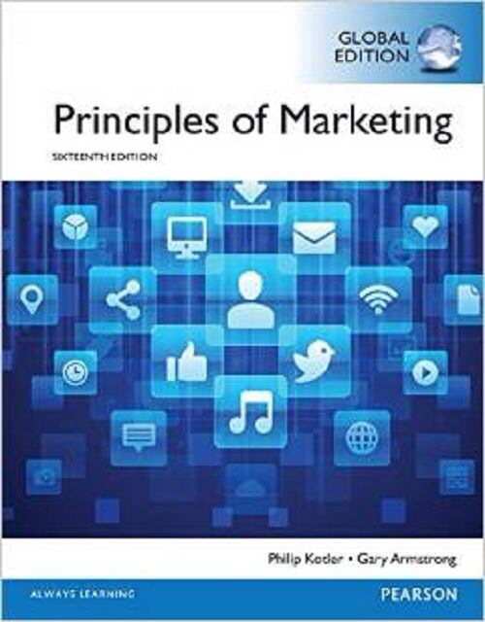
Pricing Strategy II
CHAPTER 11: Pricing Strategy: Additional Considerations
MK 202 Fundamentals of Marketing
By Aj.Suwalya K.

Slide 2
Objective Outline
Objective 1: Describe the major strategies for pricing new products.
Objective 2: Explain how companies find a set of prices that maximizes the profits from the total production mix.
Objective 3: Discuss how companies adjust their prices to take into account different types of customers and situations.
Objective 4: Discuss the key issues related to initiating and responding to price changes.
Objective 5: Overview the social and legal issues that affect pricing decisions.

Slide 3
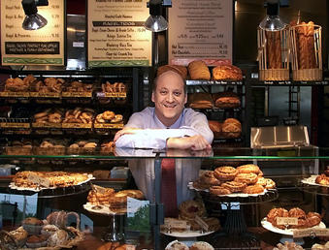
Panera Bread Company:
Value Isn’t Just about Low Prices
Panera Bread understands that low prices often aren’t the best value. Says Panera CEO Ronald Shaich, “Give people something of value and they’ll happily pay for it.”

Slide 4
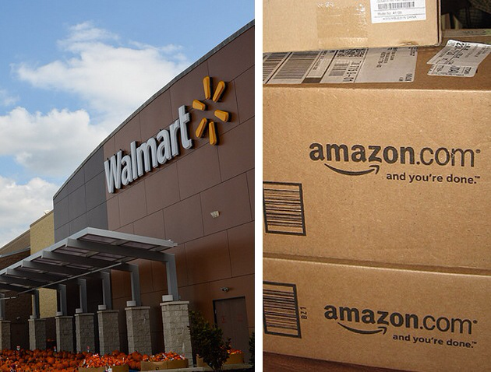
Amazon vs.Walmart
A price War for Online Supremacy
Walmart versus Amazon online: Achieving online supremacy will take more than just waging and winning an online price war. The spoils will go to the company that delivers the best overall online customer experience and value for price.

Slide 5
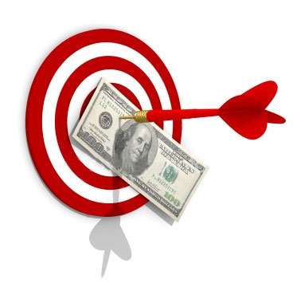
Objective 1: New-Product Pricing Strategies

Slide 6
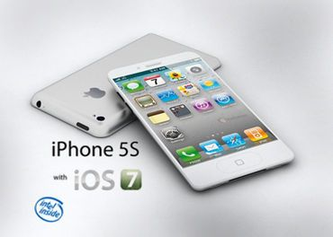
New-Product Pricing Strategies
Market-skimming pricing(price skimming): Setting a high price for a new product to skim maximum revenues layer by layer from the segments willing to pay the high price; the company makes fewer but more profitable sales.

Slide 7
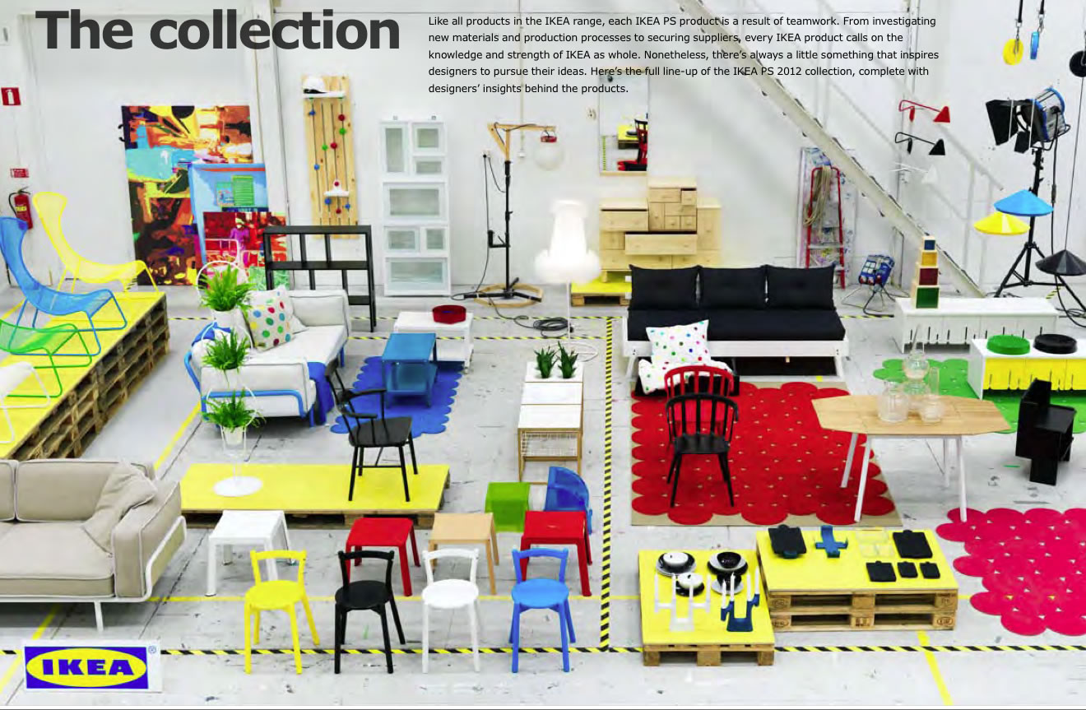
New-Product Pricing Strategies
Market-penetration pricing: Setting a low price for a new product in order to attract a large number of buyers and a large market share.

Slide 8
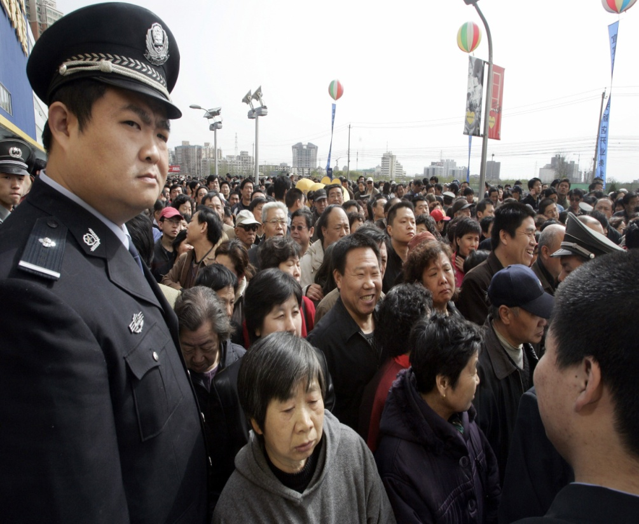
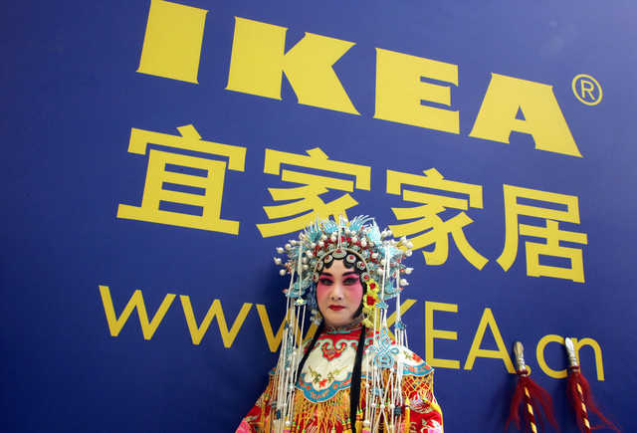
Penetration pricing: To lure famously frugal Chinese customers, IKEA slashed its prices. The strategy worked. Weekend crowds in many of IKEA’s Chinese stores are so big that employees use megaphones to keep shoppers under control

Slide 9

Penetration pricing: Samsung has used low initial prices to make quick and deep inroads into emerging mobile device markets such as Africa and India.

Slide 10
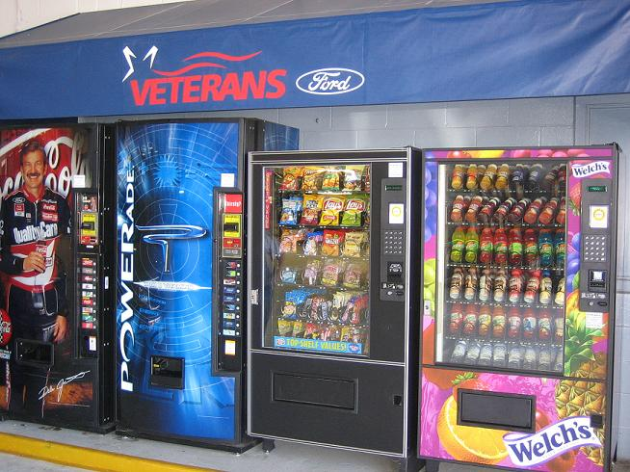
Objective 2: Product Mix Pricing Strategies

Slide 11
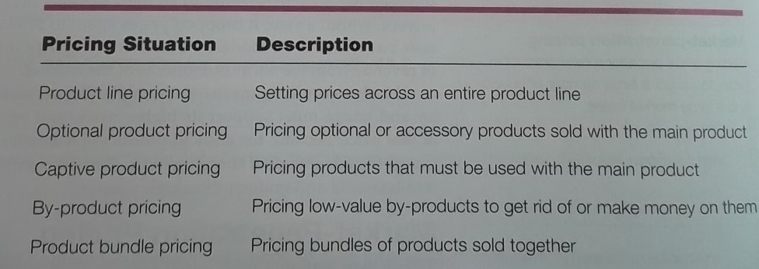
Product Mix Pricing Strategies
Table 11.1 Product Mix Pricing

Slide 12
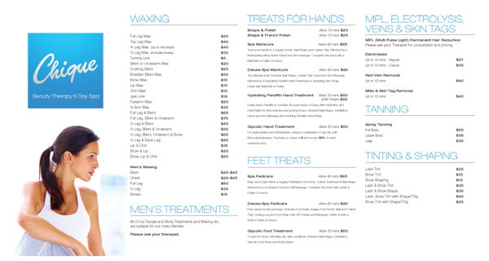
Product Mix Pricing Strategies
Product line pricing: Setting the price steps between various products in a product line based on cost differences between the products, customer evaluations of different features, and competitors’ prices.

Slide 13
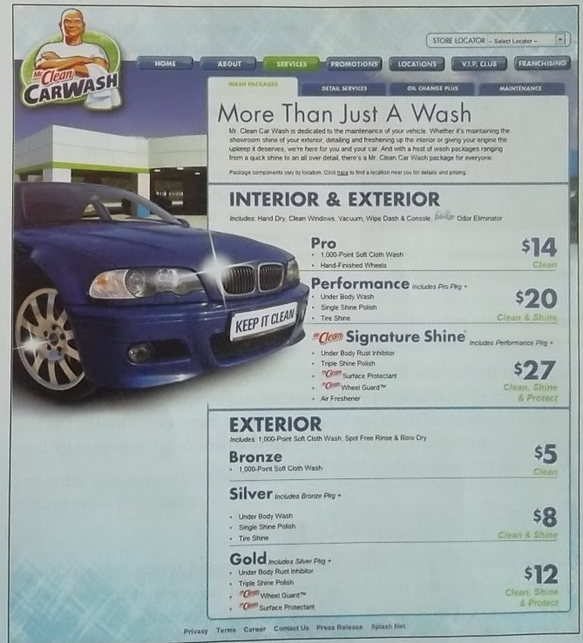
Product line pricing: Mr. Clean car washes offer a complete line of wash packages priced from $5 for the basic Bronze wash to $27 for the feature-loaded Mr. Clean Signature Shine package.

Slide 14
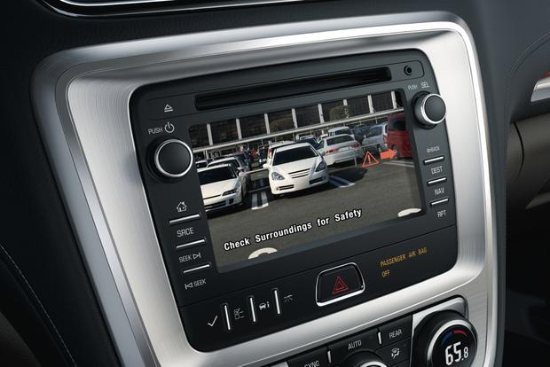
Product Mix Pricing Strategies
Optional Product Pricing: The pricing of optional or accessory product along with main product

Slide 15

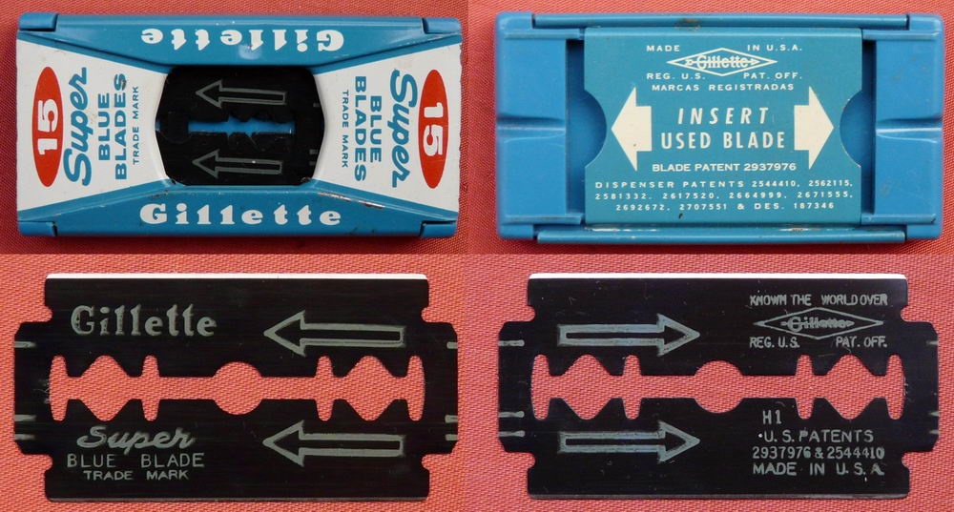
Product Mix Pricing Strategies
Captive Product Pricing: Setting a price for products that must be used along with a main product, such a blades for razor and games for a video game console.

Slide 16
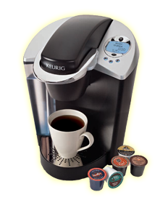
Captive product pricing: Nearly 73 percent of Keurig's sales come from its K-Cup portion packs.The brand must find the right balance between main-product and captive-product ideas.

Slide 17

Product Mix Pricing Strategies
By-Product Pricing: Setting a price for by-product in order to make the main products price more competitive.
By-Product Pricing: “There’s green and money to be made in animal poop!” exclaims Dan Corum, the Woodland Zoo’s enthusiastic Compost and Recycling Coordinator (also know as the Prince of Poo, the Emperor of Exrement, the GM of BM, or just plain Dr.Doo).

Slide 18
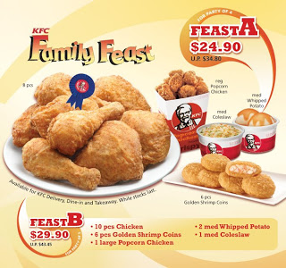
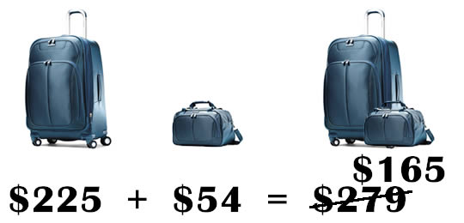
Product Mix Pricing Strategies
Product bundle pricing: combining several products and offering the bundle at a reduced price.

Slide 19

Objective 3: Price-Adjustment Strategies

Slide 20
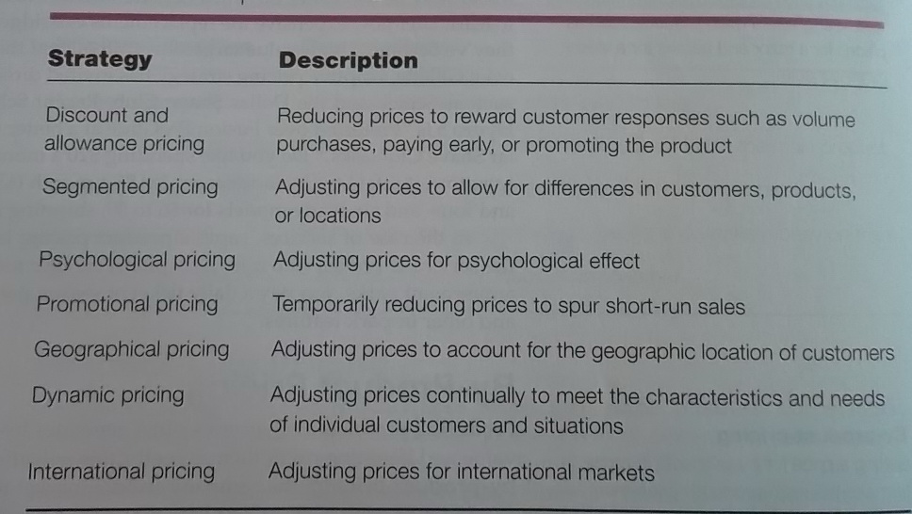
Price-Adjustment Strategies
Table 11.2 Price Adjustments

Slide 21
Price-Adjustment Strategies
Discount: A straight reduction in price on purchases during a stated period of time or in larger quantities.
Allowance: Promotional money paid by manufactures to retailers in return for an agreement to feature the manufacturer’s products in some way.
Segmented pricing: Selling a product or service a two or more prices, where the difference in prices is not based on differences in costs.

Slide 22
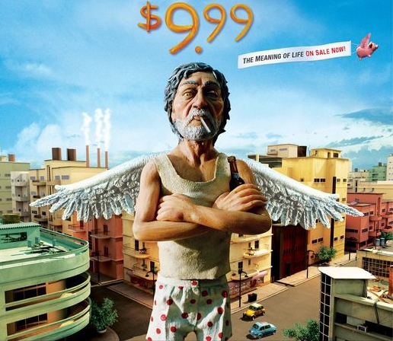
Price-Adjustment Strategies
Psychological pricing: Pricing that considers the psychology of prices and not simply the economics; the price is used to say something about the product.
Reference prices: Prices that buyers carry in their minds and refer to when they look at a given product.

Slide 23

Product-form pricing: A roomier business class seat on a flight from New York to London is many times the price of an economy seat on the same flight. To customers who can afford it, the extra comfort and service are worth the extra charge.

Slide 24
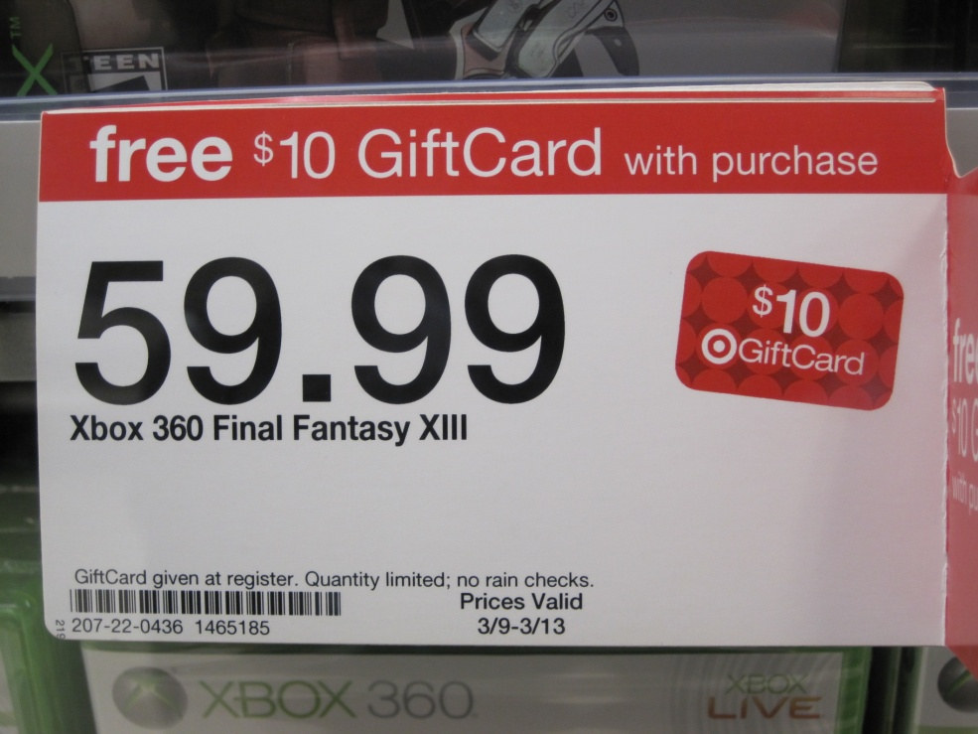
Quick, What’s a Good Price for..? We’ll Give You a Cue
Pricing cues provided by retailers, such as sales signs and prices ending in 9, can provide helpful price hints to consumers, telling them whether a given price is relatively high or low.

Slide 25
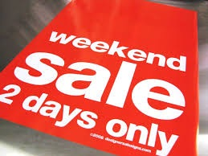
Price-Adjustment Strategies
Promotional Pricing: Temporarily pricing products below the list price, and sometimes even below the cost, to increase short-run sales.

Slide 26
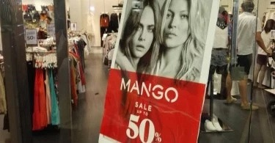
Price-Adjustment Strategies
Promotional pricing: Companies offer promotional prices to create buying excitement and urgency.

Slide 27
Price-Adjustment Strategies
Geographic pricing: Setting prices for customers located in different parts of the country or world
FOB-origin pricing: A geographical pricing strategy in which goods are placed free on board a carrier; the customer pays the freight form the factory to the destination.
Uniform-delivered pricing: A geographical pricing strategy in which the company sets up two or more zones. All customers within the zone pay the same total price; the more distant the zone, the higher the price.
Basing-point pricing: A geographical pricing strategy in which the seller designates some city as a basing point and charges all customers the freight cost from that city to the customer.
Freight-absorption pricing: A geographical pricing strategy in which the seller absorbs all or part of the freight charges in order to get the desired business.

Slide 28
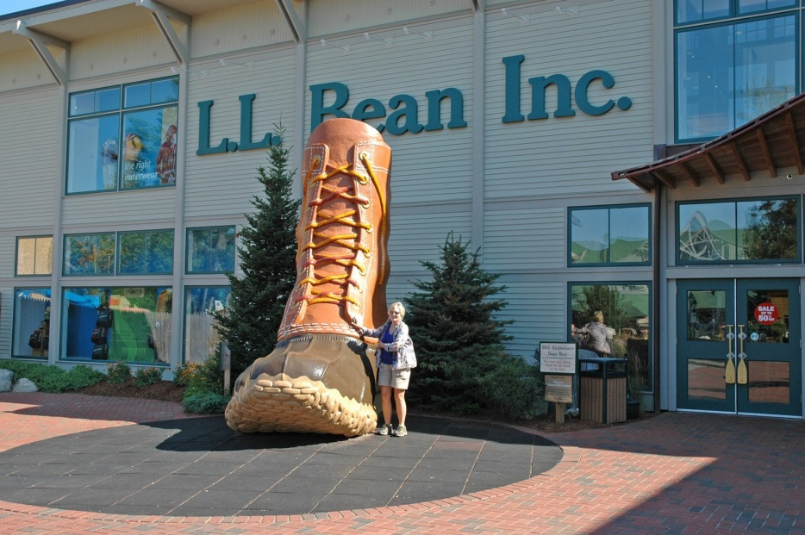
Price-Adjustment Strategies
Dynamic and Internet Pricing
Dynamic Pricing: Adjusting prices continually to meet the characteristics and need of customers and situations.
  LL Bean, Amazon.com or Dell.com mine their databases to gauge a specific shopper’s desires, measure his or her means, instantaneously tailor to fit that shopper’s behavior and price products accordingly.

Slide 29
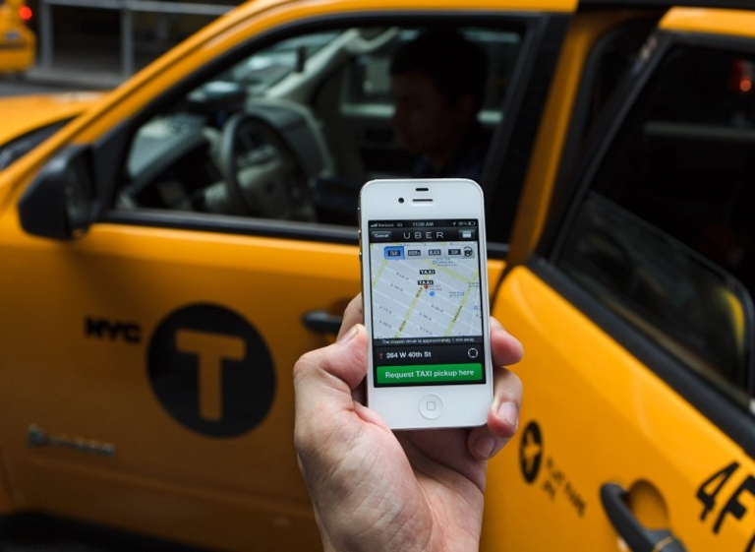
Real Marketing 11.1
Dynamic Pricing: The Wonders and Woes of Real-Time Price Adjustments
Uber's "surge-pricing": App-based car service Uber uses dynamic pricing to adjust its rates to meet market conditions. Some customers are shocked, but Uber alerts cutomers in advance about its pricing.

Slide 30
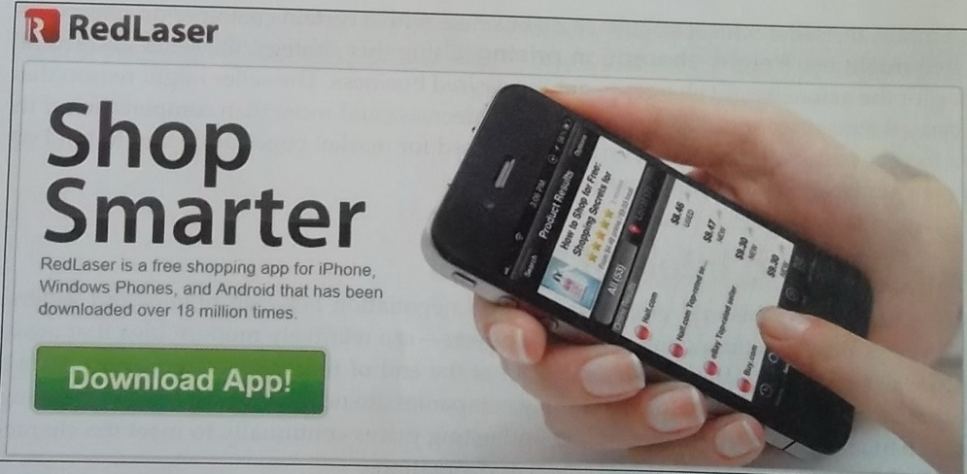
Dynamic and Internet Pricing: Using mobile apps such as eBay’s RedLaser, consumers can scan barcodes or QR codes while shopping in store and receive product reviews, availability information, and comparison prices for online and nearby stores.

Slide 31
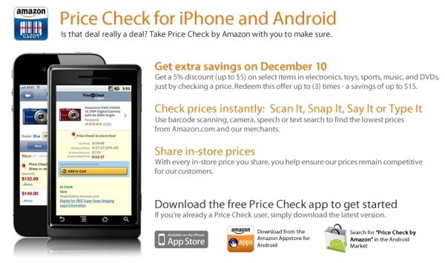
Dynamic and Internet Pricing: Using mobile apps such as Amazon's Price Check, consumers can get instant price comparisons on millions of products.

Slide 32
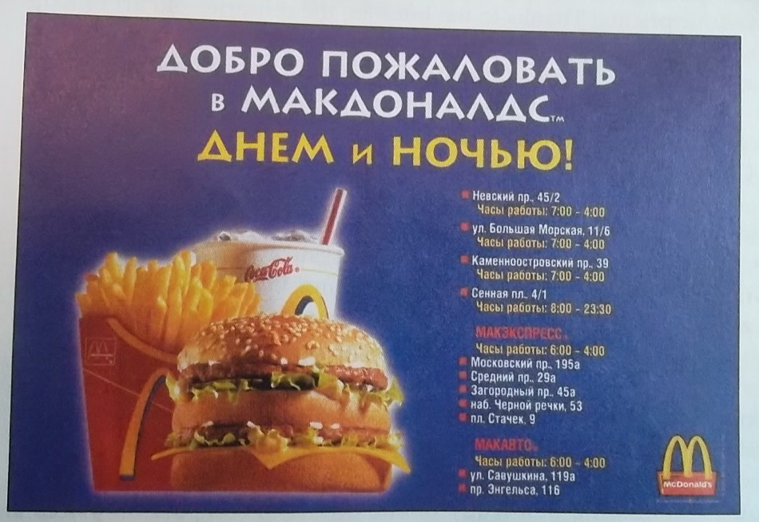
Price-Adjustment Strategies
International Pricing
Companies that market internationally must decide what prices to charge in different countries.

Slide 33
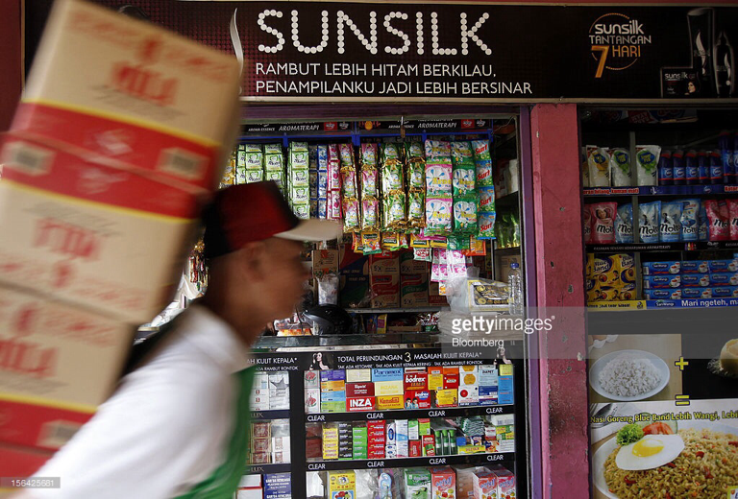
Price-Adjustment Strategies
International Pricing
International pricing: To lower prices in emerging markets, such as Indonesia shown here, Unilever developed smaller, single-use packets if Sunsilk, Ponds, Dove, and other brands that are at prices even the world's poorest consumers can afford.

Slide 34

Real Marketing 11.2
International Pricing: Targeting the Bottom of the Pyramid
To lower prices in developing countries, Unilever developed smaller more affordable packages that put the company’s premier brands within the reach of cash-strapped customers.

Slide 35

Objective 4:Price Changes

Slide 36
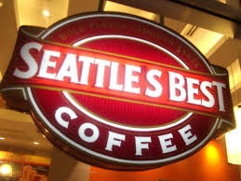
Price Changes
Responding to price changes
Fighter brands: Starbucks has positioned its Seattle’s best Coffee unit to compete more directly with the “mass premium” brands sold by Dunkin’Donuts, McDonald’s and other lower-prices competitors.

Slide 37

Price Changes
Initiating Price Cuts?
Initiating Price Increases?
Buyers Reactions to Price Changes?
Competitor Reactions to Price Changes?

Slide 38
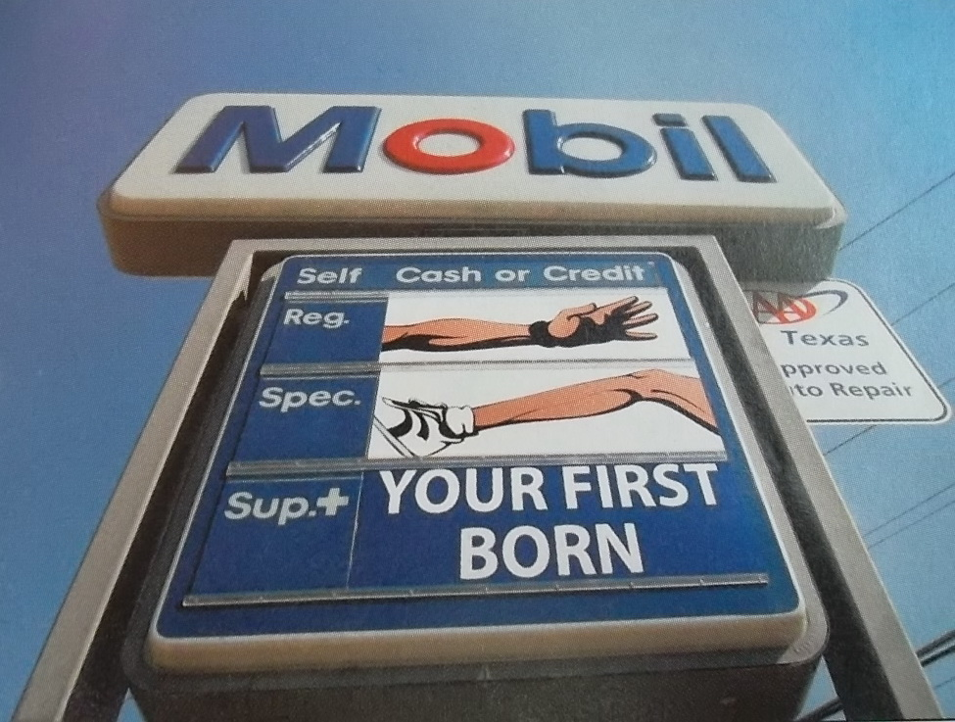
Price Changes
Initiating Price Increases: When gasoline prices rise rapidly, angry consumers often accuse the major oil companies of enriching themselves by gouging customers.

Slide 39
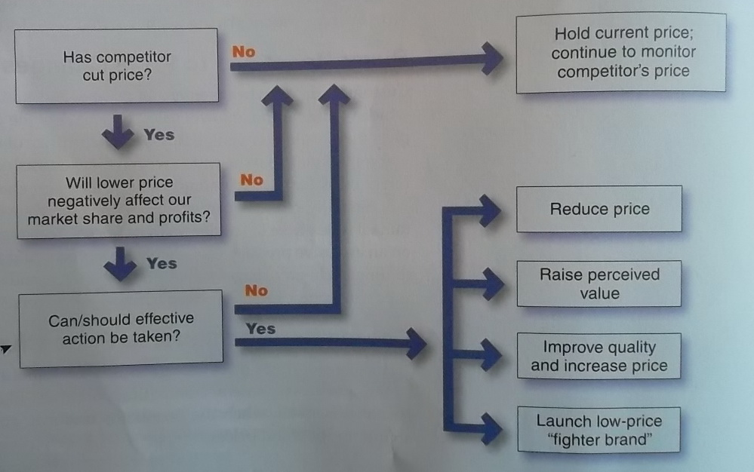
Price Changes
Responding to change
Figure 11.1 Assessing and Responding to Competitor Price Changes
When a competitor cuts prices, a company’s first reaction may be to drop its prices as well. But that is often the wrong response. Instead the firm may want to emphasize the “value” side of the price-value equation.

Slide 40
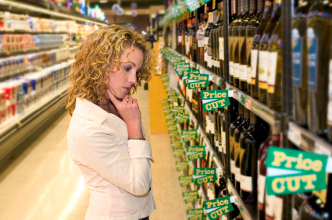
Objective 5: Public Policy and Marketing

Slide 41
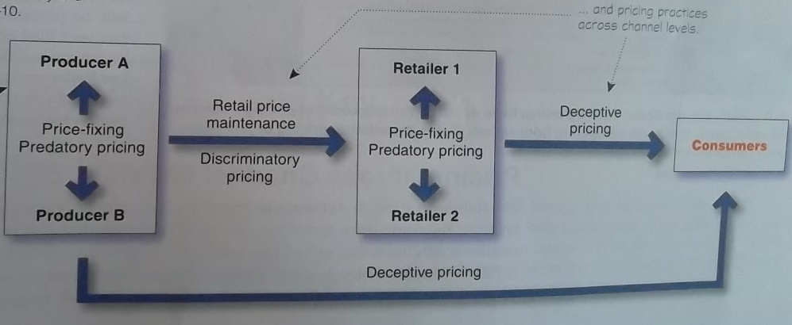
Public Policy and Marketing
Figure 11.2 Public Policy Issues in Pricing
Major public policy issues in pricing take place at two levels. Pricing practices within a given channel level…

Slide 42
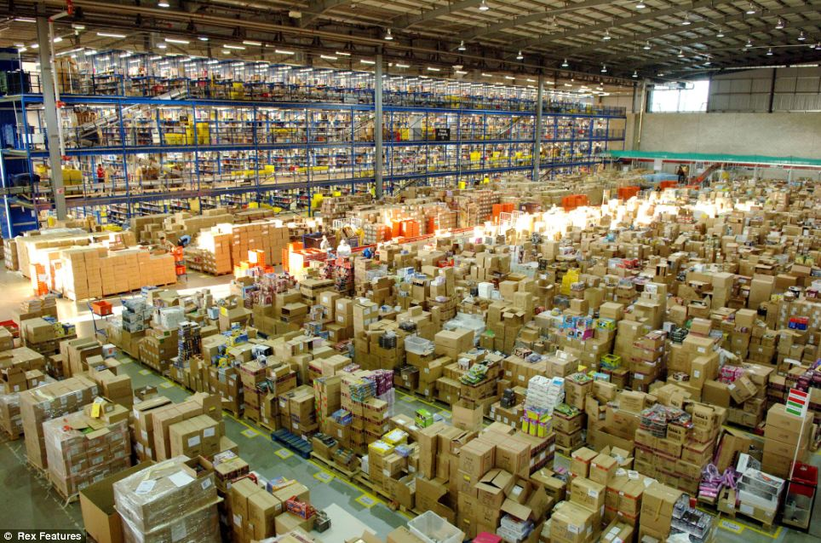

Public Policy and Marketing
Pricing with Channel Levels
Predatory pricing: Selling below cost with intention of punishing a competitor or gaining higher long-run profits by putting competitors out of business.

Slide 43
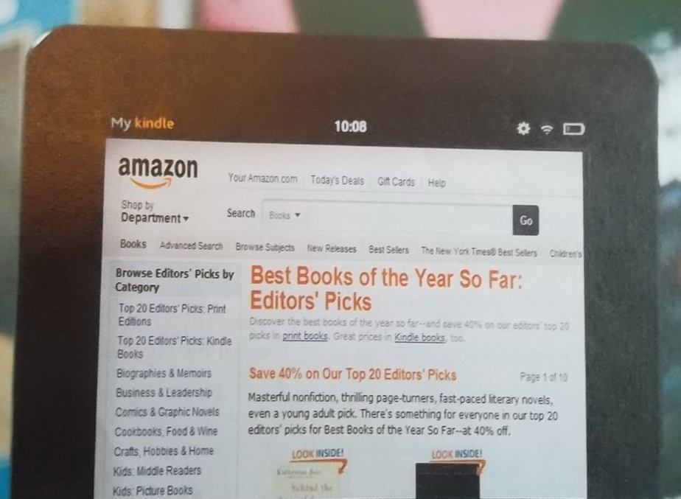
Public Policy and Marketing
Predatory pricing: Some industry critics have accused Amazon.com of pricing books at fire-sales prices that harm competing book sellers. But is it predatory pricing or just plain good competitive marketing?

Slide 44

Group Homework
5 mins presentation slides due next week
1 -2 power point slides on the pricing strategy of your new product

