Slide 1

D
BA 291 – Planning and strategic management
by Parichat Jantori

Slide 2

„One of the key reasons why companies fail is inadequate planning of the business and the management“

Slide 3
What is planning?
Planning: Defining the organization’s goals, establishing an overall strategy for achieving those goals, and developing plans for organizational work activities.
Goals
Plan
Control

Slide 4
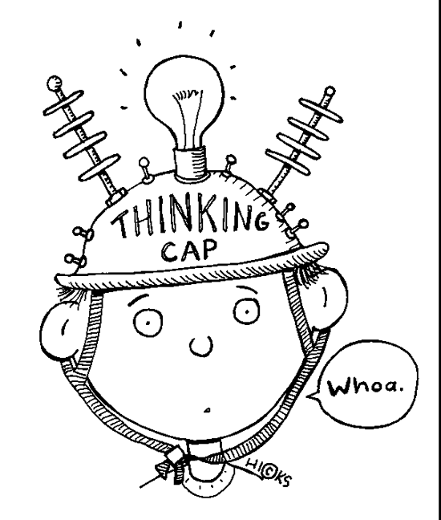
Purposes of goals and plans
Provide direction (where are the goals and how to get there?)
Resource allocation (how to use existing resource to achieve goals)
Reduce uncertainty (scenario analysis, find Plan B)
Minimize waste and redundancy
Establish goals and standard used in controlling

Slide 5
Goal
Goals provide a clear, engaging sense of direction and specify what is to be accomplished
S…………..
M………….
A…………..
R………….
T…………..

Slide 6

Goals in Organizations
How to express the goals
To (1) (action/ verb)
(2) the (single measurable resource)
by (3) (target date/ Time span)
(4) at (cost in time and/ or energy)
Roll out newly-design environmentally friendly cup in 2006.
Open approximately 1800 new stores globally in 2006.
Attain new revenue growth of approximately 20 percent in 2006.

Slide 7
Planning type
Strategic plan vs. operational plans
Long-term vs. short-term plans
Single-Use vs. standing plans
Top-down vs. bottom-up

Slide 8
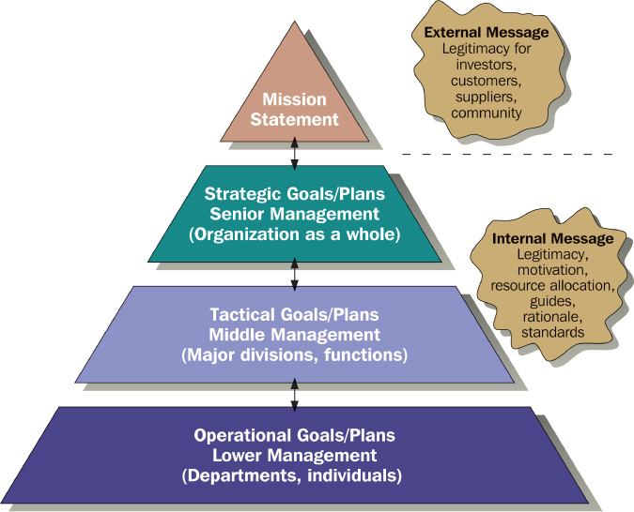
Levels of Goals/ Plans

Slide 9
Mission
Mission
The organization’s reason for existence. It describes the organization’s values, aspiration and reason for being. Without a clear mission, goals and plans may be developed haphazardly.
Mission statement
A broadly stated definition of the organization’s basic business scope and operations that distinguishes it from similar types of organization.

Slide 10
Component of a mission statement
Customer: who are the firm‘s customers?
Markets: Where does the firm compete geographically?
Philosophy: What are the firm‘s basic beliefs, values and ethical priorities?
Concern on public image: How responsive is the firm to societal and environmental concerns?
Product or services: What are the firm‘s major products or services?
Technology: Is the firm technologically current?
Self-concept: What are the firm‘s major competitive advantage and core competencies?
Concern on employees: Are the employees a valuable asset of the firm?

Slide 11

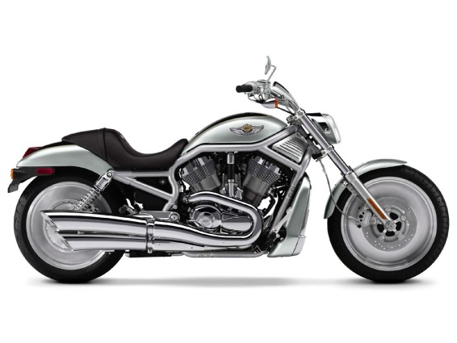

Example: Mission statement
To refresh the world...
To inspire moments of optimism and happiness...
To create value and make a difference.
We fulfill dreams through the experience of motorcycling, by providing to motorcyclists and to the general public an expanding line of motorcycles and branded products and services in selected market segments.
At Microsoft, we work to help people and businesses throughout the world realize their full potential. This is our mission. Everything we do reflects this mission and the values that make it possible

Slide 12
Strategic Goals – official goals, broad statements about the organization
  Define the action steps the company intends to attain
  The blueprint that defines activities
Tactical Goals – help execute major strategic plans
  Specific part of the company’s strategy
  Plans of the divisions and departments
Operational Goals – results expected from departments, work groups, and individuals. Operational goals direct employees and resources toward outcomes.
  Lower levels of the organization
  Specific action steps

Slide 13
Contingency planning
Contingency planning requires the development requires the development of two or more plans, each of which is based on a different set or strategic or operation conditions that could occur. It defines company response to specific situations.
Economic downturns
Declining market
Increase in cost of supplies
New technology development
Scenario thinking
Examine possible future developments that could impact on, in order to find directions for decisions that would be most beneficial no matter how the future unfolds.

Slide 14
Criticisms of Planning
Planning may create rigidity.
Plans cannot be developed for dynamic environments.
Formal plans cannot replace intuition and creativity.
Planning focuses managers’ attention on today’s competition not tomorrow’s survival.
Formal planning reinforces today’s success, which may lead to tomorrow’s failure.

Slide 15
Effective planning
Develop plans that are specific but flexible.
Understand that planning is an ongoing process.
Change plans when conditions warrant.
Flatten the organizational hierarchy to foster the development of planning skills at all organizational levels.

Slide 16

Strategic Management
Strategic management: The set of decisions and actions used to formulate and implement strategies that will be provide a competitively superior fit between the organization and its environment so as to achieve organizational goals.
Responsibility = top managers & chief executive
Notes:
Where is the organization now?
Where does the organization want to be?
What changes are among competitors?
What courses of action will help us achieve our goals?

Slide 17
Purpose of Strategy
Strategy is a plan of action that prescribes resource allocation and other activities for dealing with the environment, achieving a competitive advantage, that help the organization attain its goals
Exploit Core competencies
Creating value
for customers
Developing synergy

Slide 18

Exploit Core competencies
Core competence: the singular capability among a portfolio of capabilities that can lend the company a distinctive and sustainable competitive advantage. A core competence is something a company does especially well in comparison to its competitors.
A core competence should be:
Valuable
Rare
Difficult to immitate

Slide 19

Build Synergy
Synergy: The condition that exists when the organization‘s parts interact to produce a joint effect that is greater than the sum of the parts acting alone

Slide 20
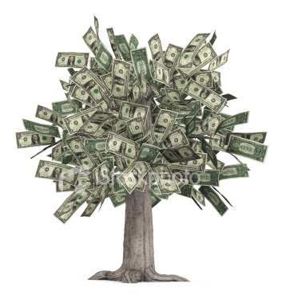
Creating Value
Delivering value to the customer is at the heart of the strategy
Value can be defined as the combination of benefits received and cost paid.
Choose the right business model, which is a strategic design for how a company intends to profits from its strategies, work processes and activities.

Slide 21
The Strategic Management Process
External environment analysis
Identify organization’s mission, vision and goals
SWOT Analysis
Strategy formulation and implementation
Strategic control
Internal environment analysis

Slide 22
Environmental analysis
Environmental analysis
Industry and market analysis
Competitor analysis
Political and regulatory analysis
Social analysis
Labor analysis
Macroeconomic analysis
Technological analysis
Notes:
PESTEL, Environmental, chance & risk analysis

Slide 23
Internal environmental analysis
Management and Organization
Marketing
Human Resources
Distribution channels
Employee experience, education
Management quality
Staff quality
Market share
Degree of centralization
Advertising efficiency
Union status
Organization charts
Customer satisfaction
Turnover, absenteeism
Planning, information, control systems
Product quality
Service reputation
Work satisfaction
Grievances
Sales force turnover
Finance
Production
Research and Development
Profit margin
Plant location
Basic applied research
Debt-equity ratio
Machinery obsolescence
Laboratory capabilities
Inventory ratio
Purchasing system
Research programs
Return on investment
Quality control
New-product innovations
Credit rating
Productivity/efficiency
Technology innovations

Slide 24
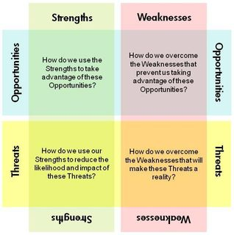
SWOT Analysis

Slide 25

MySpace is till the lead in online social networking, but Facebook is getting all the attention. The startup grew rapidly in the first over four years after 23-year-old Mark Zuckerberg founded it while still a student at Harvard University. To keep FB growing, the young CEO made some strategic decisions that can be understood by looking at the company‘s strengths, weakness, opportunities and threats .
Can you imagine what are Facebook’s strengths, weakness, opportunities and threats? Think about that!

Slide 26
Types of organizational strategies
Corporate-Level Strategy:
What business are we in?
Corporation
Business-Level Strategy:
How do we compete?
Textiles Unit
Chemicals Unit
Auto Parts Unit
Functional-Level Strategy:
How do we support the business-level strategy?
Finance
R&D
Manufacturing
Marketing

Slide 27
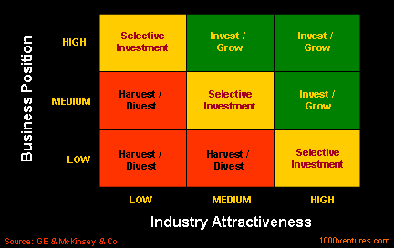
Grand corporate strategy
Notes:
Growth, stability, renewal

Slide 28
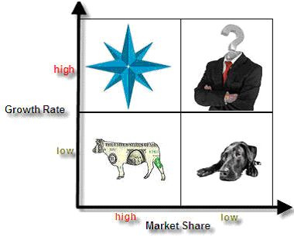
Corporate portfolio analysis
Portfolio strategy: The organization‘s mix of strategic business units and product lines that fit together in such a way as to provide the corporation with synergy and competitive advantage
Notes:
http://www.brandage.com/Modules/DesktopModules/Article/ArticleDetail.aspx?tabID=7&ArticleID=5997&ModuleID=701&GroupID=1388

Slide 29
Example: General Electric (GE)
GE has been reshuffling the corporation‘s mix of business in a way that will give GE a better position in the long run. GE is investing heavily in its stars and question marks to ensure that its portfolio will continue to include cash cows in a future that might be very different from today‘s world.
What are stars, question mark, cash cow? What do you think?

Slide 30
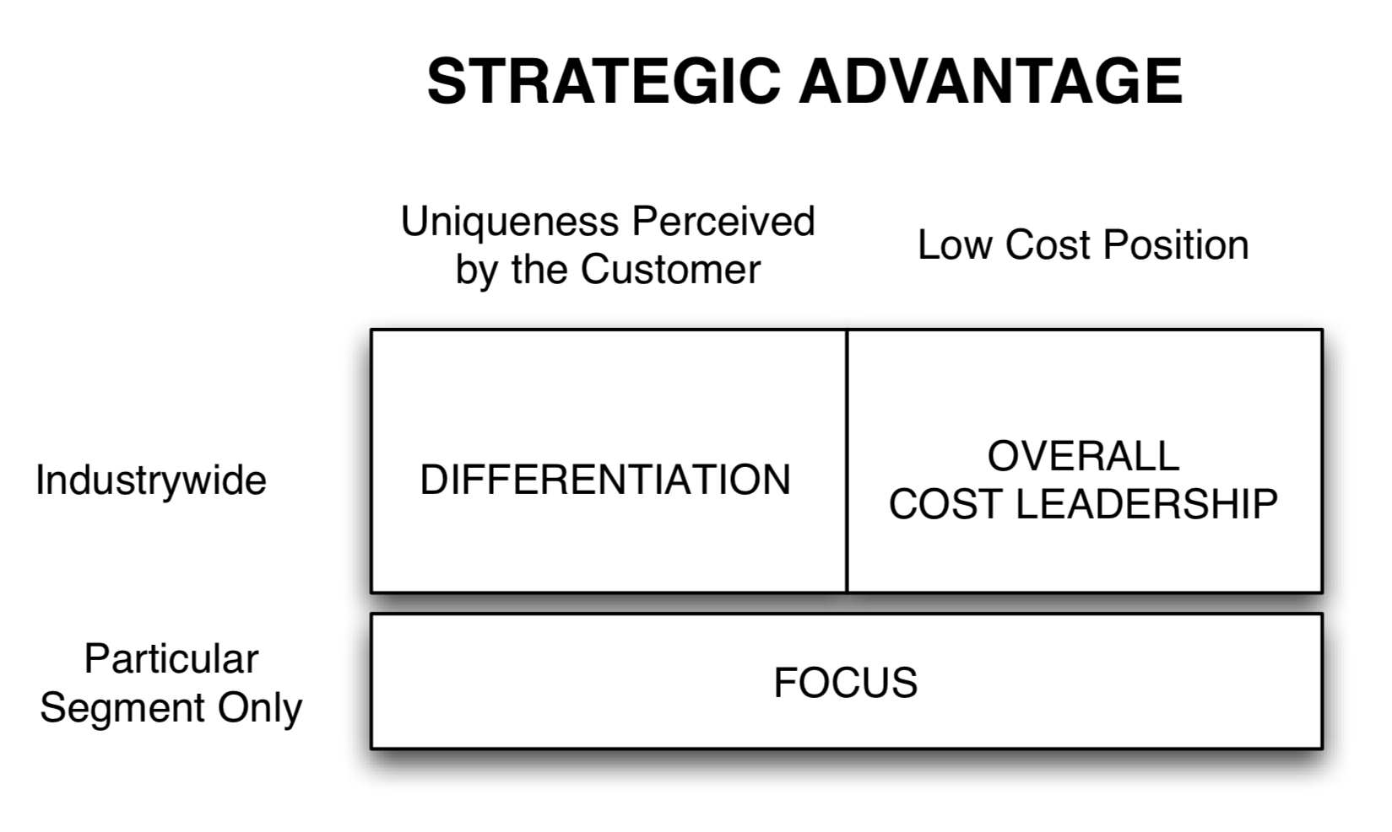
Business Level Strategy

Slide 31
Cost leadership
An integrated set of actions designed to produce or deliver goods or services at the lowest cost relative to competitors.
Cost saving actions required by this strategy:
building efficient facilities, lower waste in manufacturing process
tightly controlling production costs and overhead
minimizing costs of sales, R&D and service
monitoring costs of activities provided by outsiders
Simplifying production processes (mass production, mass customization) – economies of scale

Slide 32
Differentiation
attempt to distinguish products or services from that of competitors
(think “out of the box”)
Unique taste
  Unique design
Multiple features
Wide selection and one-stop shopping
Reliable, superior service , high quality
Spare parts availability
  High Technology
Notes:
ตัวอย่าง US post จะล้มละลาย
Unique taste
Krispy Kreme
Unique design
Porsche Design, LV bag, Cartier, Mini
Multiple features
Microsoft Windows and Office
Wide selection and one-stop shopping
Home Depot and Amazon.com, Department store
Reliable, superior service
FedEx, the oriental hotel, Thai airways
Spare parts availability
Japanese car
High technology
Internet TV, Audi

Slide 33



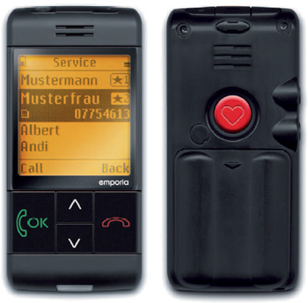
Differentiation

Slide 34


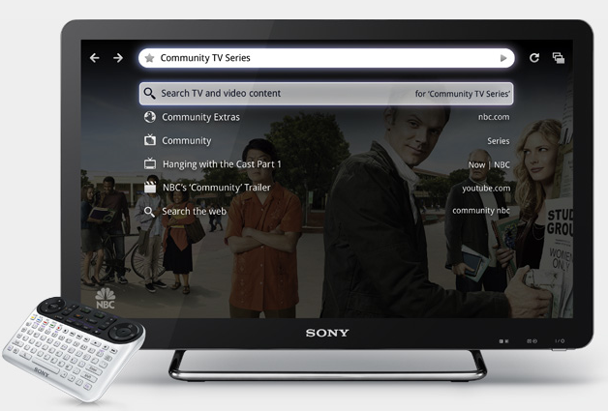
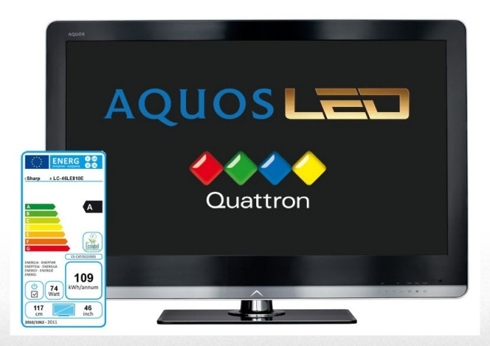

Differentiation

Slide 35
Focus strategy
A focus strategy must exploit a narrow target’s differences from the balance of the industry by:
isolating a particular buyer group
isolating a unique segment of a product line
concentrating on a particular geographic market
finding their “niche”

Slide 36
Focus strategy
Factors driving focus strategy
Large firms overlook small niches
Firm may lack resources to compete in the broader market
May be able to serve a narrow market segment more effectively than can larger industry-wide competitors
Focus may allow the firm to direct resources to certain value chain activities to build competitive advantage

Slide 37

Functional Level Strategy
Functional –level strategies are the action plans adopted by major department to support execution of business level strategy.
- concerned with coordinating the functional areas of the organization (marketing, finance, human resources, production, research and development, etc.)

Slide 38
Strategy implementation
Strategy Implementation: stage of strategic management that involves the use of managerial and organizational tools to direct resources toward achieving strategic outcomes
Leadership
■ Persuasion  Motivation  Culture/values
Organization
Structural Design  Organization Chart  Teams  Centralization
Decentralization,
Facilities, task design
Human Resources  Recruitment/selection  Transfers/promotions
■ Training
■ Layoffs/recalls
Strategy
Performance
Information and Control Systems
■ Pay, reward system  Budget allocations  Information systems  Rules/procedures

