Slide 1
The Economy of Thai Peasants in the Post WWII Era (1950s-1980s)
Thai Economic History
Thorn Pitidol
1/2018

Slide 2
Topics
Post WWII changes of rice peasants
  The changing roles of the gov’t
  The disintegration of rice peasant's society
The expansion of upland peasants
  Cash crop boom and peasant colonisation of upland frontier
  Government and Agribusiness
  Land and Poverty
  Closing the Frontier

Slide 3
Post WWII changes of rice peasants

Slide 4
Overview
After WWII, the rice economy undergone dramatic transformation
  Realignment of relationship with gov't and merchants
  The end of long period of protection
  From, 1950s-1980s, the rice paddy expanded due to new road connections. Frontier moved into Mun-Chi and Mekhong river areas
The society of small peasants disintegrated into the society of commercial farmers and wage labour

Slide 5
Transformed Villages
No longer the older pattern of a frontier settlement
  Independent small holders using exchange labour and traditional tech.
The village turned into differentiated society.
  Land under tenancy, dependency on wage labour, disappearence of exchange of labour
  Used new strain of rice seeds together with fertiliser and other chemicals. Tractors and water pumps.
The speed of change contrasted the view of rural society as fixed, unchanging, and traditional.

Slide 6
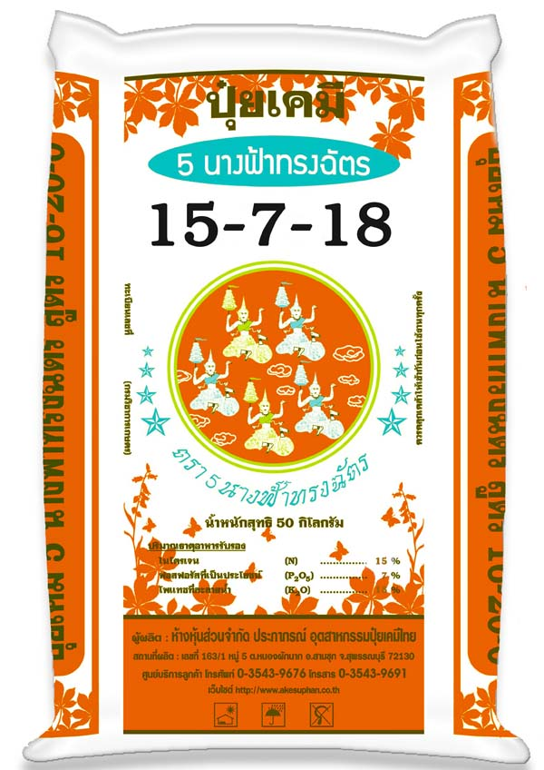
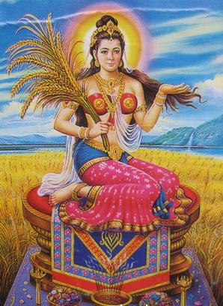
Transformed Villages

Slide 7
Beginning of New Relationships
Population growth was seen as the factor. But the change was more from commercialisation and the new relations with gov't
  1930, Chinese rice barons dominated rice trade. Local traders were organised into networks.
  1940, gov't partnered with rice barons to raise efficiency of rice trade, build better distribution networks for consumer goods.
  1960, the local trading agents of rice trade became much more integrated into the village economy.
    Middlemen performed functions in lending, advancing supplies, own and rent land, selling consumer goods, and transporting products.

Slide 8
Changing roles of the government
The gov't changed its relationship to the peasants' economy.
  Extracting from countryside to boost urban's capital accumulation.
A crucial policy was "rice premium"
  Post WWII, gov't had to pay war repatriation in the forms of rice exports. Gov't monopolized rice exports and collected the premium.
  Continue even after the payment for war finished

Slide 9
Changing roles of the government
The side effects of rice premium
  Low domestic price for rice. Equivalent to taxing rice peasants to support gov't and urban consumers.
  In 1956, rice premium yielded 17% of gov't tax revenue. In 1969, 7%
  In mid 1960s, premium represent 45% tax on value of rice production for export. Extracted 25% of rural income.
  Premium only ended in 1985.

Slide 10
Changing roles of the government
The extraction was also done by manipulating the term of trade.
  Tariff imposed higher rates on consumer goods and on inputs for agricultural production. While, rice premium pushed down product price.
    Cost of fertiliser in terms of rice was 5 times higher than Japan.

Slide 11
Changing roles of the government
But gov’t tried expanding the rice production by improving irrigation, improving new technology, and expanding ownership rights over land.
  From 1950, gov't raised investment in irrigation and in other form of infrastructure
  Promoting the adoption of new rice technology and seeds
  Issuing full deed (NS4) or Occupancy Deed (NS3)
    By late 1970s, certificates issued for 20 million rai in central plain.

Slide 12
Changing roles of the government
The position of village leaders was shifted to support the intrusion of central gov't and the merchants.
  Village headman initially from local selection
  But from 1960s, gov't extended administration into villages by coopting Kamnan and Phuyaiban into gov't pyramid of admin.
  The leaders became the channels for external business to conduct business with villagers.

Slide 13
Disintegration of peasant society
The government’s new roles led to crisis and opportunity for different elements in peasants society.
  Increased extraction turned low survival margin and high uncertainty in causes of crisis.
  Some peasants can still retreat by finding new frontier, but others turned into tenancy and landlessness.
    Khai-fak system as an indication change to landlessness.

Slide 14
Disintegration of peasant society
Power shifted toward landlords.
  Landlords' new methods of collecting fixed rents
  Growing pool of tenants allowed higher rent
  Some landlords preferred using wage labour.
Rise in “landless farmers and wage labour”.
  1970s estimation found landless families in Chaopraya Delta to be in the range of 10-25%.
  Small landholder supplement their income with trade, crafting, and wage labour

Slide 15
Disintegration of peasant society
But opportunities also enabled the rise of “commercial farmers”.
  New rice strains allowed double cropping. The uses of fertiliser and pesticides increased. Tractors helped improve yields and enlarge plot size.
  They were able to use new capital investments, afforded the whole package of land improvement, seeds, chemicals, and machinery.
  Credits also went more to the rich farmers.

Slide 16
Disintegration of peasant society
The exchange of labour rapidly declined due to the more intense cultivation and the water control via irrigation.
Better irrigation, uses of fertilizer, better rice strains, led to rising yields, especially in the central region.

Slide 17
Disintegration of peasant society
From 1950s to 1980s, the older 2 systems structure of Thai rice peasant society totally changed.
  In landlords' area, tenants settle down. Some landlords sold their land.
  In the frontier land, villages disintegrated into societies of commercial farmers and mobile wage labour.

Slide 18
Disintegration of peasant society
The changes resulted in three strata agrarian society.
  Old landlords and commercial farmers owning more than 40 rai. (30% of population)
    Use tenants or wage labour. Invest in other businesses such as service industries and crop trading.
  Middle peasants owning 15-40 rai. (40%)
    Offspring from old cultivating peasants. Combined market production and subsistence.
  Landless farmers or small farmers with less than 15 rai (30%)

Slide 19
Disintegration of peasant society
Post 1970s, saw even more intensified changes,
  1970s-1980s saw commercial peasants adjusting to new opportunities. They became owner of fruit orchards, fish and prawn farms, to serve new agribusinesses.
  But the small scale rice grower found more difficulty. From late 1970s, they faced bad prices and rising input price.
  By late 1980s, rice price support became major political issue.
More and more rice turned into wage labour. Many migrated to urban area to find works.

Slide 20
Summary of changes for peasants
In one generation, the small cultivating peasants no longer dominated the society of rice peasants
Peasant society rapidly changed into one occupied by commercial farmers and wage labourers.
The margialised members of this new society begun search for opportunities in the city.

Slide 21
The expansion of upland peasants

Slide 22
The expansion of upland peasants
Before 1950s, most of the people of Siam settled in deltas. Uplands mostly occupied by hill people.
  Population of upland were extremely sparse.
  Agriculture in upland areas was difficult.
From 1950s, a new agrarian frontier of cash crops opened in upland areas.
  Roads built as strategic highways in the fight against communism helped the expansion.

Slide 23
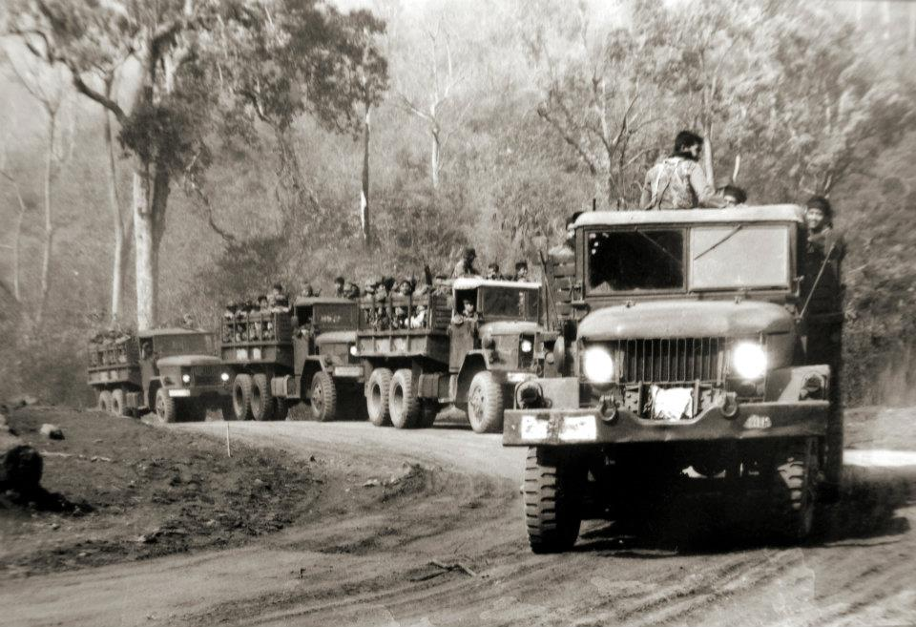
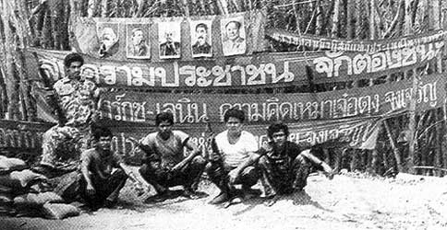
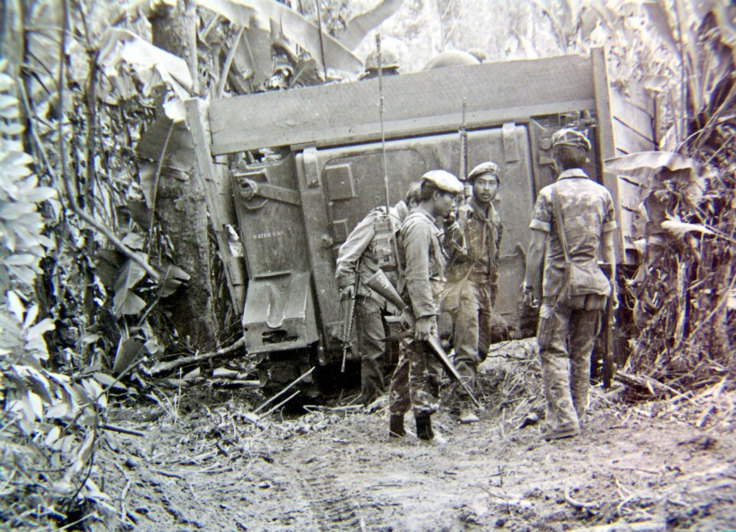
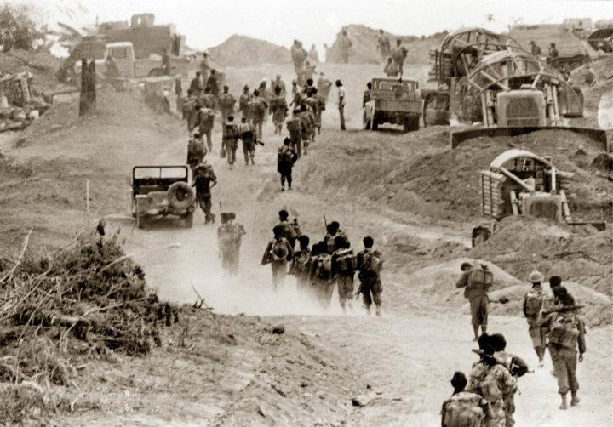
Roads Expansion
Source: http://www.chillpainai.com/scoop/46/

Slide 24
The expansion of upland peasants
The open up of uplands carried over from the expansion rice frontier, many new settlers were those who moved from being the rice farmers.
  Driven also by the gov't promotion of agri-business.
  Expansion was much faster, more than 100 millions rai planted with maize, cassava, kenaf, cotton, and other cash crops.
Process of expansion began with loggers, settler moved in together with the contact from crop trader.

Slide 25
The expansion of upland peasants
Expansion of upland farmers was different from rice farmers. Their growth was much more connected to urban capitals.
  Small holders’ settlement, but no phase of subsistence.
  They produced to feed factories, and were dependent of capitals, inputs, and links with agribusiness.

Slide 26
Cash crop boom
From 1950s, world trade in agricultural goods entered a boom period for almost 3 decades.
  Network of highways built to connect Bangkok to Isan and other regions became the channels of distribution for cash crops.
  The economic importance of road became more acknowledged, and the gov't started constucting feeder road.
  Malaria conquested, opening new areas.

Slide 27
Cash crop boom
The initial expansion was to produce kenaf, in order to be the input for gunny sacks (krasob).
Other main crops: maize, sugar, cassava
Maize: a new variety adopted to be more suitable to Thailand. Production expanded from the upland b/w central and the north region, and expanded to Isan.

Slide 28
Cash crop boom
Sugar: In the late 1950, gov't support sugar export industry. Gov't built its own sugar factory and banned sugar imports. Private firms later entered the business, owning sugar mills and support expansion of sugar production area.
Cassava: became the most widespread of upland crops. Cassava boom replaced the decline of kenaf. Cassava exports eventually overtook rice in terms of value,

Slide 29
Cash crop boom
Other expanded product
  soya-beans, cotton, oil seeds, etc.
  Pineapple for production of canned pineapple.
  Upland in Korat became the places to raise cattle and develop dairy farms.
  Tobacco production expanded in the north, while rubber plantation expanded in the south.
  Commercial forests of eucalyptus to feed fibre, pulp, and paper industries.

Slide 30
Peasant colonization of upland frontier
Between 1950-1980, number of farm holdings increased very quickly, especially outside the central region.
  Villages combine migrant from various places
  Plantation of maize and cassava extended into the forests and hills.
  Labours working on roads stayed on and had their families and friends joining. Others settler followed.
  Similar settlement also arose in the area near dam and mining construction.

Slide 31
Peasant colonization of upland frontier
Most of the upland peasants used to be tenants or landless labour in farms, labour who had moved to city to raise capital, or other who flee from authority.
  Usually moved in groups.
  Some upland peasants were actually successful cultivators who sought to expand to produce other crops.

Slide 32
Peasant colonization of upland frontier
The initial expansion driven by the good price for export crops. During this time, production method was crude, land cleared by burning and the use of hoe and bullock.
  The crude method only allowed good yield in beginning years, before the quality of soil dropped.
  The peasants often abandoned their old plot if their land no longer fertile, or if they faced debts or disputes with locally powerful.
  Many settlers moved several times in their lifetime.

Slide 33
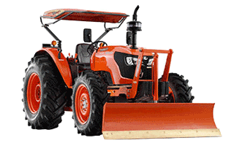
Peasant colonization of upland frontier
Use of 4 wheeled tractors help defeat imperata grass and maintain soilf.
Mid 1960s, 3000-4000 units of tractors imported per year.
By 1970s, the extension of maize production was under control of tractors owners.

Slide 34
Peasant colonization of upland frontier
After the initial phase, the key figure of the upland frontiers became the "agrarian entrepreneur (traders)".
  Most cultivations were capital intensive, requiring extensive uses of tractors, fertilisers and chemicals, and hired labour. Farmers had to finance these through lending.
  Agrarian entrepreneur became source of lendings and capitals.
  But they took the land of settlers who failed to payback and reallocate to others who are willing to work more intensively.

Slide 35
Peasant colonization of upland frontier
The production of cassava and maize expanded under the system where traders allocate land, advance settler with inputs, and buy products at pre-settled price.
While the production of sugar were linked more directly with mill owners and their network of traders. The traders mobilised a large amount of wage labour for harvesting season.

Slide 36
Peasant colonization of upland frontier
Hirsh study of upland frontier villages in Western region found 3 stages of changes.
  First stage, 1950s, gradual development of shifting cultivation. Many inhabitants were hill people and Lao.
  Second stage, 1960s-1970s, peasants moved in from lowland, clearing forest areas. Most ended up facing crisis from reducing soil fertility.
  Third stage, from 1970s onwards, traders and agribusiness moved in to organise settler and put them in more market oriented form of cultivation.

Slide 37
Government and Agribusiness
From 1960s, with the export of cash crop playing a major role in the balance of payment, Thai gov't turned to promote the expansion of cash crop production.
  Tax breaks and duty privilege to agribusiness firms.
  From 1976, agri-business given priority in investment promotion.
    First group of firms that received promotion were those that processed cash-crops such as cassava, maize, and soya.

Slide 38
Government and Agribusiness
Through investment promotion, firms found opportunities to expand their business.
  CP, for example, expanded from feedmill to cover the whole system of raising livestocks.
The gov't also encourage foreign joint investment between Thai agribusiness and foreign firms.
  CP joined by a US firm. Dole in foodcanning. Dutch and Danish in dairy. Taiwanese firms in prawn and fish farming.

Slide 39
Government and Agribusiness
The gov't increased the availability of capital to agribusinesses.
  BACC promoted to give lendings to cultivators.
  Commercial banks regulated to set certain percentage of lending to agriculture, but this rarely reached small and medium peasants
Agribusinesses developed a variety of techniques to gain more secure and effective relations with small farmers in their production.
  The system of "contract farming" was introduced in variety of products.
  Sugar mills built networks of agents to manage cultivation.

Slide 40
Forest and Land
The lives of upland peasants were affected by the gov't policies toward forests.
In 1961, gov't estimated that 53% of the country covered by forest and aimed for the number not to fall below 50%. But in the next 20 years, forest areas would continue to decline very quickly through expansion of upland farmers.

Slide 41
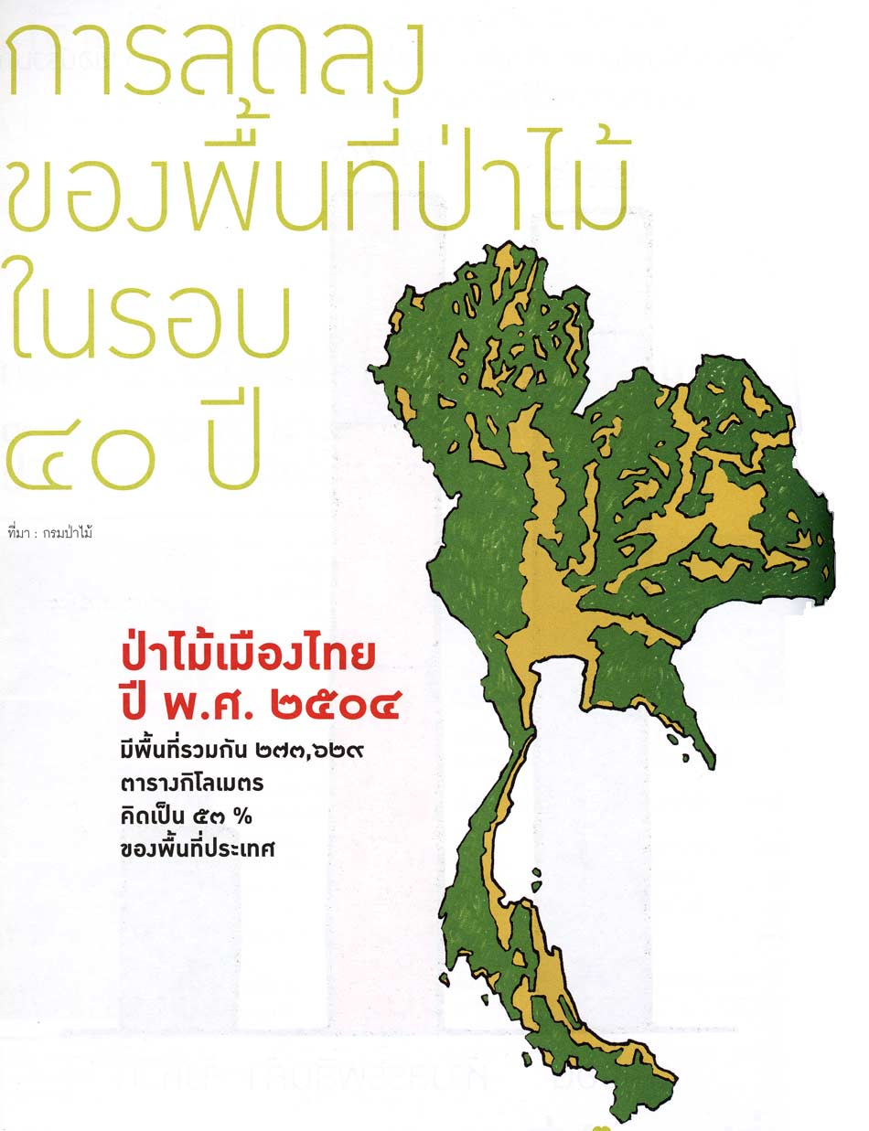
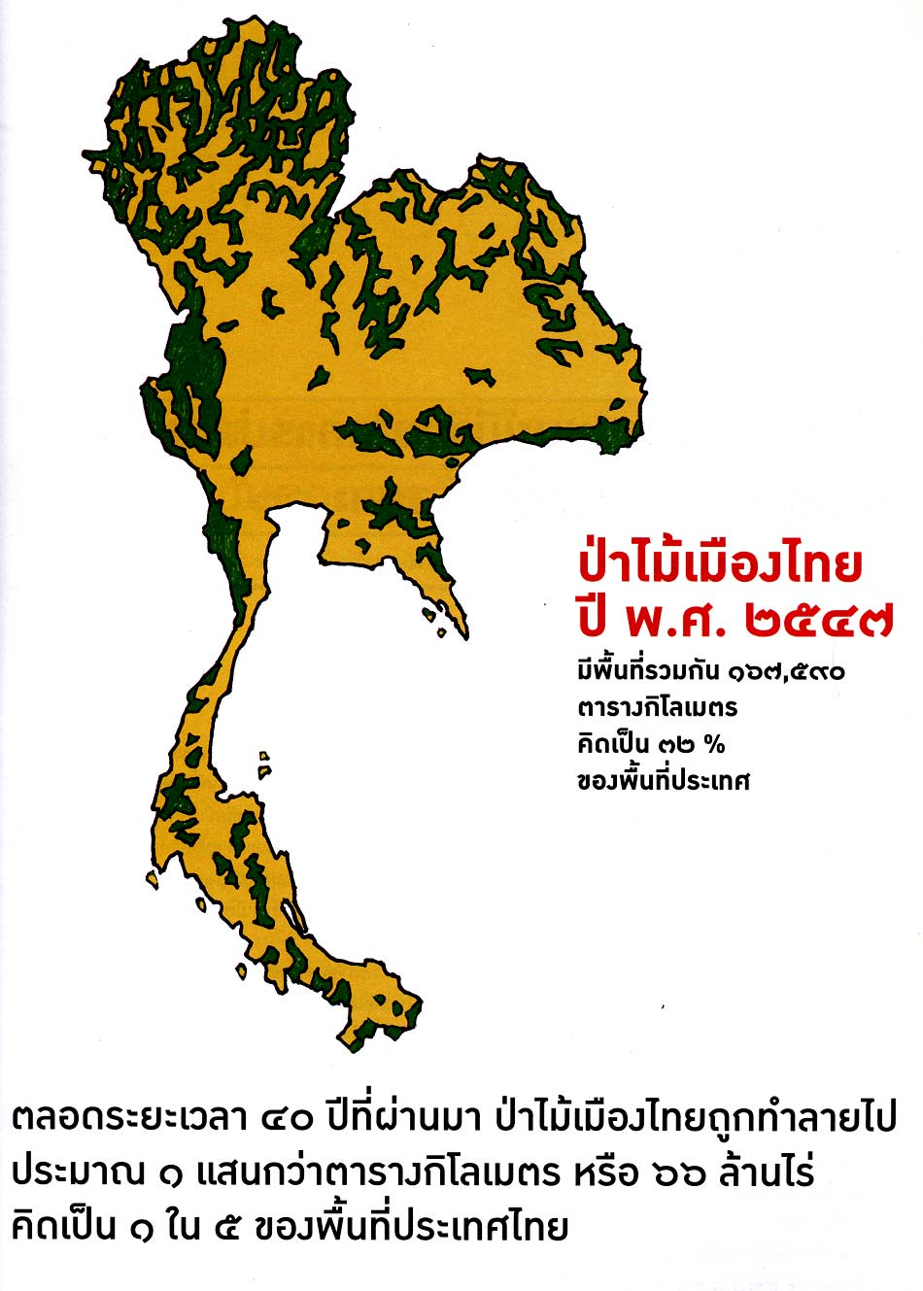
Forest and Land

Slide 42
Forest and Land
From 1950s, logging businesses expanded at rapid rate to supply industries such as matches, plywood, parawood, paper etc.
  Loggers sell all kind of timbers. Villagers set up their own small logging firms.
The army encouraged peasants to settle in new villages along the road.
  1 km radius policy. But the actual settlement went further.
Concession to logging companies also another policy to fight insurgent.
  Although there was the replanting requirement; such condition was not effectively policed.

Slide 43
Forest and Land
In 1964, the gov't passed the National Forest Reserve Act, but did not have both the will and the ability to effectively implement the policy.
  Between 1961 and 1988, total area covered by forest reduced from 171 million t 90 million rai. Most of the lost area turned into cropped area.
While the gov't actually prepared to sacrifice forests for political-economic purposes, they used the idea of protecting forests to influence the upland peasants.

Slide 44
Forest and Land
The 1964 National Forest Reserve Act aimed to keep forest area at 40%. In 1985,"forest reserves“ designated, covering 42% of the country.
  But the designation of area was not related to the actual condition. At least 1/3 or even 1/2 of all cultivated land situated in forest reserves.
The designation of forest reserves had crucial consequences on land rights of upland peasants
  They became “illegal occupants”.

Slide 45
Forest and Land
The illegal status of upland peasants also contributed by the gov't limited effort to provide them land certificates.
  The survey of land by the gov't concentrated mostly in the central region. The registration of NS certificates were slow.
  Most upland settlers had only a SK-1, which gave them no legal ownership.
In 1974s, 5-6 millions people estimated to live in untitled land in forest reserve. By 1990s, this rose to 10-12 millions.
Despite promoting the agribusiness, the gov't ended up giving no legal backing and assistance to peasant settlers.

Slide 46
Poverty and Dominance
Most of the settlers of the upland frontier were poor.
  labourers from road construction, or landless peasants fleeing debt.
Needing to cover high cost of land clearing and cultivation, most started out with loans
  Without access to land certificates, also no access to formal and cheaper loans.
  The lack of secure land title means limited incentive and capital to invest in higher productivity.

Slide 47
Poverty and Dominance
The poverty incidence among upland peasants were high.
  Estimation in 1962-3 placed 57% of total population below poverty line. In the rural north-east, the number was as high as 77%.
  Rapid expansion of upland frontier and rising crop price helped reduced the number. In 1981, poverty incidence in NE fell to 36%. The subsequent decline in agricultural prices in 1980s eventually caused the number to rise back.
Villages identified by gov't as poorest were mostly in the upland tract, and in 3/5 in Isan.

Slide 48
Poverty and Dominance
Even with the boom of agriculture in the upland, the export of labour from the tracts also accelerated.
  Cultivation throughout the upland dependent on monsoon rainfall, and limited to a single season.
  Most upland cultivators had long off-season period. They had to rely on off-season works to supplement their income.
From 1960s, the migration of upland peasants, especially from N-E, became more intensified and more complex.
  Destinations range from paddy, fruit orchards, other cash crop areas, local towns, and Bangkok.

Slide 49
Poverty and Dominance
But together with the poor, there were also small elites who acted as agents of agribusinesses.
  Early settler, traders, financiers, tractor owners, and local officials. They had control over the new settlers
The process of claiming and allocating the land was influenced by loggers, traders, and military.
  Without the formal documents, access to land was subjected to political influences
  Traders and loggers could use their influence over gov't officials to gain land titles at the expense of peasants.

Slide 50
Poverty and Dominance
As the upland frontier matured, the dominants were ones that controlled the production from the field to agribusinesses.
Power tended to lies within (1) those who owned capital or (2) those who had official positions.
  The few villagers who had access to capitals and market channels were able to acted as trading agents
  Those who had access to official positions such as Kamnan gained market privileges, better access to capitals, more secured land titles, and were favoured as agents for traders and agribusinesses.

Slide 51
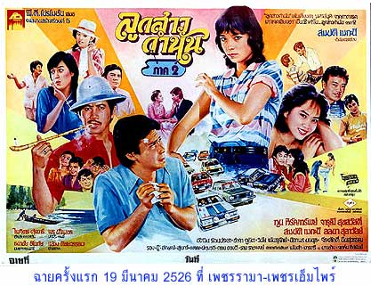
Kamnan

Slide 52
Turton’s depiction
We find, in the village after village, a small minority -perhaps 5% more or less- of households which possess a degree of wealth, control of resources, pretige and power which sets them apart from the majority….they include….larger landowners, commodity dealers, shopkeepers, village officials, some teachers, rice millers, money lenders, owners of small-scale transport and machinery, large-scale employers of wage labour etc. They derive advantage from their external connections and alliances and from their roles in 'linking' the majority of villages with state and market structures...

Slide 53
Closing the Frontier
In the 1980s, the role of agriculture in the Thai economy declined significantly.
  Urban capitals would be more interested in using land to plant industrial inputs, and in turning rural people into their supply of labour.

Slide 54
Closing the Frontier
The rapid decline was partly a result of falling prices and falling world trade.
  The post war boom in primary products came to the end in 1970s due to oil crises, chaos in currency market, and the rise in protectionism
  In rice market, China and Vietnam emerged strongly, other countries became more self-sufficient.
  From 1980-85, world rice prices declined by around 50%.

Slide 55
Closing the Frontier
The importance of agriculture was replaced by the rising roles of manufacturing.
In the late 1970s, role of agri-export as main driving force of economic growth was taken over by garments, electronics, auto-parts, gems, etc.
  In 1990, manufacturing exports grew to become 4 times larger than agri-exports.
  The Rangsit area were taken over by factories, suburban homes, and golf-courses.
As industrial sector rose, rural sector became providers of cheap labour.

Slide 56
Closing the Frontier
Against this changing background, the land frontier in the forest was closed. The closing was gradually done through the decade of 1980s.
  The closing came with the end of communist insurgency.
  The army no longer had interests in pushing the frontier. However, the expansion remained, driven by interests in logging business.
  But as the issue of preserving forests gained widespread public attention in 1980s, logging businesses shifted their operations to neighboring countries. Gov't eventually pressured by environmental groups to revoke all logging concession.

Slide 57
Closing the Frontier
The closure of forests caused intense competition to control land and forest resources, especially in the so called "degraded forests".
  Degraded forests covered 20% of country's area, occupied by 7-12 million people.
  The peasants in the area wanted to stay on. But the Forestry Dep't made degraded forests available for plantation of trees that can be used as inputs for industries.
    Commercial plantation counted in the targeted amount of the forest areas.

Slide 58
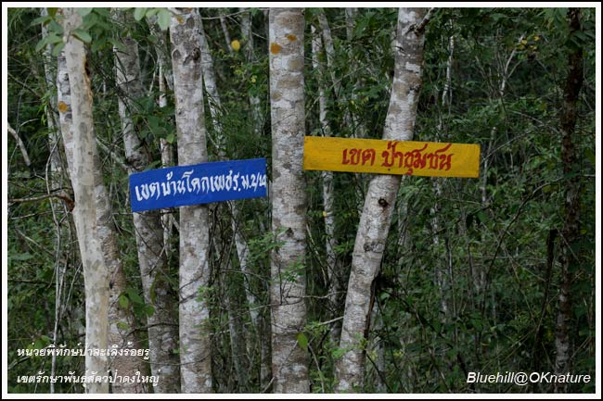
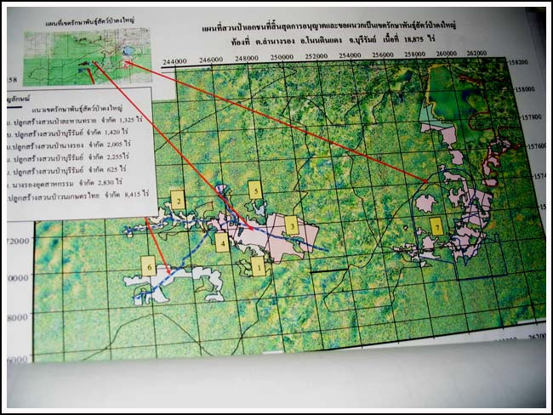
Tension in the forests
http://www.oknation.net/blog/charlee/2009/09/04/entry-1

Slide 59
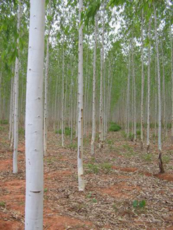
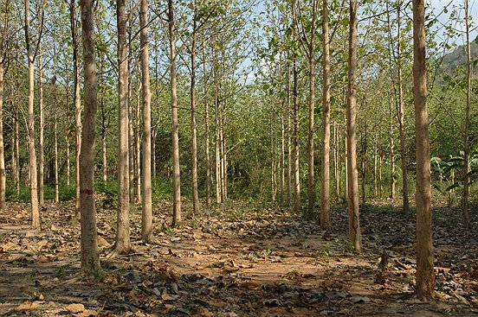
Eucalyptus

Slide 60
Closing the Frontier
While the gov't extended supports to paper mills, pulp companies, and plantation firms, the Forestry Dep't attempted to move peasants out of degraded forests
  Conflicts arose between the peasants and the businesses, as demonstrated through the objection of eucalyptus planting.

Slide 61
Closing the Frontier
In late 1980s, the military step in with a massive plan to move 9700 villages out from forest. The scheme was called Khor Jor Kor.
  Khor Jor Kor raised tension and violent conflicts between settler and authorities.
In 1991, the army implemented the removal in around 20 areas. The resettled villagers found themselves relocated to dry and barren lands, or in other settled villages.
  The large wave of protests finally led to the suspension of Khor Jor Kor.

Slide 62
Pleng-Luk-Thung
The changes of peasants lives, especially when they moved into the city, were expressed in “pleng luk thung”.
Pleng luk thung reflected the appearance of new media that knitted rural audience and their common concerns when confronted with the city.
  Giving supports to the migrants to the city. Reflecting the contempt they faced, and their desire to return homes.

Slide 63
Pleng-Luk-Thung
Isan Tears (น้ำตาอีสาน)
http://www.youtube.com/watch?v=XZeNwoRtuWw
AM Girls (สาว เอ เอ็ม)
http://www.youtube.com/watch?v=lBQ-Zgrldps
Dear Buffalo (ทุยจ๋า)
http://www.youtube.com/watch?v=jmhEe4tWXXs
Thongpan Movie (ทองปาน)
http://www.youtube.com/watch?v=ZACc45qZhDE

