Slide 1
City, Trade, and the Dawn of Absolutism
Thai Economic History
Thorn Pitidol
1/2017

Slide 2
Topics
Cities and Trade
  The Westerners’ Businesses
  Capital accumulation of the Chinese and the royal household
The Dawn of absolutism
  Context: the competition between King and nobles
  Domestic and external challenges
  The first steps of absolutism

Slide 3
Earlier context
Tax collectors and Chinese merchants
As the trade with China declined, the Chinese merchants already found wealth from being the tax collectors.
Cooperation between tax collectors and the nobles prospered
Losing out from this growing wealth, the King invited the Westerners to counter balance the system.

Slide 4
The Westerners' businesses
Seeing what happened in Burma and China, the British envoy was welcomed by Siam.
In 1820, British came with the argument for "free-trade".
  First trade negotiation by Henry Burney. But Britain wanted a re-negotiation.
    Finding a new destination for the trade in opium.
  Led to the Bowring Treaty of 1855.

Slide 5
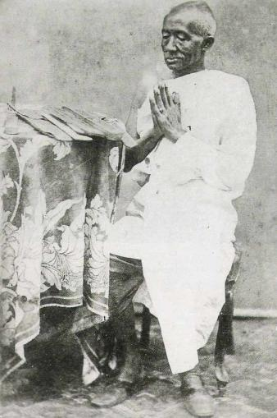
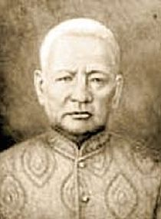
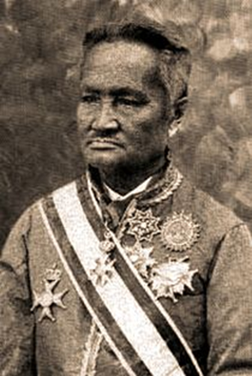
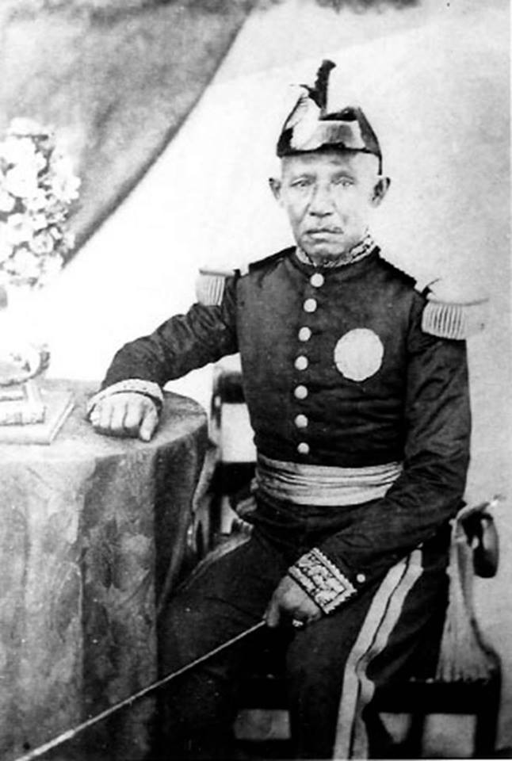
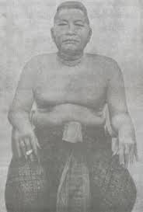
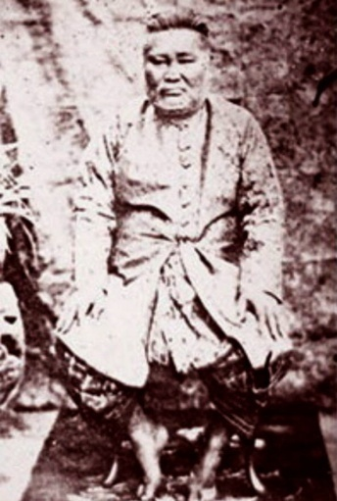
Bowring Treaty
Playing part in the treaty was Bunnag family, who wanted the benefits from the opium tax.

Slide 6
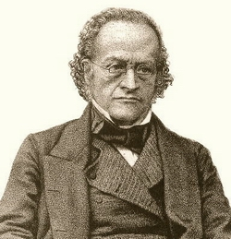
Bowring Treaty
Granted extraterritorial rights to British subjects
Allowing the British to trade freely in Siam
  British can own property in Bangkok.
3 percent tariff for import and export
Sharing profits from opium. No import tariff for opium, but the sale of opium done opium farmer
Sir John Bowring

Slide 7
The Westerners' businesses
But the Westerners only had limited success.
  Unable to break through the Chinese's network in rice production/trade
  Initiated banking and insurance businesses. Most successful in trading.
  Brief success in logging and tin-mining
  Attempt at planting rubber constrained
  Small customer base for the European imports

Slide 8
The Westerners' businesses
In comparison to other countries in the same region, Westerners' investment in Siam was much smaller.
  1/3 of investment in Malaysia. 1/10 of investment in Indonesia.
  Chinese investment was 4 times more in Siam
Reason: inability to gain full support
  But still had more important roles in politics

Slide 9
Capital accumulation of the Chinese and the Royal Housholds
From 1870s onward, as the trade in Siam was growing, the Chinese and the Royal household also expanded their capital accumulation.
The Chinese tax collectors invested in portfolios of businesses, benefiting from new opportunities coming with the access of Westerners.

Slide 10
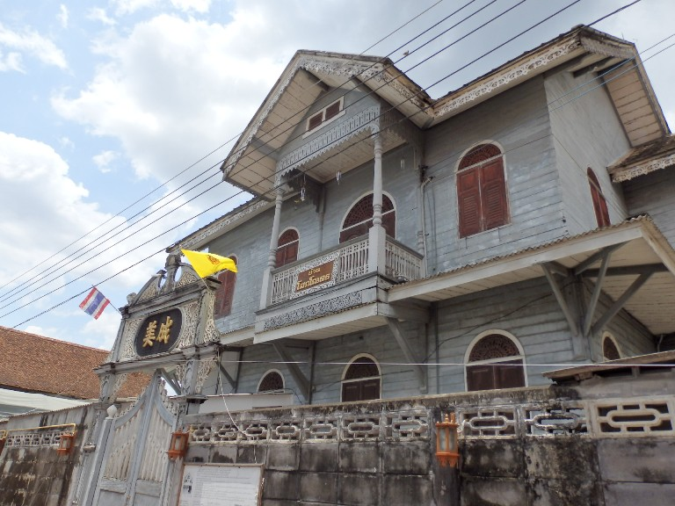
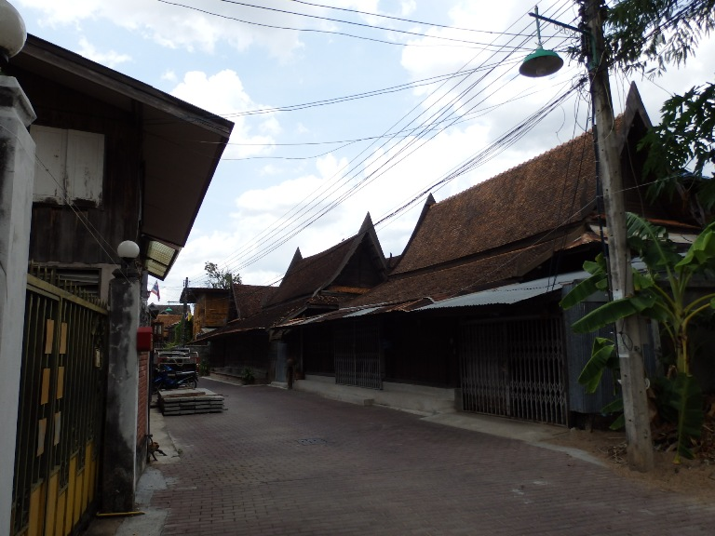
The story of Akorn Teng
  The founder of Kim Seng Lee Company, controlled tax farms in the Northern Region.
  Businesses included rice mills, sawmills, etc. His son became a partner in founding the Siam Commercial Bank
Ban-Chin Alley
source: http://www.bloggang.com/viewdiary.php?id=tuk-tukatkorat&month=06-2013&date=21&group=24&gblog=178

Slide 11
Capital accumulation of the royal household
The benefits from the businesses of tax-collectors did not accrue much to the King.
  From Rama IV, the Bunnag controlled the taxes, causing bad financial status of the King.
  The King then reacted by fighting to gain control of tax collection, expanded ownership of land, and invested in businesses.

Slide 12
Capital accumulation of the royal household
“Privy Purse Bureau” (กรมพระคลังข้างที่) (now CPB)
  Set up by Rama V to manage the wealth and land of the King and Royal Family
  Managed as much ass 1/5 of land in Bangkok
The PPB also invested in businesses.
  Joint ventures preferred with Westerners.
    Siam Land and Canals Company
    Rice mills & Shipping.
    Siam Cement, Siam Commercial Bank

Slide 13
Capital accumulation of the royal household
Rama V’s attempt to centralise control over taxes gradually reduced the power of Chinese tax collectors
Tax-collectors' wealth eventually declined. But they were compensated.
  Their adjusted by sending their Children to be part of the newly formed bureaucrats.
  This was the origin of a number of big families such as Sarasin, Huntrakul, Vejjajiva, Na Songkhla

Slide 14
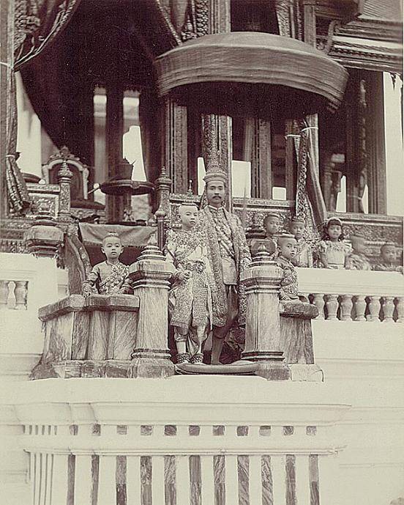
The dawn of absolutism

Slide 15
  Context: the competition between King and nobles
Competition between King and noble got more intense. The main area was in the tax collection.
  Nobles and tax collectors were keeping the majority of the share from the tax income
  Bunnags were particularly wealthy and powerful.
  During the Regency of Si-Suriyawongse, revenue to the royal government was declined from 4.8 millions baht to 1.6 millions bath

Slide 16
Domestic and external challenges
There were also challenges in governing Siam
Two domestic threats: (1) peasants and (2) Chinese immigrants.
Peasants organised their own self-protection, used "nak-leng" to provide security. But nak-leng also engaged in conflict with each other, and often rebelled against the nobles and the state.

Slide 17
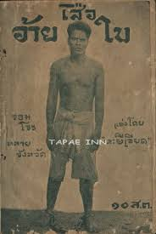
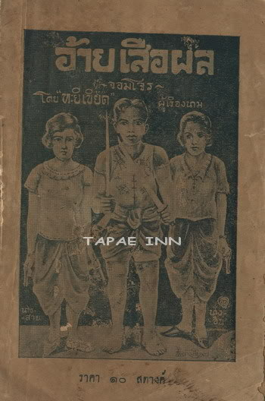
Domestic and external challenges
http://www.oknation.net/blog/prisanasweetsong/2010/01/16/entry-1

Slide 18
Domestic and external challenges
Many of the Chinese, especially the labour, also had their own system of self protection, using secret societies (or Ung-Yee)
  Ung-Yee entered into conflicts with each other, and also rebelled against the government.
  With a large number of Chinese in Bangkok, the government was concerned that the Chinese could take over the capital.

Slide 19

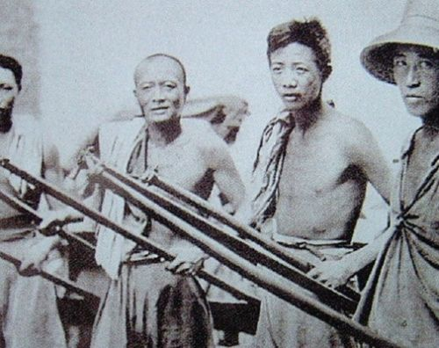
Domestic and external challenges

Slide 20
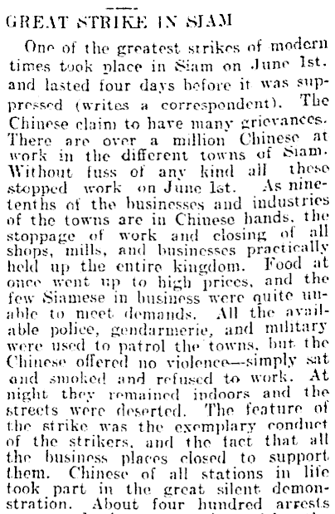
Domestic and external challenges
Great (Chinese) Strike in Siam (1910)
Source: http://paperspast.natlib.govt.nz/cgi-bin/paperspast?a=d&d=CHP19100730.2.48

Slide 21
Domestic and external challenges
Colonization threats also apparent, with Britain and France extended their control in the region.
  They could argue for extending their control to Siam to protect their own people.
  Efforts to contain Westerners within the realm of Bangkok to ensure their safety.
All the threats provided the reasons for a group of reformers to established a modern system of bureaucracy.

Slide 22
The early steps of building Absolutism
First step of reform was gaining control over tax system.
  Only then can the centralised government be established.
  But the ruling class of Siam was divided in responses.
  Conflicts between fractions escalated as Rama V set up “auditing office” (ho-ratsadakorn-pipat) to oversee the tax collection of the nobles, and the "privy council" to consolidate his rule.

Slide 23
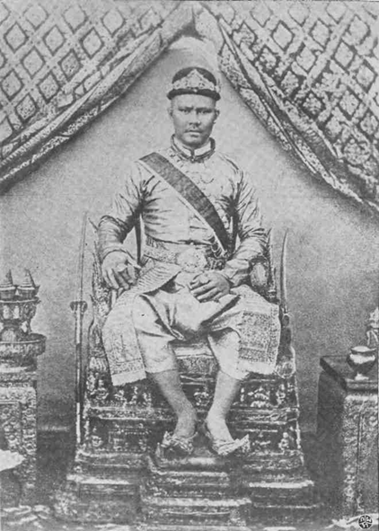
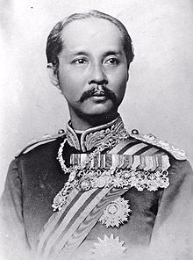
The early steps of building Absolutism
Old Siam, Conservative Siam and Young Siam
Wang-na (Front Palace)
Prince Vichaicharn
Si-Suriyawongsa
(Somdej Chaophraya)
Rama V

Slide 24
The early steps of building Absolutism
Old Siam: Want to preserve the old system. Resisting modernisation and Westernisation.
Conservative Siam: Want the benefits from foreign trades, but did not want to lose controls over taxes.
Young Siam: Want to modernised the government, expand the trade, and contralised the tax collection.

Slide 25
Wang-na crisis (1874-1875)
Rama V made a move to check the Bunnag family's corruption of tax collection. But Wang-Na crisis would tilt the balance of power toward him.
Wang-na Crisis
  Prince Vichaicharn, Wang-na and the leader of Old Siam, inherited power and wealth from Phra Pinklao.
  He had his own army, and enjoyed a large share of tax-revenue.
  Rama V reform caused tension with Wang-na. Both suspected another of accumulating forces.

Slide 26
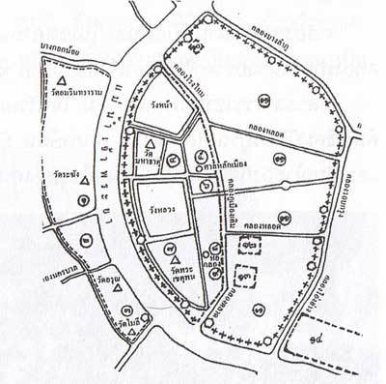
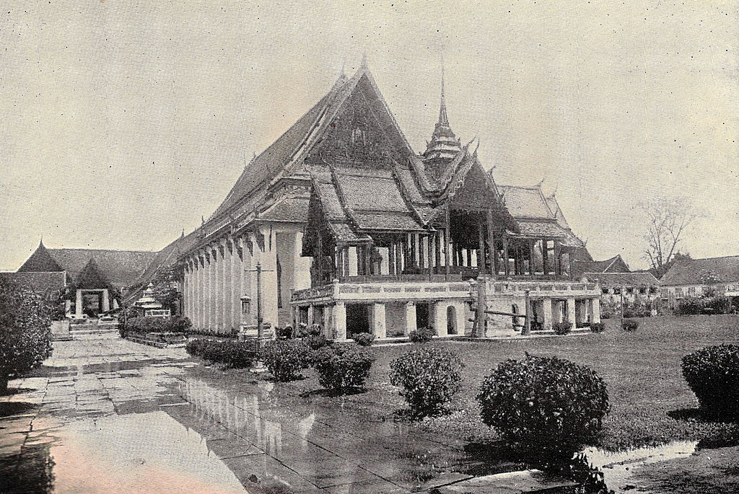
Wang-na crisis (1874-1875)

Slide 27
Wang-na crisis (1874-1875)
A mysterious fire broke out in the Royal Palace, causing confusion.
The king called for help from a middle-man, Si-Suriyawongse, who tried to manipulate the situation to his benefit.
But Wang-na called for the intervention from the British consulate, whom he had close relationship.

Slide 28
Wang-na crisis (1874-1875)
The situation culminated in the arrival of the British Governor of Straits Settlement, Sir Andrew Clarke, who turned out to be a stong supporter of Rama V's reform.
After the Wang-na crisis, Prince Vichaicharn was deprived of his power. Si-Suriyawonse withdrew from politics.
Rama V consolidated his regime with the appointment of his brothers in all important positions.

Slide 29
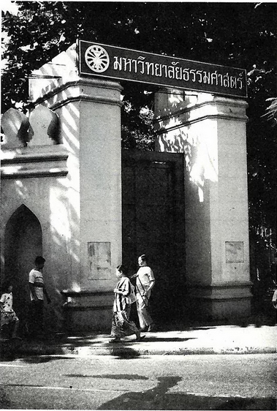
Wang-na crisis (1874-1875)
The position of Wang-na was abandoned and replaced the position of the heir to the throne

Slide 30
Implications from the pattern of capital accumulation during Rama V
Capital accumulation under three groups
  Chinese, European, and Royal households
But the Chinese dominated the rice-based trading economy.
  European capitals only had little share of domestic economy
  Royal households invested mainly in land ownership.

Slide 31
Implications from the pattern of capital accumulation during Rama V
The domination of the Chinese led to a particular pattern of development called “trade-expansion with no industrial development” (Suehiro, 1996)
  The Chinese were merchant capitals, rather than industrial capitals.
  They expanded through relying on privileges, and aimed to develop trade, not industrialisation.
  Compounded by the roles of 3% tariff, manufacturing sector in Siam did not have much room to grow. Investment in such a sector unattractive.

